Slide 1
D-Sparse Algorithm
Computer Vision
Lewis Spencer
lms118@bham.ac.uk

Slide 2
Introduction
The aim of this lecture is to discuss my personal research that I have been doing into real-time stereoscopic algorithms for robotic vision/navigation
What we will cover
  Algorithm overview
    Nodal generation
    Nodal list to Triangle mesh
    Mesh Refinement
  Results
  Discussion

Slide 3
D-Sparse Algorithm
Aim of the algorithm
  To enable real-time process of stereo data on a standard CPU
  To reduce the information need to be computed to make path planning decisions
  To allow dynamic sparse generation of a disparity map, where more computation is given to non-fronto parallel objects

Slide 4
D-Sparse Algorithm
Based on a iterative triangulation that makes a rough estimate of the disparity map and then refines the map based on a guided search
Use of a planar hypothesis and triangle confidence measure to access areas of the mesh that need further refinement
2 main stages:
  The initial triangle mesh generation
  The triangle mesh refinement

Slide 5
Nodal Generation
Assumed that the algorithm is presented with two gray-scale image that have been rectified for the epipolar constraint (I_{l} and I_{r})
First step is to apply a Sobel template convolution to the left hand image I_{l} to create a binary image of the edges

Slide 6
Nodal Generation cont.
In fact we use the optimised 1D Sobel convolution to compute the result faster, so:
Once the binary image is compute we apply a morphological filter “clean” filter, that is any defined as individual 1s which are surrounded by 0s
Then a random selection of nodes is made up to a set amount (T_{points}).

Slide 7
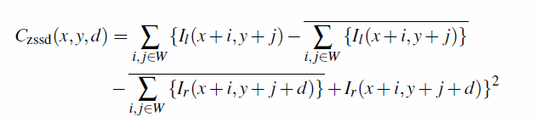
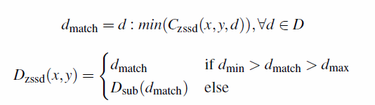
Nodal Generation cont.
Calculate the disparity for each node using the Zero Mean Sum of the Squared Difference (ZSSD) and refine using sub-pixel parabolic fitting.

Slide 8

Nodal Generation cont.
Filter poor matching based on the confidence measure of the confidence measure, use the mean score measure (in this case that is the ZSSD matching cost)
We now have our final nodal list we need to covert it to a triangle mesh

Slide 9
Delaunay Triangulation
Is a method to find the minimum amount of triangles need to represent a set of nodes (N)
For the d-sparse algorithm we use the state of the art s-hull algorithm http://www.s-hull.org/
We are going to discuss the implementations of one of simplest Delaunay algorithms.

Slide 10
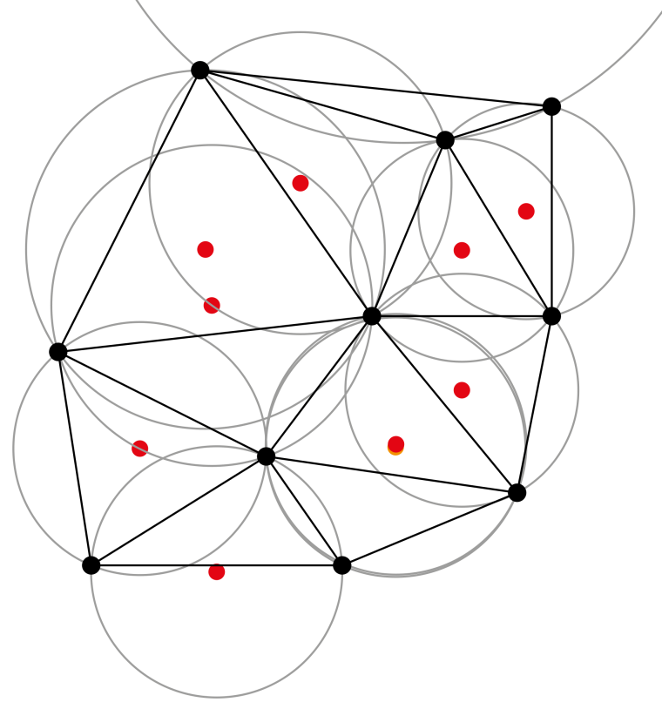
Delaunay Triangulation cont.
Given a set of nodes
Based on the Delaunay condition:
  That the circumcircle of each vertex does not contain any other nodes
  Can work at any dimension, but we only need to consider a 2D solution
  Create a super-triangle that covers all nodes add to set O

Slide 11
Pseudo Code
For each node in the N set until |N| = 0
  Check each triangle is complete w.r.t. each node N
  Pass completed triangles to the Output buffer
  Check each node is in the circumcircle of each triangle
    If true covert the triangle to the edge buffer
  Clear up triangle buffer
  Remove duplicate edges from edge buffer
  Add edge and node to triangle buffer
  Clear edge buffer

Slide 12
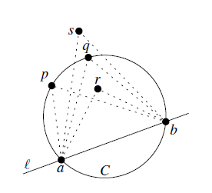
Delaunay Triangulation
Breakdown of the Delaunay circumcircle check:
  Given a node n, for each triangle in the triangle buffer
    Perform the circumcircle check
    Calculate the centre of the circumcircle
    If the distance between centre and node is less than the radius
      Test passed
      Else failed

Slide 13
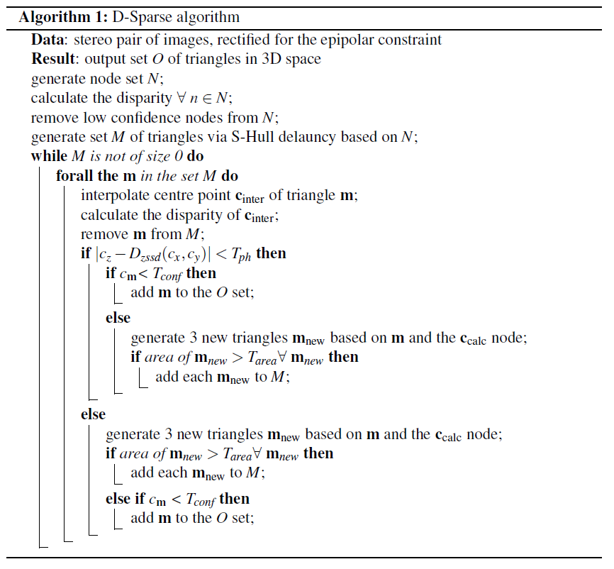
Algorithm Overview

Slide 14
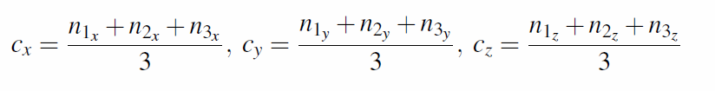
Mesh Refinement
Mesh refinement is a based on the planar hypothesis and confidence measure of each individual triangle
Loop for all m in M (all triangle in the OPEN buffer)
First calculate the interpolated centre point of the triangle:

Slide 15

Mesh Refinement cont.
Planar Hypothesis:
  For each triangle we make the hypothesis that the triangle is mapping a planar surface in the disparity space
  We test the planar hypothesis by thresholding the absolute difference between the interpolated disparity and the calculated disparity:
  Makes a few key assumptions on the disparity space:
    That non-planar surfaces would have a large difference between the interpolated and calculated disparity

Slide 16
Mesh Refinement cont.
Triangle confidence
  The planar hypothesis is not the only measure of the systems certainty in a triangles representation of the disparity space
  The use of a triangle confidence allows for a 2nd stage of testing system
    The triangle confidence measure is a combination of the planar hypothesis, the mid point mean score measure and the absolute difference in the triangles disparity
    Each part is weighted

Slide 17
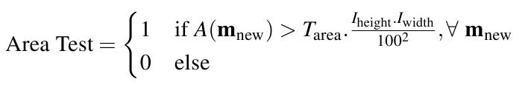
Mesh Refinement cont.
If the triangle pass both the planar hypothesis (PH) and the triangle confidence (m_{c}) measure:
  The triangle is pass to the CLOSED buffer (O)
  Else if the PH is failed the triangle is sub divided into three new triangles add to the M set
  There is a limit to the new triangles minimum area:
  Else if the m_{c} is passed then the triangle m is passed to O

Slide 18
Mesh Refinement cont.
If the triangle m pass the PH test but fails m_{c} then the triangle is sub-divided if it passes the area test else the triangle m is removed from the M set
Mesh refinement loops around until the set M is of size 0 or until an external event ask for the results
  This gives the algorithm near-anytime properties
  Final output of the algorithm is the O set

Slide 19
Multi-Threaded Optimisation
The way the algorithm is designed is to allow the for multiple threads to be used to compute the mesh refinement
  The triangle mesh is split into equal parts for the number of concurrent threads being run
  The only part of the memory that need to be handled with mutexes to ensure data is not corrupted is the O set
  Multi-threading the nodal generation provides no performance increase due to the amount of mutexes/semaphores needed to handle the information.

Slide 20
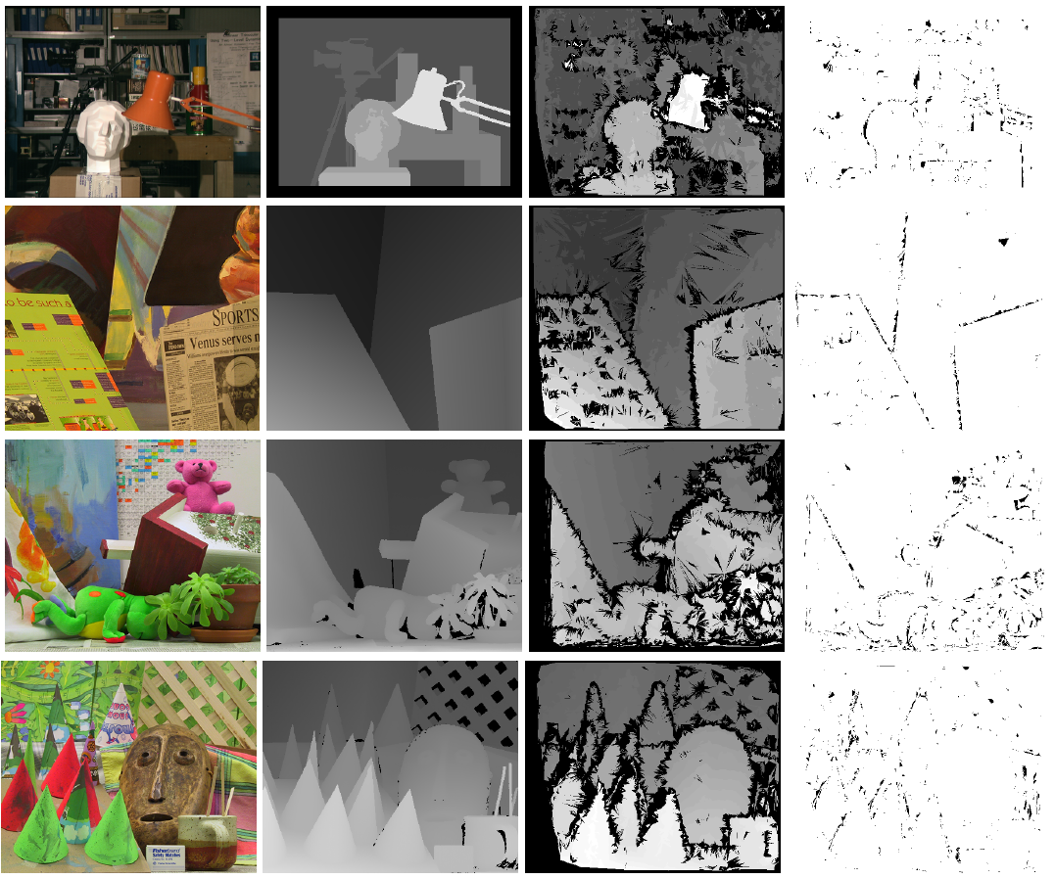
Results – Middlebury Set

Slide 21
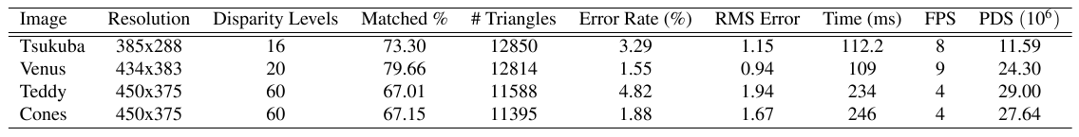
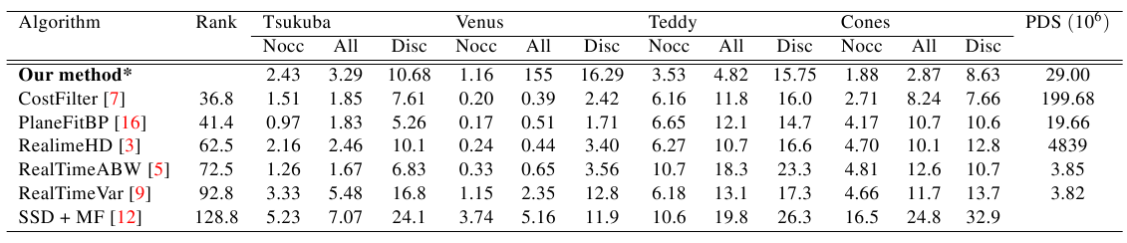
Results - Tables
Computation done on a Intel 2500k with 4Gb of RAM

Slide 22
Results
Performance:
  Fast 10 Fps at 434*383 with 20 disparity levels
  95% accuracy with a coverage of the disparity space > 67%
Comparison
  Outperforms other real-time algorithms on a CPU in run time, with a max PDS of 29 vs. ≈ 4, even beats some GPU/CPU set ups
  Accuracy is comparable to existing real-time algorithms
  Similar performance with "Tsukuba" and "Venus" data sets, dramatically outperforms with the "Teddy" and "Cones" images

Slide 23
Discussion
Further work:
  Increase coverage
    System prone to removing triangles due to the edge boarder problem
    Variance minimisation of each triangle:
  Improve speed
    Optimisations
    GPU/CUDA or FPGA implementation
  Improve accuracy
    Improve local matching score measure used
    Reduce the hyper-dimensionality in tuning the algorithm

Slide 24
Conclusion
System allows for real time computation on a standard CPU
Information is reduced by 8 – 14 times compared to a dense pixel match.
Produces a reduce data size that makes path planning for robotics simpler
High accuracy at the cost of reduced coverage

