Slide 1
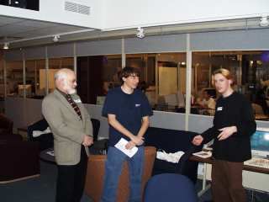
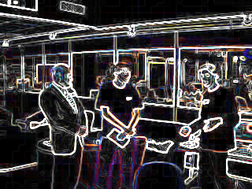
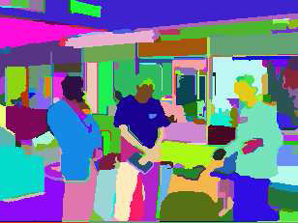
Image Processing
Low-level
working at the pixel level, identification of edges
Medium-level
identification of regions and shapes
High-level
associating shapes with real objects.
Low
Medium
High

