Slide 1
Motion and Stereo
EE4H, M.Sc 0407191
Computer Vision
Dr. Mike Spann
m.spann@bham.ac.uk
http://www.eee.bham.ac.uk/spannm

Slide 2
Introduction
Computer vision involves the interpreting the time varying information on the 2D image plane in order to understand the position, shape and motion of objects in the 3D world
Through measurements of the optical flow, made using sequences of time varying images, or through measurements of disparity using a pair of images in a stereo image pair, we can infer 3D motion and position information from 2D images

Slide 3
Introduction
The topics we will consider are
The geometry of stereo and motion analysis
Motion detection
Background subtraction
Motion estimation
Optical flow
3D motion and structure determination from image sequences
I will not cover feature point matching for stereo disparity determination as time is limited and motion analysis has more application

Slide 4
The geometry of motion and stereo
Consider a point P with co-ordinates (X,Y,Z) relative to a camera-centred co-ordinate system
The Z axis is oriented so that the axis points along the camera optical axis
Point P projects to point p(x,y) in the image plane

Slide 5
The geometry of motion and stereo

Slide 6
The geometry of motion and stereo
The projected coordinates on the image plane (x,y) are defined in terms of the perspective projection equation
f is the camera focal length

Slide 7
The geometry of motion and stereo
Suppose point P is moving with some velocity V
This projects to a velocity v on the image plane
This projected velocity is sometimes known as the optical flow

Slide 8
The geometry of motion and stereo

Slide 9
The geometry of motion and stereo
Optical flow is measurable from a set of frames of a video sequence
Using optical flow vectors measured at a large number of image locations, we can infer information about the 3D motion and object shape
Requires assumptions about the underlying 3D motion and surface shape

Slide 10
The geometry of motion and stereo
In the case of stereo imaging, we assume 2 cameras separated by some distance b
The measurement of disparity allows us to infer depth
The distance along the camera viewing axis

Slide 11
The geometry of motion and stereo

Slide 12
The geometry of motion and stereo

Slide 13
The geometry of motion and stereo
The disparity is the difference between the projected co-ordinates in the left and right stereo images x_{L}- x_{R}
Gives a measure of the depth
The greater the disparity, the lower the depth
The key task of stereo imaging is to establish a correspondence between image locations in the left and right camera image of an object point
This allows the depth of the imaged point to be computed either using the disparity or through triangulation

Slide 14
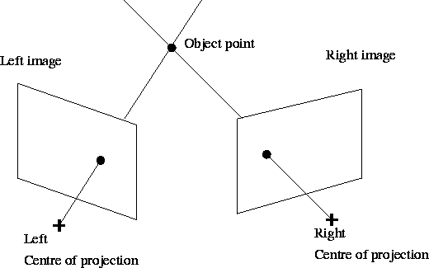
The geometry of motion and stereo
Triangulation enables the depth of an object point to be found given its image point in each camera

Slide 15
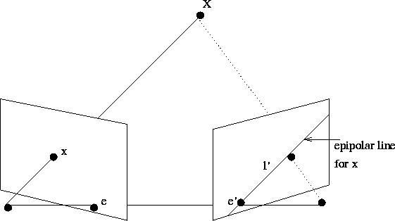
The geometry of motion and stereo
The geometry of stereo imaging is based on the epipolar constraint and the epipolar plane
C
C’

Slide 16
The geometry of motion and stereo
The epipolar line limits the search for a corresponding image point to one dimension
If the camera calibration parameters are known (intrinsic and extrinsic), the epipolar line for an image point in one camera can be computed

Slide 17
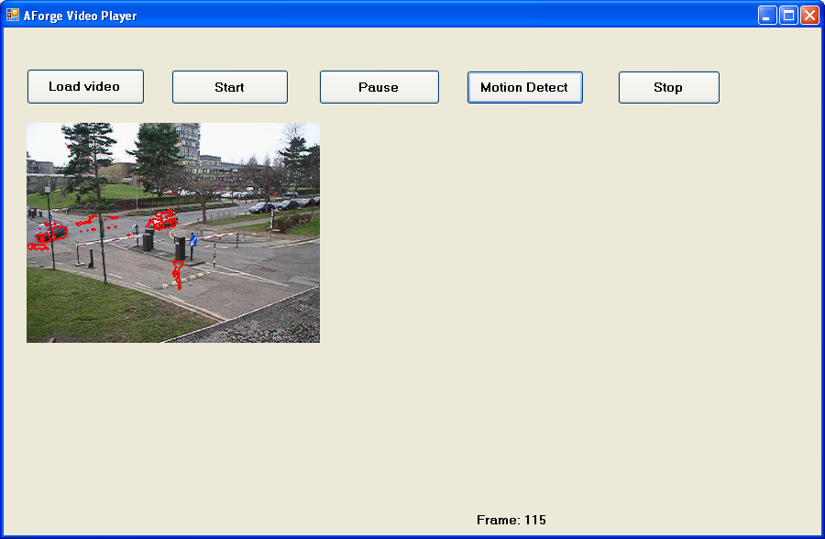
Motion detection/estimation
Motion detection aims to highlight areas of motion in an image
Motion areas can be defined by a binary ‘motion mask’

Slide 18
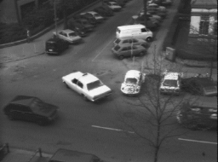
Motion detection/estimation
Motion estimation
Assigns a motion vector v(x,y) to each image pixel
Optical flow

Slide 19
Motion detection
Let the current frame be f (x, y, t)
Let f _{r}(x, y, t) be a reference frame
d(x , y, t) highlights regions of large change relative to the reference frame
Normal to threshold d(x , y, t) to produce a binary motion mask m(x, y, t) and suppress noise

Slide 20
Motion detection
2 usual cases
Frame differencing
Simple implementation but prone to noise and artefacts
Background subtraction
b(x, y, t) estimate of the (stationary) background at time t
More complex but yields a ‘cleaner’ motion mask

Slide 21
Motion detection
Fame differencing
Simple concept
Produces artefacts
Covered (occluded) and uncovered (disoccluded) regions highlighted whose size depends on the speed of the object relative to the video sampling rate
Very susceptible to inter-frame noise and illumination changes

Slide 22
Motion detection

Slide 23
Motion detection
Background subtraction
A ‘background’ image b(x ,y ,t) is computed which (hopefully!) is the stationary image over which objects move
The most simplistic approach is to average a number of previous frames
Or slightly more robust is to compute a weighted average

Slide 24
Motion detection
Both approaches lead to a background image that contain moving (foreground) objects
A better approach is to use a median filter
If the moving object is small enough such that it doesn’t overlap pixel (x,y) for more than T/2 frames it won’t appear in the background image
But, more susceptible to noise as it is not averaged out

Slide 25
Motion detection
Practical requirements:
The difference image is subtracted to compute a binary motion mask
Post thresholding enhancement
Morphological closing and opening to remove artefacts
Opening removes small objects, while closing removes small holes
Closing (I) = Erode(Dilate(I))
Opening (I) = Dilate(Erode(I))

Slide 26
Motion detection
For improved performance in scenes that contain noise, illumination change and shadow effects more sophisticated methods are required
Statistical modelling of the background image
Simple greylevel intensity thresholds
W4 system
Gaussian models
Single Gaussian
Gaussian mixture models (GMM’s)

Slide 27
Motion detection
W4 system
Uses a training sequence containing only background (no moving objects)
Determine minimum Min(x,y) and maximum Max(x,y) intensity of background pixels
Determine the maximum difference between consecutive frames D(x, y)
Thresholding – f (x,y,t) foreground pixel if:

Slide 28
Motion detection
Complete W4 system is as follows:
Background sequence
Training
Min(x,y), Max(x,y), D(x,y)
f(x,y,t)
Thresholding
f_{b}(x,y,t)
Opening,Closing
Component analysis
Small region elimination

Slide 29
Motion detection
Gaussian models
Scalar grey-level or vector colour pixels
Single Gaussian model statistically models either the greyscale or colour of background pixels using a Gaussian distribution
Each background pixel (x,y) has its own Gaussian model represented by a mean µ(x,y) and standard deviation σ(x,y) for the case of greyscale images
For colour these become vectors and 3x3 matrices
For each frame, the mean and standard deviation images can be updated

Slide 30
Motion detection
Mean/standard deviation update
A simple foreground/background classification based on a log-likelihood function L(x, y, t)

Slide 31
Motion detection
Threshold t determines whether a pixel is a background pixel
The size of the threshold is a trade-off between false negative and false positive background pixels
Essentially the same as a background filter (with the background image being the mean and the threshold depending on the standard deviation)

Slide 32
Motion detection
Gaussian Mixture Model (GMM)
Scalar greylevel or vector colour pixels
A single Gaussian distribution cannot characterize an image with:
Noise
None uniform illumination
Complex scene content
Variation in light illumination
A GMM has been shown to represent more faithfully the variation in greylevel or colour at each background pixel

Slide 33
Motion detection
The GMM models the probability distribution of each pixel as a mixture of N (typically 3) Gaussian distributions

Slide 34
Motion detection
Mixture model dynamically updated
If a pixel f(x,y,t) within 2.5 standard deviations of the kth mode, the parameters of that mode are updated:

Slide 35
Motion detection
Detection of Foreground / Background
Compute w/σ for each distribution
Sort in descending order of w/σ
First B Gaussian modes represent the background:

Slide 36
Motion detection
The final method combines a simple frame differencing method with relaxation labelling to reduce noise
Use p_{foreground} for neighbouring pixels in space to update the probabilities and exploit the spatial continuity of moving objects
Doesn’t have the problem of ‘ghosting’ that background subtraction has
Can implement the simple iterative relaxation labelling algorithm efficiently for close to normal frame rate performance

Slide 37
Motion detection
Demo

Slide 38
Motion estimation – Optical flow
Background subtraction algorithms detect motion but don’t give us an estimate of the motion
Many applications in 3D vision require an estimate of the motion (pixels/second) – see later!
Also background subtraction algorithms require a static background
More difficult (but not impossible) when the camera is moving
The main difficulty with optical flow is computing it robustly!

Slide 39
Motion estimation – Optical flow
Optical flow is a pixel-wise estimate of the motion
It relates to the real 3D velocities which are projected onto the image plane
A displacement V(X,Y,Z )Δt in 3D projects to a displacement v(x,y) Δt in the image plane
v(x,y) Δt is called the displacement
v(x,y) is called the optical flow
2 approaches to computing flow
Feature matching
Gradient based methods

Slide 40
Computing optical flow
Feature matching involves matching some small image region between successive frames in an image sequence or between stereo pairs
Leads to a sparse flow field v(x,y)
Usually involves matching corner points or other ‘interesting’ regions
Involves detecting suitable features and assigning correct correspondences

Slide 41
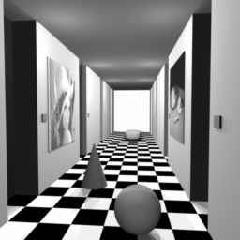
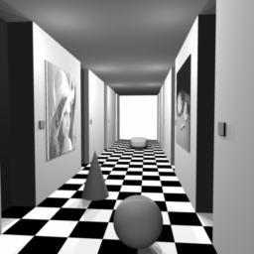
Computing optical flow
Left
Right

Slide 42
Computing optical flow
In gradient-based methods, the greylevel profile is assumed to be locally linear which can be matched in the image pair
The implied assumption is that the local displacement between images is small
This is the normal approach to the estimation of a dense optical flow field in image sequences

Slide 43
Computing optical flow
Gradient-based methods assume a linear-ramped greylevel edge is displaced by vΔt between 2 successive frame
Easy to relate the change in greylevel to the gradient and optical flow v
We will look in detail at an algorithm later

Slide 44
Computing optical flow
vΔt
t
v
t+Δt
x
x+Δx

Slide 45
Computing optical flow
We can derive a simple expression for optical flow by considering a 1D greylevel ramp moving with a speed of in the x direction

Slide 46
Computing optical flow

Slide 47
Computing optical flow
Gradient of ramp =
Greylevel conservation equation

Slide 48
Computing optical flow
In 2D we have a planar surface translating with velocity (v_{x},v_{y})
Greylevel gradient vector

Slide 49
Computing optical flow
In 2D, the greylevel conservation equation becomes :
Or in vector notation

Slide 50
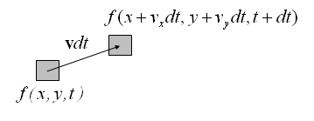
Computing optical flow
We can explicitly derive the 2D conservation equation by considering a 2D greylevel patch moving with velocity v = (v_{x} ,v_{y})

Slide 51
Computing optical flow
Greylevel conservation
But
Hence

Slide 52
Computing optical flow
We can take a Taylor expansion of the right hand side
This leaves us with the 2D conservation equation

Slide 53
Computing optical flow
The conservation equation is almost universally used but we have to recognise its limitations and validity
∇f (x,y,t )^{T}v is the component (up to a scaling factor) of v in the direction of the greylevel gradient vector ∇f (x,y,t )
Only this component is determined by the 2D conservation equation – the aperture problem

Slide 54
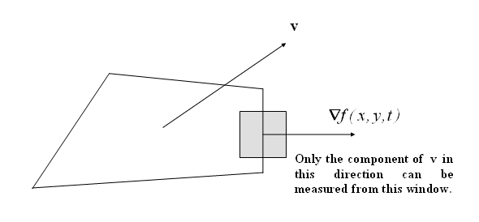
Computing optical flow

Slide 55
Computing optical flow
Other limitations of the conservation equation are :
Greylevel conservation doesn’t hold at occlusions as object surfaces disappear or re-appear
As objects move, the relative orientation of a surface patch relative to the illumination and camera changes and the observed intensity will change. Thus greylevel conservation is an approximation which is only really valid for planar objects and/or small motions

Slide 56
Computing optical flow
An nice way of looking at the aperture problem is through the velocity constraint line
In 2D the greylevel conservation equation is a linear equation in the velocity components v_{x} and v_{y}
The true flow can lie anywhere on this line
Only the component along the gradient vector direction is determined

Slide 57
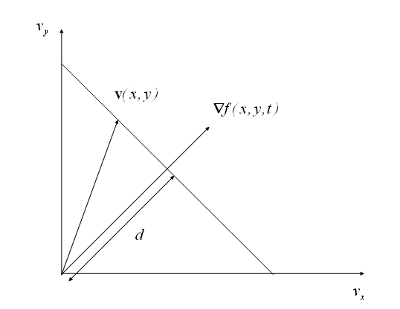
Computing optical flow

Slide 58
Computing optical flow
The 2D conservation equation is :
Distance d is given by :

Slide 59
Computing optical flow
In order to solve the aperture problem, optical flow algorithms make simple assumptions
v(x,y) is smooth (Horn & Shunck’s algorithm). This takes account of the fact that most real surfaces are smooth and do not have depth or orientation discontinuities
The smoothness assumption is not valid at object boundaries

Slide 60
Computing optical flow
v(x,y) is locally piecewise constant or linear (Lucas and Kanade’s algorithm).
Locally constant flow fields tend to be used for motion compensation algorithms for video compression applications
Locally linear flow fields more realistically model projected 3D motions
We will now look in detail at Lucas and Kanade’s algorithm which is based on the local constant flow field assumption. (Haralick & Shapiro, pp. 322).

Slide 61
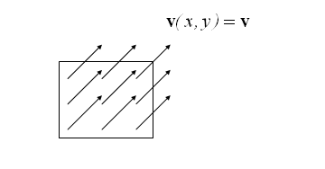
Computing optical flow
Lucas and Kanade’s algorithm that allows us to compute both an estimate of the optical flow field for each position v(x,y) and the statistical certainty of the estimate as expressed by the covariance matrix C_{v}
The algorithm assumes that, in the neighbourhood around some point , the optical flow is constant

Slide 62
Computing optical flow
We must also assume that the current frame f (x,y,t ) is corrupted with inter-frame noise and so we can only observe the noisy greylevels
Our model becomes :
This model is valid within some small m point neighbourhood N_{m} where the optical flow is assumed constant

Slide 63
Computing optical flow
n(x,y,t ) is noise corrupting the true greylevel values and is assumed zero-mean and spatially uncorrelated

Slide 64
Computing optical flow
We can linearise our model by taking a Taylor expansion :
Where :

Slide 65
Computing optical flow
For each point we have an equation :
We can write this equation in matrix form as follows :

Slide 66
Computing optical flow

Slide 67
Computing optical flow

Slide 68
Computing optical flow
We can solve for the flow estimate using a least squares technique :
The result is as follows :

Slide 69
Computing optical flow

Slide 70
Computing optical flow
We can then easily solve for by inverting the 2x2 matrix

Slide 71
Computing optical flow
We are also interested in the quality of the estimate as measured by the covariance matrix
of :
It can be show that :

Slide 72
Computing optical flow
Thus, we can determine the variances of the estimates of the optical flow components v_{x} and v_{y} :

Slide 73
Computing optical flow
We can estimate the noise variance as follows :
We now have a complete algorithm, involving simple matrix-vector computations, which enable us to compute the optical flow in an image and also determine the locations where the flow estimates will be reliable

Slide 74
Computing optical flow
In order to get good flow estimates, a number of implementational issues must be borne in mind
Computation of the derivatives
Derivatives are approximated by a central difference

Slide 75
Computing optical flow
Pre-smoothing
This is usually necessary in stabilising the derivative estimation which is susceptible to noise. Usually a spatio-temporal Gaussian filter is used :
The filter widths are chosen in an ad-hoc fashion

Slide 76
Computing optical flow
Confidence measure
From the covariance matrix , it can be seen that the optical flow estimate accuracy depends on :
The number of points in the neighbourhood
The noise variance
Local edge busyness’ as measured by :

Slide 77
Computing optical flow
Confidence ellipse
Around each point (x,y), we can draw an ellipse which tells us with a certain probability (eg. 99%) that the flow lies in this ellipse with the flow estimate at the centre of the ellipse
The major and minor axes of the ellipse are proportional to the eigenvalues of the covariance matrix
Lucas and Kanade’s algorithm only accepts the flow estimate if the corresponding largest eigenvalue of the covariance matrix is below some threshold value

Slide 78
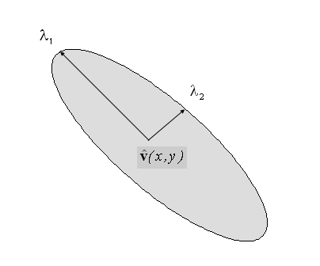
Computing optical flow

Slide 79
Computing optical flow
Example results
Yosemite sequence. The true optical flow, and the flow before and after confidence thresholding
Confidence thresholding produces a more accurate but sparser flow field

Slide 80
Computing optical flow
Yosemite
True flow field
L&K flow field. Confidence thresholded
L&K flow field

Slide 81
Motion and 3D structure from optical flow
We have looked in detail at an algorithm to compute optical flow
An important area of computer vision research is to look at ways to reconstruct the structure of the imaged 3D environment and the 3D motion of objects in the scene from optical flow measurements made on a sequence of images

Slide 82
Motion and 3D structure from optical flow
Applications include autonomous vehicle navigation and robot assembly
Typically a video camera (or more than one camera for stereo measurements) are attached to a mobile robot
As the robot moves, it can build up a 3D model of the objects in its environment

Slide 83
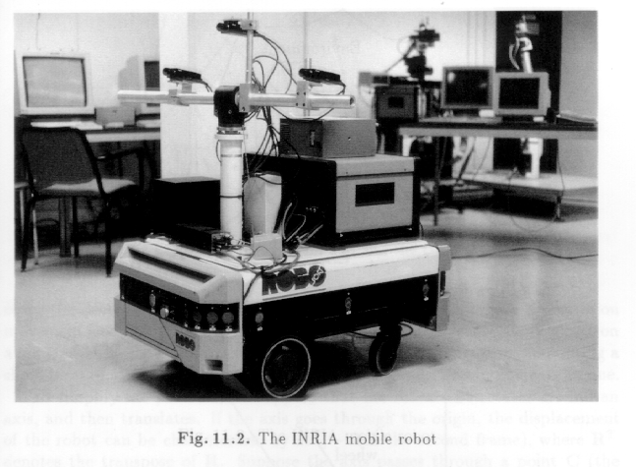
Motion and 3D structure from optical flow

Slide 84
Motion and 3D structure from optical flow
As we saw previously, the relationship between image plane motion and the 3D motion that it describes is summed up by the perspective projection
We assume that the object has a rigid body translational motion of V=(V_{X} ,V_{Y} ,V_{Z}) relative to a camera centred co-ordinate system (X,Y,Z)

Slide 85
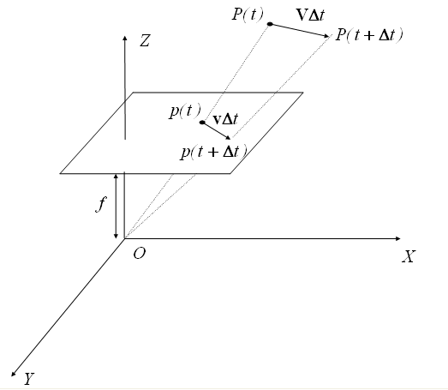
Motion and 3D structure from optical flow

Slide 86
Motion and 3D structure from optical flow
The equations for perspective projection are :
Z(x,y) is the depth with projects to point (x,y) in the image plane

Slide 87
Motion and 3D structure from optical flow
Differentiating with respect to time :

Slide 88
Motion and 3D structure from optical flow
Substituting in the perspective projection equations, this simplifies to :

Slide 89
Motion and 3D structure from optical flow
We can invert this equation by solving for (V_{X} ,V_{Y} ,V_{Z}) :
This consists of a component parallel to the image plane and an unobservable component along the line of sight

Slide 90
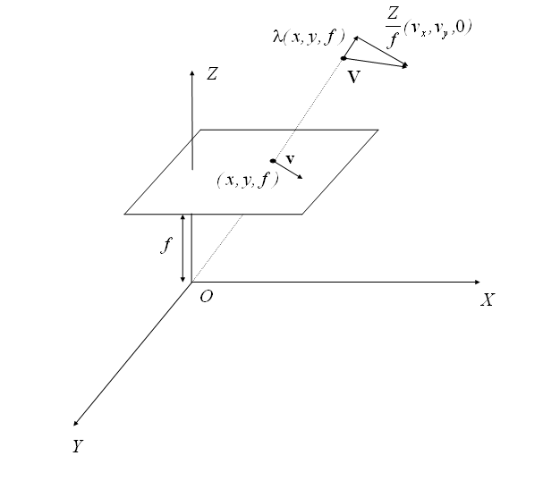
Motion and 3D structure from optical flow

Slide 91
Motion and 3D structure from optical flow
The optical flow field produced by rigid body motion can be interpreted in terms of a focus of expansion
We can rewrite the optical flow equations as follows :

Slide 92
Motion and 3D structure from optical flow
(x₀ ,y₀) is called the focus of expansion (FOE)
For V_{Z} towards the camera (negative), the flow vectors point away from the FOE (expansion) and for V_{Z} away from the camera, the flow vectors point towards the FOE (contraction)

Slide 93
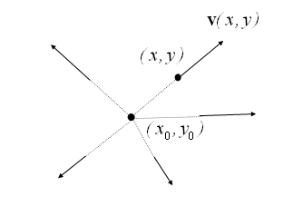
Motion and 3D structure from optical flow

Slide 94
Motion and 3D structure from optical flow
Example – several frames from the Diverging Tree sequence and the optical flow field
The divergent nature of the flow is evident as the camera moves into the image plane

Slide 95
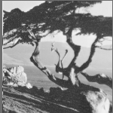
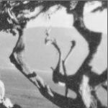
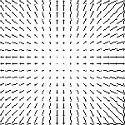
Motion and 3D structure from optical flow

Slide 96
Motion and 3D structure from optical flow
What 3D information does the FOE provide?
Thus, the direction of translational motion can be determined by the FOE position

Slide 97
Motion and 3D structure from optical flow

Slide 98
Motion and 3D structure from optical flow
We can also determine the time to impact from the optical flow measurements close to the FOE

Slide 99
Motion and 3D structure from optical flow
τ is the time to impact, an important quantity for both mobile robots and biological vision systems!

Slide 100
Motion and 3D structure from optical flow
The position of the FOE and the time to impact can be found using least-squares techniques based on measurements of the optical flow at a number of image points
See Haralick & Shapiro, Robot Vision vol 2, pp. 191

Slide 101
Conclusion
We have looked at the following topics
The geometry of motion and stereo analysis
An algorithm to compute optical flow
An algorithm to compute 3D motion and structure from an optical flow field

