Slide 1
M.Sc. Multimodal Interaction
M.Eng. EE4H: Speech and Vision
2010-11
Gesture with speech
Lip tracking and speech

Slide 2
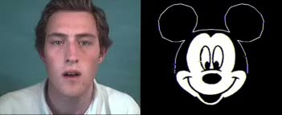
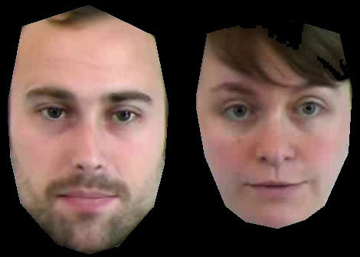
Background
Possible Applications for the integration of Speech and Vision Processing:
  Gesture Recognition
  Aids for the hearing impaired
  Forensic ID
  Sign language interpretation
  Lie detection
  Navigation & manipulation in a virtual environment
  Video conference communication
  Lecture communication
  Animation of avatars
  www.image-metrics.com & www.imm.dtu.dk/~aam
  To assist human speech interpretation
  Multimodal computer interface

Slide 3
Gestures can be:
  Static (95% accuracy achieved)
  Dynamic (accuracy for continuous gesture recognition is very low)
  Static and dynamic
  Context dependent
    Cultural context
    Application context
    The manner in which gestures are associated with speech depends on the context.
    The association’s are different in:
      Weather forecasting (pointing)
      A discussion of a Shakespearean play (to emphasise abstract concepts)
      Directing an aircraft into a parking space (a particular style of pointing)

Slide 4
Broad types of Gesture
  Hand and arm gestures
  Head and face gestures
  Body gestures

Slide 5
Lip Tracking
Uses
  To animate an avatar or an image of another person
  To aid speech interpretation
  Automated lip reading
Issues
  Adorned lips
    Much easier to track but not always possible
  Unadorned
    More likely
  Pose
    Front portrait or profile (hard)
  Not obvious how lip movement and speech are temporally related.

Slide 6
Detection of Hands and Lips
Colour
  Problematic for hands when the scene is “busy”
Infra-red
  Can be complications
Background subtraction
  Problematic for hands when the scene is “busy”
Corner detection
  More complex than segmentation and still prone to errors with a “busy” background
Hidden Markov Models (HMM)
  Used to combine evidence

Slide 7
PCA - Eigenvector analysis
  The model matching aspect of model-based strategies Tracking
  Gesture motion is not normally smooth
  This make sit difficult to track
Lips
  Difficult to detect and track in profile

Slide 8
Sources
Academic Papers such as:
  Mitra S and Achyra T, Gesture Recognition: A Survey, IEEE Trans. SMC, Part C, Vol. 37, No 3 May 2007, pp311-324
Text books provide information about techniques:
  Forsyth DA and Ponce J,
  Computer Vision: A Modern Approach,
  Prentice Hall, ISBN 0131911937
  Sonka M, Hlavac V and Boyle R,
  Image Processing and Machine Vision, 3rd Ed. Thomson Eng., ISBN 0495244384

Slide 9
Grey-level
Alvey Video
Natural scenes and images are perceived on a continuous scale
Computer images are quantised:
  Spatial quantisation: 640x480 pixels, upwards
  Grey-levels: 256
    Corresponds to 8 bits
    Human vision distinguishes a change of 1 in 32 to 1 in 64

Slide 10
sEGMENTATION Part 1
M.Sc. Multimodal Interaction
M.Eng. EE4H: Speech and Vision

Slide 11
Colour Spaces
Variety of colour spaces
  RGB :
    Defined on orthogonal rectangular axes
    Relates to electronic display devices
    Can be 8, 8, 8 bits; 4, 5, 5 bits
    Variations include:
      RGB, sRGB, Adobe RGB and Adobe Wide Gamut RGB
      Each have a different gamut and different matrices to transform to and from the XYZ space (see later).
  YIQ, YUV:
    Intensity (Y), colour (I and Q or U and V).
    YIQ is rotated 33 degrees wrt YUV
    Is a cylindrical space.
value
hue
saturation

Slide 12
  CMY:
    A subtractive space – Cyan, Magenta, Yellow
    Defined for printing
    Matches the behaviour of a monitor
  HSV:
    Hue, Saturation and Value (or B: Brightness)
    Defined for printing
    Cylindrical
  Lab:
    Cylindrical: Intensity (L), colours (a, b)
    A chromatic value space, i.e. opposing colours
    a: green – magenta
    b: blue - yellow
    Defined for printing
L: lightness
a*
b*
- green
+ yellow
- blue
+ red

Slide 13
  L*a*b*:
    As for Lab plus:
      Each unit change in each axis has a similar perceptual significance.
      This is the most appropriate space for colour image interpretation
  XYZ:
    A conceptual space in which all gamuts can be represented
    Cannot be realised because at some wavelengths the spectral intensity is negative
  All colour spaces represent a similar range of colours
    The ability of each colour space to represent colours is not identical
      The scale of variation differs
      The mode of variation differs

Slide 14
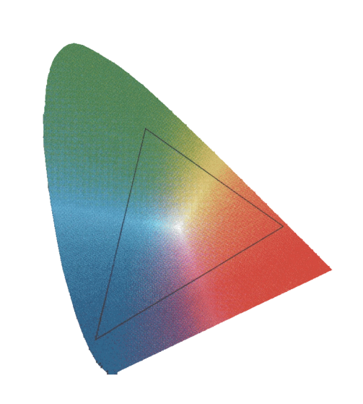
Gamut
Drawn on the plane X+Y+Z=1 of the X, Y, Z space
White is at the centre
Lines that radiate from the
central white point are lines
of increasing saturation in
a colour determined by the
orientation of the line
y
λ
y
Typical monitor gamut
x

Slide 15
Colour Constancy
Colour Perception depends on:
  Colour of illumination
  Direction of viewing
  Reflection from neighbouring surfaces
  Surface finish:
    The diffuse reflective colour of a material may be different to the specular reflective colour of the surface
  Subjective effects
    Surrounding colours affect our interpretation of colour
    Human visual response varies from person to person
  Perceived colour = angular variation & surface colour
  specular variation across surface
  diffuse variation across surface
  reflected illumination from neighbouring objects

Slide 16
Colour Perception
Depends on colour of illumination
Depends on colour of illumination reflected from a neighbouring object
Depends on the observer
Depends on specular and matt colour of object

Slide 17
  A simple model of how a colour camera receives an image is:
  Forsyth describes ways to identify specularities.
  This could help in identifying the true surface colour
  Using the model above requires extensive knowledge of material in the scene
    This information is unlikely to be available

Slide 18
Correct the Gamut so that corresponding colours (metamers) look the same
  Compute the maximal gamut for many surfaces in white light and normalise the gamut of a new scene to this model (Finlayson)
Cannot correct for subjective variation
Colour camera white balance correction
  Commonly simple crude strategies are adopted
    Scale each colour to make the average colour of a scene grey
      Clear not well justified
    Assume the brightest point in the image has the colour of the illumination
      Depends on surface properties

Slide 19
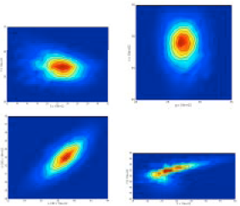
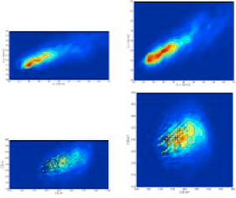

Skin Colour Space Histograms
r-g
E-S
T-S
IQ
CIE-a*b*
CIE-xy
CIE-u*v*
CIE-SH
H-S

Slide 20
Measures of skin pixel detection:
 |  | Simple Gaussian Density Model |  | Gaussian Mixture
colour space | HIN | MSDN | Calibration TP=TN (%) | Calibration TP=TN (%)
TSL | 0.2653 | 1.0000 | 83.32 | 82.87
r-g | 0.2627 | 1.0034 | 81.35 | 80.38
CIE-xy | 0.2845 | 2.1915 | 73.77 | 75.20
CIE-DSH | 0.2657 | 3.3466 | 77.73 | 82.30
HSV | 0.2618 | 3.4951 | 76.43 | 83.46
YIQ | 0.5801 | 4.9076 | 61.59 | 59.57
YIS | 0.5809 | 3.6299 | 60.69 | 56.53
CIE-u*v* | 0.4177 | 3.3806 | 68.36 | 86.44
CIE-L*a*b* | 0.4050 | 3.7381 | 80.10 | 87.65

Slide 21
Infra-Red
Solid state sensors are sensitive to near infra-red
  Some have a filter to block the infra-red
  Need a visible light blocking filter to enhance infra-red
  Glass lenses do not transmit infra-red well
  Silicon lenses transmit infra-red but not visible light
  Focal length of a lens is different in infra-red
  A camera measures the surface energy emitted from a surface, not temperature
    To determine temperature we need to know the emissivity of the material

Slide 22
Infra red images behave very differently to visible light images
  Many bodies emit infra-red
  A metal plate that does not reflect visible light well may reflect infra-red
  A surface will hold an infra-red imprint.
    An “after” image is held for some time after a hot body, such as a hand, has been in contact with a surface such as a sheet of card
  Imaging devices
    CCTV cameras etc
      Image passive infrared illumination and include a strong visible sensitivity
      Thermal cameras used for surveying buildings, medical and scientific purposes image only infra red
        Near or short wavelength (almost visible)
        Far or long wavelength

Slide 23
Infra-Red for Gesture Recognition
Good to recognise hands in an environment where there are no heat sources
  Desktop
  Against a map (weather forecast), provided that the body can be avoided
Not so good
  Lip detection – rest of face is quite hot

Slide 24
Image Interpretation
Traditional strategy
  Noise removal (filtering)
  Segmentation
  Trace object boundaries
  Compute properties
  Recognise
Model-based
  Need a description of what you want to find
  Need cues that suggest where to look
  Ways of processing the image locally to try to match the model to the image, flexibly

Slide 25
Segmentation
Purpose is to:
  Partition an image into meaningful regions
    What is meaningful depends on the application
  Identify objects in a scene
  Identify moving objects in a scene
  Identifying foreground and background
    May not always give meaningful regions

Slide 26
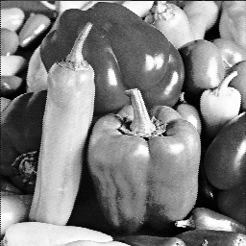
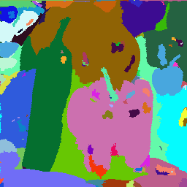
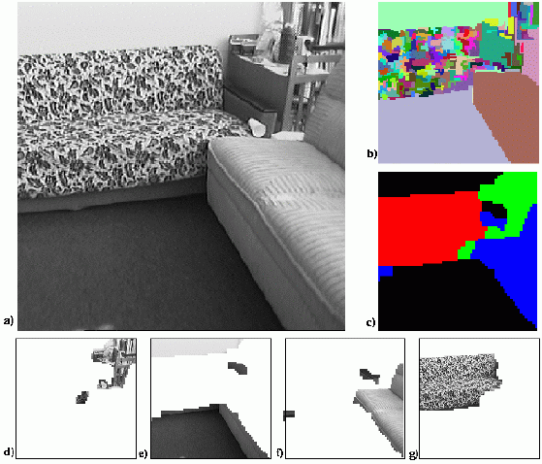
Segmentation
Takes measurements
from the image
  Grey level
    Note inaccuracies
  Colour
  Texture
  Depth
  Motion
    Based on the flow field
    not the motion

Slide 27
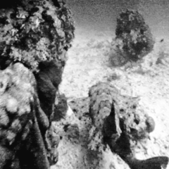

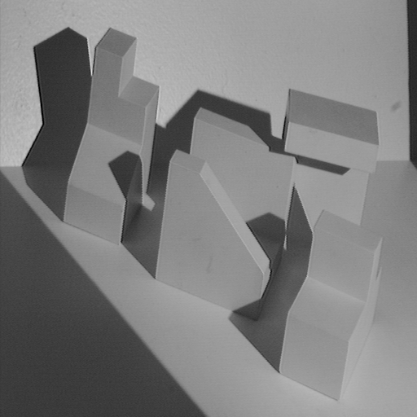
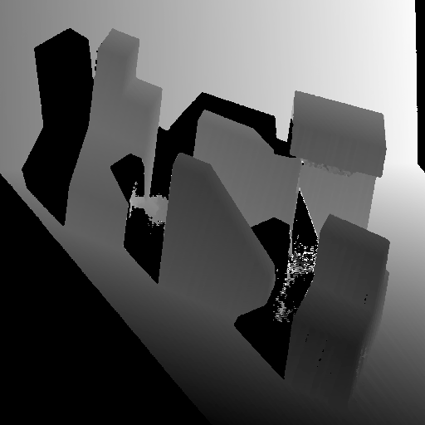
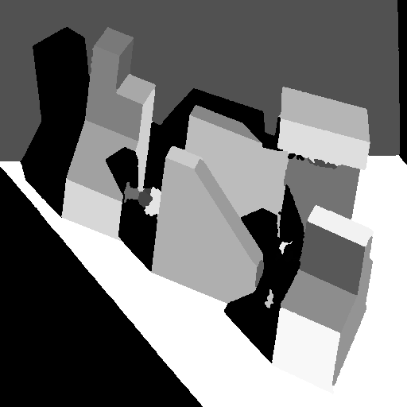
Motion
Estimated flow
Depth

Slide 28
Segmentation
Strategies
  Region identification
    Identify pixels that are similar
  Boundary identification
    Identify discontinuities
Methods
  Low-Level Pixel Operations such as Thresholding
  Mid-Level Clustering
  High-Level Model Fitting
  High-Level Probabilistic Methods

Slide 29

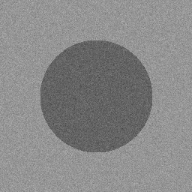
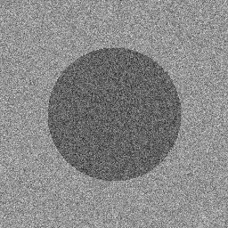
Segmentation:
Grey-Level Histogram Threshold Selection
Clustering of histogram values
  Global threshold of the image
    Low-level pixel operations
Noise free
SNR =
Low noise
SNR = 5
High noise
SNR = 2
∞
  Appraise using images with various signal to noise ratios:
μ_{a}
μ_{b}

Slide 30
Segmentation Part 2
M.Sc. Multimodal Interaction
M.Eng. EE4H: Speech and Vision

Slide 31
Grey level Threshold Selection
Let g(x,y) be the grey level value at (x, y)
If g(x, y) < T then pixel is an object pixel
else pixel belongs to the background
Threshold selection
  Minimisation of within
  class variance
    Robot Vision, Haralick
    & Shapiro, Vol 1., p 20
Background
Object

Slide 32
Minimisation of within Group Variance
    Robot Vision, Haralick & Shapiro, Vol 1., p 20
Foreground and Background pixels each have their own:
  Grey level population with
    A mean grey-level
    A variance
  The homgeneity
  (or in-homgeneity) of each population is measured by the variance of the population

Slide 33
  Select a threshold to maximise the homogeneity
    A threshold that minimises the within group variance for the foreground and the background
  Let the foreground be pixels with a
  grey level <= Threshold, T
  Let background be pixels with a
  grey level > Threshold, T
  Convert the histogram to a probability distribution:
  Prior probability of foreground and background regions, respectively, is taken to be:

Slide 34
  The mean and the variance of each group are:
The sum of the grey-levels weighted by the probability of each grey-level, divided by the sum of probabilities
The sum of the variances (g-μ)² weighted by the probability of each variance, divided by the sum of probabilities

Slide 35
  The nett within group variance is:
Minimise the nett within group variance with respect to T:
  Requires 256 comparisons for an 8 bit grey-level image

Slide 36
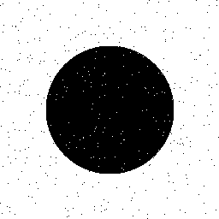
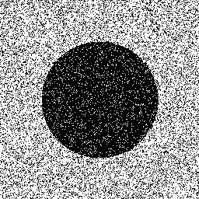
Application of Minimisation of within Group Variance
Low noise image
  T=124
  Almost exactly halfway between the foreground and background peaks
Low noise image
High noise image

Slide 37
High level of pixel miss-classification
  Common with a global
  threshold
  Extent determined by the
  overlap in the distribution
  of grey-levels for each
  group
  Can quantify the probability of error
Background
Object

Slide 38
Grey-level clustering
Consider ideally separated
foreground and background
histograms
  Clustering tries to separate
  the histogram into 2 groups
  Centred at C₁ and C₂
  Grey levels classified by
  nearest cluster centre
Background
Object
C₁
C₂
Segmentation performed this way is nearest neighbour clustering
  This is a simplified version of K-means clustering
  There is a simple iterative algorithm with known convergence properties

Slide 39
Iterative Clustering Algorithm
Properties
  Has defined convergence properties
  Is a simple method of computation
Method
  A set of grey-levels in an image: {g(1), g(2), … g(N)}
  Can be partitioned into two groups:
  {g₁(1), g₁(2), … g₁(N₁)} and {g₂(1), g₂(2), … g₂(N₂)}
  Mean of clusters 1 and 2, respectively, are:

Slide 40
Re-define clusters according to:
  Associate grey levels with the closest cluster centre
Practicality
  Don’t know the correct cluster centres at the start
  Start with an approximation and iterate
Algorithm
Randomly initialize the label of each pixel
Repeat
C₁ = mean of pixels assigned to foreground or object label (1)
C₂ = mean of pixels assigned to background label (2)
Compute the partition for sets 1 and 2
Until no more pixel labels change

Slide 41
Convergence: Outline Proof
  Define a ‘cost function’ at iteration r
    Sum of average distance, in grey level, of members from from each cluster centre (mean squared distance)
E^{(r)}>0
Update cluster centres:
Update cost function
Easy to show that:
Since E^{(r)}>0 must converge

Slide 42
Convergence
  E₁ is the sum of variances within each cluster
  This is minimised at convergence
  Good results for well separated clusters
  Similar to thresholding
Weakness
  Segmentation determined on the basis of the grey-level value of each pixel

Slide 43
Relaxation Labelling
Incorporates constraints, such as the spatial arrangement of pixels
  Consider a miss-classification:
The constraint may be that single
pixels should not be labelled
differently to those which surround
them
Relaxation labelling can apply to colour, texture and motion segmentation
Originally related to 3-D geometric interpretation
Background
Object

Slide 44
Consider a simple image with a foreground (object) and background
  Let p(i) be the probability that pixel i is a background pixel
  Then 1-p(i) is the probability
  that pixel i is a foreground pixel
  Define consistencies c_{s} and c_{d}
    c_{s} is a positive supporting weight
    c_{d} is a negative discouraging weight
  An image
    With a simple bimodal grey-level distribution
    Maximum grey-level g_{max}
i₁
i₂
i₃
i₄
i
i₅
i₆
i₇
i₈

Slide 45
Initialise the probabilities
Forces labelling to extremes of grey-level range
Want the relaxation algorithm to move the background pixel probabilities, p(i) to 1 and the object pixel probabilities to 0
We wish to take into account
  The probabilities of neighbouring pixels
  The consistency values
Want an algorithm in which p(i) ≥ 1

Slide 46
For a neighbour i₁ of pixel i
  Consider the increment in p(i) due to i₁
  Let that increment be q(i₁)
  If q(i₁)>0.5 the contribution from
  pixel i₁ should increment p(i)
  If q(i₁)<0.5 the contribution from pixel i₁
  should decrement p(i)
  This can be formulated as:
i₁
i₂
i₃
i₄
i
i₅
i₆
i₇
i₈
  Sum the contributions from the 8 neighbours to get the total change to p(i):

Slide 47
Can be shown that if -1 < c_{s}, c_{d} < 1
Then -1 < Δp(i) < 1
Update p(i) using:
This ensures that p(i) remains positive
This is a basic form of relaxation labelling
After each iteration need to normalise p(i) to the range {0 .. 1}
  Normalise with respect to the largest probability:
  When all the p(i) in a neighbourhood are the same will get stuck

Slide 48
Improved normalisation
  Has the correct properties
    When p^{(r-1)}(i) = 1, p^{(r)}(i) = 1
    When p^{(r-1)}(i) = 0, p^{(r)}(i) = 0
    When p^{(r-1)}(i) = 0.9 and Δp(i) = 0.9, p^{(r)}(i) = 0.994
    When p^{(r-1)}(i) = 0.1, and Δp(i) = -0.9, p^{(r)}(i) = 0.012
    p(i) converges to 0 or 1
  Can be derived from the basic principles of relaxation labelling
  Can show that 0 < p^{(r)}(i) < 1

Slide 49

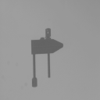
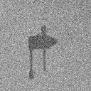

Comparison of Thresholding and Relaxation Labelling
High noise circle image
‘Optimum’ threshold
Relaxation labeling - 20 iterations
clamp image
original
clamp image
noise added
segmented clamp image 10 iterations

Slide 50
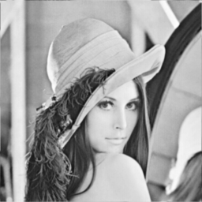
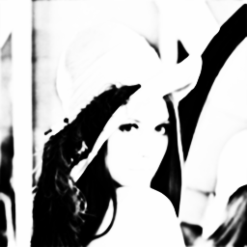
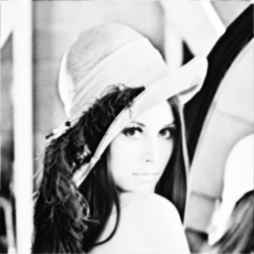

Relaxation Labelling applied to a natural image
Original
5 iterations
2 iterations
10 iterations

Slide 51
Background Subtraction
M.Sc. Multimodal Interaction
M.Eng. EE4H: Speech and Vision

Slide 52
Background Subtraction
Used to detect objects in motion
Features
  Fast and simple
  Can be error prone
Concept
  Need to model image background
  Need to track changes in image background
  Subtract the background model and apply a threshold
The challenges
  To model the background and not the object
  To track illumination changes but not the object
  To be effective but fast – frame rate

Slide 53
Basic Background Subtraction
Compute an average of the last few frames, say 10
  May include the foreground
  If object moves slowly then the segmentation may fragment the object
    The leading a trailing regions where the contrast is larger remain

Slide 54
Detailed Description
Practical requirements:
  Post subtraction enhancement
    Morphological closing and opening
      Closing (I) = Erode(Dilate(I))
      Opening (I) = Dilate(Erode(I))

Slide 55
Statistical Models for Background Subtraction
Improved performance in scenes that contain:
  Noise, illumination change and shadow
  W4 system
  Min (M), Max(N) and maximum difference (D) of grey-level
    Foreground:
    Followed by morphological opening and the removal of small regions

Slide 56
Mixture Models
(Background and Foreground)
Update model of image background & foreground
Update threshold if pixel is in background
Background image is updated from both the background and the foreground
  Normally only update from the background

Slide 57
Gaussian Mixture Model
Scalar grey-level or vector colour pixels
A single univariate distribution cannot characterize an image with:
  Noise
  None uniform illumination
  Complex scene content
  Variation in light illumination
This scheme allows for multiple models

Slide 58
    Probability of a pixel value observations is:

Slide 59
Outline Description of Algorithm
Initialise the K Gaussian Distributions with
  Mean, high variance, low prior weight
  Check a new pixel against each Gaussian mean and find the closest match (variance normalized)
    If no match update the lowest probability distribution making the mean the current pixel value and setting a high variance and low prior weight (re-initialize)
  To match a new value must be within 2.5 standard deviations of the mean

Slide 60
  Update weights, means and standard deviations using:
Detection of Foreground / Background
  Compute w/σ for each distribution
  Sort by w/σ
  Select as Background:

Slide 61
Edge enhancement
M.Sc. Multimodal Interaction
M.Eng. EE4H: Speech and Vision

Slide 62
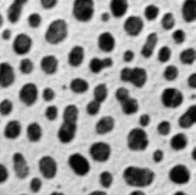
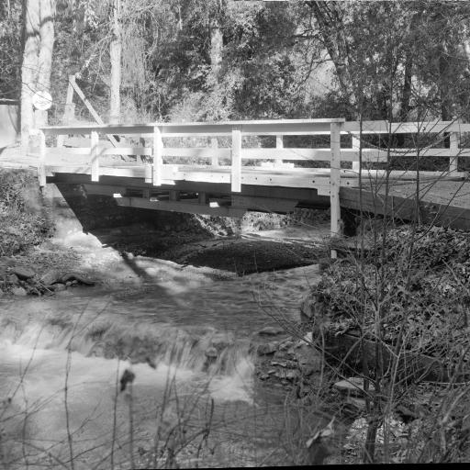
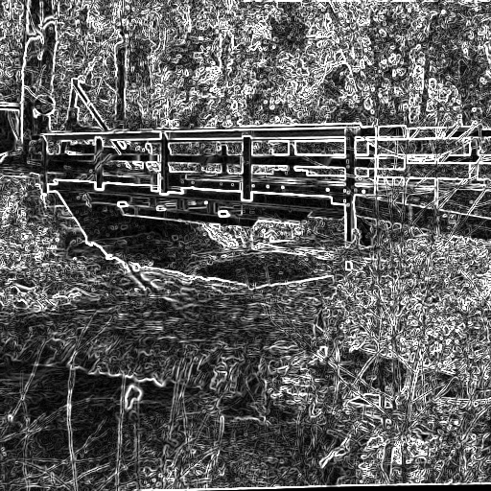
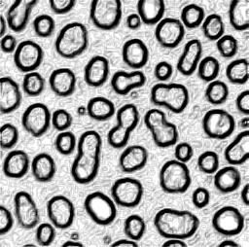
Edge Enhancement
Edges are important features for the interpretation of images
  Consider the cartoonists sketch
  The problem is to identify the important edges

Slide 63
Overview of Edge Enhancement
Many methods of edge enhancement are based on filters
  Linear, law of superposition applies:
  F(I₁+I₂) = F(I₁) + F(I₂)
    Neighbourhood operators
    Convolution operators that take a region of an image, commonly 3x3 or 5x5 and combine the values with weights to produce a single output value
    Can be decomposed into a pair of 3x1 (5x1) and 1x3 (1x5) operators for faster computation
    Common examples are:
    Roberts, Prewitt, Sobel, Kirsch
  Non-linear, law of superposition does not apply
    Common examples are:
    Min-max, Fourier Transform, Difference of Gaussian,
    Wavelet transforms, SPHIT, Canny

Slide 64
Linear Edge Enhancement
  First derivative has a peak where the gradient is steepest
  Second derivative has a zero crossing where the gradient is steepest
  This can be located more readily and precisely
f(x)
f’(x)
f’’(x)

Slide 65
Linear, Convolution Operators
Roberts (first derivative)
  2x2 operator
  Introduces a displacement
  in the resulting image
  Little spatial smoothing
R₁
R₂
1 | 0
0 | -1
0 | 1
-1 | 0
Prewitt (first derivative)
  3 x 3 operator
  Magnitude and orientation of the maximum response
  Strictly 8 orientations
P₁, P₂, P₃, P₄
1 | 1 | 1
0 | 0 | 0
-1 | -1 | -1
0 | 1 | 1
-1 | 0 | 1
-1 | -1 | 0
-1 | 0 | 1
-1 | 0 | 1
-1 | 0 | 1
-1 | -1 | 0
-1 | 0 | 1
0 | 1 | 1

Slide 66
Robinson and Kirsch
(first derivative)
  As Roberts but different weights
Sobell
  Combine the result of two 3x3 operators
  No displacement of resulting image
  Introduce smoothing
Rob₁, Rob₂, Rob₃, Rob₄
1 | 1 | 1
1 | -2 | 1
-1 | -1 | -1
0 | 1 | 1
-1 | -2 | 1
-1 | -1 | 0
-1 | 1 | 1
-1 | 2 | 1
-1 | 1 | 1
-1 | -1 | 0
-1 | 0 | 1
0 | 1 | 1
K₁, K₂, K₃, K₄
3 | 3 | 3
3 | 0 | 3
-5 | -5 | -5
3 | 3 | 3
-5 | 0 | 3
-5 | -5 | 3
  Common simplifications:
-5 | 3 | 3
-5 | 0 | 3
-5 | 3 | 3
-5 | -5 | 3
-5 | 0 | 3
3 | 3 | 3
-1 |  | 1
-2 |  | 2
-1 |  | 1
-1 | -2 | -1
1 | 2 | 1
S₁
S₂

Slide 67
Second Derivate Edge Enhancement
Laplace
  Second derivative
  Impulse response
  4 and 8 connected mask
  As a differencing operator emphasises noise
0 | 1 | 0
1 | -4 | 1
0 | 1 | 0
1 | 1 | 1
1 | -8 | 1
1 | 1 | 1
Laplacian of Gaussian (LoG)
  Combines with the smoothing of the Gaussian
  Pre-convolve
  “Mexican Hat” response
Second Derivative of the
Gaussian
  Pre-convolve
  “Mexican Hat” response

Slide 68
A Gaussian distribution of coefficients avoids edge effects
  A Gaussian filter can be
  applied before after, and with
  an edge convolution
  without alteration to the effect
Difference of Gaussian (DoG)
  Approximates the Second
  derivative with Gaussian
  smoothing
    It is not the same
  A Gaussian filter is a
  smoothing filter

Slide 69
Canny Edge Detector: Introduction
Introduced to characterise Edge Detectors
  Not as the best edge detector
  Not as the standard edge detector
  Introduced criteria for
    Detection: Proportion of edges detected.
    Minimise No. of edges missed
    No. of spurious responses
    Localization: Edge in correct position
    Mean error of edge position
    Specificity: Single response at the edge
    Repeatability: Variation in position of edge
    SD of error in edge position

Slide 70
  Closed form solution for first two criteria
    Added third criteria
    First derivative of a Gaussian was within 20% of ideal for a step edge

Slide 71
Canny Edge Detector:
Outline of Algorithm
The Canny Edge Detector is frequently described incorrectly
The chief steps are:
  1. Repeat through a sequence of scales:
    1.1 Gaussian smoothing with a scale of σ
    1.2 Compute normal to the edge, n
    1.3 Locate the edges as extremum along each normal
    (zero crossing of second derivative)
    1.4 Threshold the edge magnitude response by following paths of the extremum and applying a hysteresis
  2. Aggregate the evidence across scale

Slide 72
Canny Edge Detector: Key Detail
Compute normal to the edge, n
  The Gaussian smoothing helps to
  compute a stable edge orientation.
  Edge normal is given by:
Non maximum suppression
  The second derivative of the Gaussian in
  direction, n, is used to locate the edge.
  The image gradient gives the edge strength.

Slide 73
Canny Edge Detector: Key Detail
Threshold edges with hysteresis
  1. Set a lower threshold t₀ and an upper
  threshold t₁
  2. Repeat
  2.1 For each pixel in the image
  2.1.1 Mark all edges with a magnitude greater than t₁
  2..1.2 If a 4- or 8-connected neighbour of a marked edge pixel has an edge response in the range [t₀, t₁] then mark it as bordering.
  Until no change

Slide 74
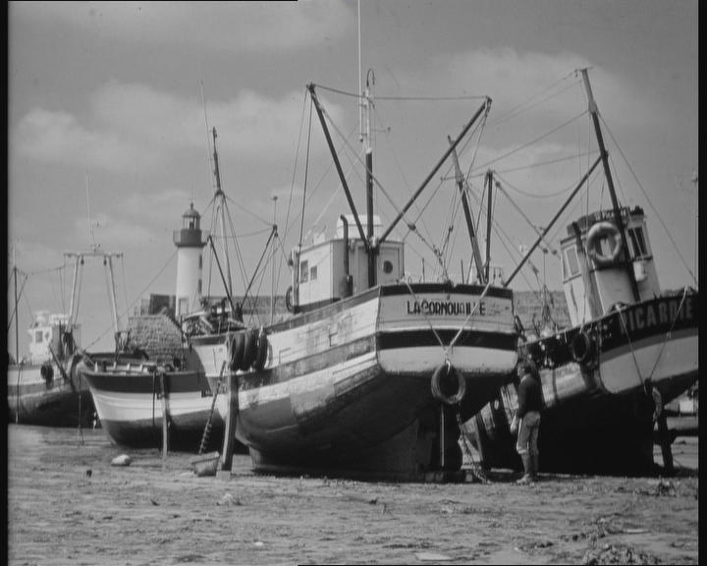
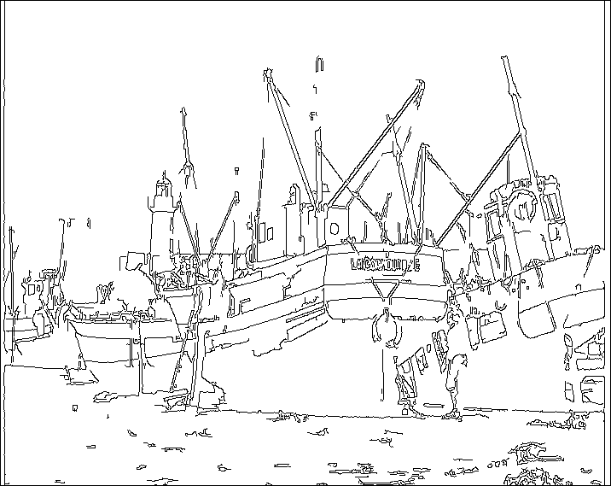
Canny Edge Detector: Key Detail
Aggregate edges across scale using feature synthesis
  Mark edges at finest scale
  Synthesise coarser scale edges
  Additional edges at each coarser scale are added, only if their edge response is stronger than that synthesised from the finer scale.

Slide 75
Corner detection
M.Sc. Multimodal Interaction
M.Eng. EE4H: Speech and Vision

Slide 76
Corner Detection
Corners
  V-type, T-type, X-type
  Rounded corners; scale
Provide a better reference in an image than an edge
  Stereo interpretation
    Motion perpendicular to edge only can be detected
    Motion in several directions can be detected at a corner
  Locating lips, Locating finger tips
    A corner is a unique landmark.
    It is homologous – the same from all direction

Slide 77
Corner Detection strategies
Detection of high curvature regions on a boundary
Detection of grey-level or colour “corners”
Corner detection is concerned with the detection of a gradient discontinuity
Making a corner detector robust is difficult

Slide 78
Moravec Corner Detector
Locates points at the centre of a local high variability in grey-level value as the 8-connected neighbours are sampled
Primarily detects V-type corners

Slide 79
Case study
M.Sc. Multimodal Interaction
M.Eng. EE4H: Speech and Vision

Slide 80
Case Study
Audiovisual Coanalysis
  Kettebov S, Yeasin Mohammed Sharma R, Prosody Based Audiovisual Coanalysis for Coverbal Gesture Recognition, IEEE Trans. on Multimedia, &, 2, 2005, pp 234-242
Application domain
  Weather forecast presentation
Features
  Spontaneous narration
  Natural gestures
    Deictic gestures; used to direct the listener’s attention to a physical reference
    Iconic and metamorphic gestures; associated with abstract ideas
    Beat gestures; marks of emphasis or pace

Slide 81
  Kinematics of Gestures
    Preparation-stroke-retraction
      Stroke has a peaking effort
      Identified strokes of: contour, point and circle
      Add a hold phase
Data
  60 mins of monologues
  Each of monologue lasts 1-2 mins and is uninterrupted
  Taken from 8 people (5 men and 3 women)
Visual Feature Tracking
  Motion and skin colour to track position of head and hand
  Tracking using Viterbi algorithm and proximity to location in previous frame

Slide 82
Prosodic Speech Features
  Pitch change
  Duration
  Pitch - The fundamental frequency contour
Interpretation
  Hidden Markov Model
  Where:
  v_{h}, a_{h}, v_{hd}, a_{hd}: are the velocity and acceleration of the hand and head, respectively
  |s_{h, hd}|: Is the absolute distance between the hand and the head
  F₀, δF₀/δt: Is the fundamental frequency contour and its time derivative

Slide 83
Detecting Prosodically Significant Segments
Segment
  A continuous part of the F₀ contour corresponding to a voiced interval
  Marked by rises or falls in the F₀ contour and by pauses
    Used F₀ amplitude and voiceless intervals to model prosodic discourse
      Assume a normal distribution of parameters of the form:
      Where ξ_{max}, ξ_{min} are prominence measures min and
      max of the F₀ contour
      δξ_{max} /δt is the maximum gradient of a given F₀
      obtained using the Canny operator

Slide 84
Prosodically Prominent Segments
F₀
  The prominent segment is required to be distinct using a threshold of 0.7 to 1.1 on the Mahalanobis distance measure:
ξ_{max}
ξ_{min}
time
Audiovisual Feature Co-Occurrence
v_{hand}, F₀
τ_{max}
F₀
τ₀
τ_{min}
  δv_{max}/δt found using the Canny
  operator
v_{hand}
time

Slide 85
Bayesian Network
  Relates evidence from a set of classifiers, prior to co-occurrence, co-occurrence, from speech and from gesture
    This has more impact than simply combining visual gesture detection with speech cues

Slide 86
Results Summary
Recognition Mode |  | Correct %
Visual HMM | Prepare | 67.7
 | Point | 58.0
 | Contour | 79.0
 | Retract | 73.4
 | Total | 72.4
Audio-Visual HMM | Prepare | 72.9
 | Point | 69.6
 | Contour | 80.8
 | Retract | 76.3
 | Total | 75.6
Audio-Visual HMM & Bayesian Network | Prepare | 82.5
 | Point | 90.6
 | Contour | 87.0
 | Retract | 80.9
 | Total | 84.2

Slide 87
Revision Recap
Background
An intro to applications
Nature of gestures
Lip tracking
Detection of Hands and Lips
  Colour
    Valid even across ethnic origins.
    With suitable segmentation (Gaussian Mixture model) L*a*b* is most effective colour space
  Infra-red
  Background subtraction
    Difficult to ignore irrelevant changes and detect important regions

Slide 88
Colour
  Colour spaces
  Gamut
  Colour constancy
Segmentation
  Criteria
    Grey-level
    Colour
    Texture
    Depth
    Motion

Slide 89
  Mode
    Region
    Boundary
    Low-level, pixel-based
    Mid-level, clustering
    High-level model-based
    High-level probabilistic methods
Threshold selection
  Interactive
  Adaptive
  Minimisation of within class variance
    High-level of errors with overlapping distributions
  Clustering
    High-level of errors with overlapping distributions

Slide 90
Relaxation Labelling
  Applicable to 3D interpretation
  Edge labelling
  Region labelling
  Issues
    Convergence criteria
    Support and contraindication weights not easy to estimate
    Computation of probability of background membership likelihood based on grey-level value is unreliable

Slide 91
EM Algorithm
  E step
    Estimate probability of belonging to a class
  M step
    Update parameters for E step
  Gaussian Mixture Model
  Issues
    Can get stuck in a local minima
    Needs a good initialization
Background Subtraction
  Basic Method
  Mixture Models

Slide 92
Edge enhancement
  Linear operators
  First derivatives
    Edge at minima and maxima
  Second derivatives
    Edge at zero crossing
  Canny Edge Detector
    Select normal to edge
    Non-maxima suppression
  Facet model
    Fit a cubic or other surface patch
    Compute coefficients using convolution masks

Slide 93
Corner Detection
  Moravec
  Harris-Stephens
Case study for gesture and speech in weather forecast presentation

