Slide 1
Stereo Vision
EE4H, M.Sc 0407191
Computer Vision
Lewis Spencer
lms118@bham.ac.uk

Slide 2
Introduction
Stereo vision is to find an answer to the correspondence problem such that we can calculate the disparity of two points between a minimum of two homogenous images so that we can derive the matching homogenous point in 3D space.
Stereo vision is one of the major components to human depth perception as well as other monocular and binocular clues.
Uses range from robotics to mapping.

Slide 3
Introduction
The topics we will consider are:
  The geometry and optics of stereo
  Epipolar constraint and camera calibration
  Homogenous Transforms
  Division of stereoscopic algorithms
  Issues with stereo matching
  Local matching
  Confidence measures
  Sub-pixel refinement
  Metrics and analysis
  Advanced local matching algorithms
  My personal research

Slide 4
Additional Reading
Davies, E.R., Machine Vision: Theory, Algorithms, Practicalities. Microelectronics and Signal Processing, ed. P.G. Farrell and J.R. Forrest. 2012, London: Academic Press. 4th Edition
Dhond, U.R. and J.K. Aggarwal, Structure from Stereo - A Review. IEEE Transactions on Systems Man and Cybernetics, 1989. 19(6): p. 1489-1510.
Scharstein, D. and R. Szeliski, A Taxonomy and Evaluation of Dense Two-Frame Stereo Correspondence Algorithms. Int. J. Comput. Vision, 2002. 47(1-3): p. 7-42.

Slide 5
The geometry of stereo
Consider a point P with co-ordinates (X,Y,Z) relative to a camera co-ordinate (CCC) system
  The Z axis is oriented so that the axis points along the camera optical axis
  Point P projects to point p(x,y) in the image plane
  Point O is the optical centre (or centre of projection) of the camera
  f is the focal length of the camera

Slide 6
The geometry of stereo

Slide 7
The geometry of stereo
The projected coordinates on the image plane (x,y) are defined in terms of the perspective projection equation
  f is the camera focal length

Slide 8
The geometry of stereo

Slide 9
The geometry of stereo
The disparity d is the difference between the projected co-ordinates in the left and right stereo images x_{L}- x_{R}
Gives a measure of the depth
  The greater the disparity, the lower the depth (i.e. the object is closer)
  As objects tend to ∞ disparity tends to 0
The key task of stereo imaging is to establish a correspondence between image locations in the left and right camera image of an object point allowing the depth of the imaged point to be computed through triangulation

Slide 10
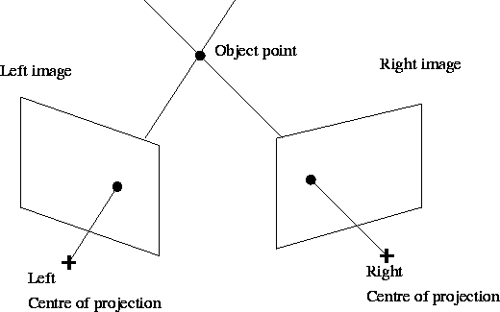
The geometry of stereo
Triangulation enables the depth of an object point to be found given its image point in each camera

Slide 11
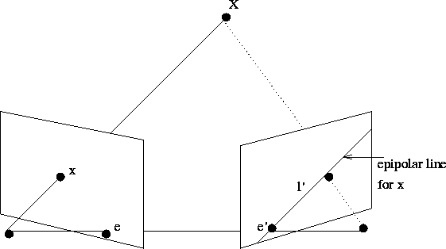
The geometry of stereo
The geometry of stereo imaging is based on the epipolar constraint and the epipolar plane, where B is the baseline between the two optical centres C and C’
B
C
C’

Slide 12
The geometry of stereo
The epipolar line limits the search for a corresponding image point to one dimension
If the camera calibration parameters are known (intrinsic and extrinsic), the epipolar line for an image point in one camera can be computed
Normally the image is pre-rectified before stereo matching to allow for the use of the epipolar constraint.
Given that for P(x,y,z) in 3D space, based on the pinhole camera model:

Slide 13
Camera Calibration
Camera does not act like a pinhole model therefore we need to calibrate the camera and rectify the image to make it match up with our model
Distortions cause issues with the output image:
  Radial distortions = variations in the angular magnification with respect to the angle of incidence
    Cause barrel and pincushion distortions
  Tangential distortions = is displacement of a point in an image caused by the misalignment of the components of the lens

Slide 14
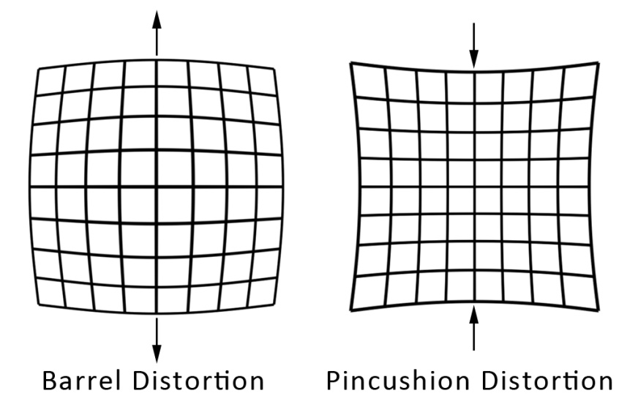
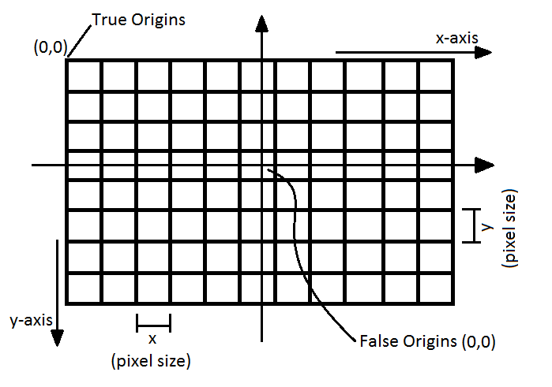
Camera Calibration
Tangential Distortion
Radial Distortions

Slide 15
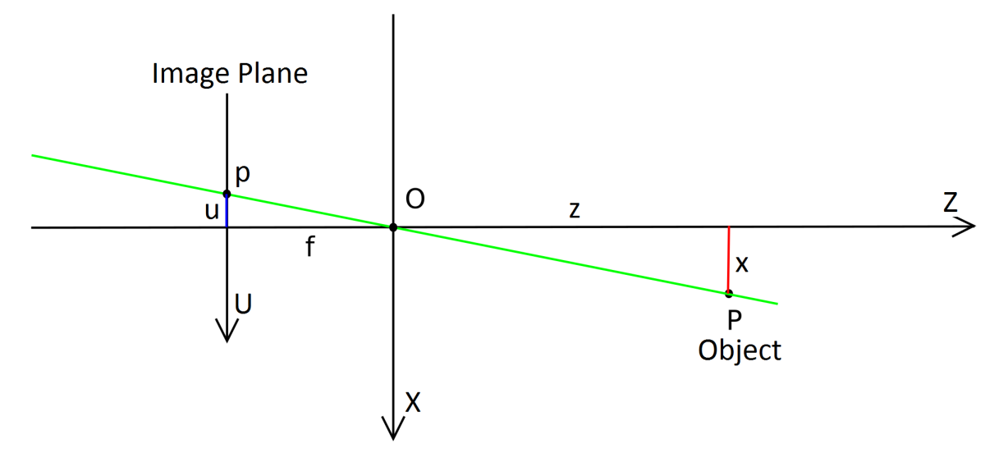
Camera Calibration
Camera matrix:
  p ~ CP where P = homogeneous coord in 3d space = [x,y,z,s]⁻¹ , s = scale = 1. p = the homologous point to P in the image plane = [u,v,s]⁻¹
  C = camera matrix (often called the fundamental matrix) maps p to P

Slide 16
Camera Matrix
Composed of the intrinsic and extrinsic parameters:
Intrinsic parameters are fundamentally defined by the camera given in A matrix:
α_{x}=f.m_{x} and α_{y}=f.m_{y} represents the focal length in terms of pixels, γ = skew factor (often 0) and u0 and v0 are the co-ordinates of the principal point
The focal length is measured to the principal point which is in the centre of a thin double convex lens but changes position in more complex configurations

Slide 17
Camera Matrix
Extrinsic parameters are use to map the camera co-ordinates to the real world co-ordinates : T= translation vector and R is the rotaion matrix (3x3)
Finding the C matrix is a complicated method and we don’t have enough time to go into the details.
  Often solving the eight-point pose problem is done to find the matrix
Bouguet, J. Camera Calibration Toolbox for Matlab. 2010; Available from: http://www.vision.caltech.edu/bouguetj/calib_doc/.

Slide 18

Homogenous Transforms
Effectively the C matrix performs the same as a homogenous transform to convert from one co-ordinate system to another
Point p relative to frame {b} transformed by a rotation and translation relative to {a} is:
Transform can be represented by homogenous matrix, which is composed of a 3x3 rotation matrix and a 1x3 translation vector

Slide 19
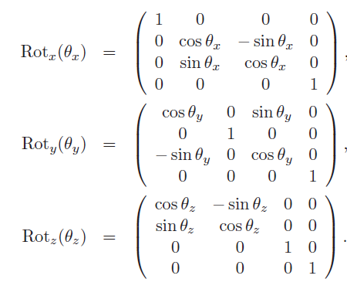

Homogenous Transform
Rotation matrix can be composed of three individual rotation matrix for the X, Y and Z
Standardly we use Z-Y-X Euler angle combination to generate the rotation matrix
Homogenous transforms can be combined to allow for finding the vector for any point relative to any reference frame.

Slide 20
Image Rectification
Once we know the C matrix we can rectify the images to apply the epipolar constraint
Normally this is done via the use of bilinear interpolation:
  1) Subtract principal point, and divide by the focal length:
  p_{distort}(u,v) = [(u - u₀)/α_{x} , (v - v₀)/α_{y}]
  2) Remove skew:
  u_{distort}= u_{distort}- γ* v_{distort}
  3) Compensate for lens distortion given the k_{c} 4x1 vector that represents radial and tangential distortions:
    See next slide

Slide 21
Image Rectification cont.
  Oulu university method to remove tangential and radial distortion:
  p = p_{distort}
  Do 20 times
  r₂= u_{distort}² + v_{distort}²
  k_{radial} = 1 + k_{c}(1) * r₂ + k_{c}(2) * r₂² + k_{c}(5) * r₂³
  Δp = [2.k_{c}(3). p(1).p(2) + k_{c}(4).(r₂ + 2.p(1)²) ,
  k_{c}(3).(r₂ + 2.p(2)²)+2.k_{c}(4).p(1).p(2)]
  p_{out}(u,v) = (p_{distort}- Δp )./(ones(2,1)* k_{radial})
  end

Slide 22
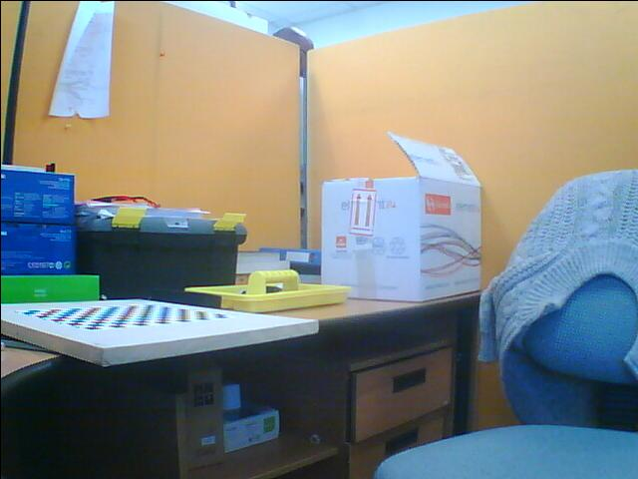
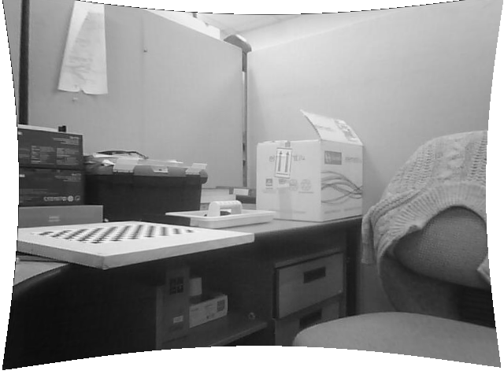
Image Rectification Results

Slide 23
Types of Stereo Algorithms
Local algorithms are based on information in a support window around a given pixel being tested.
Global algorithms utilise information in the entire image, normally via the use of an energy minimisation strategy.
Will only be covering local matching algorithms in these lectures
 | Local Algorithms | Global Algorithms
Dense Output | SAD, SSD, NCC, ASW | Graph Cut, Belief Propagation
Sparse Output | D-Sparse

Slide 24
Local Matching
Local matching compares a pixel (normally in the left hand side image I_{L} but it doesn’t have to be) and its surrounding support window W where (i,j) ϵ W to set of potentially matching pixels and there support windows in the opposite image (I_{R}) that lie on the epipolar constraint
We don’t need to search the entire epipolar line, since our matches will lie between two constraints (d_{min} , d_{max}) where:
d_{range} = d_{max} - d_{min} +1

Slide 25
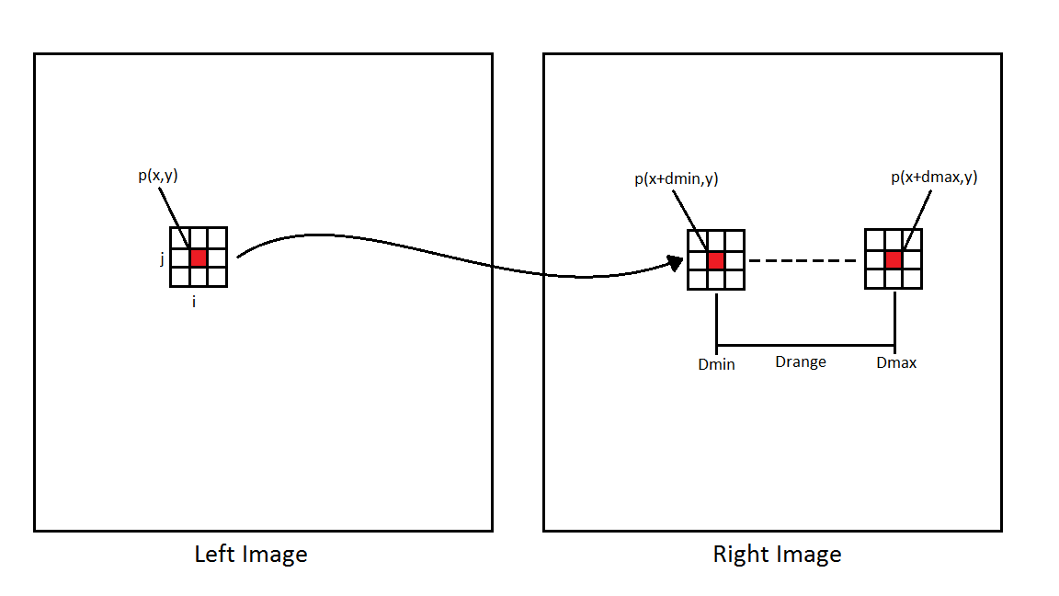
Local Matching

Slide 26
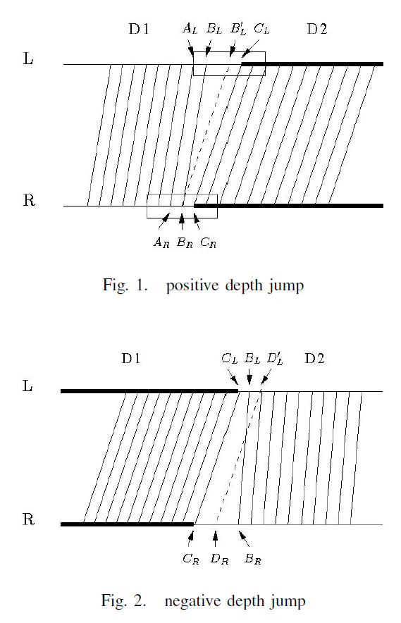
Issues with Local Matching
Issues include:
  Texture-less regions
  Occlusions
  Object boundaries
  Reflections
Zhao, J. and J. Katupitiya, A fast stereo vision algorithm with improved performance at object borders, in 2006 IEEE/RSJ International Conference on Intelligent Robots and Systems. 2006, IEEE: New York. p. 5309-5314.

Slide 27
Pre-Processing
Use of filters to aid matching score performance
  Medium/Gaussian filters used to remove noise.
  Normalise the intensity/colour space to improve local matching.
  Laplacian filters used to increase edge sharpness, useful in a number of stereo algorithms.

Slide 28
Matching Scores
Normally work in intensity space (gray-scale) over colour space
Both SAD and SSD measure the dissimilarity between support windows, therefore a lower score = a better match
Sum of the Absolute Difference (SAD):
Sum of Squared Difference (SSD):

Slide 29
Matching Scores
Normalised Cross Correspondence (NCC):
NCC measures the similarity instead of the dissimilarity, therefore we want to maximise the score

Slide 30
Disparity Selection
Winner-Takes-All (WTA) approach where the best match is always used
For SAD and SSD:
For NCC:
Where

Slide 31
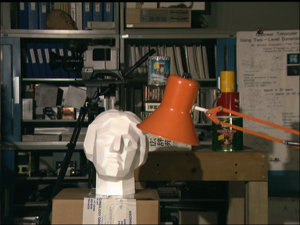
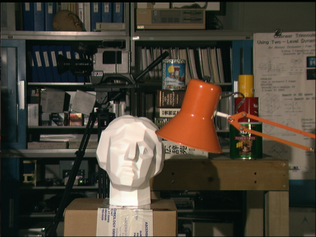
Results
Image taken form: Scharstein, D. and R. Szeliski. Middlebury Stereo Dataset. 2012; Available from: http://vision.middlebury.edu/stereo/.

Slide 32
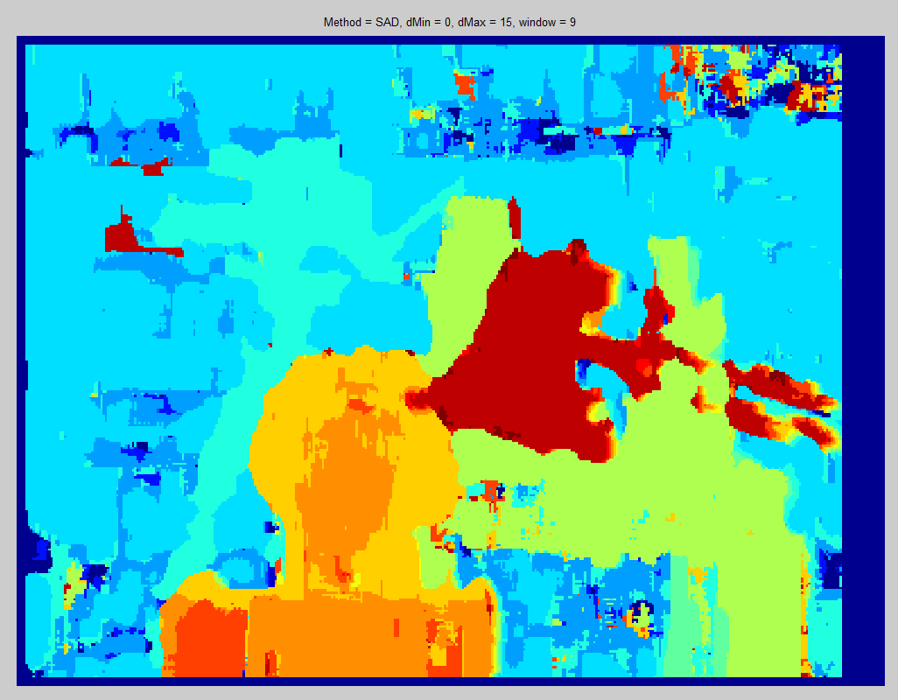
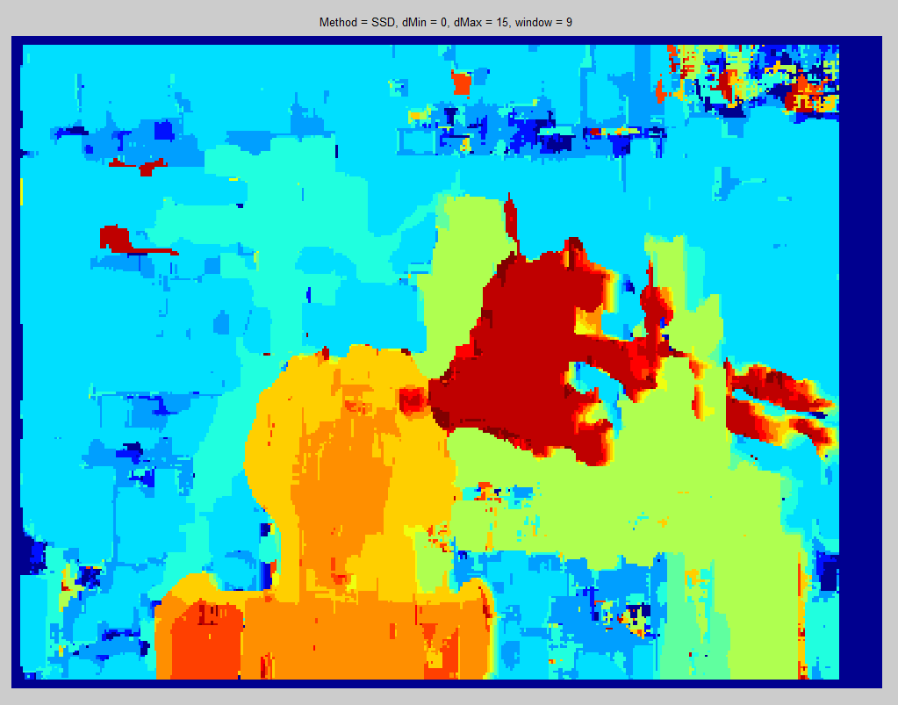
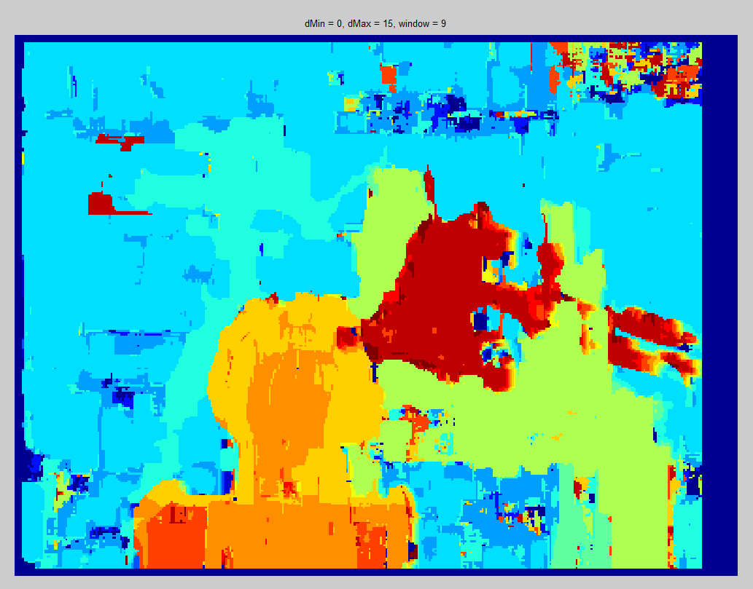
Results
SAD
SSD
NCC

Slide 33
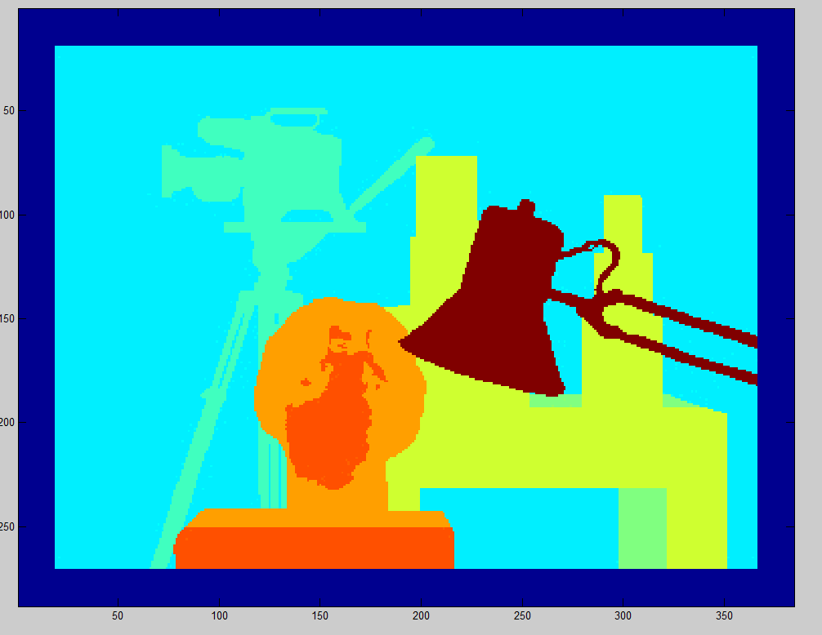
Ground Truth

Slide 34
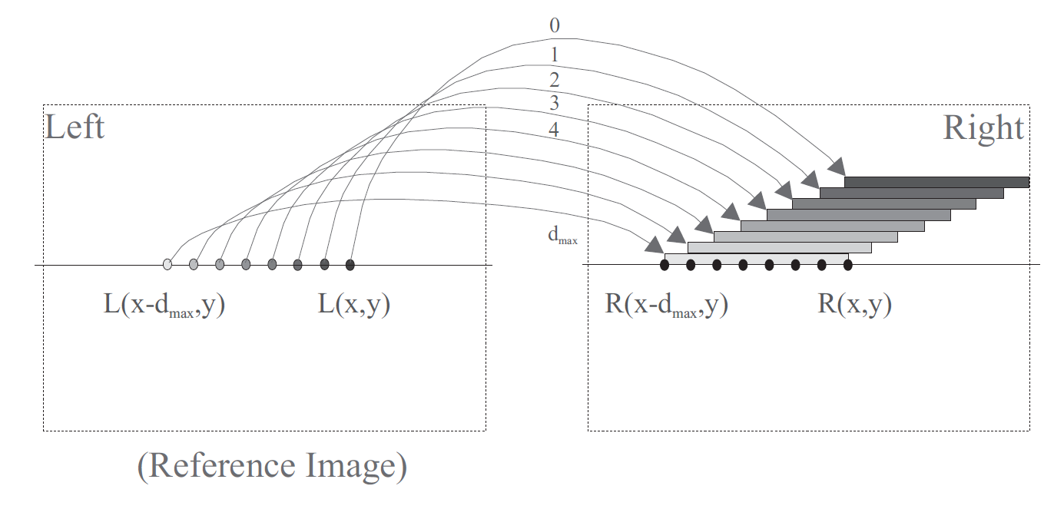
Disparity Selection
Alternative methods to WTA can be used because of the matching issue. That is the multiple pixels in the reference image match to the same pixel in the matching image (many to one).

Slide 35
Disparity Selection
Left-Right Consistence Check
  Only accept matches if the same disparity for the pixel is matched in left-to-right matching as right-to-left matching
  Requires double the computation since each disparity has to be checked twice.
  Output generated is sparse in nature.

Slide 36
Disparity Selection
Uniqueness Constraint:
  States that a 3D point can be projected to at most 1 point in each image of the stereo pair.
  Takes the minimum/maximum matching score that matches to a particular pixel in the in the matching image.
  Therefore:
  Means that it does not require computation from both left-to-right and right-to-left matching. But the S vector is required to be kept.

Slide 37
Sub-Pixel Refinement
Issue with stereo matching is that disparity is measured in a incremental manor which is defined by the pixel size.
One method is to increase the image resolution and therefore increase the amount of disparity values that need to checked, but increases the depth resolution. Also the window size needs to increase proportionally.
The other is too use a sub-pixel refinement stage:

Slide 38
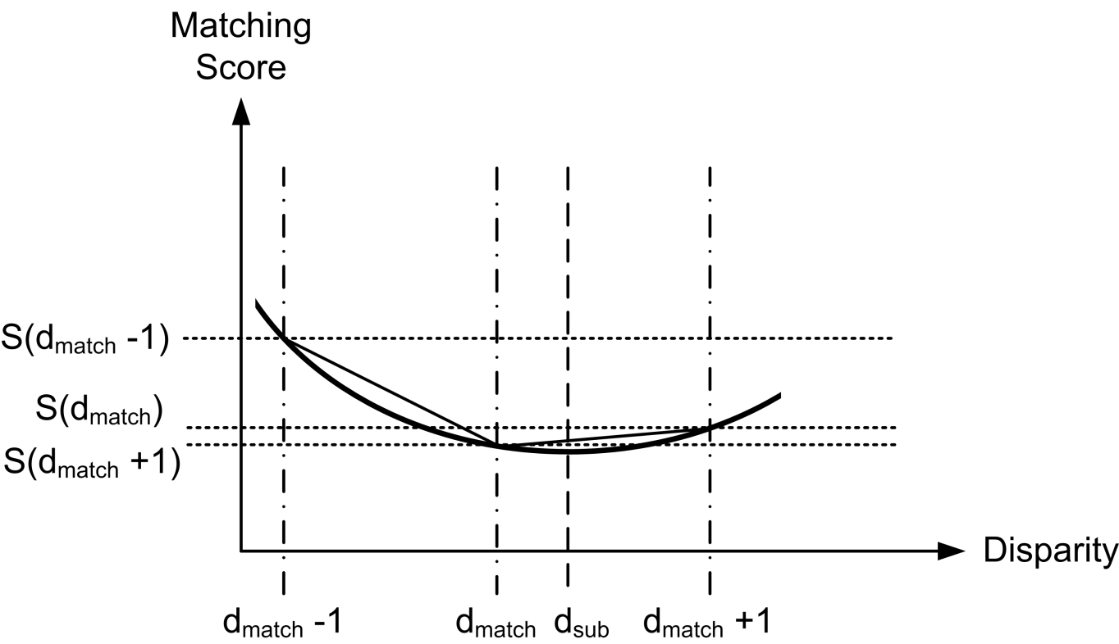
Sub-Pixel Refinement
Parabolic Fitting – assumes that the matching score graph can be assumed to be a parabolic shape.

Slide 39
Sub-Pixel Refinement
Parabolic Fitting:
Y = [S(d_{match} -1), S(d_{match}), S(d_{match} +1)]
X = [d_{match} -1, d_{match}, d_{match} +1]
d₁ = (X(3) – X(2)). (Y(1) – Y(2))
d₂ = (X(2) – X(1)).(Y(3) – Y(2))
Tian, Q. and M.N. Huhns, Alogrithms for Subpixel Registration. Computer Vision Graphics and Image Processing, 1986. 35(2): p. 220-233.

Slide 40
Metrics
Need methods to prove the accuracy and performance of stereo algorithms
Accuracy – Compare results versus ground truth (g)
  Root Mean Squared Error (RMSE):
  Pixel Error Percentage (T often = 1):

Slide 41
Metrics
Run Time Performance
  Run-time – issues with varying image size and disparity levels
  PDS = point disparity per second = (d_{range}.I_{width}.I_{height}.FPS ) Normally stated in terms of 10^6
  Have to take into account differences in hardware when comparing these measures

Slide 42
Computation Time
Amount of computations needed:
Run-time = SAD < SSD < NCC
Improve run-time using custom hardware DSPs, GPUs, FPGAs
Alternatively we can optimise our matching.

Slide 43
Optimised Local Matching
Di Stefano, L., et al., A Fast Area-Based Stereo Matching Algorithm. Image and Vision Computing, 2004. 22(12): p. 983-1005.
Optimise by reduction of redundant calculations:
  Example given is done using the SAD matching cost, but the principal can be applied to any local matching cost when a dense match is generated
  Method used is highly memory intensive

Slide 44
Optimised Local Matching
Given that the window W is of size (2n+1).(2n+1) centred at the co-ordinate L(x,y) (in the left hand image) and R(x+d,y) (in the right hand image)
  We can rewrite are SAD equation as:
  Therefore to calculate SAD(x,y+1,d) we can represent it as the difference of the two.
  Where U(x,y+1,d) represents the difference between the upper most and lower most rows

Slide 45
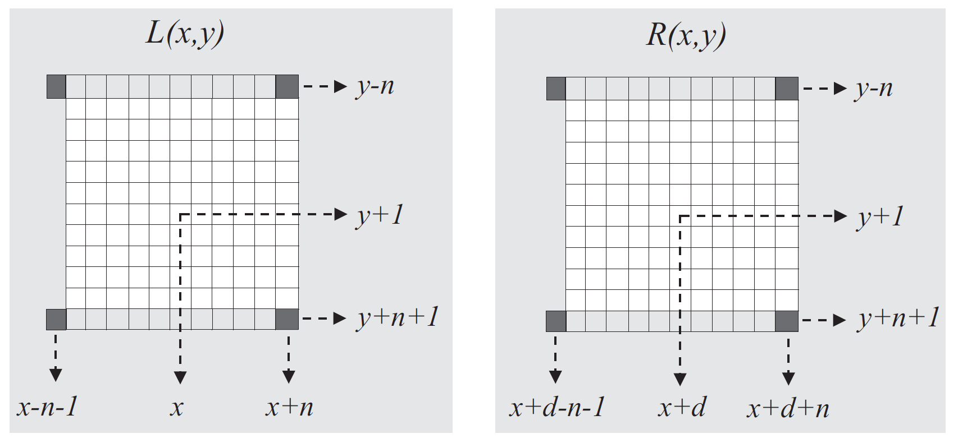
Optimised Local Matching

Slide 46
Optimised Local Matching
U(x,y+1,d) the difference between the upper most and lower most rows is defined as:
Currently if we apply this level of optimisation we need to recalculate the lower-most row each time .: we have to perform 2n+1 comparisons.
Also we have to recomputed the initial matching box for every column

Slide 47
Optimised Local Matching
Furthermore we can compute U(x,y+1,d) from U(x-1,y+1,d)

Slide 48
Optimised Local Matching
Now we only need to compare 4 pixels to calculate the matching score. This means that this optimisation is invariant to the size of the matching window W.
Remember that you need to compute the first row for each disparity level normally or via the row optimised method to infer all the other matching scores

Slide 49
State-of-the-art Local Matching
So far we have looked at the basic SAD, SSD and NCC matching cost in the intensity space only.
Issues that local matching costs suffer are still a problem
We are going to look at some of the more recent developments in stereo matching, but we can cover them all in the course of these lectures so we are going to look at adaptive support weight (ASW) aggregation.

Slide 50
Adaptive Support Weight
Initially purpose by Yoon and Kweon : Yoon, K.J. and I.S. Kweon. Locally adaptive support-weight approach for visual correspondence search. in Computer Vision and Pattern Recognition, 2005. CVPR 2005. IEEE Computer Society Conference on. 2005.
Many recent algorithms try to alter the size/shape of the support window to over come issues at boarder/texture-less regions.
This is hard to tune so Yoon purposed altering the weight given to each match in the support window (you can think of the weight for previous algorithms shown as 1)

Slide 51
Adaptive Support Weight
Pixel weight based on the photometric and geometric relationship between that pixel and the pixel under consideration
Assumption in local matching algorithms is that the support region pixels are of the same depth, otherwise the matching cost is incorrect
Therefore the support weight should be proportional to the probability that the pixel in the support window are of the same depth.
w = weight, p = pixel under consideration, q = pixel in support region

Slide 52
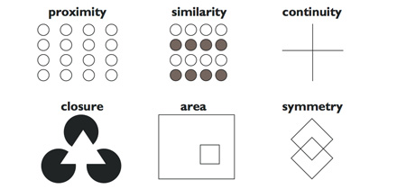
Adaptive Support Weight
How do we calculate Pr(d_{p}=d_{q}) if we don’t already know the disparity levels?
Gestalt principles:
  - Some objects (figures)
  seem more prominent
  than others aspects
  recede into the background (ground)
  Object changing in the background make little impact on the correspondence problem

Slide 53
Adaptive Support Weight
Based on similarity and proximity:
  Δc_{pq} is the colour difference and Δ g_{pq} is the spatial difference, k is a constant, f_{s}(Δc_{pq} ) and f_{p}(Δ g_{pq} ) is the function representing the strength based on the respective difference
  Colour difference is the Euclidean distance between p and q in the CIELab colour space (see next slide)

Slide 54

LAB colour space
LAB space is a different means to of mapping colours compared to the more familiar RGB space. It is designed to mimic human perception
  It is based on three values L = luminosity , a = green to magenta scale and b = blue to yellow scale.
  Large changes in Euclidean distance = large visual change, small distances = small visual change
  Forward transform (for RGB (0-1 scale)) first transform to XYZ space:

Slide 55


LAB space cont.
Where Y_{n}, X_{n} and Z_{n} are the reference white point calculated via a normalization process
Reverse transform is a similar process but not need to understand the workings of AWS

Slide 56
ASW cont.
The proximity change is given by:
The strength functions f_{s} and f_{p} are based on a Laplacian kernel so:
γ_{c} = 7 and y_{p} =36

Slide 57
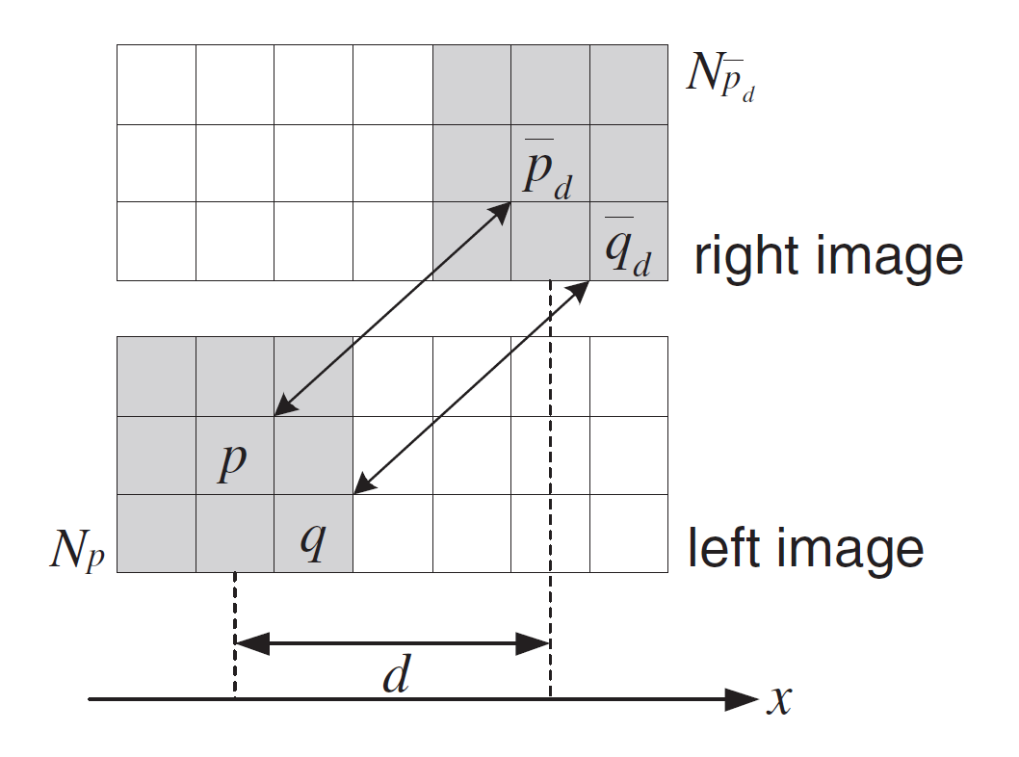
ASW cont.
Matching cost is then calculate as a combination of the weight of the pixel in the reference image, the weight of the pixel in the matching image and the absolute difference (AD) of the two pixels in RGB space.
WTA approach used to select
disparity

Slide 58
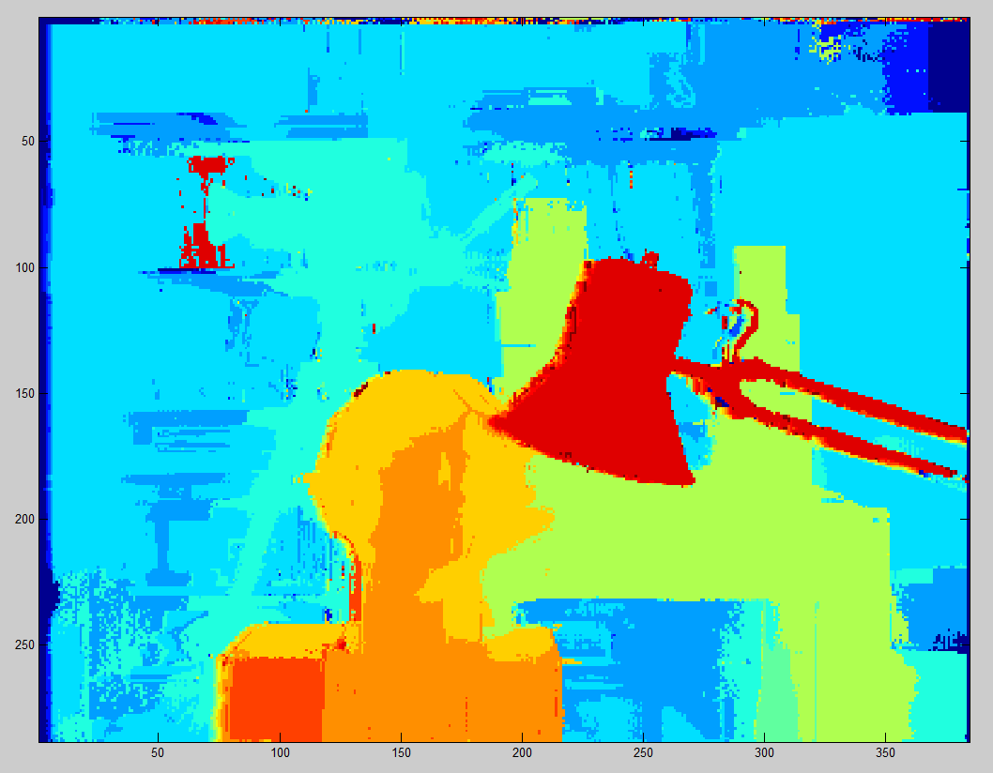
ASW Results
Window size =33x33

Slide 59
Conclusion
Applications
  Robotic vision
  Mapping environments
Issues – 4 main problems
Optimisations
  Can reduce the computational costs

