Slide 1
Motion Estimation

Slide 2
Why estimate motion?
Lots of uses
  Motion Detection
  Track object behavior
  Correct for camera jitter (stabilization)
  Align images (mosaics)
  3D shape reconstruction
  Video Compression

Slide 3
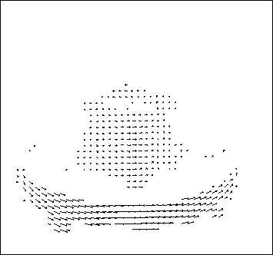
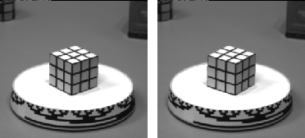
Optical flow
Measurement of motion at every pixel

Slide 4
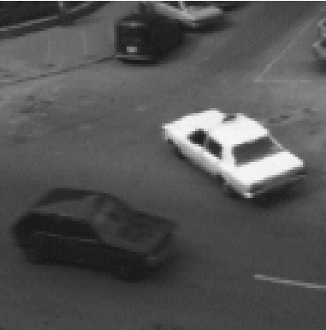
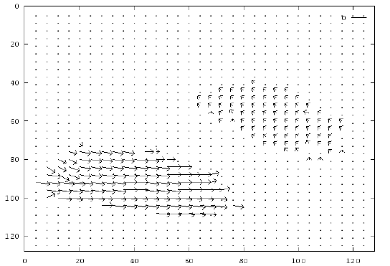
Optical flow
An image from Hamburg Taxi Sequence

Slide 5
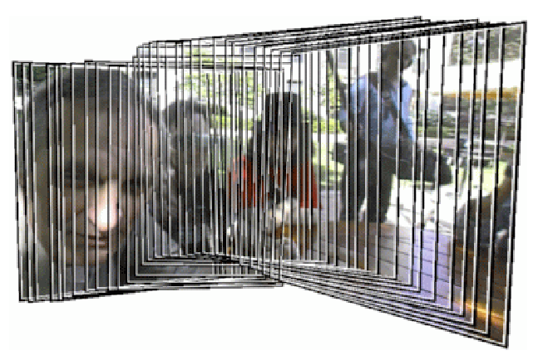
Video Mosaics

Slide 6
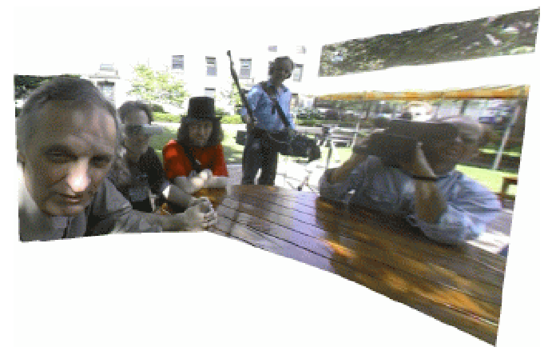
Video Mosaics

Slide 7
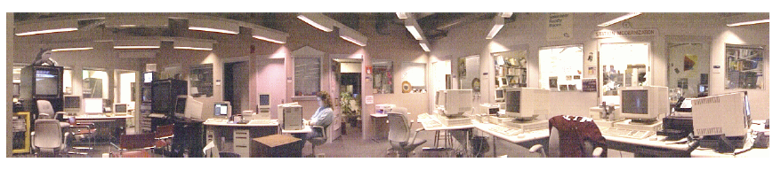
Video Mosaics

Slide 8
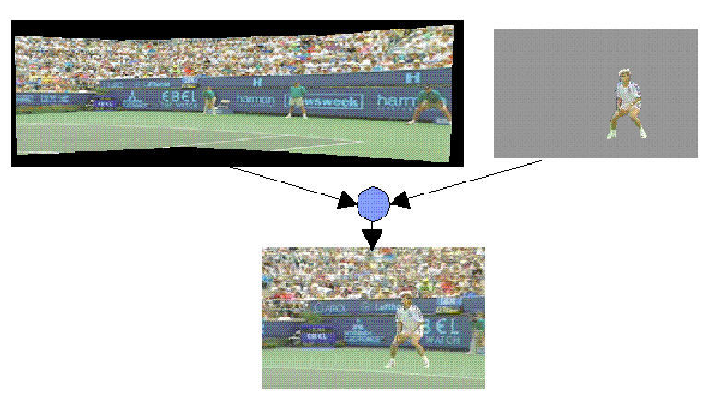
Video Compression

Slide 9
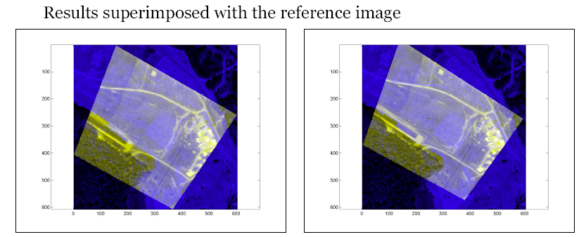
Geo Registration

Slide 10
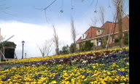
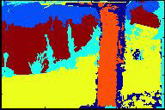
Video Segmentation

Slide 11
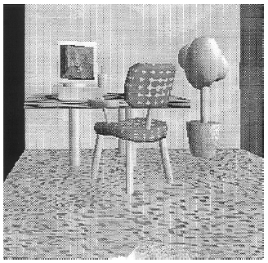
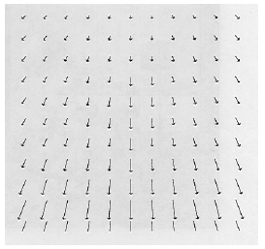
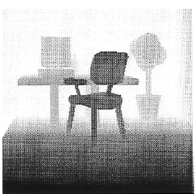
Structure From Motion

Slide 12
Optical flow
Measurement of motion at every pixel

Slide 13


Problem definition: optical flow
How to estimate pixel motion from image H to image I?
  Solve pixel correspondence problem
    given a pixel in H, look for nearby pixels of the same color in I
Key assumptions
  color constancy: a point in H looks the same in I
    For grayscale images, this is brightness constancy
  small motion: points do not move very far
This is called the optical flow problem

Slide 14


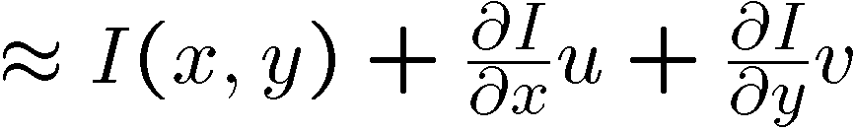
Optical flow constraints (grayscale images)
Let’s look at these constraints more closely
  brightness constancy: Q: what’s the equation?
  small motion: (u and v are less than 1 pixel)
    suppose we take the Taylor series expansion of I:
Notes:
A: H(x,y) = I(x+u, y+v)

Slide 15
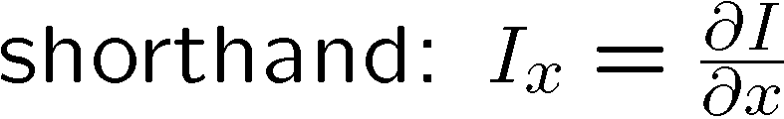


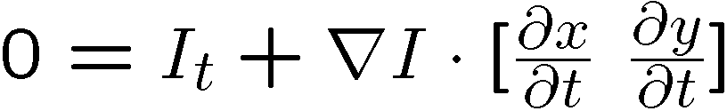
Optical flow equation
Combining these two equations
In the limit as u and v go to zero, this becomes exact

Slide 16

Optical flow equation
Q: how many unknowns and equations per pixel?
Intuitively, what does this constraint mean?
  The component of the flow in the gradient direction is determined
  The component of the flow parallel to an edge is unknown
Notes:
A: u and v are unknown, 1 equation

Slide 17
Aperture problem

Slide 18
Aperture problem

Slide 19
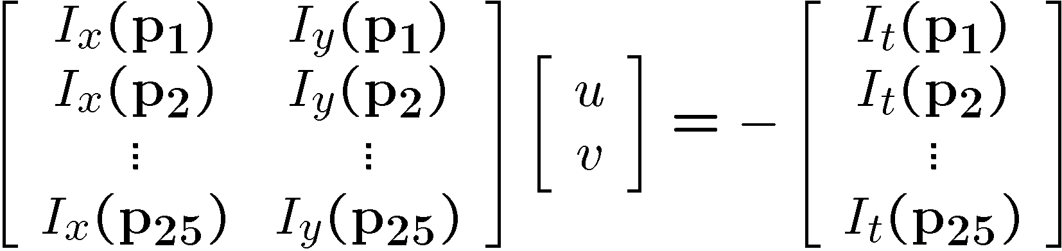




Solving the aperture problem
How to get more equations for a pixel?
  Basic idea: impose additional constraints
    most common is to assume that the flow field is smooth locally
    one method: pretend the pixel’s neighbors have the same (u,v)
      If we use a 5x5 window, that gives us 25 equations per pixel!

Slide 20
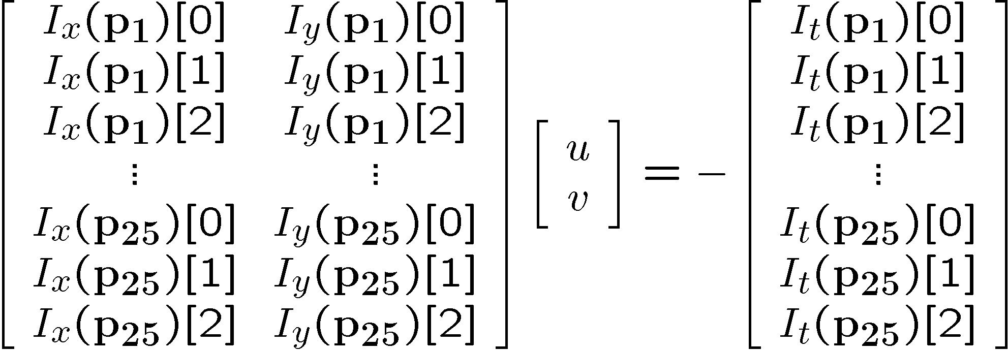


RGB version
How to get more equations for a pixel?
  Basic idea: impose additional constraints
    most common is to assume that the flow field is smooth locally
    one method: pretend the pixel’s neighbors have the same (u,v)
      If we use a 5x5 window, that gives us 25*3 equations per pixel!

Slide 21







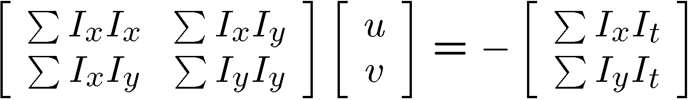


Lukas-Kanade flow
Prob: we have more equations than unknowns
Solution: solve least squares problem
  minimum least squares solution given by solution (in d) of:
  The summations are over all pixels in the K x K window
  This technique was first proposed by Lukas & Kanade (1981)
    described in Trucco & Verri reading

Slide 22
Conditions for solvability
  Optimal (u, v) satisfies Lucas-Kanade equation
When is This Solvable?
  A^{T}A should be invertible
  A^{T}A should not be too small due to noise
    eigenvalues λ₁ and λ₂ of A^{T}A should not be too small
  A^{T}A should be well-conditioned
    λ₁/ λ₂ should not be too large (λ₁ = larger eigenvalue)

Slide 23
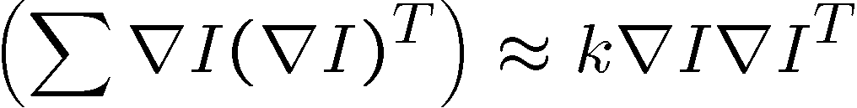
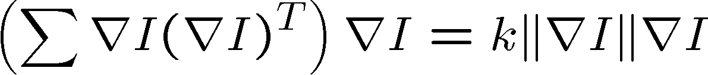


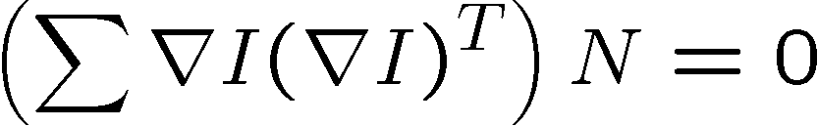
Eigenvectors of A^{T}A
  gradients along edge all point the same direction
  gradients away from edge have small magnitude
  is an eigenvector with eigenvalue
  What’s the other eigenvector of A^{T}A?
    let N be perpendicular to
    N is the second eigenvector with eigenvalue 0
The eigenvectors of A^{T}A relate to edge direction and magnitude
Suppose (x,y) is on an edge. What is A^{T}A?
Notes:
Suppose M = vv^T . What are the eigenvectors and eigenvalues? Start by considering Mv

Slide 24
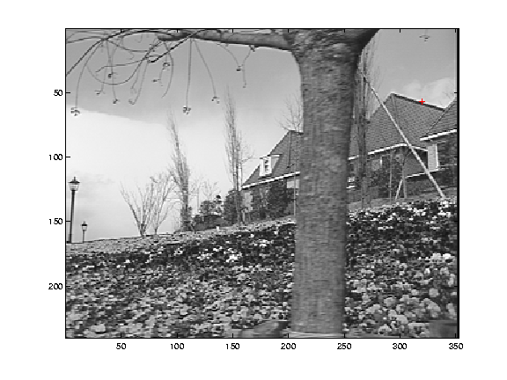
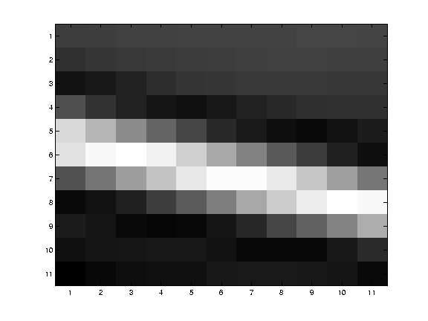
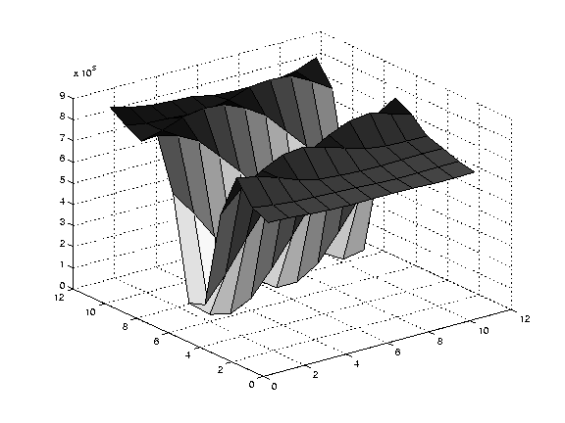
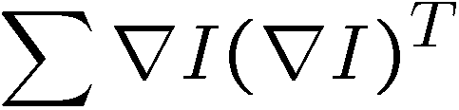
Edge
large gradients, all the same
large λ₁, small λ₂

Slide 25
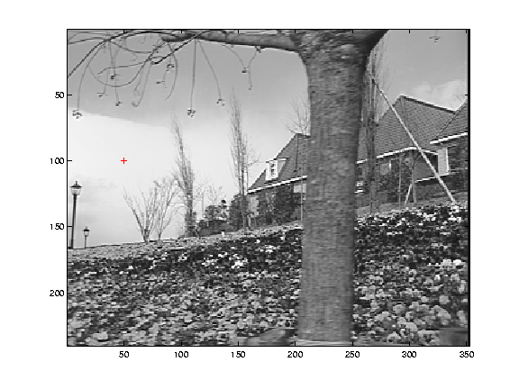
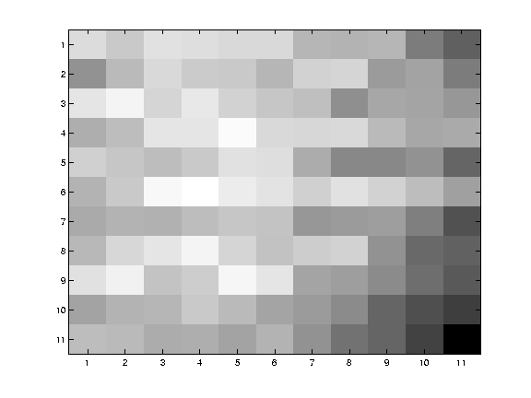
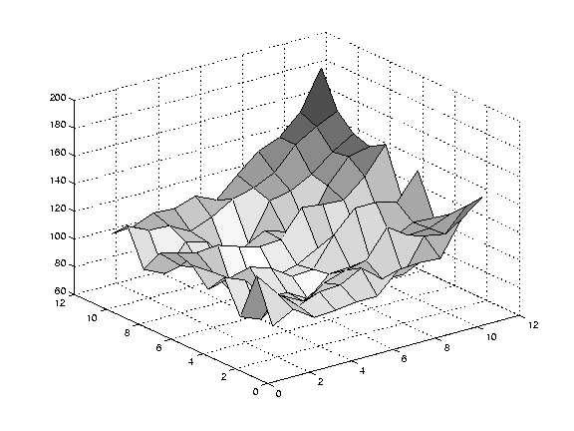
Low texture region
gradients have small magnitude
small λ₁, small λ₂

Slide 26
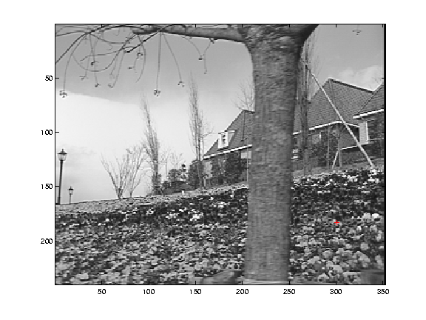
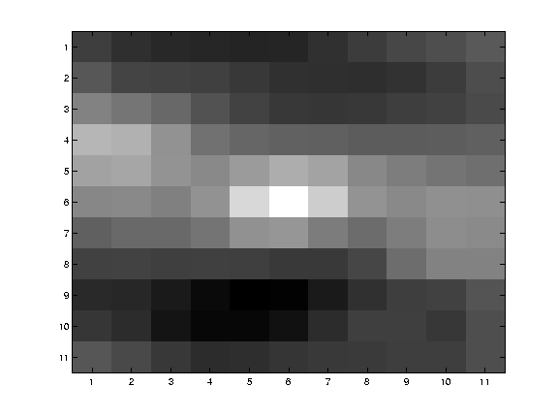
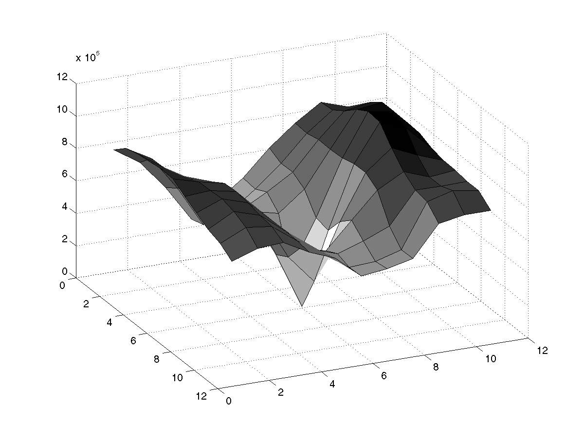
High textured region
gradients are different, large magnitudes
large λ₁, large λ₂

Slide 27
Observation
This is a two image problem BUT
  Can measure sensitivity by just looking at one of the images!
  This tells us which pixels are easy to track, which are hard
    very useful later on when we do feature tracking...

Slide 28
Errors in Lukas-Kanade
What are the potential causes of errors in this procedure?
  Suppose A^{T}A is easily invertible
  Suppose there is not much noise in the image
When our assumptions are violated
  Brightness constancy is not satisfied
  The motion is not small
  A point does not move like its neighbors
    window size is too large
    what is the ideal window size?

Slide 29
Improving accuracy
Recall our small motion assumption
This is not exact
  To do better, we need to add higher order terms back in:
This is a polynomial root finding problem
  Can solve using Newton’s method
    Also known as Newton-Raphson method
  Lukas-Kanade method does one iteration of Newton’s method
    Better results are obtained via more iterations

Slide 30
Iterative Refinement
Iterative Lukas-Kanade Algorithm
  Estimate velocity at each pixel by solving Lucas-Kanade equations
  Warp H towards I using the estimated flow field
    - use image warping techniques
  Repeat until convergence

Slide 31
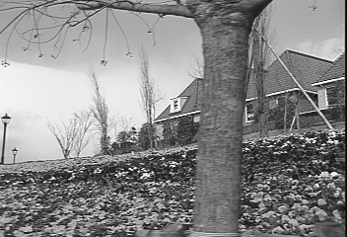
Revisiting the small motion assumption
Is this motion small enough?
  Probably not—it’s much larger than one pixel (2nd order terms dominate)
  How might we solve this problem?

Slide 32
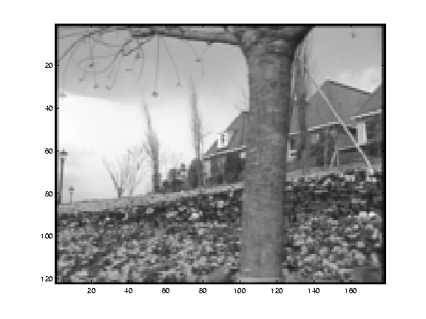
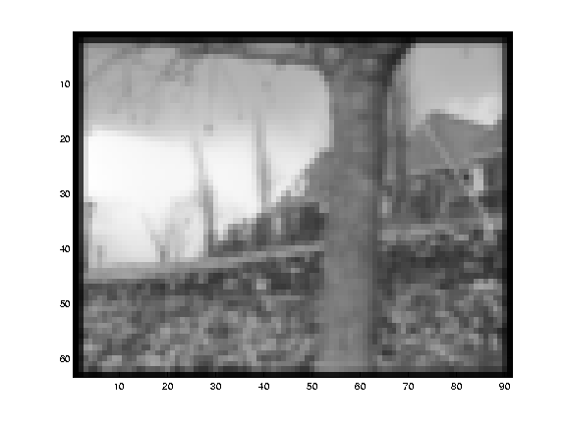
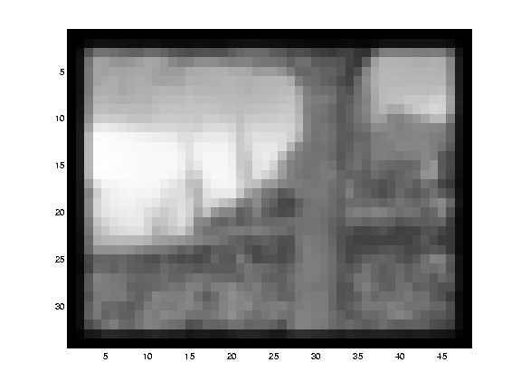
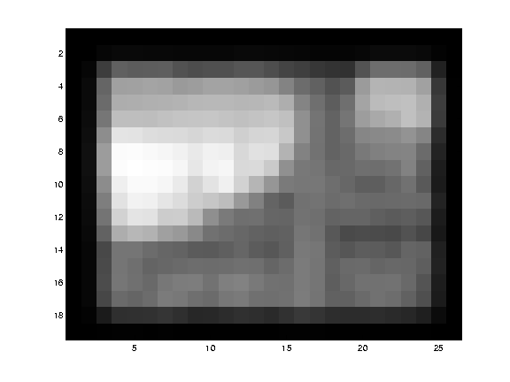
Reduce the resolution!

Slide 33
Coarse-to-fine optical flow estimation
u=1.25 pixels
u=2.5 pixels
u=5 pixels
image H
u=10 pixels
image H
image I
image I
Gaussian pyramid of image H
Gaussian pyramid of image I

Slide 34
Coarse-to-fine optical flow estimation
run iterative L-K
warp & upsample
run iterative L-K
.
.
.
image J
image H
image I
image I
Gaussian pyramid of image H
Gaussian pyramid of image I

Slide 35
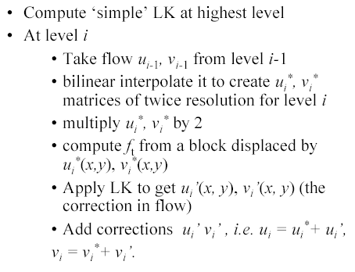
Multi-resolution Lucas Kanade Algorithm

Slide 36
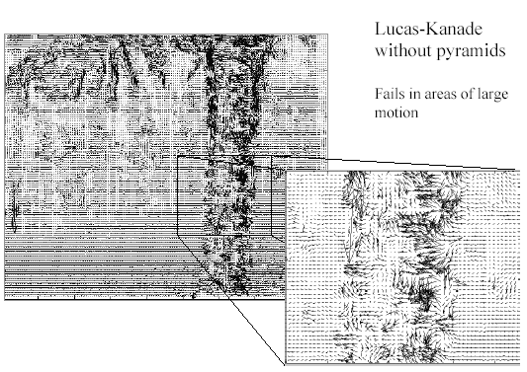
Optical Flow Results

Slide 37
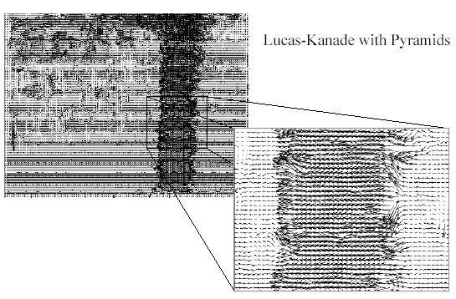
Optical Flow Results

Slide 38
Optical flow Results

Slide 39
Suggested Readings
Chapter 8, Emanuele Trucco, Alessandro Verri, “Introductory Techniques for 3-D Computer Vision”

