Slide 1
Multimedia Data An Introduction to Photography and Vision
A very short visual history of photography and introduction to human vision.
Dr Mike Spann
http://www.eee.bham.ac.uk/spannm
M.Spann@bham.ac.uk
Electronic, Electrical and Computer Engineering

Slide 2
But first some media history. Was this the earliest personal and portable information “technology”?

Slide 3
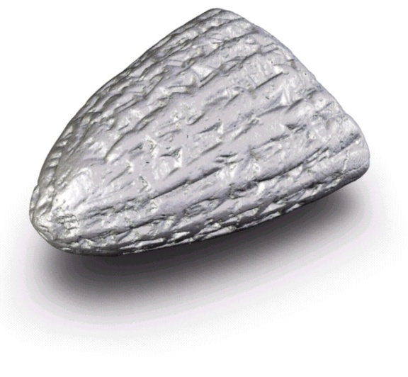
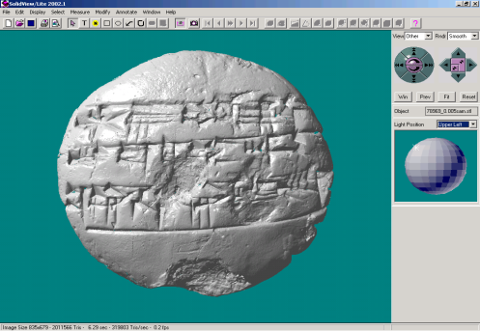
Earliest Personal Media?
Cuneiform was the first form of writing, predating Egyptian hieroglyphs.
Clay cuneiform tablets were perhaps the first personal and portable information “technology”
They were used for legal documentation, statements of freedom, record-keeping.
Our university is home to “The Cuneiform Digital Palaeography Project” You can read more at www.cdp.bham.ac.uk. A collaborative project, headed by Assyriologist Dr Alasdair Livingstone, between The University of Birmingham and The British Museum.

Slide 4
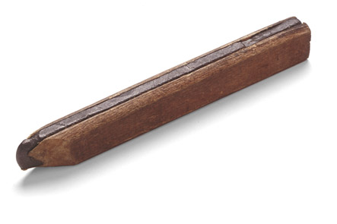
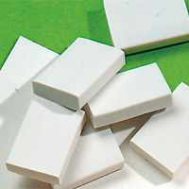
The Media History Project Timeline
Selected examples from media history
1565 - The pencil
1770 - The eraser
1858 - Eraser fitted to the end of a pencil
Good design and good products need more than good technology.
The clever bit is connecting cooperating technologies with people and the things they do.
http://mediahistory.umn.edu/timeline/
A carpenters pencil - the oldest known pencil found in the roof of a 17th-century German house.
Photo Sandra Suppa, FABER-CASTELL GmbH & Co., Germany

Slide 5
Early Photography and the Use of Image Media

Slide 6
Camera Obscura
The Camera Obscura (Latin for Dark room) was a dark box or room with a hole in one end.
If the hole was small enough, an inverted image would be seen on the opposite wall.
The principle was known by thinkers as early as Aristotle (c. 300 BC).
The earliest record of the uses of a camera obscura can be found in the writings of Leonardo da Vinci (1452-1519).
Several artists are said to have used them; including Canaletto (1697- 1768) and Vermeer (1632-1675), Joshua Reynolds (1723-1792).
Forerunner of the pinhole camera
The projective geometry of which is used extensively in 3D computer vision

Slide 7
The Portable Camera Obscura
Just as we do today – people wanted to make their own pictures out and about.

Slide 8
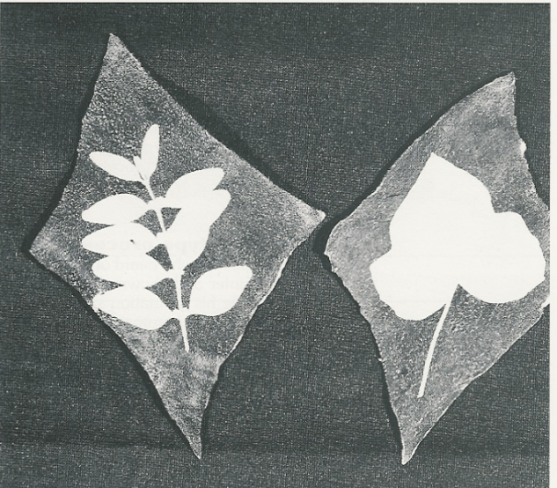
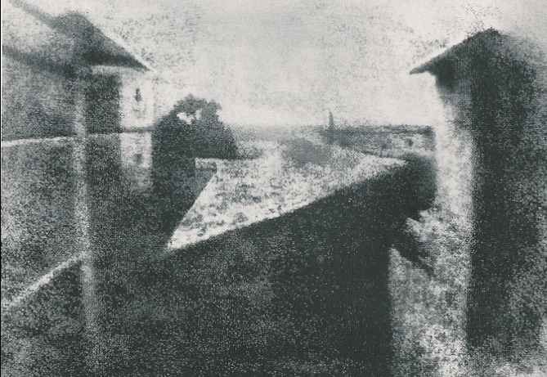
Saving the Image
Some way of automatically saving the image was needed.
1800: Above: Wedgwood’s “sun pictures” - using silver nitrate on leather
1826: Right: The oldest* picture in the world - the view from Niepce’s window.
(*In 2002 a Niepce photograph of an engraving was found to have been taken in 1825.)

Slide 9
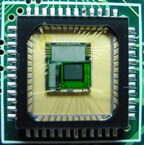
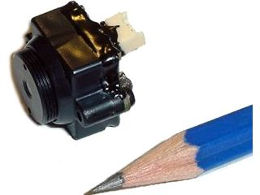
The Simplest Camera - The Pinhole Camera
Pinhole cameras are very easy to make (but you need a dark room to load and process the photographic paper.)
The lack of a lens means there is no focal plane. Both the foreground and background are in focus.
Exposure times vary on camera size and lighting, but typically take about 3 minutes.
Above a simple pinhole camera box and a pinhole photograph example captured with a tea caddy camera.
Far left: a CMOS image sensor. Both CCD and CMOS image sensors convert light into electrons.
http://electronics.howstuffworks.com/digital-camera2.htm
Near left: a pinhole CMOS camera that can be used with or without a lens.
http://www.superinventos.com/S130351.htm

Slide 10
Pinhole Camera Geometry
Pinhole camera geometry is very simple but leads to big problems in 3D computer vision applications
Perspective projections
Non-linear in depth Z
The solution is to introduce a new coordinate system
Projective (or homogenous) coordinates turn non-linear equations into linear equations
Nice simple matrix/vector operations!
Y
f
y
Z

Slide 11
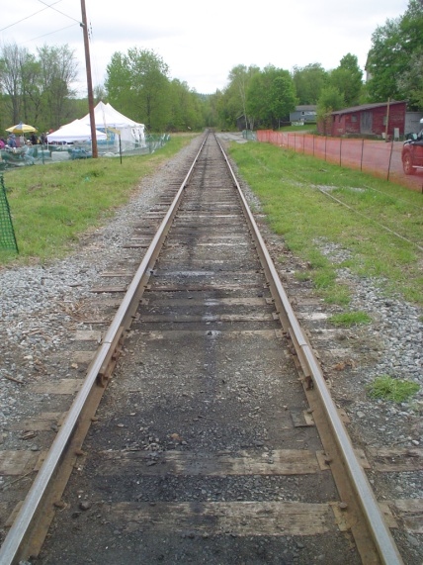
Perspective
Artists knew how to accurately represent perspective (in other words rendering a 3D scene on a 2D canvas) by about the 15th Century
Perspective is the rein and rudder of painting" - Leanardo de Vinci
It was several hundred years later that mathematicians introduced projective geometry enabling the study of shapes in the projective plane
For example, parallel lines meet at a vanishing point
V
Parallel lines meet at the vanishing point V

Slide 12
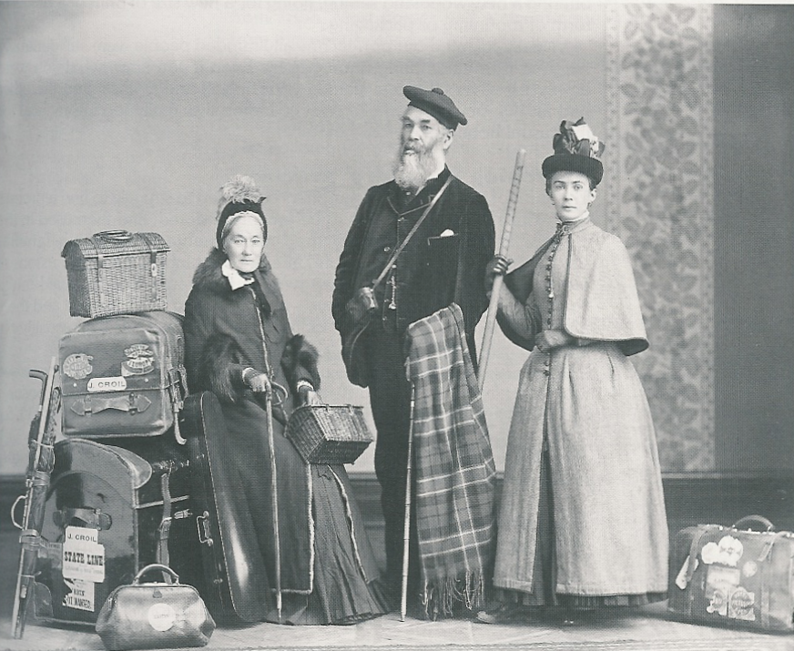
An Information Revolution
Early cameras were not portable.
People had to go to studios to have their pictures taken.
This early family holiday picture was taken in a studio ... together with their luggage.

Slide 13
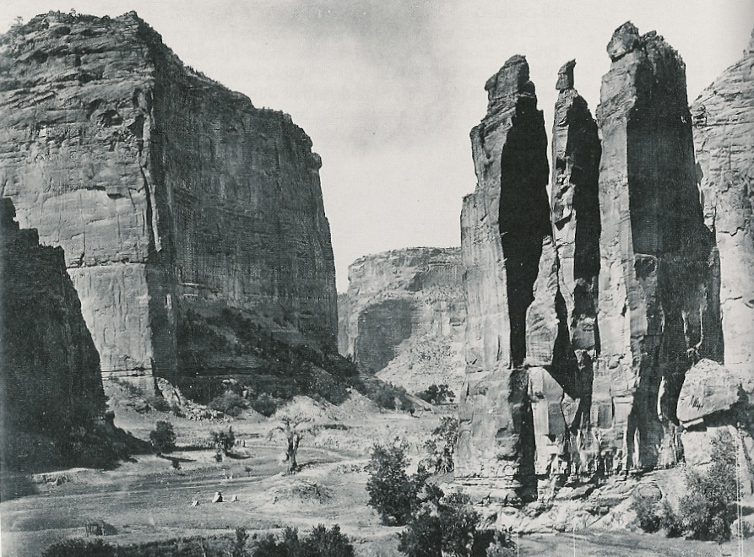
An Information Revolution
But photographs from beyond the studio were what people really wanted.
New cameras were portable.

Slide 14
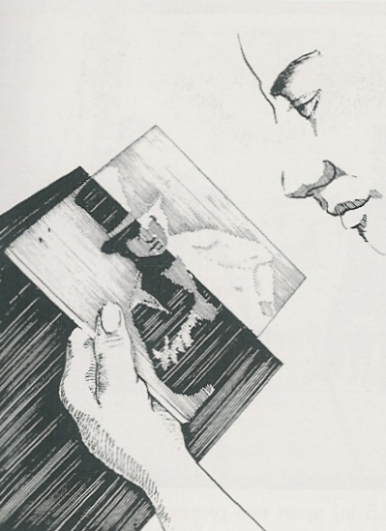
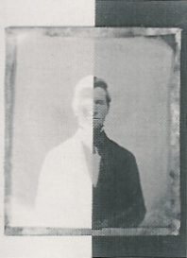
The Ambrotype
Next came low cost photography.
The ambrotype was a very underexposed glass negative against a black backing produces an inexpensive positive image.

Slide 15
An Information Revolution
Ambrotypes made photography affordable for the masses.

Slide 16
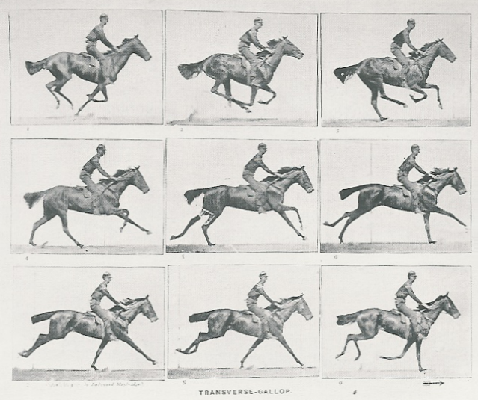
An Information Revolution
The first fast motion photographs resolved the debate among artists and horse enthusiasts proving that during a horse's running stride, there is a moment of suspension where no hooves are touching the ground.

Slide 17
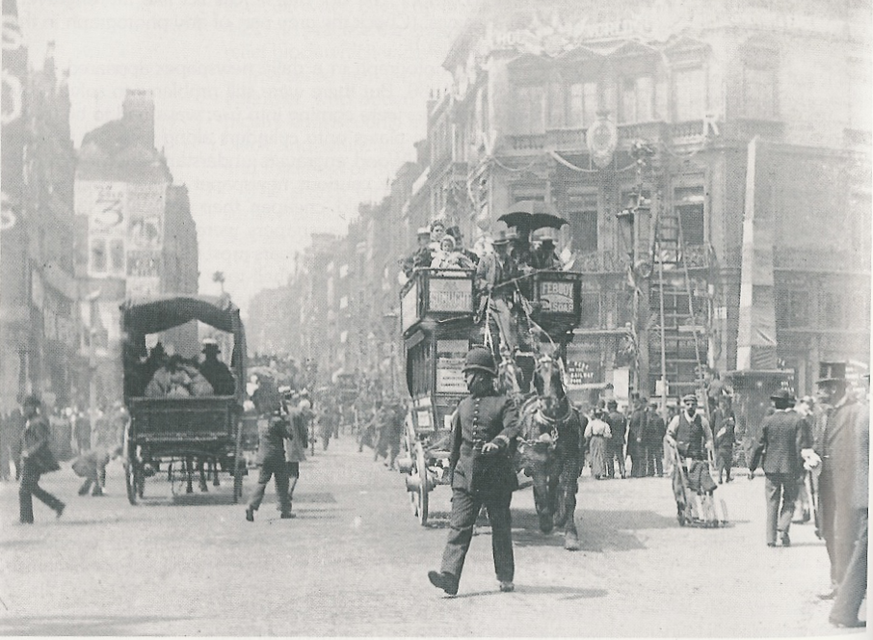
An Information Revolution
Shorter exposure times enabled action photography to capture the animation of real life.

Slide 18
An Information Revolution
The demand for images changed the way information was communicated.
This is the front page of the Daily Mirror newspaper from May 2 1904.
Each report has a picture.
Note the front page coverage of the polo.
Also St Louis world fair, cricket and the latest royal photograph.
“All the news by telegraph, photograph and paragraph”

Slide 19
Early colour
This is an example of an early colour “autochrome”.
These are Navajo men on horseback photographed in about 1915.
Fred Payne Clatworthy (U.S., 1875-1953)
Navajo Men on Horseback
Autochrome circa 1915, 5 x 7 inches
http://www.photographymuseum.com/autochromeclatworthy.html

Slide 20
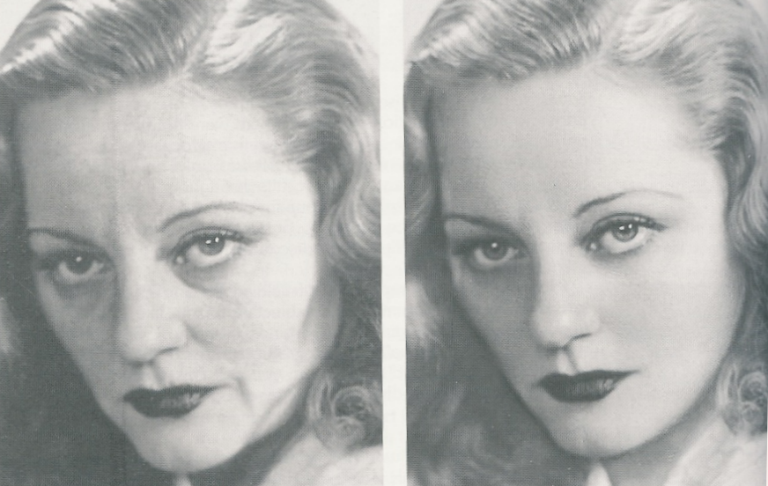
An Information Revolution
An example of pencil retouching on a large studio negative.
Image manipulation is not new ...

Slide 21
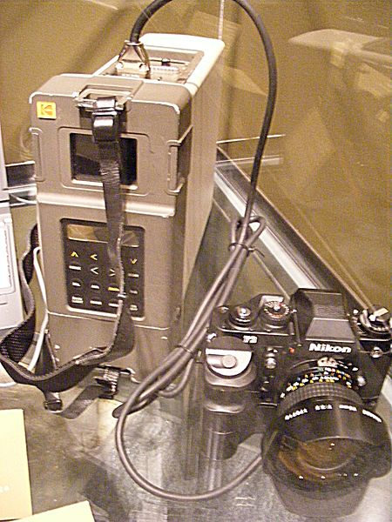
Digital Photography
Digital cameras use an array of light sensitive sensors to capture the image focused by the lens, as opposed to an exposure on light sensitive film
Digital cameras were introduced in the early 90’s by companies such as Kodak
Kodak DCS 100 came with a separate shoulder carried Digital Storage Unit (DSU) to store
The DSU contained a Winchester 200 megabyte hard disk drive that could store up to 156 images without compression
It cost $13000!
Kodak DCS100

Slide 22
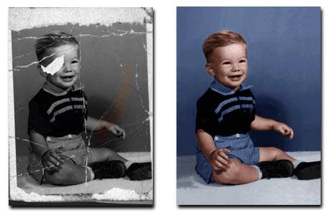
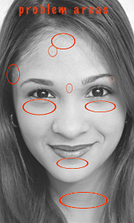
Digital Retouching
Digital photography made the retouching and manipulation of digital images is much easier and much more common.
Top: http://www.bigdigitalprints.com/prep2.html
Bottom: http://www.davidbeyda.com/digitalheadshotretouching.htm
Suzette Troche-Stapp : http://dyna-fx.com/dfx_community/viewtopic.php?p=11&sid=d99dc755a35bb508c2aec9b48bbcb759

Slide 23
The Human Visual System (HVS)

Slide 24
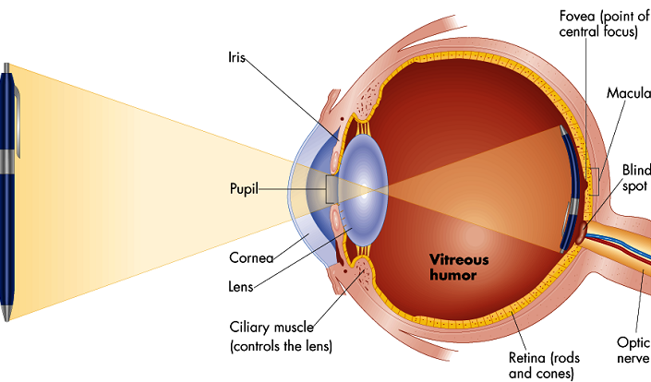
The Human Vision System (HVS)
As in the camera obscura the image is projected upside down on the back surface.
However, the human vision system (HVS) is an extremely sophisticated multi-stage process.
The first steps in the sensory process of vision involve the stimulation of light receptors to create an image signal.
Electrical signals containing the vision information from each eye are transmitted to the brain through the optic nerves.
The image information is processed in several stages, ultimately reaching the visual cortex of the cerebrum.
We see with our brain not our eyes!

Slide 25
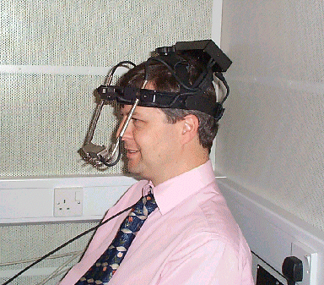
The Human Vision System (HVS)
The eye can adapt to a huge range of intensities from lowest visible light to highest bearable glare.
The eye uses two types of discrete light receptors.
6-7 million centrally located cones are highly sensitive to colour and bright light.
75 million rods across the surface of the retina are sensitive to light but not colour.
Eye movements include steady fixations and extremely rapid movements called saccades. These movements can be captured by carefully calibrated cameras directed on the eye
We used an eye tracking system in a recent research project to determine how a cardiologist views digital angiograms
Above : A cardiologist examining a coronary angiogram.
Above right: http://www.wiu.edu/users/mfmrb/PSY343/SensPercVision.htm

Slide 26
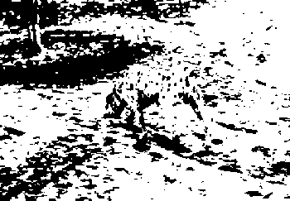
What do we really see?
There is very much more to human vision and perception than the physics and biology of signal transportation.
This is beyond the scope of our course but we can look at just a few examples to demonstrate how what we may perceive can vary from what we see.

Slide 27
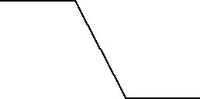
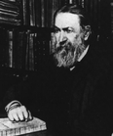
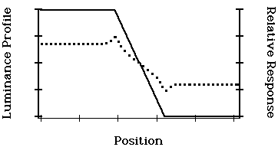
Mach Bands
"The Mach band effect" (studied by Ernst Mach in the 1860s) describes the illusion of an exaggeration of contrast at edges.
The light and dark bars at the edge of the intensity transitions below do not exist. The intensity gradient is linear as shown underneath.

Slide 28
Scintillation Grid
Can you see black dots?
Black dots appear to form and vanish at the intersections of the gray horizontal and vertical lines.
Our peripheral vision involves something called lateral inhibition (a kind of tuning of brightness like the brightness setting on our computer or television).
Read more at http://www.brainconnection.com/teasers/?main=illusion/hermann and http://en.wikipedia.org/wiki/Hermann_grid_illusion

Slide 29
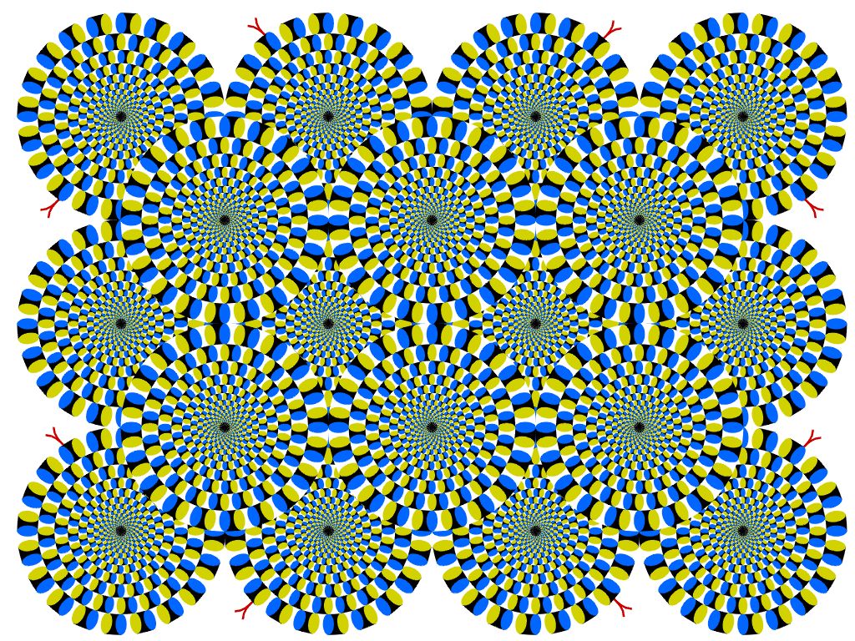
Kitaoka Rotating Illusion
Do you see the circles rotate when you read the text?
This is a beautiful demonstration of peripheral drift.
More beautiful rotating illusions at http://www.ritsumei.ac.jp/~akitaoka/rotate-e.html
“Rotating Snakes” Copyright A.Kitaoka 2003 (September 2, 2003)

Slide 30
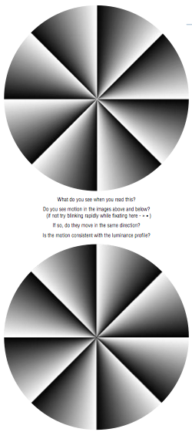
Peripheral Drift
The peripheral drift illusion is easily seen when fixating off to the side, and then blinking as fast as possible.
Most observers see the illusion more easily when reading text with the illusion figure in the periphery.
Motion is consistently perceived in a dark-to-light direction, so the two circles to the right should spin in opposite directions.
The precise reason for the motion illusion is still of research interest.
.... “Two recent papers have been published examining the neural mechanisms involved in seeing the PDI (Backus & Oruç, 2005; Conway et al., 2005). Faubert and Herbert (1999) suggested the illusion was based on temporal differences in luminance processing producing a signal that tricks the motion system. Both of the recent articles are broadly consistent with those ideas, although contrast appears to be an important factor (Backus & Oruç, 2005)”.
Image copyright Wikipedia http://en.wikipedia.org/wiki/Peripheral_drift_illusion

Slide 31
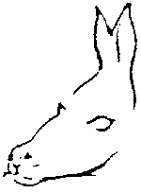
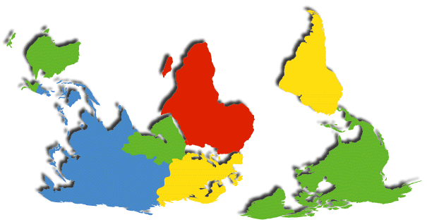
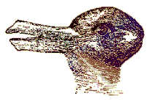
Interpreting Images
Here are just a few examples to demonstrate ways in which we interpret images.
Try the pictures below.
Top right is a well-known image from textbooks on visual perception.
Can you see what it’s of?

Slide 32
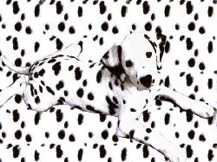
Interpreting Images
This is an easier one.

Slide 33
Interpreting Images
Can you see anything in the picture?

Slide 34
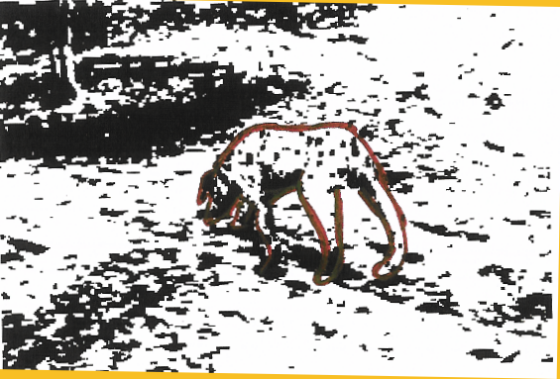
Interpreting Images
A
Dalmatian dog?

Slide 35
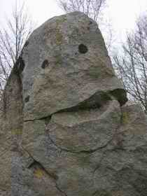
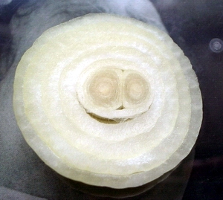
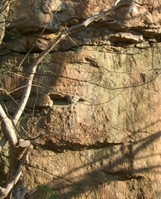
And Finally .... Seeing Faces?
The human visual system is especially good at picking out and analysing things that look like faces.
A phenomenon known as Pareidolia
http://www.geekosystem.com/things-that-look-like-faces-pareidolia/
Even at a distance we can interpret the direction of a person’s gaze.
High image and video quality is especially desirable for human faces.
http://www.healingtaobritain.com/p42-magazine-portrait-gallery.htm

Slide 36
This concludes our very short history of photography and introduction to human vision.
In the next lectures we will consider image data in more detail.
You can find course information, including slides and supporting resources, on-line on the course web page at
Thank
You
http://www.eee.bham.ac.uk/spannm/Courses/ee1f2.htm

