Slide 1
Multimedia Data Introduction to JavaScript and Scaleable Vector Graphics (SVG)
Dr Mike Spann
http://www.eee.bham.ac.uk/spannm
M.Spann@bham.ac.uk
Electronic, Electrical and Computer Engineering

Slide 2
Summary of Content
HTML (HyperText Markup Language)
An introduction
Examples of HTML tags
Introduction to JavaScript
Objects, properties, methods
Events
Values and variables, operators
Simple JavaScript examples
Alert boxes and rollovers
Introduction to SVG (Scaleable Vector Graphics)
Simple demonstration by example

Slide 3
HTML (HyperText Markup Language)
HTML is the basic language of the web. It comprises a set of ‘tags’ which are instructions to web browsers, e.g.,
<b>bold</b> text appears as
bold text
<b> applies bold until </b>, similarly
<i> applies italics until </i>
<u> for underline,
<p> for paragraph,
<br> for line break
also
<center> <left> and <right> for positioning
adding links:-
<a href=“web address”>Link text</a>

Slide 4
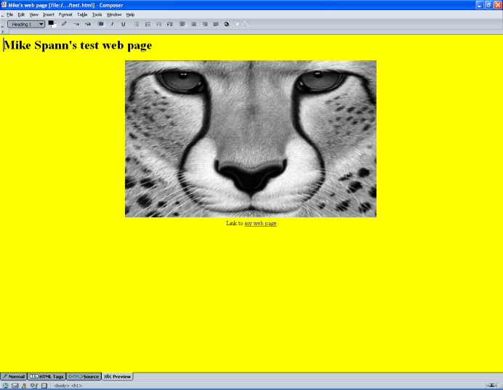
A Simple HTML File test.html
Simple html file
test.html
<html> <head> <title>Mike's web page</title> </head> <body style="background-color: white;"> <h1> Mike Spann's test web page</h1> <center>
<img src="Demos/Images/cheetah.gif" alt="" picture="" style="width: 640px; height: 400px;">
<br> Link to <a href="../../M.Spann.html">my web page</a>
</center> </body> </html>

Slide 5
Introduction to JavaScript
JavaScript is not Java
Java is a full-feature OO programming language developed by Sun Microsystems. It is a descendant of C and C++ and was designed to be cross-platform. Java is used to create web “applets” (small programs downloaded over the internet and run inside web browsers) as well as standalone application and network (client/server) applications
JavaScript - Netscape added a basic scripting ability to its Navigator web browser called “Livescript” ... at a time when Java was new/exciting .... and renamed Livescript, JavaScript. JavaScript is a scripting* language which can manipulate simple webpage objects.
A scripting language is a programming language that controls a software application. They enable the behaviour of the application to be adapted by the user. Typically it is interpreted rather than compiled to native machine code

Slide 6
About JavaScript
JavaScript is an object-oriented scripting language.
Objects have properties
e.g.,
cat has fur
computer has keyboard
bicycle has wheels
car has wheels
window has title
Changing a property of an object can modify the object. Objects can share properties. Properties can be objects, i.e., objects can have sub-objects.
The things objects do are called methods, e.g.,
cat purr
computer crash
JavaScript objects have methods, e.g.,
buttons click()
windows open()
text selected()
(brackets indicate that we are referring to a method rather than a property.)
Objects and properties are separated by a “.”, e.g.
bicycle.wheels
cat.paws.front.left
referring to methods :-
cat.purr()

Slide 7
Events
Event | What it handles
onAbort | User aborts loading the page
onBlur | User leaves the object
onChange | User changes the object
onClick | User clicked on an object
onError | The script encountered an error
onFocus | User made an object active
onLoad | Object finished loading
onMouseover | Cursor moved over an object
onMouseout | Cursor moved off an object
onSelect | User selects content of an object
onSubmit | User submitted a form
onUnload | User left the window
Events are actions that a user (i.e., a viewer) performs whilst visiting your page.
JavaScript can react to events with event handlers.
In JavaScript, if the user clicks on a button the onClick event handler will take note of the action and perform the specified task.
When we write scripts we do not need to anticipate every possible event the user might take, we just encode the ones we want. E.g., pages load as normal without an onLoad event handler.

Slide 8
Values, Variables and Operators and Script Tags
In JavaScript, pieces of information are values, e.g., numbers, strings, Booleans, nulls, objects, functions.
Variables contain values.
E.g., myname = “mike”
(“=” can be read as “is set to”)
Notes
JavaScript is CaSEseNSiTivE!
Variable names should not start with numbers nor contain spaces.
As in other languages, operators are the symbols used to work with variables, e.g., +, -, *, / etc.
JavaScript must be enclosed in <script> tags and can be inserted into the head or body of a web page.
A simple “HELLO WORLD” example:
Demo
Hiding script from old browsers is easily achieved by enclosing the script in HTML comments.
<script type="text/javascript">
document.write('Hello World!');
</script>
<script type="text/javascript">
<!--
document.write('Hello World!');
//-->
</script>

Slide 9
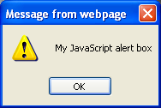
What JavaScript Can Do?
The demonstration examples use a subset of JavaScript for simple client-side scripting - i.e., for processes performed on the users’ computer not on the server.
Simple examples of JavaScript functionality include:-
Reactions to user actions
Detection of browser type, version and plug-ins
Status bar messages
Date- and time-related messages
Alert boxes
Alert box example:
<SCRIPT LANGUAGE = “JAVASCRIPT”>
alert(“My JavaScript alert box”)
</SCRIPT>
Demo

Slide 10
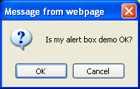
What JavaScript Can Do?
Conditional alert box example
<SCRIPT LANGUAGE = “JAVASCRIPT”>
if(confirm(“Is my alert box demo OK?”))
{
alert(“You said OK ... thanks!”)
}
else
{
alert(“You said Cancel (but must have clicked the wrong button)”)
}
</SCRIPT>
Demo

Slide 11
Simple Image “Rollovers”
These are neat things to add to web pages
Allow 2 different images to be displayed at 1 location
Easy to do in html
Involves handling the ‘OnMouseover’ and ‘OnMouseout’ events
Demo

Slide 12
Simple Image “Rollovers”
<!DOCTYPE HTML PUBLIC "-//W3C//DTD HTML 4.01 Transitional//EN">
<html>
<head>
<title>Mike's web page</title>
</head>
<body style="background-color: yellow;">
<h1> Mike Spann's test web page</h1>
<center>
<img src="Demos/Images/cheetah.gif" alt="Picture rollover demo" picture=“” border="10" name="mypicture"
style="width: 640px; height: 400px;“
onMouseover="document.mypicture.src='Demos/Images/test.gif'"
onMouseout="document.mypicture.src='Demos/Images/cheetah.gif'"
<br><br>
Link to <a href="../../M.Spann.html">my web page</a>
</center>
</body>
</html>

Slide 13
An Introduction to SVG
SVG is short for Scalable Vector Graphics
It is a part of "XML" ; the "eXtensible Markup Language" XML
XML is a `metalanguage' — a language for describing other languages.
Unlike HTML which is a fixed format markup language, XML allows us to design our own customized markup languages for different types of documents (e.g. for representing music or hieroglyphs.)
See http://www.w3.org/ - the worldwide web consortium web pages for details.
SVG is the graphical component of XML - it allows the rendering of graphics in a web page
IE 9 has svg capability (but not earlier versions)
Mozilla Firefox and Safari (amongst others) can also handle svg
It is a very useful, and much more efficient, alternative to bitmap images (i.e., an alternative to .gif and .jpeg images.) The scalability means that web browser graphics automatically resize according to the size of the browser window.

Slide 14
Vector Graphics
Vector graphics represent graphical objects (points, lines, curves, and shapes or polygons), by their mathematical description rather than a rendering of the object itself
Leads to small file sizes and automatic rescaling according to the window size
Demo showing difference between raster and vector graphics

Slide 15
An Introduction to SVG
SVG can be used to create interactive functionality like JavaScript.
SVG authoring tools are available.
The most popular commercial multimedia graphics alternative is Adobe Flash©.
The following slides demonstrate some very basic capabilities of SVG by example. These and other demonstration files can be found on the course web page
Demo
<!--File svg1.svg-->
<svg viewBox="0 0 1000 1000">
<!-- Draw a blue rectangle -->
<rect x="200" y="200" width="200" height="100" stroke="blue" fill="none"/>
</svg>

Slide 16
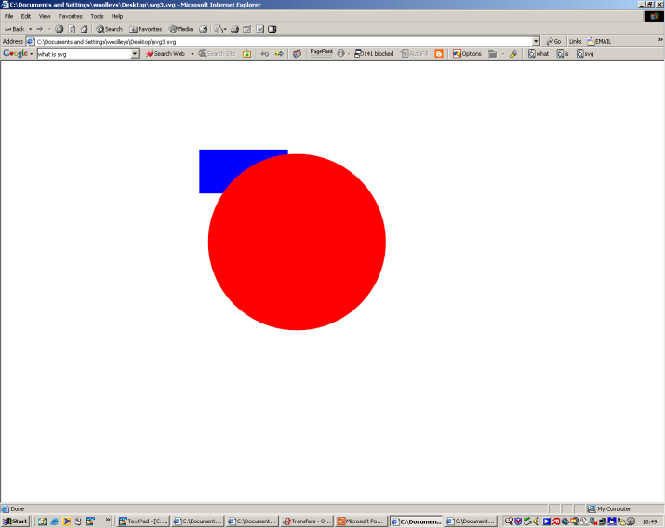
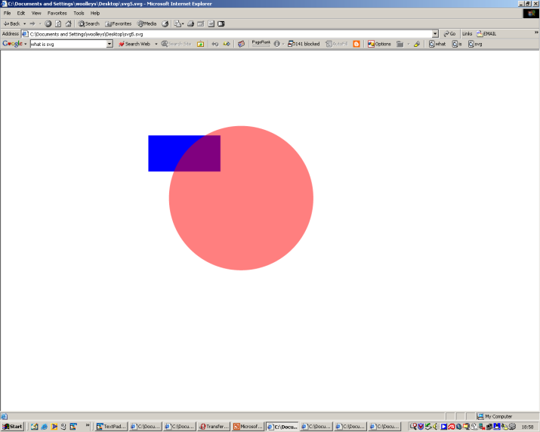
SVG Examples Simple Examples for Illustration – SVG code NOT assessed.
<svg viewBox="0 0 1000 1000">
<!-- svg3.svg Draw a blue rectangle and a red circle -->
<rect x="200" y="200" width="200" height="100" fill="blue" />
<circle cx="420" cy="410" r="200" fill="red" />
</svg>
<svg viewBox="0 0 1000 1000">
<!-- svg5.svg Draw a moving blue rectangle and a red semi-opaque circle -->
<!-- Draw the rectangle. -->
<rect x="-100" y="-50" width="200" height="100" fill="blue">
<animateMotion dur="10s" repeatCount="indefinite" path="M 220,410 A 200 200 0 1 1 620 410 A 200 200 0 1 1 220 410" />
</rect>
<!-- Draw the circle -->
<circle cx="420" cy="410" r="200" fill="red" opacity="0.5"/>
</svg>

Slide 17
SVG Demos
http://blogs.sitepointstatic.com/examples/tech/svg-curves/cubic-curve.html
http://raphaeljs.com/analytics.html
http://www.themaninblue.com/experiment/Blobular/

Slide 18
This concludes our introduction to JavaScript and SVG.
All the demonstration files can be found on the course web page.
You will not be required to write any JavaScript or SVG code in the exam. But you may expect bookwork questions on the content of these slides, for example, about what these languages provide or about what objects, properties or events are.
You can find course information, including slides and supporting resources, on-line on the course web page at
Thank
You
http://http://www.eee.bham.ac.uk/spannm/Courses/ee1f2.htm

Slide 19
EE1F2 Exam Information
The exam is 100% if the 10 credit module mark
Answer 2 questions out of 3 in 1½ hours
Which parts of the syllabus are examinable?
Everything is fair game except:
Historical description of photography
Detailed mathematical understanding of RSA or DES although you need to understand why prime factorization relates to private/public key selection
Detailed mathematical understanding of the DCT (although you should understand why it is applied in JPEG and MPEG)
Detailed knowledge of SVG code

Slide 20
EE1F2 Exam Information
Other things to bear in mind
The exam tests basic understanding along with ability to apply what you have learnt
The ‘structure’ of the paper hasn’t changed over the past few years even though I took over the course 2 years ago
Attempting previous years papers is by far the easiest way to revise

