Slide 1
Multimedia Data
Introduction to Image Data
This lecture provides a short introduction to image anatomy that will provide useful background for image processing and image compression which we will consider shortly.
Dr Mike Spann
http://www.eee.bham.ac.uk/spannm
M.Spann@bham.ac.uk
Electronic, Electrical and Computer Engineering

Slide 2
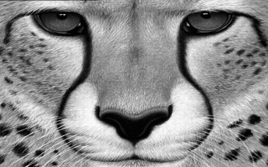
Content
The contents of an image file.
Some simple test images.
Image histograms and pixel correlations.
Raw image files.
Cheetah test image.

Slide 3
Digital Image Data

Slide 4
Producing a Digital Image

Slide 5
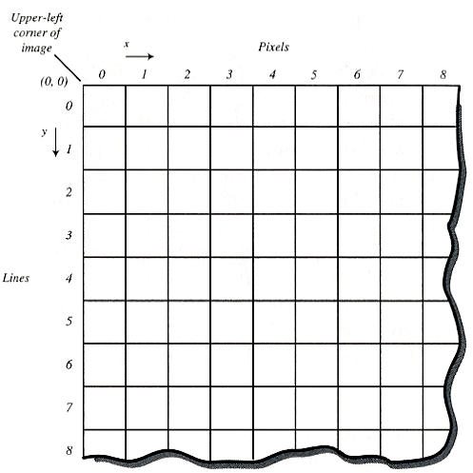
Image Pixels
Image pixels form a natural matrix that we can easily label.
The picture on the right shows the pixels labelled as (x,y).
Starting at the top left at (0,0) x increases in the horizontal direction and y increases vertically down.
We could label them differently if we wanted. The important thing is that we can unambiguously identify them.
There are TWO easy ways to confuse pixel locations.
  Mixing up numbers that start at (0,0) with ones start at (1,1).
  Mixing (x,y) notation and (row, column). (row, column) is (y,x).

Slide 6
A Simple Image
320
This mouse image has 320x200 pixels.
It is an 8-bit greyscale test image. We will consider colour later.
8 bits per pixel (bpp) means we have 256 intensity values (black=0 white = 255).
The histogram below shows the number of pixels (y-axis) for each intensity (x-axis).
The x-axis plots intensity from black=0 to white=255.
200
No. pixels
Intensity

Slide 7
Image Processing Software
Paintshop, ImageJ and FastStone are examples of useful image processing/graphics editing applications.
The image on the right shows mouse in PaintShop after it has been lightened. Notice the histogram has moved to the right (remember black=0 and white=255)

Slide 8
Comparing Histograms
Notice the different histogram for this cheetah image.
This image uses a wider range of intensity values than the mouse image.
The mouse image was a very simple image. “Real world” images are usually more complex. They tend to have histograms more like cheetah’s, i.e., flatter, because they contain a wider range of pixel values.

Slide 9
Differencing Neighbouring Pixels
The actual difference in value between adjacent pixels is often very small.
The histograms on the right show the pixel values for the cheetah image before and after pixel differencing.
The differenced values can be compressed more efficiently.

Slide 10
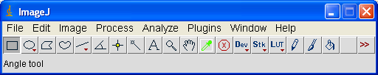
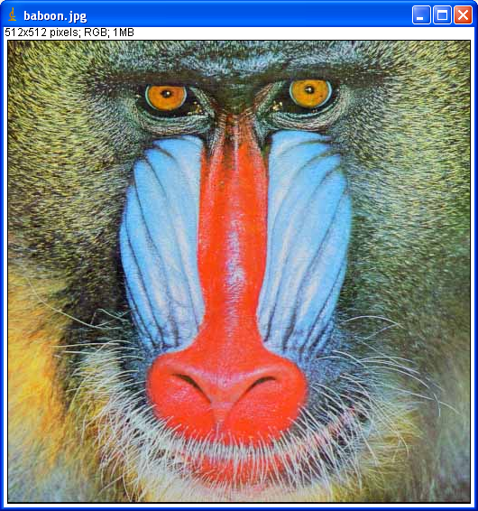
ImageJ
ImageJ is a Java based platform for demonstrating image processing techniques
I can run it as an applet to give live image processing demos
  An applet is a Java program which can be run by a web browser
ImageJ is also a good tool for testing out image processing algorithms
  Its easy to attach Java programs to the GUI and call them from the Plugins menu item

Slide 11
ImageJ demo
http://rsb.info.nih.gov/ij/signed-applet/

Slide 12
Raw Image Data

Slide 13
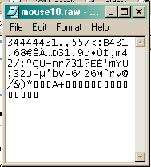
Mouse at 10x10 pixels
A raw image file is the simplest type of image file. It has no header information and it is not compressed.
This is mouse at just 10x10 pixels.
The 10x10 image of mouse simply contains only 100 continuous 8-bit bytes (these are shown open in a text editor below mouse.)
If we try to open a raw file in an imaging application it would need to be told the dimensions of the image. Not all imaging applications support raw image files.

Slide 14
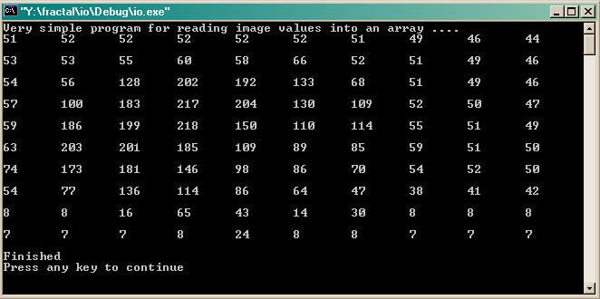
Accessing Pixels
If we wanted to read (or manipulate) image pixel values we could write a simple program to open the file.
This is an example of output from a simple program that prints out the 100 pixel values of mouse in 10 rows of 10.
Notice that the darkest regions at the bottom of the image are represented by very low values as you would expect. Similarly the lighter regions of mouse have high values (200 and above).

Slide 15
This concludes our short introduction to image data.
Next we will look at how to perform simple image processing and how we can use compression to represent the image without losing too much quality.
You can find course information, including slides and supporting resources, on-line on the course web page at
Thank
You
http://www.eee.bham.ac.uk/spannm/Courses/ee1f2.htm

