Slide 1
Multimedia Data
Introduction to Image Processing
Dr Mike Spann
http://www.eee.bham.ac.uk/spannm
M.Spann@bham.ac.uk
Electronic, Electrical and Computer Engineering

Slide 2
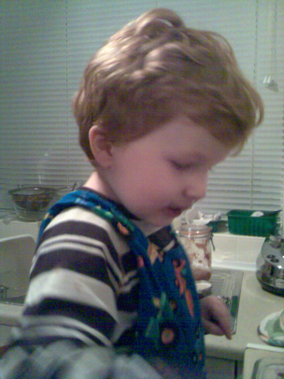

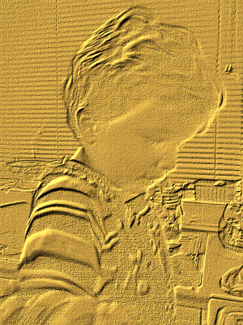
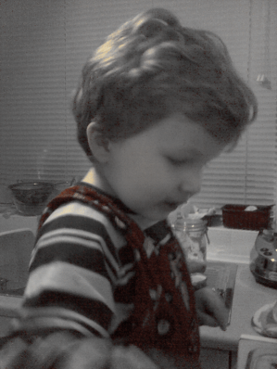
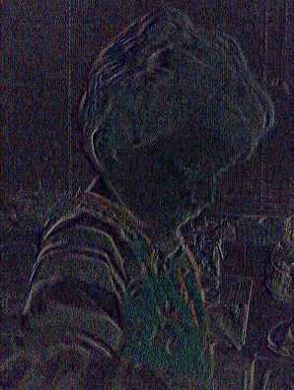
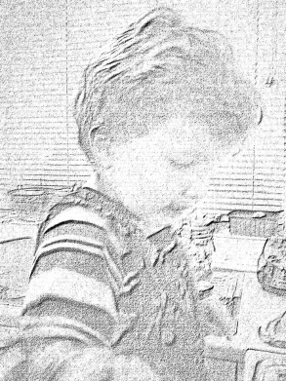
Image Processing Content
Image histograms, histogram equalization and image frequency content.
Low level image processing
  Brightening, darkening, thresholding and quantizing
Simple filtering examples
  Simple low-pass and high-pass filters
  Median filtering
Examples will be included in the lecture session.

Slide 3
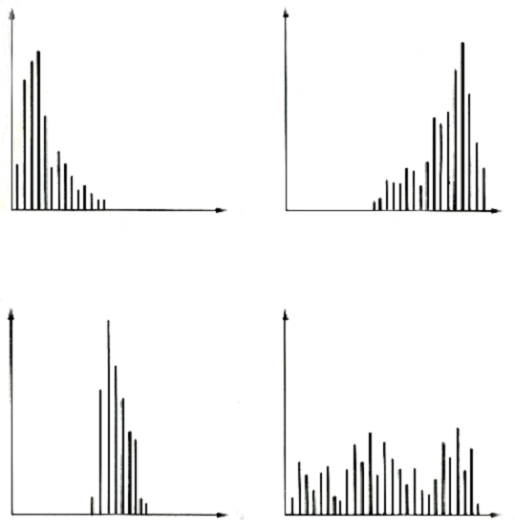
Image Histograms
It is easy to count the numbers of pixels at different intensity values to produce histograms.
These histograms give us useful information about the dynamic range of the image data.
The wider the spread of pixel intensities the higher the contrast.
Dark
image
Light
image
Number of pixels
Intensity
Low-contrast
image
High-contrast
image

Slide 4
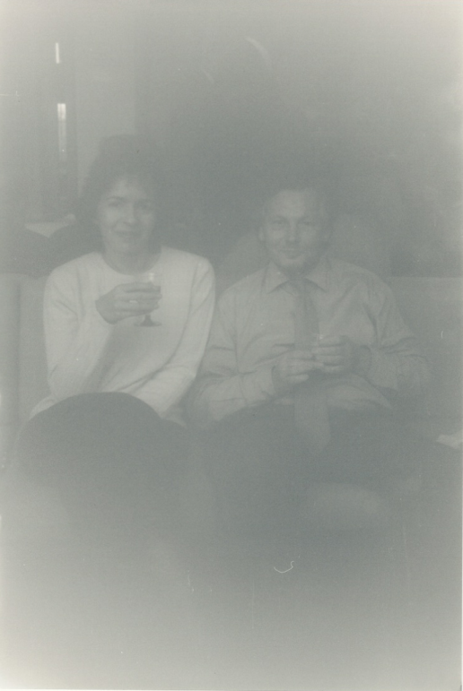
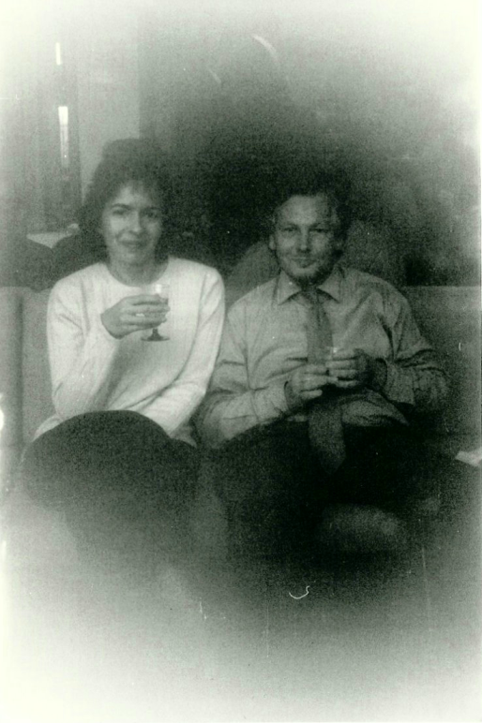
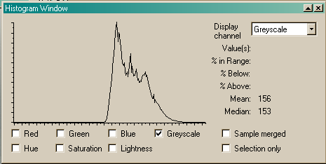
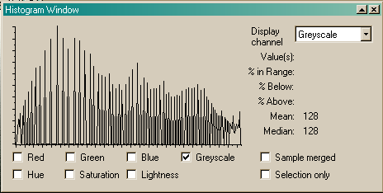
Histogram Equalization
Histogram equalization can be very useful for improving image contrast by spreading pixel values across the full dynamic range.
Ideally, pixels would use a wide range of values.
See the underexposed photograph on the left. Its image histogram shows that the intensity values have a compact range between mid to light grey.
The histogram equalized photograph on the right has better contrast. Its histogram has the same shape as the original but is stretched across the full range of intensity values.

Slide 5
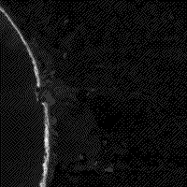
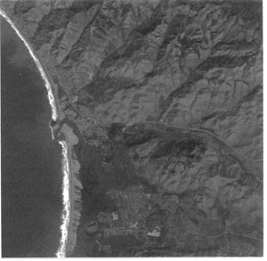
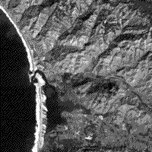
Histogram Equalization
Examples from http://rst.gsfc.nasa.gov/Sect1/Sect1_12a.html
Left: a low contrast original image.
Middle: the image after linear equalization.
Right: the image after selected emphasis to a range of values of interest.
Low contrast
Higher contrast
Selective high contrast

Slide 6
Histogram Equalization
ImageJ demo
  http://rsb.info.nih.gov/ij/signed-applet/

Slide 7


Frequencies in Images
The image histogram tells us nothing about the distribution of pixel intensities in an image.
For example, a “U” shaped histogram with peaks around black and white values could be either of the images below.
We can refer to the frequency content of an image.
Smooth areas are low frequency.
Edges and other rapid changes are high frequency.
increasing
frequency
These images have
the same histogram.
increasing
frequency

Slide 8
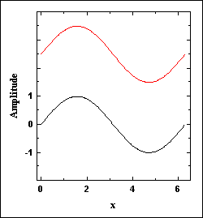


Frequencies in Images
Signals are often efficiently represented by the addition of simple sine or cosine waves.
But there’s a problem. If we try to create a SQUARE shaped wave using these simple waves, the ripples never go away. As we add smaller and smaller amounts of higher frequency sine waves we still have ripples.
The animation on the right shows the result of adding sine waves of higher and higher frequency. The sine wave is shown on the top and the sum of all the waves is shown on the bottom. See how a rippled square shaped signal appears.
Images often contain many sharp edges just like the square wave. You can often see these rippling or ringing artefacts about edges in heavily compressed images and video.
http://www.numerit.com/samples/fours/doc.htm
Demonstration of ringing www.utdallas.edu/~dxa081000/IMAGEFILTERING.ppt

Slide 9
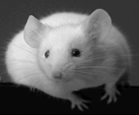

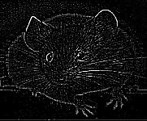
Filtering Frequencies
We can adjust the amount of frequencies in signals and images.
Low-pass filtering preserves (passes) lower frequencies but drops higher frequencies.
High-pass filtering preserves (passes) higher frequencies but drops lower frequencies.
Both high- and low-pass filters have their uses. Low-pass filters can remove noise from poor quality images by smoothing. High-pass filters can usefully pick out edges.
Original
After low-pass filtering.
Appears smooth or blurred.
After high-pass filtering.
Edges remain.

Slide 10
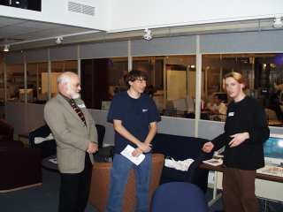
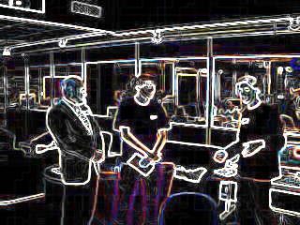
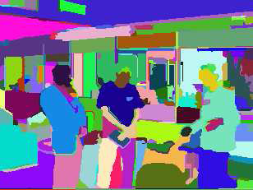
Image Processing
Low-level
  working at the pixel level, identification of edges
Medium-level
  identification of regions and shapes
High-level
  associating shapes with real objects.
Low
Medium
High

Slide 11
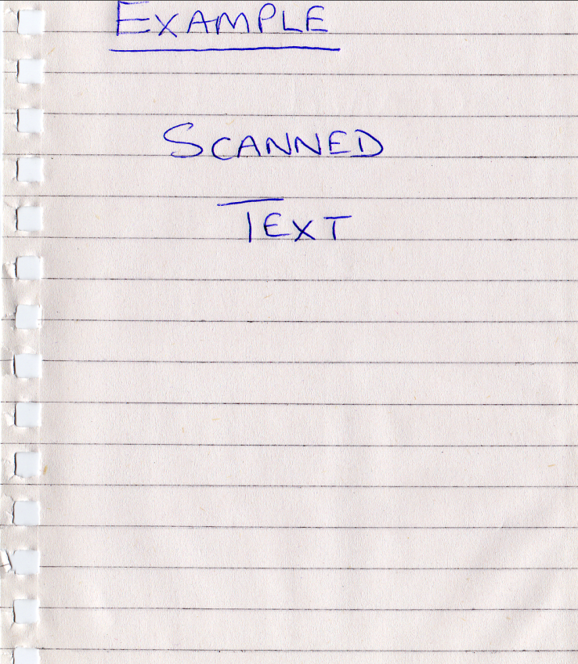
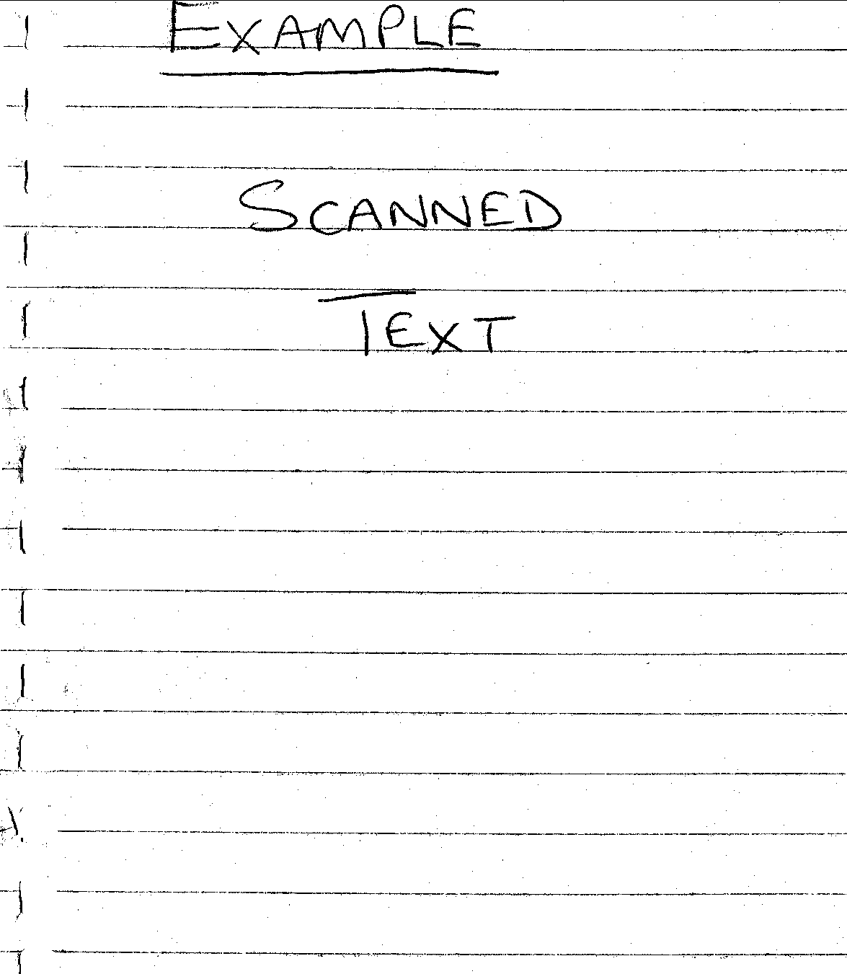
Low-level Image Processing Examples
Adjusting brightness
To lighten or darken images we can simply add or subtract a constant value from all pixel values.
Thresholding
Used to remove grey-levels in an image or segment components.
It involves changing pixel values if they are above or below a certain value (threshold).
For example, setting all pixel values below a threshold to zero and/or above a certain value to a maximum.
Thresholding can be useful by removing unwanted variations.
Example of simple thresholding
Before : top After : below
(threshold = 180)

Slide 12
Simple Image Filtering

Slide 13
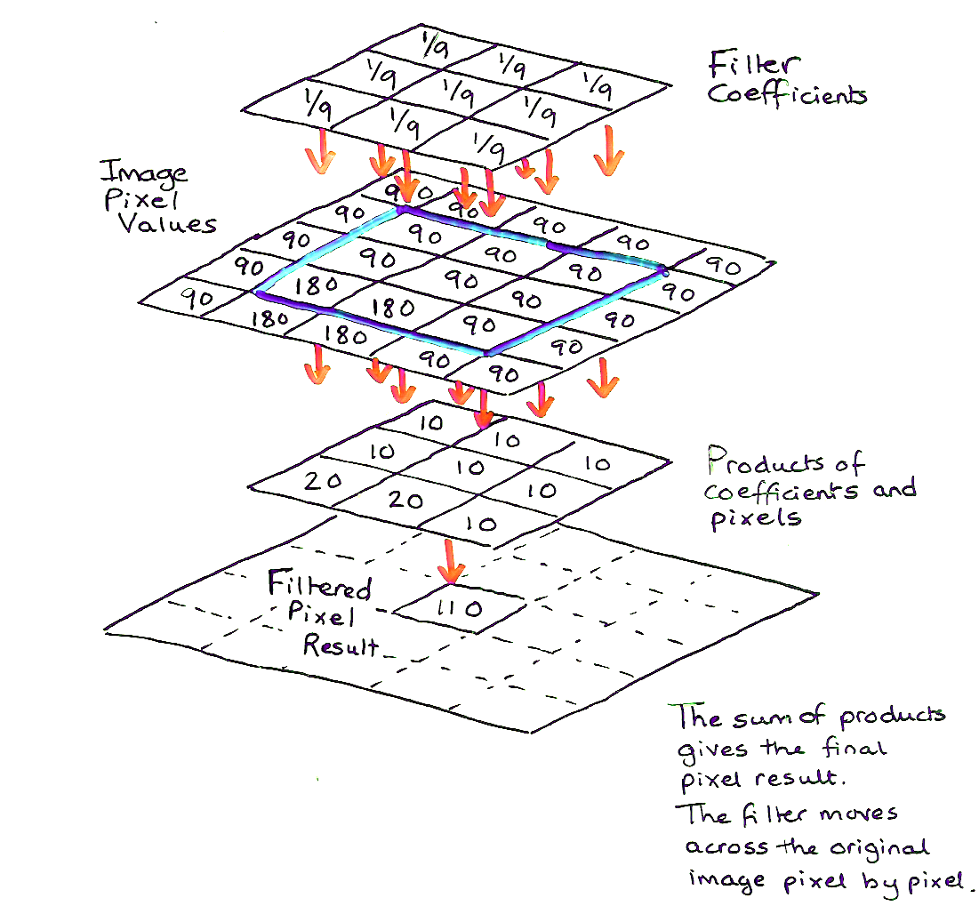
Template Operations
Templates (in this context) are arrays of values.
Here are 3 examples;
They are very useful as simple image filters.
For example, for image smoothing or edge detection.

Slide 14
Template Operations
We apply a template filter to the image using a convolution operation.
Convolution involves moving the template step-by-step over the image creating a window over pixel neighbours. This will be demonstrated in the lecture.
Template and pixel values are used for computation (typically multiplication and addition) at each step. This process is referred to as convolution of the template with the image.
You will see that the new result is smaller than the original. We could avoid this by wrapping edges together (periodic convolution) .

Slide 15
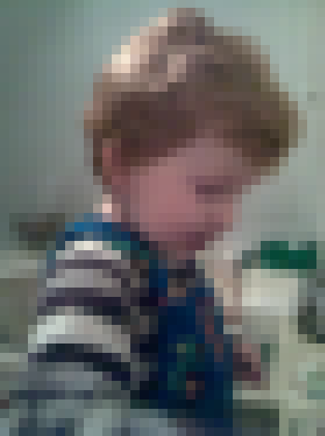

Common Templates
This is a simple 3x3 averaging (smoothing/blurring) template :-
It is an example of a low-pass filter. It passes low frequency and removes high frequency.
Left: A low resolution original image.
Right: After 3x3 averaging filter.
Notice the blurring effect.
This is caused by the averaging of pixels across every block of 9 pixels.
In a higher resolution image the effects would be less noticeable for such a small filter.

Slide 16




Common Templates
This is a simple high-pass filter.
Both high- and low-pass filters have their uses.
Low-pass filters can remove noise from poor quality images by smoothing.
High-pass filters can detect edges. Horizontal edges, vertical edges and diagonal edges.
Simple examples of detected edges.
Top left: a low resolution original,Top right: horizontal edges
and Below left: vertical edges and Below right: All edges

Slide 17
Examples

Slide 18
Examples
ImageJ demo
  http://rsb.info.nih.gov/ij/signed-applet/

Slide 19
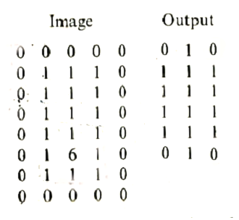
Median Filtering
Median filtering is useful for removing noise but usefully preserves edges.
  The median is the central value in a range
  Median {4,2,0,1,3,0,5} = 2
Median filtering is a popular low-pass filtering method. Pixel values are sorted and the median (middle value) is output.
Median filtering removes sparse outliers.
Sparse outliers appear as “salt and pepper” noise in images, i.e., dark pixels in light areas and light pixels in dark areas. This type of noise was common in analogue television.
You will use some simple filters in the laboratory. A median filter will be used to remove noise.
Passing a 3x3 median filter over the image pixels shown above on the right produces the output on the right.
Notice how the outlier (the 6) is removed.

Slide 20
Median Filtering
ImageJ demo
  http://rsb.info.nih.gov/ij/signed-applet/

Slide 21
This concludes our introduction to image processing.
You can find course information, including slides and supporting resources, on-line on the course web page at
Thank
You
http://www.eee.bham.ac.uk/spannm/Courses/ee1f2.htm

