Slide 1
Multimedia Data
Data Compression
Dr Mike Spann
http://www.eee.bham.ac.uk/spannm
M.Spann@bham.ac.uk
Electronic, Electrical and Computer Engineering

Slide 2
Content
An introduction to data compression
Lossless and lossy compression
Measuring information
Measuring quality
  Objective and subjective measurement
  Rate/Distortion graphs

Slide 3
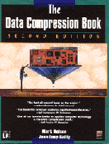
Optional Further Reading
The Data Compression Book
(recently out of print but several copies in our library)
Mark Nelson and Jean-loup Gailly,
M&T Books
2nd Edition.
ISBN 1-55851-434-1

Slide 4
What is Compression?
Compression is an agreement between sender and receiver to a system for the compaction of source redundancy and/or removal of irrelevancy.
Humans are expert compressors. Compression is as old as communication.
We frequently compress with abbreviations, acronyms, shorthand, etc.
A classified advertisement is a simple example of compression.
Lux S/C aircon refurb apt, N/S, lge htd pool, slps 4, £350 pw, avail wks or w/es Jul-Oct. Tel (eves)…
Luxury self-contained refurbished apartment for non-smokers. Large heated pool, sleeps 4, £350 per week,available weeks or weekends July to October. Telephone (evenings) …

Slide 5
The 40 Most Commonly Used Words
1 the
2 of
3 to
4 and
5 a
6 in
7 is
8 it
9 you
10 that
Ave. length
=2.4 letters
11 he
12 was
13 for
14 on
15 are
16 with
17 as
18 I
19 his
20 they
Ave. length
=2.7 letters
21 be
22 at
23 one
24 have
25 this
26 from
27 or
28 had
29 by
30 hot
Ave. length
=2.9 letters
31 word
32 but
33 what
34 some
35 we
36 can
37 out
38 other
39 were
40 all
Ave. length
=3.5 letters
Notice that more commonly used words are shorter

Slide 6
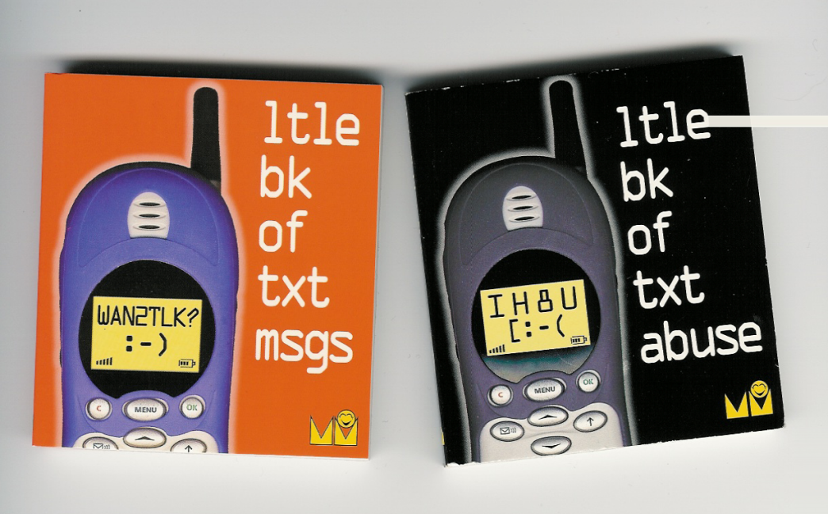
Text Message Abbreviation
IYSS
BTW
L8
OIC
PCM
TTFN
LOL
IYKWIMAITYD

Slide 7
Run-Length Coding
Run-length coding is a very simple example of lossless data compression. Consider these repeated pixels values in an image …
0 0 0 0 0 0 0 0 0 0 0 0 5 5 5 5 0 0 0 0 0 0 0 0
we could represent them more efficiently as
(12,0)(4,5)(8,0)
24 bytes reduced to 6 gives a compression ratio of 24/6 = 4:1
Notice 0 5 0 5 0 5 would actually expand to (1,0)(1,5)(1,0)(1,5)(1,0)(1,5)
How could we avoid expansion?
With binary valued data (eg. 0/1) we can increase the compression ratio. How?

Slide 8
Data Compression Trade-Offs
More
efficient (cheaper)
storage
and faster (cheaper)
transmission.
Coding delay
Legal issues (patents and licences)
Specialized hardware
Data more sensitive to error
Need for decompression ‘key’

Slide 9
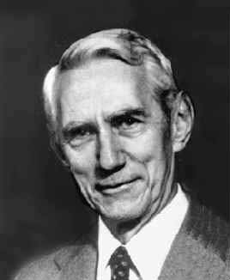
Measuring Information
The entropy of a source is a simple measure of the information content. For any discrete probability distribution, the value of the entropy function (H) is given by:-
(r=radix = 2 for binary)
The units of entropy are bits/symbol.
We can compare the performance of our compression method with the calculated source entropy.
Where the source ‘alphabet’ has q symbols of probability p_{i} (i=1..q).
Note: Change of base :
Note: Thermodynamic entropy measures the amount of disorder in a system and always increases in closed systems
Claude Shannon
1916-2001
Founder of information theory
Published
“A Mathematical Theory of Communication”
in the Bell System Technical Journal (1948).

Slide 10
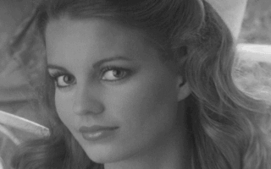

Lossless and Lossy Compression
Lossless compression (reversible) produces an exact copy of original.
Lossy compression (irreversible) produces an approximation of original.
Lossy compression is used on image, video and audio files where imperceptible (or “tolerable”) losses to quality are exchanged for much larger compression ratios.

Slide 11
Lossless vs. Lossy Compression
Lossless compression achieves much less compression than lossy compression.
It can be difficult to get a lossless compression ratio of more than 2:1 for images, but most lossy image compression can usually achieve 10:1 without too much loss of quality.
Increasing lossy compression beyond specified limits can result in unwanted compression artefacts (characteristic errors introduced by compression losses).
Lossless
Lossy

Slide 12

Measuring “Quality”
How do we measure the “quality” of lossy compressed images?
Objective:- impartial measuring methods
Subjective:- based on personal feelings
We need definitions of “quality” (“degree of excellence”?) and to define how we will compare the original and decompressed images.

Slide 13
Measuring “Quality”
Objectively
E.g., Root Mean Square Error (RMSE)
  Calculates the root mean square difference of pixels in the original image f(x,y) and pixels in the decompressed image f’(x,y). Hence, RMSE tells us the average pixel error.
Subjectively
E.g., Mean Opinion Score (MOS)
  Observer opinion rated according to the scales below.
  The viewers personal opinion of perceived quality.
    5=very good … 1=very poor
    or...
    5=perfect, 4=just noticeable, 3=slightly annoying, 2=annoying, 1=very annoying

Slide 14
Subjective Testing
Just a few examples of things we should consider.
Which images will be shown?
For example, is direct comparison possible (is the original always visible?)
What are the viewing conditions?
Lighting, distance from screen, monitor resolution?
Are these consistent between viewers?
What is the content and how important is it?
Is all the content equally important?
Who are the viewers and how do they perform?
Viewer expertise/ cooperation/ consistency/ calibration (are viewers scores relevant to the application, consistent over time, consistent between each other)

Slide 15
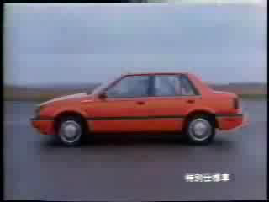
What About Content?
Does image or video content affect quality perception?
Can very poor image quality be offset by interesting content?

Slide 16
The Rate/Distortion Trade-Off
Rate distortion graphs are useful in clearly showing the trade-off between the bits per pixel and measured quality or error.
We would normally expect larger MOS values and smaller RMSE for more bits per pixel.

Slide 17
Rate/Distortion Example
Good and bad EXCEL graphs
of MOS against bpp
for the test image lisaw.raw
MOS against bpp

Slide 18
Rate/Distortion Example
The bad graph example
The actual points are not clearly shown.
The interpolated line makes invalid assumptions.
There are no x-axis or y-axis labels.
The title is incomplete.
The y-axis goes up to 6 (MOS is limited to 5.)
The background shading is unnecessary.
The good graph example
The actual data points are clear.
The axis and title labelling is much clearer, for example, also identifying the image and compression method.

Slide 19
Optimizing the Rate/ Distortion
Quality can fall rapidly (notice the steep slope of the rate/ distortion graph).
When viewed full screen a significant drop in quality can be seen between these example images c-d-e.
Notice the relatively small change in compression ratio between images c) d) and e).
Key to figures:
The images were compressed with a method called DCT.
CR = compression ratio, QF tells us the amount of quantization used to compress the image. QF=25 is the most lossy.

Slide 20
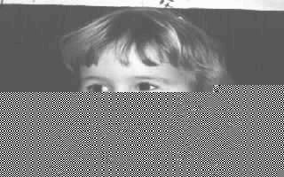
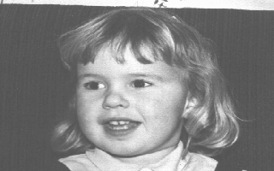
Compression and Channel Errors
Noisy or busy channels are especially problematic for compressed data.
Unless compressed data is delivered 100% error-free (i.e., no changes and no lost packets) the whole file is often destroyed.
Compress
Decompress
Errors can be introduced by the communication channel here.
Error starts here and propagates to the end of file.

Slide 21
This concludes our introduction to compression.
The laboratory exercise compresses selected test images with different compression methods and plotting rate/distortion graphs. In future lectures we will look at how these methods work.
You can find course information, including slides and supporting resources, on-line on the course web page at
Thank
You
http://www.eee.bham.ac.uk/spannm/Courses/ee1f2.htm

