Slide 1
Multimedia Data
The DCT and JPEG Image Compression
Dr Mike Spann
http://www.eee.bham.ac.uk/spannm
M.Spann@bham.ac.uk
Electronic, Electrical and Computer Engineering

Slide 2
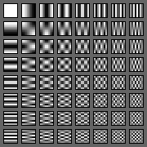
Contents
The philosophy behind the lossy of processes of DCT image compression.
A summary of the processes involved in DCT image compression.
Consideration of DCT ringing and blocking compression artefacts; their appearance and their origin.

Slide 3

Lossy DCT Image Compression
The lossy (Discrete Cosine Transform) DCT method compression method is widely used in current standards. For example, JPEG images and MPEG-1 and MPEG-2 (DVD) videos.
The image here is increasingly compressed from left to right.
Blocking artefacts are visible. Ringing artefacts can also be seen around edges.
This lecture will explain how the method works and how these artefacts are caused.

Slide 4
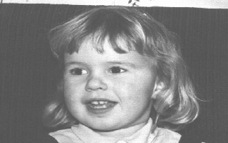




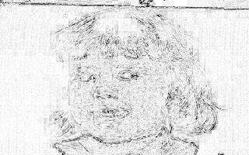
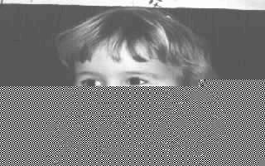
Rate/Distortion
As we have seen, quality can fall rapidly as shown by the steep slope of rate/ distortion graph.
The DCT methods typically* work well up to around 10:1 compression ratios and then quality falls rapidly beyond this.
*Note – the original quality and image type are important considerations.
a) Original b) CR 8:1
c) CR 11.6:1 d) CR 13.6:1
e) CR 14.2:1 f) Difference a-e
g) CR=8:1 with Channel Error

Slide 5
DCT Compression

Slide 6
DCT Compression

Slide 7
DCT Compression

Slide 8
DCT Compression

Slide 9
DCT Image Compression
The philosophy behind DCT image compression is that the human eye is less sensitive to higher-frequency information and also more sensitive to intensity than to colour.
The examples here show the effects of percentage reduction of colour by spatially sub-sampling the colour (UV) channels

Slide 10
DCT Image Compression
The DCT method is an example of a transform method. Rather than simply trying to compress the pixel values directly, the image is first TRANSFORMED into the frequency domain. Compression can now be achieved by more coarsely quantizing the large amount of high-frequency components usually present.
The JPEG* standard algorithm for full-colour and grey-scale image compression is a DCT compression standard that uses 8x8 blocks.
It was not designed for graphics or line drawings and is not suited to these image types.
*Joint [CCITT and ISO] Photographic Experts Group

Slide 11
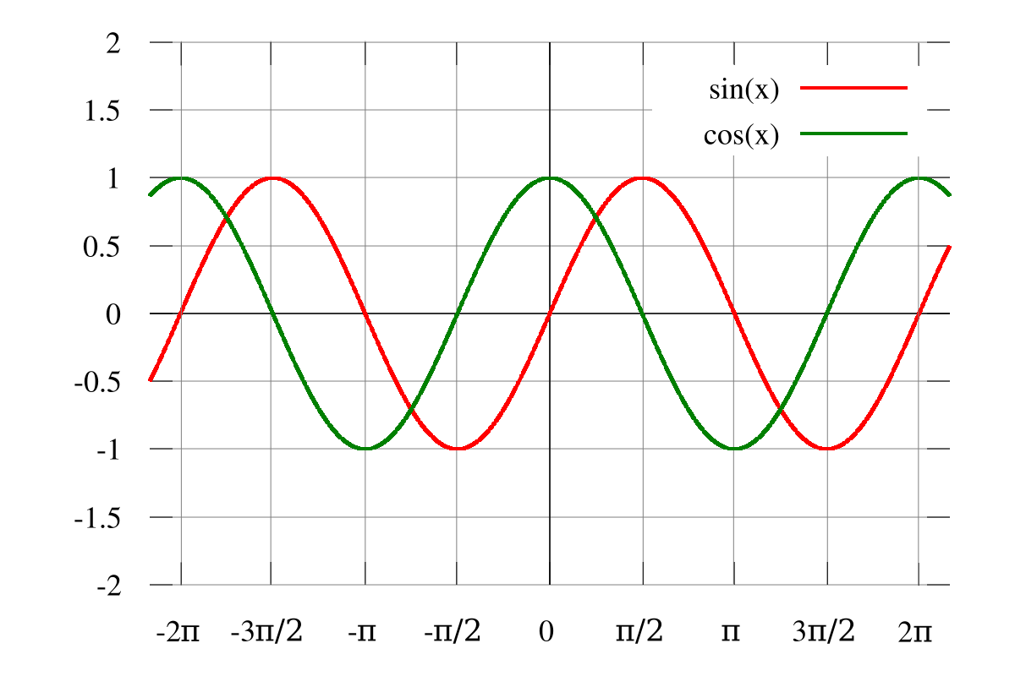
DCT Image Compression
The Discrete Cosine Method uses continuous cosine waves, like cos(x) below, of increasing frequencies to represent the image pixels.
The bases are the set of 64 frequencies that can be combined to represent each block of 64 pixels.
Firstly, the image must be transformed into the frequency domain. This is done in blocks across the whole image.

Slide 12
The Discrete Cosine Transform Bases
Low frequency
High frequency

Slide 13
The DCT
Take each 8x8 pixel block and represent it as amounts (coefficients) of the basis functions (the frequency set).
  represent the 8x8 pixels as amounts of lowest frequency (the average or DC value) through to the highest frequency
  64 pixels values are TRANSFORMED into 64 coefficients which represent the amount of each frequency.

Slide 14
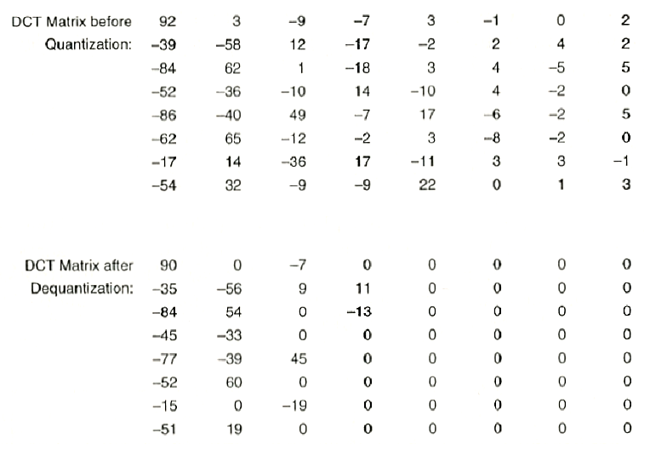
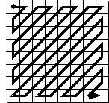
DCT Image Compression
The DCT itself does not achieve compression, but rather prepares the image for compression.
Once in the frequency domain the image's high-frequency coefficients can be coarsely quantised so that many of them (>50%) can be truncated to zero.
The coefficients can then be arranged so that the zeroes are clustered (zig-zag collection) and Run-Length Encoded.
The remaining data is then compressed with Huffman coding*.
*The JPEG standard actually specifies many variants which have not been widely used. For example, a more efficient algorithm than Huffman, called arithmetic coding, is a standard variant, but there are several patents on this method. We usually refer to the JPEG baseline algorithm if there is a possibility of confusion between variants.

Slide 15
DCT Image Compression
‘Baseline’ JPEG uses a standard quantization matrix - determined by subjective testing
  Higher frequency DCT coefficients G_{ij} are attenuated more as the HVS is less sensitive to high frequencies
16 11 10 16 24 40 51 61
12 12 14 19 26 58 60 55
14 13 16 24 40 57 69 56
14 17 22 29 51 87 80 62
18 22 37 56 68 109 103 77
24 35 55 64 81 104 113 92
49 64 78 87 103 121 120 101
72 92 95 98 112 100 103 99
Q =

Slide 16
DCT Compression Stages
Blocking (8x8)
DCT (Discrete Cosine Transformation)
Quantization
Zigzag Scan
DPCM* on the dc value (the average value in the top left)
  DPCM – Differential Pulse Code Modulation – Instead of sending the value send the difference from the previous value.
RLE on the ac values (all 63 values which aren’t the dc/ average)
Huffman Coding

Slide 17
DCT Mathematics
The formula is shown here for interest only (not assessed material!).
The Discrete Cosine Transform below takes the image pixels I(x,y) and generates DCT(i,j) values.
  Its easy to go in the opposite direction as shown in the second equation

Slide 18
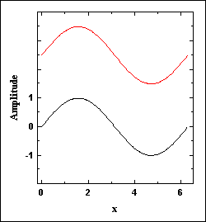
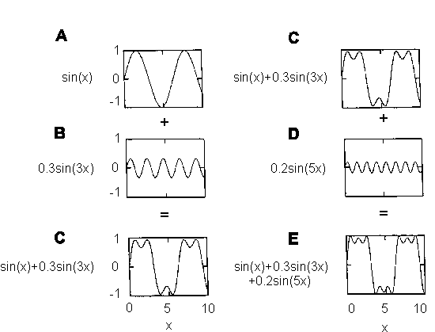
Gibb’s Phenomenon
The presence of artefacts around sharp edges is referred to as Gibb's phenomenon.
These are caused by the inability of a finite combination of continuous functions (like cosines) to describe jump discontinuities (e.g. edges).
At higher compression ratios these losses become more apparent, as do the boundaries of the 8x8 blocks.
The loss of edge clarity can be clearly seen in a difference mapping comparing an original image with its heavily compressed equivalent.
http://www.numerit.com/samples/fours/doc.htm

Slide 19
Original Test Image
An extreme example for demonstrating Gibb’s phenomenon

Slide 20
Heavily Compressed DCT Image

Slide 21
The Difference (Gibb’s Phenomenon)

Slide 22
Summary of DCT
The philosophy behind the lossy processes of DCT image compression.
A summary of the processes involved in DCT image compression.
Consideration of DCT ringing and blocking compression artefacts; their appearance and their origin.
For interest …
more links on compression …
http://www.eee.bham.ac.uk/woolleysi/links/datacomp.htm

Slide 23
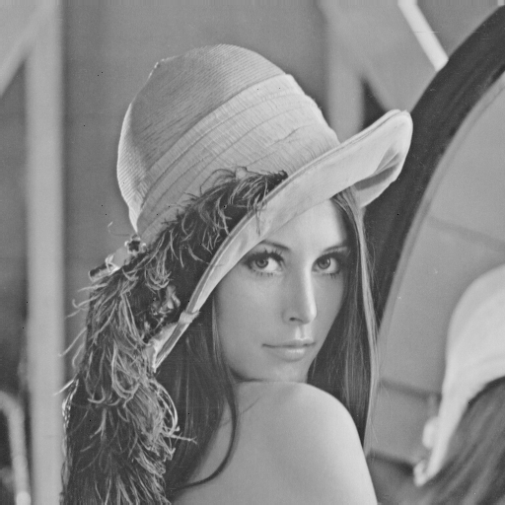
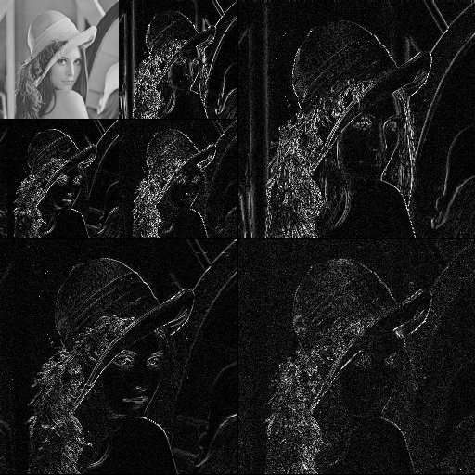
State of the art compression methods
The DCT is the transformation underpinning the original JPEG standard
  Block based transformation
  Blocking artefacts will always be an issue at high compression rates
JPEG2000 is based on the discrete wavelet transform (DWT)
  A more complex transformation across the whole image
  Blocking artefacts no longer a problem
DWT

Slide 24


State of the art compression methods
Performance of wavelet based methods is impressive
  This is in terms of the quality of the compressed image at high compression rates
  AND
  The absence of blocking artefacts
We can compare DCT and DWT based compression at 32:1 compression ratio
DCT
DWT

Slide 25
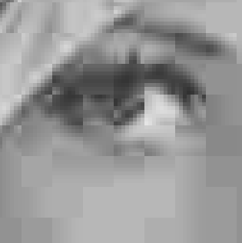
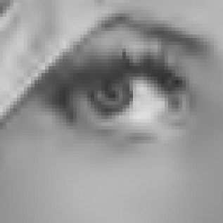
State of the art compression methods
Its much easier to see a difference if we ‘zoom in’ on a small region
  Blocking artefacts are clearly visible in the DCT based method
  Wavelet based methods ‘degrade’ much more gracefully at higher compression ratios
DCT
DWT

Slide 26

State of the art compression methods
Another advantage of these methods is that it produces an ‘embedded’ bitstream
  Important for video streaming services
  The image can be reconstructed from the bitstream at any time according to the quality required at any given compression
bitstream
….1100101011100101100011………01011100010111011011101101….
lossless

Slide 27
This concludes our introduction to DCT image compression.
You can find course information, including slides and supporting resources, on-line on the course web page at
Thank
You
http://www.eee.bham.ac.uk/spannm/Courses/ee1f2.htm

