Slide 1
Multimedia Data
Security and Cryptographic Algorithms
Dr Mike Spann
http://www.eee.bham.ac.uk/spannm
M.Spann@bham.ac.uk
Electronic, Electrical and Computer Engineering

Slide 2
Contents
We look briefly at the importance of secure cryptography and at some simple cryptographic approaches.
We introduce the key distribution problem and look at how we might achieve secure communication over an insecure network.
A super book on the subject is Simon Singh’s “The Code Book”
Security threats and requirements
The Caesar cipher
Cryptanalysis
The Vigenère cipher
The key distribution problem
Public-private key cryptography
Diffie-Hellman-Merkle key exchange
RSA (Rivest, Shamir and Adleman)
PGP (Pretty Good Privacy)

Slide 3
Network Security Threats
replay
replay
replay
Request
Request
Request
Information can be observed and recorded by eavesdroppers.
Imposters can attempt to gain unauthorised access to a server.
An attacker can flood a server with requests, causing a denial-of-service for legitimate clients.
An imposter can impersonate a legitimate server and gain sensitive information from a client.
An imposter can place themselves in the middle, convincing a server that it is a legitimate client and a client that it is a legitimate server.
Server
Server
Client
Server
Client
Client
Response
Response
Response
Server
Server
Client
Server
Client
Client
Imposter
Imposter
Imposter
Server
Server
Attacker
Server
Attacker
Attacker
Server
Server
Client
Server
Client
Client
Imposter
Imposter
Imposter
Man in
Man in
Client
Man in
Client
Client
Server
Server
the
Server
the
the
middle
middle
middle

Slide 4
Security Requirements
Privacy - information should be readable only by the intended recipient.
Integrity - the recipient can confirm that the message has not been altered during transmission.
Authentication - it is possible to verify the identity of the sender and/or receiver.
Nonrepudiation - the sender cannot deny having sent a given message.
  The above requirements are not new and various security mechanisms have been used for many years in important transactions.
  What is new is the speed at which break-in attempts can be made from a distance by using a network.

Slide 5
Cryptography
Cryptography (Greek : kryptos-hidden) is the science of making messages secure.
The original message is the plaintext.
The encryption/decryption algorithm is called the cipher.
The encrypted message is the ciphertext.
Note – cryptography is different from steganography.
  Steganography (from Greek steganos-covered and graphein-to write) involves hiding the existence of a message.

Slide 6
Cryptography and the Caesar Cipher
The Caesar cipher is a very simple example of a monoalphabetic cipher. It can use a simple shift between the plain alphabet and cipher alphabet. The exact shift can be considered as the cipher key.
  An example of a 3 letter shifted Caesar cipher (lower case for plaintext and UPPERCASE for ciphertext.
  a b c d e f g h i j k l m n o p q r s t u v w x y z
  D E F G H I J K L M N O P Q R S T U V W X Y Z A B C

Slide 7
Keys and the Caesar Cipher
The simple Caesar cipher has just 25 keys (i.e., 25 possible shifts). So that cryptanalysts could quickly break the code by trying all possible shifts.
A compromise involves the use of a keyword or key phrase, e.g., ‘JULIUS CAESER’
  a b c d e f g h i j k l m n o p q r s t u v w x y z
  J U L I S C A E R T V W X Y Z B D F G H K M N O P Q

Slide 8
Cryptanalysis
In “The Code Book”, Simon Singh describes how early Arabian scholars invented cryptanalysis, for example, using frequency analysis to identify substitutions.
Relative frequencies of letters of the alphabet:
a | 8.2 | h | 6.1 | o | 7.5 | v | 1.0
b | 1.5 | i | 7.0 | p | 1.9 | w | 2.4
c | 2.8 | j | 0.2 | q | 0.1 | x | 0.2
d | 4.3 | k | 0.8 | r | 6.0 | y | 2.0
e | 12.7 | l | 4.0 | s | 6.3 | z | 0.1
f | 2.2 | m | 2.4 | t | 9.1
g | 2.0 | n | 6.7 | u | 2.8

Slide 9

The Vigenère Cipher
The Vigenère cipher was published in 1586. It is a polyalphabetic cipher (as opposed to a monoalphabetic cipher) because it uses several cipher alphabets per message. This makes frequency cryptanalysis more difficult.
Again a key (keyword or key phrase) is required.

Slide 10
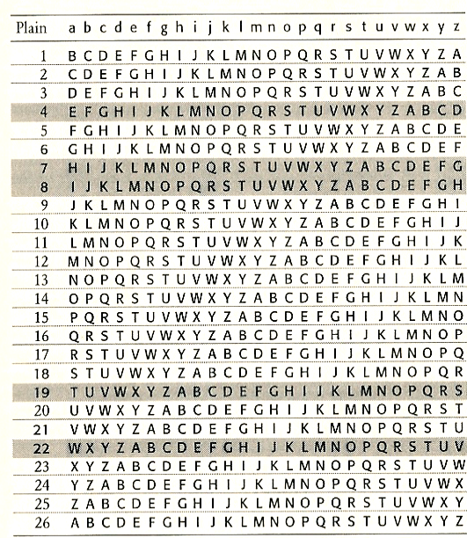

Slide 11
DES – The Data Encryption Standard
IBM invented "Lucifer", an encryption system adopted as the Data Encryption Standard (DES) in 1976.
DES repeatedly scrambles (mangles) blocks of 64 bits with an encryption key of 56bits.
The key was reduced from a longer key to 56bits as required by the American NSA (National Security Agency).

Slide 12


The Key Distribution Problem
How can secret keys be exchanged by parties who want to communicate?
In the late 1970s, banks distributed keys by employing special dispatch riders who had been vetted and were among the company's most trusted employees. They would travel across the world with padlocked briefcases, personally distributing keys to everyone who would receive messages from the bank over the next week.

Slide 13
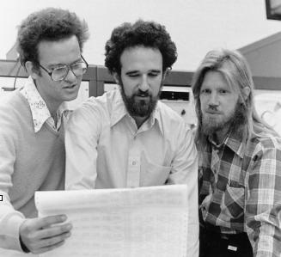
Diffie-Hellman-Merkle
Whitfield Diffie and Martin Hellman.
Diffie accepted a research position with Hellman and was later joined by Ralph Merkle at Stanford.
Diffie imagined two strangers (Alice and Bob) meeting on the Internet and wondered how they could send each other an encrypted message which an eavesdropper (Eve) could not read).
Although safe key exchange had been considered impossible ...
(c) Chuck Painter/Stanford News Service
- Ralph Merkle, Martin Hellman, Whitfield Diffie (1977)

Slide 14
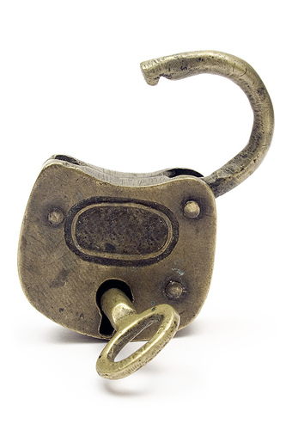
A Simple Padlock Example
It is possible to imagine secure message exchange over an insecure communication system.
Imagine Alice sends a package to Bob securing it with a padlock. Bob can't open it – but adds his own padlock to it and sends it back to Alice who removes her padlock and sends it back to Bob – Bob can now open his own padlock. QED.
Alice and Bob both kept their keys safe and the package was never unlocked in the system.
The problem with applying this simple solution was the order of events. Encryption methods up to this time have required a "last on, last off" ordering.
  The solution is to have 2 keys. A public key and a private key

Slide 15
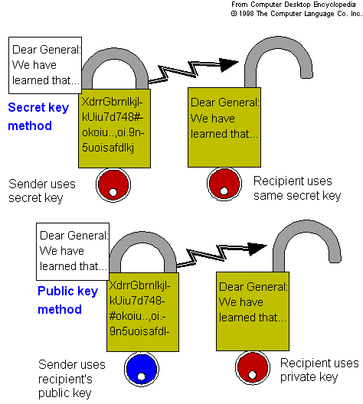
Public key encryption
Alice wants to send Bob a confidential email
  She encrypts it with Bob’s public key which is available to anyone
  Bob can decrypt the message with his private key which only he knows
  Anyone intercepting the email would need Bobs private key to decrypt it

Slide 16
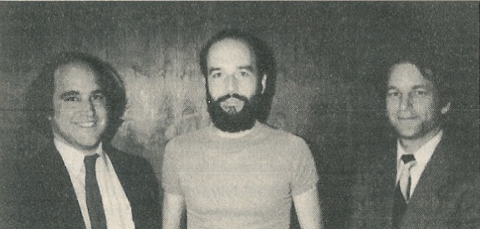
RSA (Rivest, Shamir and Adleman)
RSA is a public key encryption method using asymmetric keys
This was developed by Rivest, Shamir and Adleman at MIT and announced in Scientific American in August 1977.
The system is based on 2 large primes, p and q which are multiplied together as part of the public key N.
  Factoring N into p and q is extremely difficult for large N.
  For banking transactions, N>10³⁰⁸ provides an extremely high level of security (a hundred million PCs would take more than 1000 years to find p and q.)

Slide 17
RSA (Rivest, Shamir and Adleman)
RSA numbers are published online
  RSA-100 100 digit number
  RSA-155 155 digit number
  etc
The RSA factoring challenge put forward by RSA labs on March 18, 1991 (and retracted in 2007) to encourage research into practical algorithms for factoring large integers and cracking RSA keys http://www.rsa.com/rsalabs/node.asp?id=2092
  Researchers in computational algorithms develop techniques to perform these massive factorizations and prizes are awarded
  The largest number factorised was RSA-768 (768 bits, 232 digits) in 2009
RSA-100 = 152260502792253336053561837813263742971806811496130688657908494580122963258952897654000350692006139
=
37975227936943673922808872755445627854565536638199 × 40094690950920881030683735292761468389214899724061

Slide 18
The mathematics of RSA
Based on the mathematics of congruences
  2 numbers p and q are congruent modulo N if they have the same remainder when divided by N
  Eg.
The idea behind RSA is to raise a number to a power to move it between columns in a table with N columns
  If each column is labelled with a letter, moving it to a different column creates the cyphertext

Slide 19
The mathematics of RSA
For example raising 2 (“B”) to the power of 3 moves it to column 3 so B becomes a C
  Our table has 5 columns so N=5
To decipher our code, we need to multiply 3 by 2²=4
  This moves us back to column 2
  In general the sender must know the first multiplying power and N and the receiver must know the second multiplying power and N
A | B | C | D | E
1 | 2 | 3 | 4 | 5
6 | 7 | 8 | 9 | 10
11 | 12 | 13 | 14 | 15
16 | 17 | 18 | 19 | 20

Slide 20
The mathematics of RSA
In order to proceed further, we need 2 definitions
2 numbers p and q are relatively prime if they have no prime factors in common
  10=5 x 2 and 21=7 x 3 are relatively prime (even though neither are prime numbers)
  10 and 15 are not relatively prime as they have prime factor 5 in common
  We often say that 10 is prime to 21 and vice versa
Euler's function Φ(p) counts the number of numbers less than p that are relatively prime to p

Slide 21
The mathematics of RSA
The combination of encryption and decryption must be equivalent to raising a number to a power so that it ends up back in the same column
  This is nicely summarised in a simple formula for integers N and m which are relatively prime and for any integer k:
    Some number m in an N column array raised to the power k Φ(N)+1 will be in column m of the array
    or (more mathematically put!)
Example, N=6, Φ(N)=2, m=5, 5^{2k+1}
 | 5^{2k+1} | 5^{2k+1} mod 6
k=1 | 125 | 5
k=2 | 3125 | 5
k=3 | 78125 | 5

Slide 22
The mathematics of RSA
The trick is to factor kΦ(N)+1=E x D
  E is the public key
  D is the private key
Enciphering involves raising some number m to the power of E
Deciphering involves raising m^{E} to the power of D, m^{E} ^{x D}
m^{E} ^{x D} ≡ m mod N
So where does the factorisation of large numbers come into this?
  For N small, its easy to compute Φ(N)
    Given the public key E, kΦ(N)+1 can be factored for different values of k
    The value of k which yields a D to decipher the message can be determined easily
  Therefore we need a huuuuuuuge N !!!

Slide 23
The mathematics of RSA
For large N, computing Φ(N) is computationally immense
  Would involve determining all the prime factors of N
We know that for p prime Φ(p)=p-1
Also (and I will leave this as an exercise for you to prove!), if N=pq, for p and q prime, Φ(N)=(p-1)*(q-1)
  So to determine a public/private key pair, take 2 massive primes p and q and multiply them to get N
  Compute Φ(N)=(p-1)*(q-1)
  For some k, compute kΦ(N)+1
  Factor kΦ(N)+1 into E x D
Knowing N and E will not enable D to be found since N cannot easily be factored and hence Φ(N) cannot be determined!

Slide 24
Applications of RSA
Most major hardware and software vendors have a license from RSA Data Security to develop products using the RSA encryption system
  Extensively used in banking applications, defence and large manufacturing companies
The RSA system is actually a combination of the DES encryption system and public key encryption
  DES is used for the bulk of the message as it is faster than RSA
  The DES key is sent using RSA
  The combination of the encrypted message (using a symmetric key) and the public key encrypted symmetric key is known as a digital envelope

Slide 25

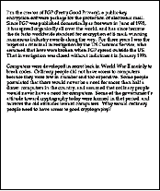



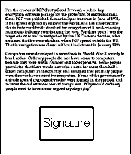

Digital Signatures for Verification
A digital signature is something that is attached to data (documents) which verify the source and also verify that the data has not been tampered with (authenticity and integrity)
  The signature is a hash function computed from the data
  Essentially a binary digest of the data
  The signature is encrypted with the senders private key and appended to the document
    The public and private key can be applied in either order!
      m^{E} ^{x D} = m^{D} ^{x E} ≡ m mod N
10110011010100
http://www.youdzone.com/signature.html

Slide 26

Digital Signatures for Verification
  The signature can be decrypted with the senders public key
  If the hash strings match, then it can only have come from the sender
  AND
  Data integrity is guaranteed
?

Slide 27
This concludes our introduction cryptography
You can find course information, including slides and supporting resources, on-line on the course web page at
Thank
You
http://www.eee.bham.ac.uk/spannm/Courses/ee1f2.htm

