Slide 1
Multimedia Data Course Introduction
Dr Mike Spann
http://www.eee.bham.ac.uk/spannm
M.Spann@bham.ac.uk
Electronic, Electrical and Computer Engineering

Slide 2
EE1F2 Multimedia
An introduction to the format, compression, processing and security of communicated multimedia information.
Assessment
Written examination
Assessed material includes recommended laboratory exercises, lecture slides and notes from in-class examples.

Slide 3
Useful Information
Any issues relating to the course admin, access to Canvas, timetabling changes etc. please contact our departmental administrator Ben Clarke
ClarkeBJ@adf.bham.ac.uk
Please consult the course web page or Canvas page for lecture material, tutorial/lab exercises etc.
http://www.eee.bham.ac.uk/spannm/Courses/ee1f2.htm
https://canvas.bham.ac.uk/login
Lab exercises 9-11am, Wed 5th Feb, NG22 and Wed 12th Feb.
Tutorial Wed 26th Feb. (ignore 2nd timetabled slot)

Slide 4
Syllabus Summary - I
Information and Image Data
Introduction to multimedia data
Data types and file sizes
Human vision
Image data
Image filtering (simple high and low pass, edge and median filtering)
Image processing
Data Compression
Lossless compression
Huffman, Lempel-Ziv (eg .GIF)
Lossy compression
DCT (.JPEG)
Methods of quality assessment and rate/distortion graphs

Slide 5
Syllabus Summary - II
Cryptography
Securing communicated information
Public/private key encryption
Video
MPEG-1 video coding
Speech and Audio
Sampling, quantization and coding methods (waveform and vocoding)
Audio data (MP3 - perceptual audio coding)
Web Page Coding
HTML – HyperText Markup Language
JavaScript
SVG – Scalable Vector Graphics and Flash

Slide 6
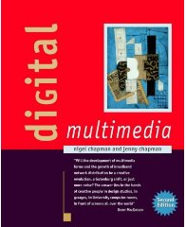
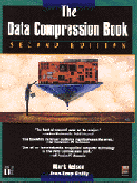
Texts for Optional Further Reading
Here are just a few examples of texts relevant to the course content. There are many other good and quite detailed books on various aspects of multimedia such as compression, image processing and cryptography.
The Digital Multimedia text gives a high-level summary of multimedia issues with less technical detail. The other texts are more detailed. It is very important to note that these books usually cover each topic in far more detail than required by the course. For these reasons the texts are recommended only as optional advanced further reading.
Digital Multimedia
Chapman and Chapman
2nd Edition, Wiley
ISBN 0-470-85890-7
Amazon link
The Data Compression Book
(now out of date/print but several copies in the library)
Mark Nelson and Jean-Loup Gailly
2nd Ed. 1996, M and T Books, ISBN 1-55851-434-1
Amazon link
JAVASCRIPT for the World Wide Web
(An example of good book on JavaScript)
Negrino and Smith, Peachpit Press, 4th Ed 2001
ISBN 0-201-73517-2
(www.javascriptworld.com)
Amazon link
Introductory Computer Vision and Image Processing
Adrian Low
McGraw Hill
The Code Book
Simon Singh
Fourth Estate

Slide 7
Multimedia Systems or Data??
We will concentrate on the data
Processing
Compression
Transmission
Representation
Perception
Security
Etc

Slide 8
Multimedia Systems or Data??
We will be not be concerned with input/output devices
Input devices such as:
Keyboard, mouse (track balls, joysticks, etc)
graphics tablets - drawing
Scanner – capture image from printed material
Digital camera - capture and transform image/video into digital form
Touch screen for kiosk application
Analogue audio input from microphone and audio player
Output devices such as:
High resolution screen, 256 colors (at least) – output video
Speakers, amplifier or tape devices - Output audio
Printer for text, graphics
Nor will we be concerned with storage devices (discs, cd’s, IPODs …) or processors (computers, micro-controllers, specialized hardware etc) or other pieces of hardware

Slide 9
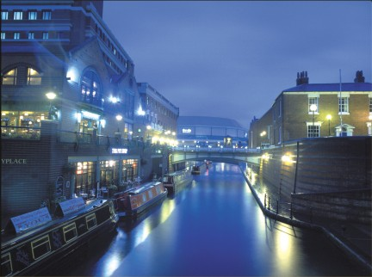
Examples of Data Types
There are many different types of data.
Data files
Program files
Software applications
Graphics/Animations
Sound
Speech, audio, music
Images
Satellite, medical, camera, webcam, phone,
also stereo and 3D images
Video
Movies, games, short clips, ….
Birmingham

Slide 10
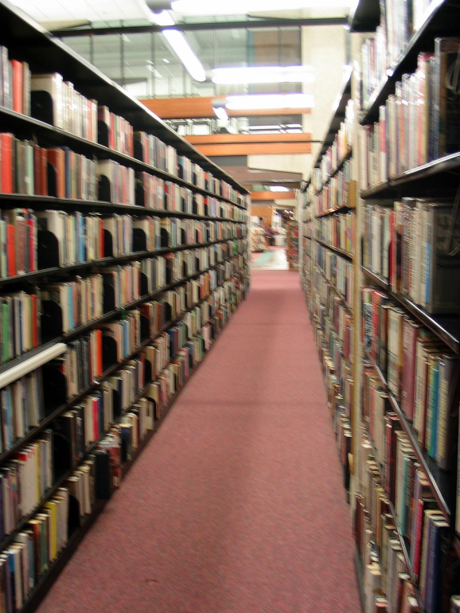
File sizes: Data Powers of Ten
We are using, saving and communicating increasingly large amounts of data.
bit : A binary decision
100 Kbyte : A low resolution photograph
2 Mbyte : A high resolution photograph
5 Mbyte : Complete works of Shakespeare or 5 s of TV-quality video
10 Mbyte : A digital chest X-ray
100 Mbyte : 1 metre of shelved books
1 Gbyte : A low resolution video
2 Terabytes (1 000 000 000 000 bytes) : An academic research library
2 Petabytes (1 000 000 000 000 000 bytes) : All US research libraries
5 Exabytes (1 000 000 000 000 000 000 bytes) : All words ever spoken
Zettabyte (1 000 000 000 000 000 000 000 bytes)
Yottabyte (1 000 000 000 000 000 000 000 000 bytes)
http://www2.sims.berkeley.edu/research/projects/how-much-info/datapowers.html

Slide 11
Some multimedia history. Was this the earliest personal and portable information “technology”?

Slide 12
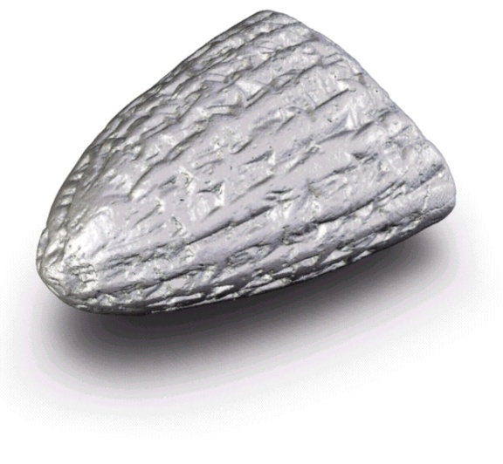
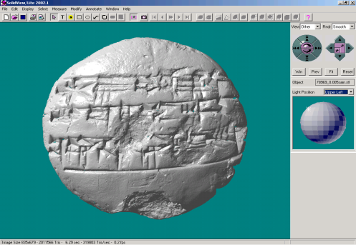
Earliest Personal Media?
Cuneiform was the first form of writing, predating Egyptian hieroglyphs.
Clay cuneiform tablets were perhaps the first personal and portable information “technology”
They were used for legal documentation, statements of freedom, record-keeping.
Our university is home to “The Cuneiform Digital Palaeography Project” You can read more at www.cdp.bham.ac.uk. A collaborative project, headed by Assyriologist Dr Alasdair Livingstone, between The University of Birmingham and The British Museum.

Slide 13
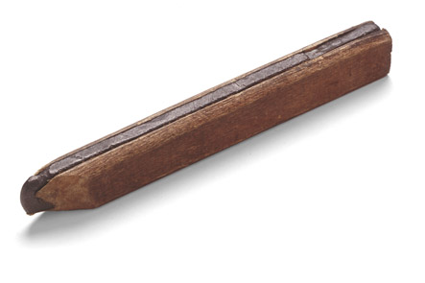
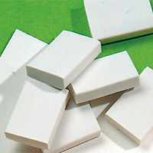
The Media History Project Timeline
Selected examples from media history
1565 - The pencil
1770 - The eraser
1858 - Eraser fitted to the end of a pencil
Good design and good products need more than good technology.
The clever bit is connecting cooperating technologies with people and the things they do.
http://mediahistory.umn.edu/timeline/
A carpenters pencil - the oldest known pencil found in the roof of a 17th-century German house.
Photo Sandra Suppa, FABER-CASTELL GmbH & Co., Germany

Slide 14
History of multimedia technological development
1975-79. First portable computer and games systems. Text input only.
1980-87. First personal computers for word processing, spreadsheets, games, slide shows. Basic interactivity. Better monitors with higher quality color graphics, increased storage.
1988-92. Faster processors, and more memory. Sophisticated GUI’s; interactive environments. Beginning of the WWW with HTML.
1993-2000. CD_quality audio and wide use of CD’s and DVD’s for data storage. 3D computer animation and virtual reality. Enhanced presentation software. The Web becomes interactive with GUI’s. Widespread internet access.

Slide 15
History of multimedia technological development
2001-2011. Extensive internet use with broadband Ethernet. All-in-one handheld devices for email, internet, phone, music and video. Game systems and smart phones with Wi-Fi and 3G access. Vast search capabilities. Real-time video conferencing and live news broadcasts. Video on demand. TV recording devices. Social networking. Rich multimedia presentation software. HD tv with Blu-ray technology. Downloadable music such as iTunes.

Slide 16
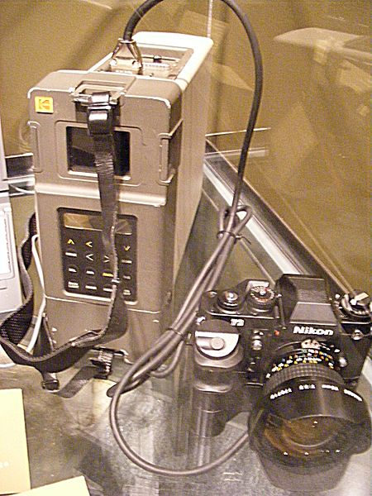
Digital Photography (an example of rapid evolution!)
Digital cameras use an array of light sensitive sensors to capture the image focused by the lens, as opposed to an exposure on light sensitive film
Digital cameras were introduced in the early 90’s by companies such as Kodak
Kodak DCS 100 came with a separate shoulder carried Digital Storage Unit (DSU) to store
The DSU contained a Winchester 200 megabyte hard disk drive that could store up to 156 images without compression
It cost $13000!
Kodak DCS100

Slide 17
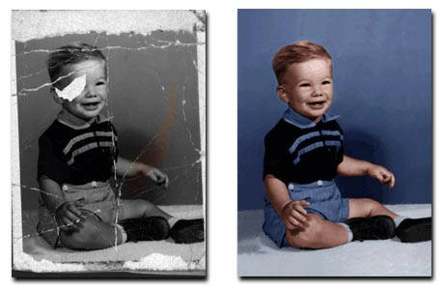
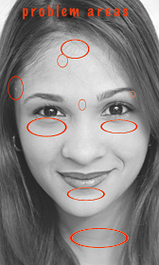
Digital Retouching
Digital photography made the retouching and manipulation of digital images is much easier and much more common.
Top: http://www.bigdigitalprints.com/prep2.html
Bottom: http://www.davidbeyda.com/digitalheadshotretouching.htm
Suzette Troche-Stapp : http://dyna-fx.com/dfx_community/viewtopic.php?p=11&sid=d99dc755a35bb508c2aec9b48bbcb759

Slide 18
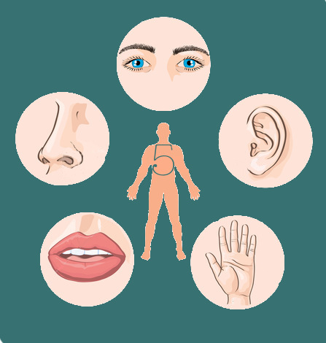
Multimedia and Human Perception
“How do humans perceive information”
We perceive information from what we see, what we hear, what we touch and what we smell
Visual media:
Text, graphics, images, video
Auditory media:
Music, sound and voice
We can input and output!
Touch
Haptic sensors
Smell
Electronic noses

Slide 19
How is this information represented?
The encoding used is of importance as it relates to the storage, interactivity, reproducibility, security and transmission of the data
Several options:
Text is encoded in ASCII
An audio data stream in PCM (Pulse Coded Modulation)
Image in JPEG format
Video in MPEG format

Slide 20
Multimedia data classification
We can classify based on the way it is perceived (and not the internal representation)
Based on time-dimension in the representation space, media can be
Time-independent (Discrete)
Text, Graphics
Time-dependent (Continuous)
Audio, Video
Video, sequence of frames (images) presented to the user periodically.

Slide 21
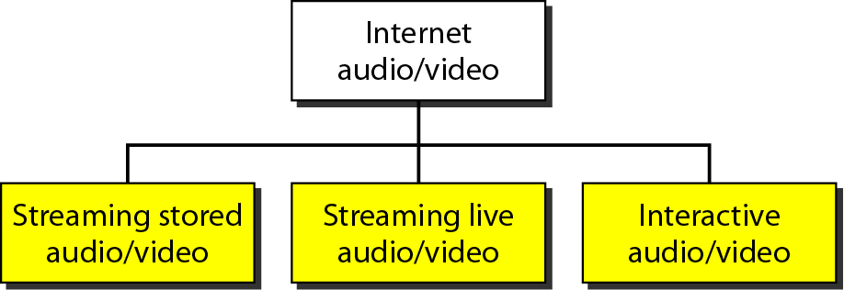
Multimedia presentation on the internet
We are now familiar with the internet being able to handle audio, and video content as well as text
We can stream content from the internet for a variety of applications
Streaming stored audio/video refers to on-demand requests for compressed audio/video files
Streaming live audio/video refers to the broadcasting of radio and TV programs through the Internet
Interactive audio/video refers to the use of the Internet for interactive audio/video applications
Video conferencing, Skype, VoIP etc
All of these applications require data compression

Slide 22
Multimedia presentation on the internet
The following are a couple of video clips are ‘low’ and ‘high’ compression:
‘Heads’ high compression ……
‘Heads’ low compression …....

Slide 23
Multimedia presentation on the internet
‘Horses’ high compression ……
‘Horses’ low compression ……

Slide 24
This concludes our very short course introduction to multimedia
In the next lectures we will consider human vision and image data in more detail.
Thank
You

