Slide 1
Human/Computer Vision and Introduction to Image Data
An introduction to human vision and a short introduction to image data.
Dr Mike Spann
http://www.eee.bham.ac.uk/spannm
M.Spann@bham.ac.uk
Electronic, Electrical and Computer Engineering

Slide 2
The Human Visual System (HVS)

Slide 3
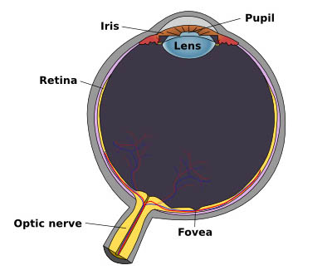
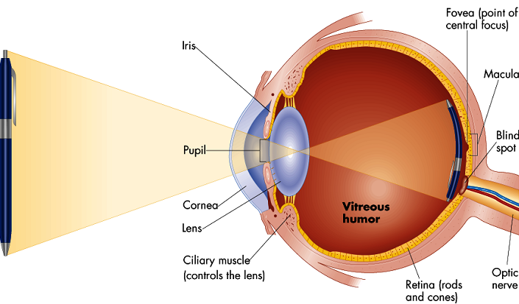
The Human Vision System (HVS)
The human vision system (HVS) is an extremely sophisticated multi-stage process.
The first steps in the sensory process of vision involve the stimulation of light receptors in the retina to create an image signal.
Electrical signals containing the vision information from each eye are transmitted to the brain through the optic nerves.
The image information is processed in several stages, ultimately reaching the visual cortex of the cerebrum.
We see with our brain not our eyes!

Slide 4
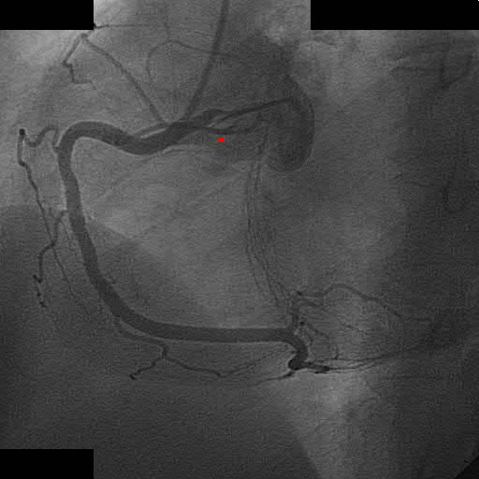
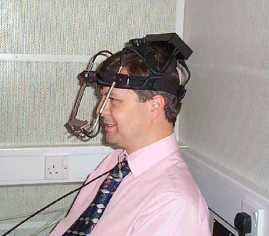
The Human Vision System (HVS)
The eye can adapt to a huge range of intensities from lowest visible light to highest bearable glare.
The eye uses two types of discrete light receptors.
  6-7 million centrally located cones are highly sensitive to colour and bright light.
  75 million rods across the surface of the retina are sensitive to light but not colour.
Eye movements include steady fixations and extremely rapid movements called saccades. These movements can be captured by carefully calibrated cameras directed on the eye
  We used an eye tracking system in a recent research project to determine how a cardiologist views digital angiograms
Above : A cardiologist examining a coronary angiogram.
Above right: http://www.wiu.edu/users/mfmrb/PSY343/SensPercVision.htm

Slide 5
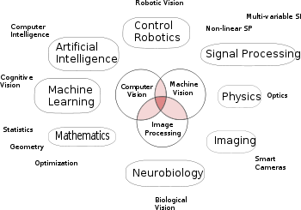
Computer Vision
Computer vision is a very active research area trying to build systems which can use visual information to perform a task
  It’s very much a multi-disciplinary research field
Applications include
  Medicine
  Robotics
  Manufacturing
  Space exploration
  Television
  Sport
  Visual surveillance

Slide 6
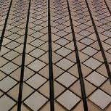
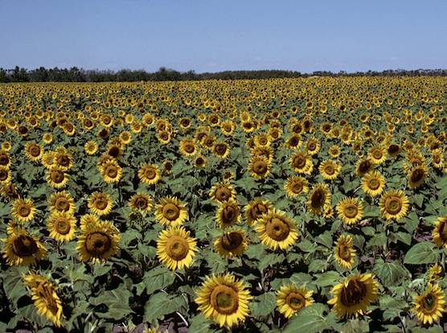
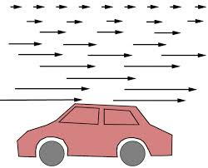
Computer Vision
A key challenge of computer vision is to infer 3D information (position/motion) from a 2D image
The HVS is especially good at this
  It can seamlessly combine visual cues
    Stereo
    Motion/parallax
    Texture gradients

Slide 7
Computer Vision
Stereo vision uses 2 cameras to infer depth from a scene
  Based on a perspective projection camera model
  The distance between 2 corresponding points in the image plane (x_{L} – x_{R}) depends on the depth Z
  The ‘trick’ is to find the corresponding points
    Inferring the depth then just depends on the calibrated camera parameters
P( X , Y , Z)

Slide 8
Magic Eye (Stereogram)
Originally a stereogram (invented by Bela Julesz) consisted of 2 images of random dots with one image slightly shifted
  By ‘fusing’ the 2 images, the perception of 3 could be obtained
  Some 20 years later, his student, Chris Tyler, realized the same effect could be obtained with a single image
  The vision science behind the magic eye is a bit complicated (and the algorithm to produce them is patented) but relies on the fact that to get the 3D effect, we focus either behind or in front of the image
Normal focus
Focus behind the image

Slide 9
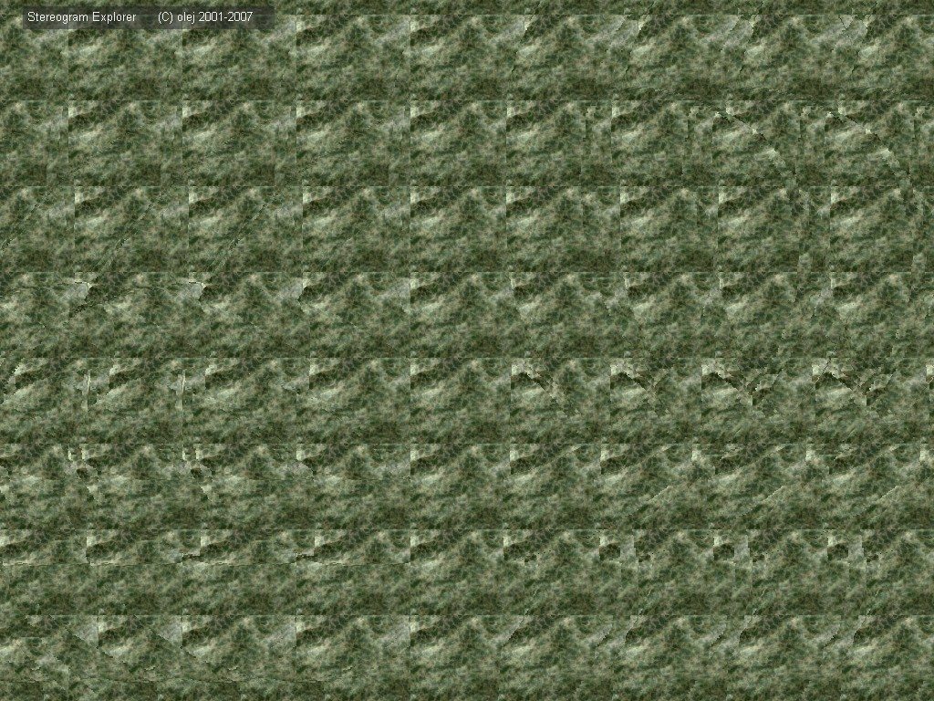

Slide 10
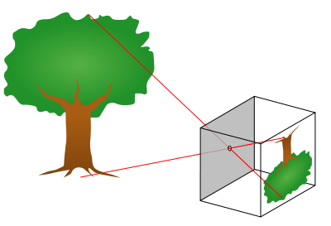
Pinhole Camera Geometry
Pinhole camera geometry is very simple but leads to big problems in 3D computer vision applications
  Perspective projections
  Non-linear in depth Z
  The solution is to introduce a new coordinate system
  Projective (or homogenous) coordinates turn non-linear equations into linear equations
    Nice simple matrix/vector operations!
Y
f
y
Z

Slide 11
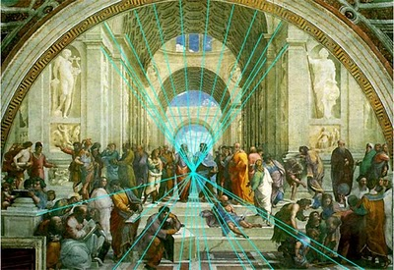
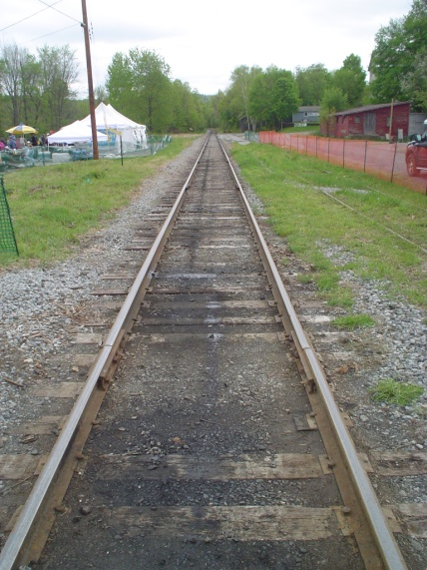
Perspective
Artists knew how to accurately represent perspective (in other words rendering a 3D scene on a 2D canvas) by about the 15th Century
  Perspective is the rein and rudder of painting" - Leanardo de Vinci
It was several hundred years later that mathematicians introduced projective geometry enabling the study of shapes in the projective plane
  For example, parallel lines meet at a vanishing point
V
Parallel lines meet at the vanishing point V

Slide 12
Perspective and Vanishing Points
Being able to compute the vanishing point in an image gives important 3D information
The projection of points on a line in 3D is a line in the image (in 2D)
The vanishing point is where 2 projected lines of 2 parallel lines (in 3D) meet
We can show that the vanishing point only depends on the direction of each line in 3D
  A simple example of 2D -> 3D
image plane
vanishing point v
camera
center
C
line in 3D
image plane
vanishing point v
camera
center
C
line
line

Slide 13
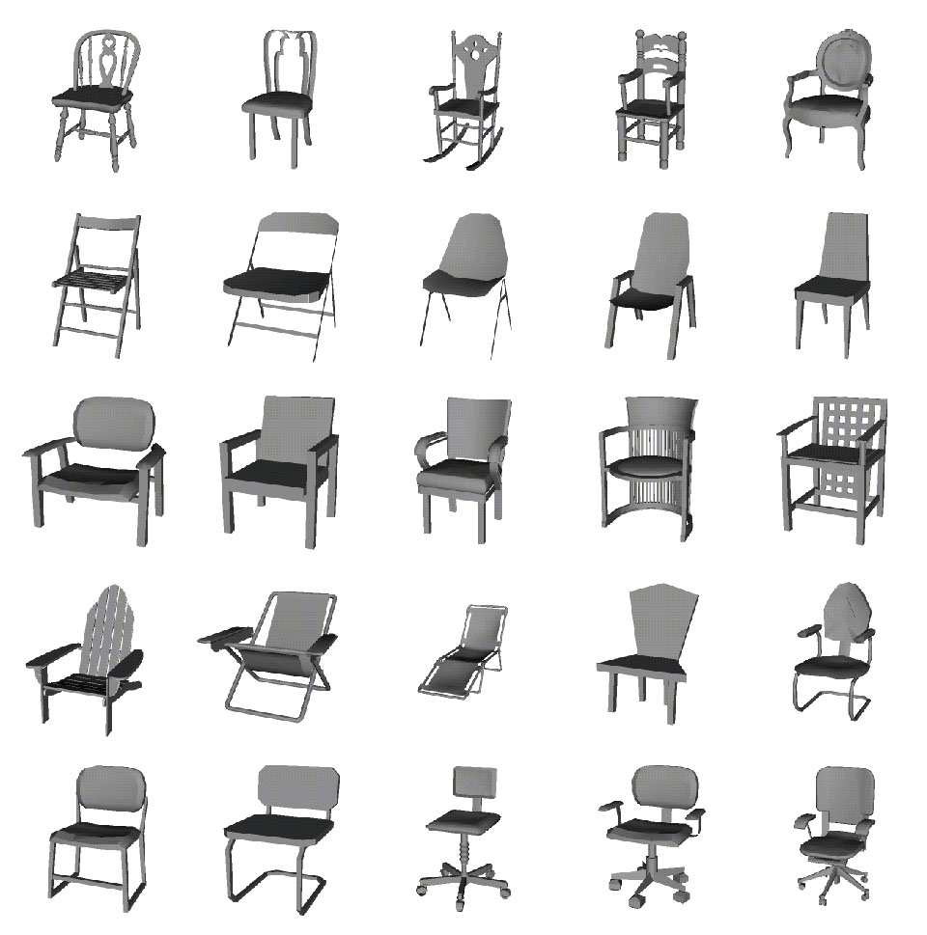
Recognizing Objects
This is another key challenge in computer vision
  A chair is a chair but for a computer vision system, it can come in many shapes and sizes!
  Human vision has an amazing capacity to give objects with widely differing appearance the same label
  Combines information gained from features in the image with stored cognitive models

Slide 14
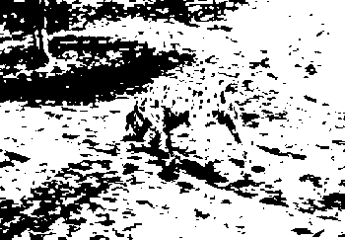
Perception: What do we really see?
Sometimes the image information is sparse or confusing
Human vision will still attempt to ‘fit’ a cognitive model
This is beyond the scope of our course but we can look at just a few examples to demonstrate how what we may perceive can vary from what we see

Slide 15
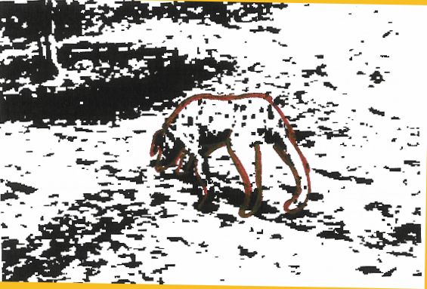
Interpreting Images
A
Dalmatian dog?

Slide 16

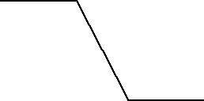
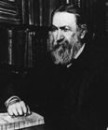
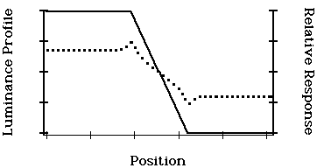
Mach Bands
"The Mach band effect" (studied by Ernst Mach in the 1860s) describes the illusion of an exaggeration of contrast at edges.
The light and dark bars at the edge of the intensity transitions below do not exist. The intensity gradient is linear as shown underneath.

Slide 17
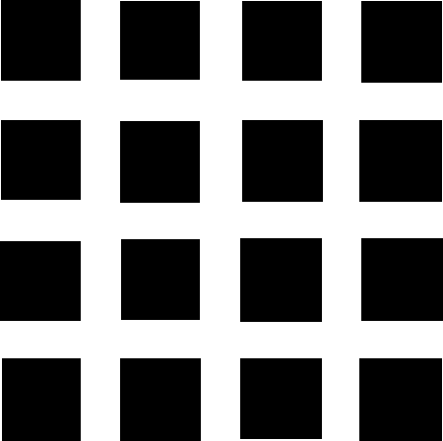
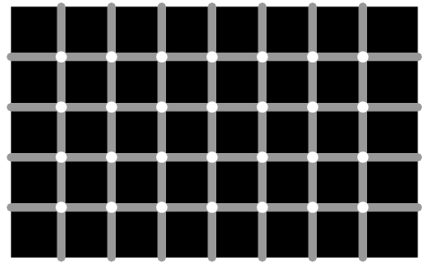
Scintillation Grid
Can you see black dots?
Black dots appear to form and vanish at the intersections of the gray horizontal and vertical lines.
Our peripheral vision involves something called lateral inhibition (a kind of tuning of brightness like the brightness setting on our computer or television).
Read more at http://www.brainconnection.com/teasers/?main=illusion/hermann and http://en.wikipedia.org/wiki/Hermann_grid_illusion

Slide 18
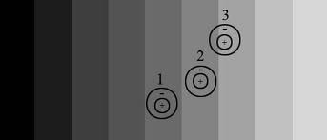
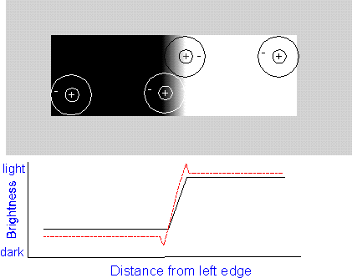
Explanation of Mach bands
Both Mach bands and the scintillation grid can be explained in terms of the response of the retina’s photo-receptors
  These receptors have an excitatory central region and an inhibitory surrounding region
  The stronger the luminance falling on an excitatory (inhibitory) region of the cells receptive field the stronger the positive (negative) response of that region
  A similar approach is used to design filters in image processing

Slide 19
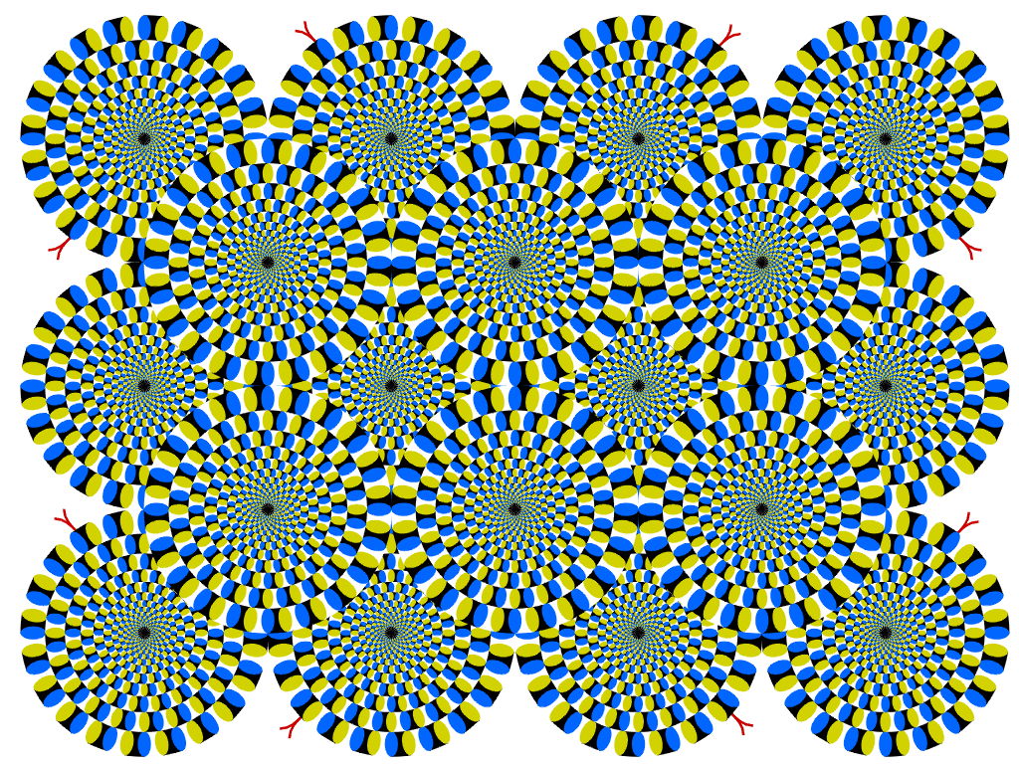
Kitaoka Rotating Illusion
Do you see the circles rotate when you read the text?
This is a beautiful demonstration of peripheral drift.
More beautiful rotating illusions at http://www.ritsumei.ac.jp/~akitaoka/rotate-e.html
“Rotating Snakes” Copyright A.Kitaoka 2003 (September 2, 2003)

Slide 20
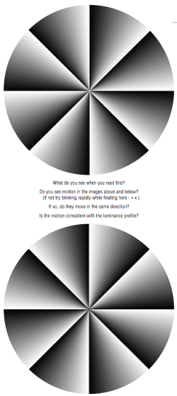
Peripheral Drift
The peripheral drift illusion is easily seen when fixating off to the side, and then blinking as fast as possible.
Most observers see the illusion more easily when reading text with the illusion figure in the periphery.
Motion is consistently perceived in a dark-to-light direction, so the two circles to the right should spin in opposite directions.
The precise reason for the motion illusion is still of research interest.
.... “Two recent papers have been published examining the neural mechanisms involved in seeing the PDI (Backus & Oruç, 2005; Conway et al., 2005). Faubert and Herbert (1999) suggested the illusion was based on temporal differences in luminance processing producing a signal that tricks the motion system. Both of the recent articles are broadly consistent with those ideas, although contrast appears to be an important factor (Backus & Oruç, 2005)”.
Image copyright Wikipedia http://en.wikipedia.org/wiki/Peripheral_drift_illusion

Slide 21
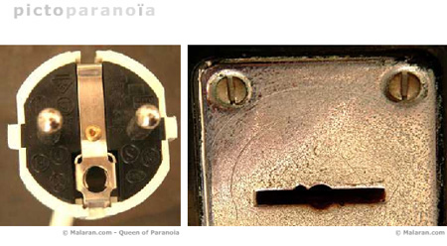
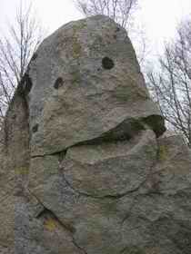
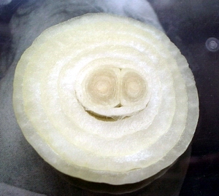
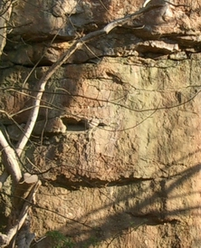
And Finally .... Seeing Faces?
The human visual system is especially good at picking out and analysing things that look like faces.
  A phenomenon known as Pareidolia
  http://www.geekosystem.com/things-that-look-like-faces-pareidolia/
Even at a distance we can interpret the direction of a person’s gaze.
High image and video quality is especially desirable for human faces.
http://www.healingtaobritain.com/p42-magazine-portrait-gallery.htm

Slide 22
Digital Image Data

Slide 23
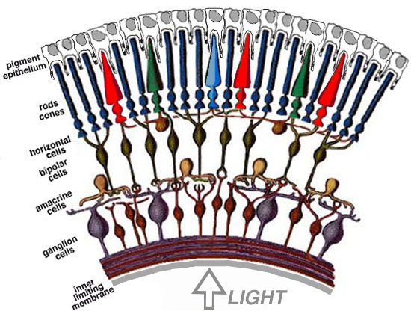
Retinal Images
Photoreceptors (rods and cones) in the retina trigger according to the intensity and spectral content of the light falling on them
  Sampling is non-uniform and sampling regions are overlapping
  Results in foveal and peripheral vision
Light must penetrate the thickness of the retina to fall on the photoreceptors (rods and cones)
The retinal image is transmitted to the brain via the optical nerve from the spiking discharge pattern of the ganglion cells

Slide 24
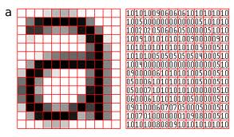
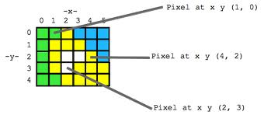
Digital images
Computer images are usually rectangular grids of pixels representing the average luminance or colour over that small region
Usually indexed by spatial coordinates (x,y)
  There are TWO easy ways to confuse pixel locations.
    Mixing up numbers that start at (0,0) with ones start at (1,1).
    Mixing (x,y) notation and (row, column). (row, column) is (y,x).

Slide 25
Producing a Digital Image

Slide 26
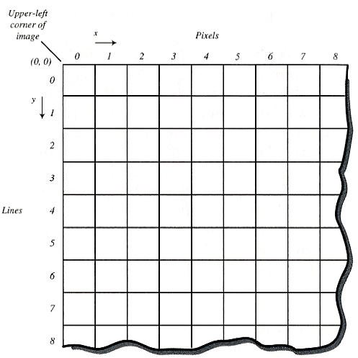
Image Pixels
Image pixels form a natural matrix that we can easily label.
The picture on the right shows the pixels labelled as (x,y).
Starting at the top left at (0,0) x increases in the horizontal direction and y increases vertically down.
We could label them differently if we wanted. The important thing is that we can unambiguously identify them.

Slide 27
Image Quantisation
Images are quantised spatially
  Each pixel has a ‘size’
  The smaller the size, the greater the ‘sampling rate’
  We need the sampling rate to be high enough to notice fine detail in an image
    Aliasing
Images are also quantised in greylevel (luminance) or colour
  Each greylevel value or colour channel value has a finite number of bits (8) to represent it
  It’s surprising how we can still recognize what the image using just 1 bit per pixel!

Slide 28
Image Quantisation
Demonstrating the effect of spatial quantisation
Demonstrating the effect of greylevel quantisation
Demonstrating the effects of aliasing

Slide 29
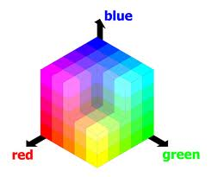
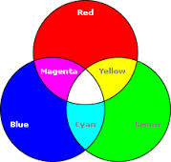
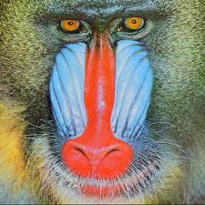
Colour Images
A full colour image is represented as a 24 bit per pixel RGB image
  Often an ‘alpha’ channel is included which represents transparency
For a reasonably sized image (say 512 x 512 pixels), this occupies ¾ of a mega byte
  Often the colours are quantized using sophisticated algorithms such that fewer colours are required
  The ‘RGB’ cube is partitioned into a number of regions
  Typically 256 with no loss of visual quality
Converting from a colour to greylevel is easy
  Typically a linear function of R,G and B

Slide 30
Colour Quantisation
Demonstrating colour quantisation
Demonstrating colour to greylevel projection

Slide 31
A Simple Image
320
This mouse image has 320x200 pixels.
It is an 8-bit greyscale test image. We will consider colour later.
8 bits per pixel (bpp) means we have 256 intensity values (black=0 white = 255).
The histogram below shows the number of pixels (y-axis) for each intensity (x-axis).
The x-axis plots intensity from black=0 to white=255.
200
No. pixels
Intensity

Slide 32
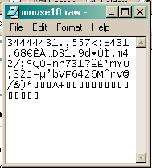
Mouse at 10x10 pixels
A raw image file is the simplest type of image file. It has no header information and it is not compressed
  Captured by digital cameras although saved as a ‘formatted’ image file such as JPEG
This is mouse at just 10x10 pixels.
The 10x10 image of mouse simply contains only 100 continuous 8-bit bytes (these are shown open in a text editor below mouse.)
If we try to open a raw file in an imaging application it would need to be told the dimensions of the image. Not all imaging applications support raw image files.

Slide 33
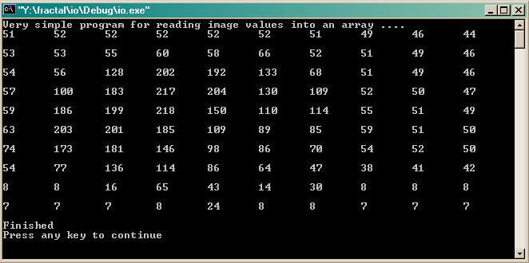
Accessing Pixels
If we wanted to read (or manipulate) image pixel values we could write a simple program to open the file.
This is an example of output from a simple program that prints out the 100 pixel values of mouse in 10 rows of 10.
Notice that the darkest regions at the bottom of the image are represented by very low values as you would expect. Similarly the lighter regions of mouse have high values (200 and above).

Slide 34

Image File Formats
Whilst the ‘raw’ image format is the simplest, it is usually converted before processing
There are many other file formats
  Typically classified into uncompressed, compressed and vector formats
PNG, JPEG (JPG), and GIF formats are most often used to display images on the Internet
  GIF uses lossless compression and is usually used for simple graphics images with few colours and for animations
  JPEG supports lossy compression where the visual quality can easily be altered
  PNG uses lossless compression and is fully streamable with a progressive display option so used a lot in web browsers
BMP (bitmap) format only supports lossless compression and leads to large file sizes

Slide 35
Image Processing Software
Paintshop, ImageJ and FastStone are examples of useful image processing/graphics editing applications.
The image on the right shows mouse in PaintShop after it has been lightened. Notice the histogram has moved to the right (remember black=0 and white=255)

Slide 36
Comparing Histograms
Notice the different histogram for this cheetah image.
This image uses a wider range of intensity values than the mouse image.
The mouse image was a very simple image. “Real world” images are usually more complex. They tend to have histograms more like cheetah’s, i.e., flatter, because they contain a wider range of pixel values.

Slide 37

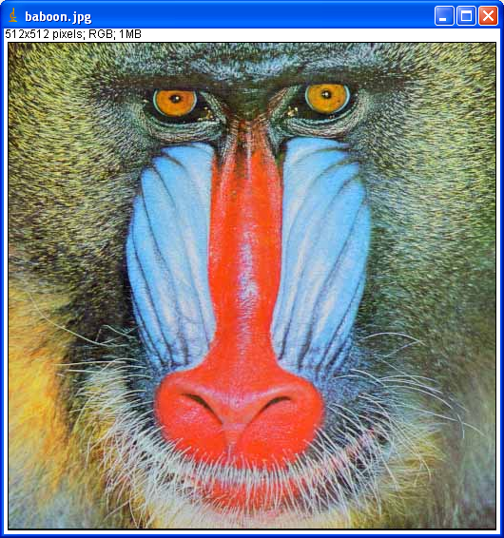
ImageJ
ImageJ is a Java based platform for demonstrating image processing techniques
I can run it as an applet to give live image processing demos
  An applet is a Java program which can be run by a web browser
ImageJ is also a good tool for testing out image processing algorithms
  Its easy to attach Java programs to the GUI and call them from the Plugins menu item

Slide 38
ImageJ demo
http://rsb.info.nih.gov/ij/signed-applet/

Slide 39
This concludes our brief discussion of human vision and image data
In the next lectures we will look at some aspects of image processing
You can find course information, including slides and supporting resources, on-line on the course web page at
Thank
You
http://www.eee.bham.ac.uk/spannm/Courses/ee1f2.htm

