Slide 1
Multimedia Data
Introduction to Image Processing
Dr Mike Spann
http://www.eee.bham.ac.uk/spannm
M.Spann@bham.ac.uk
Electronic, Electrical and Computer Engineering

Slide 2
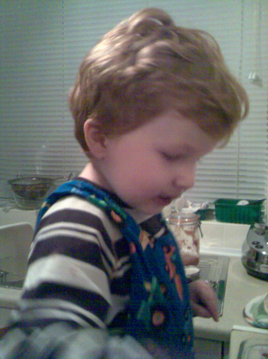

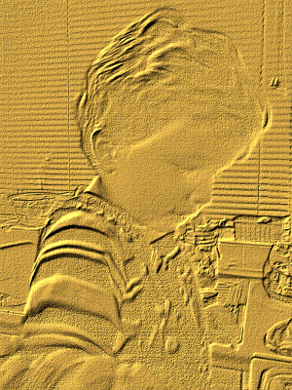
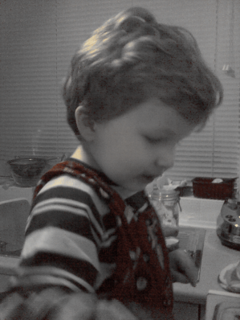
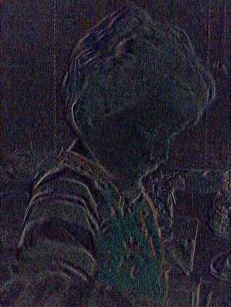
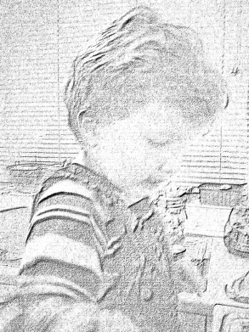
Image Processing Content
Image histograms, histogram equalization and image frequency content.
Low level image processing
  Brightening, darkening, thresholding and quantizing
Simple filtering examples
  Simple low-pass and high-pass filters
  Median filtering
Examples and demonstrations will be included in the lecture session.

Slide 3
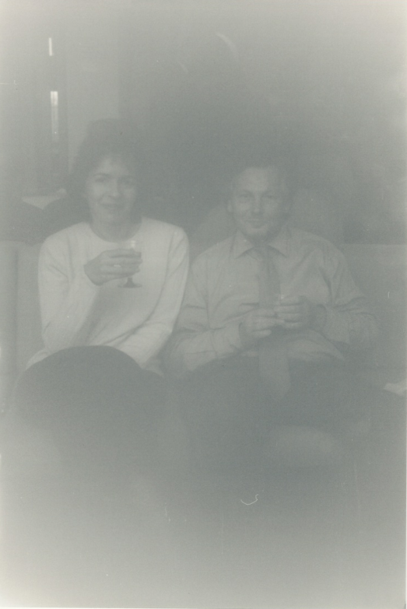
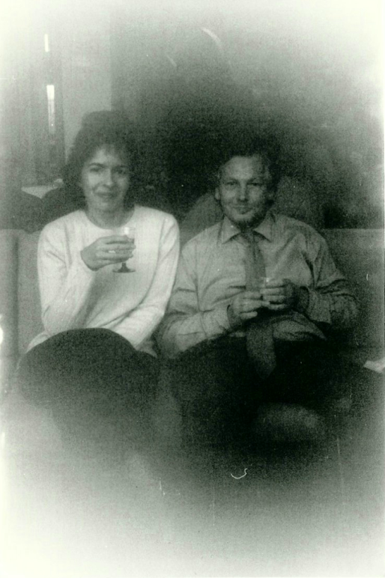
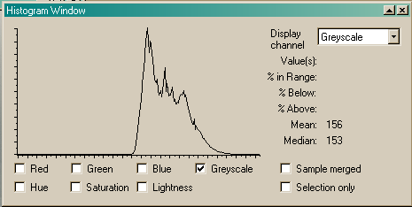
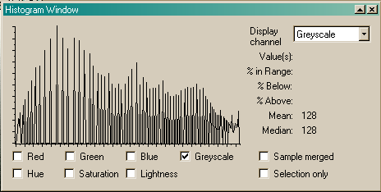
Histogram Equalization
Histogram equalization can be very useful for improving image contrast by spreading pixel values across the full dynamic range.
Ideally, pixels would use a wide range of values.
See the underexposed photograph on the left. Its image histogram shows that the intensity values have a compact range between mid to light grey.
The histogram equalized photograph on the right has better contrast. Its histogram has the same shape as the original but is stretched across the full range of intensity values.

Slide 4
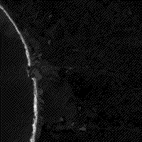
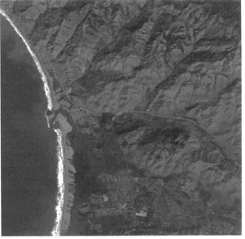
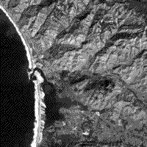
Histogram Equalization
Examples from http://rst.gsfc.nasa.gov/Sect1/Sect1_12a.html
Left: a low contrast original image.
Middle: the image after linear equalization.
Right: the image after selected emphasis to a range of values of interest.
Low contrast
Higher contrast
Selective high contrast

Slide 5
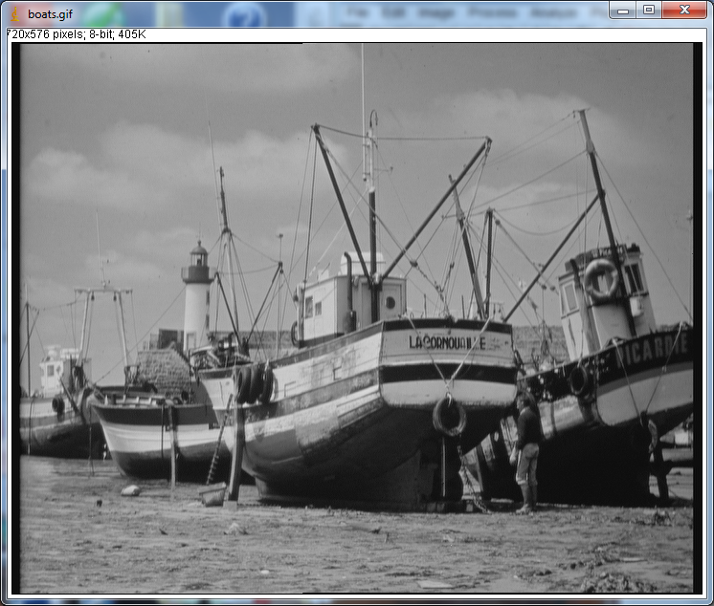
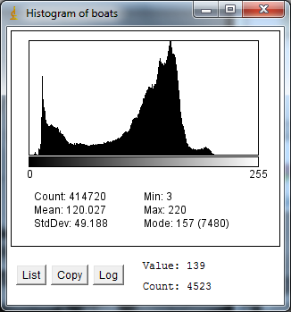
Image Histograms
We can look at a simple and efficient algorithm to perform image equalisation
  But first we need to formally define what me mean by a histogram and how we compute it across an image
  The histogram h(i) of a grey scale image is simple the number of pixels with greylevel equal to i
  In effect h(i) is an array with 256 entries for an 8 bit greyscale image
  One simple thing we can say about the histogram is that if we add up all the entries, we will get the number of pixels in an image
    We can compute other more interesting measurements from the histogram

Slide 6
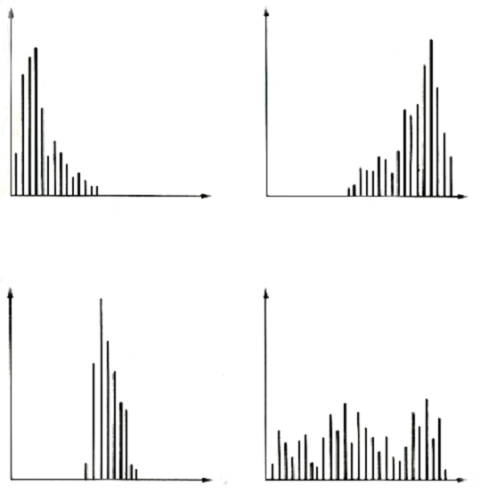
Image Histograms
It is easy to count the numbers of pixels at different intensity values to produce histograms.
These histograms give us useful information about the dynamic range of the image data.
The wider the spread of pixel intensities the higher the contrast.
Dark
image
Light
image
Number of pixels
Intensity
Low-contrast
image
High-contrast
image

Slide 7
Computing the Histogram
There is a simple and efficient way of computing the histogram
Just involves a single sweep through the image
We can describe the algorithm in pseudo-code
Easy to translate into C or any other programming language
foreach i=0..255
hist(i)=0
foreach pixel (x,y)
i=image(x,y)
hist(i)=hist(i)+1

Slide 8
The Histogram Equalisation Algorithm
The histogram equalisation algorithm is a simple method of increasing the contrast in an image
  The histogram of a low contrast image occupies a narrow range of possible greyscale values
  We want to stretch (equalise) the histogram such that it occupies the full range of possible greyscale values
  Based on a ‘lookup’ function g(i)
i
g(i)
g(i)
i

Slide 9
The Histogram Equalisation Algorithm
A ‘lookup’ function (or table) g(i) is a simple input -> output mapping
  Very efficient to implement in hardware or software
  It is a set of stored number indexed by the input i
  g(i) defines the mapped output of input i

Slide 10
The Histogram Equalisation Algorithm
We need to design a lookup function g(i) that ‘stretches’ the dynamic range of grey levels in the image histogram
We have to think carefully about g(i) as, after applying it, the histogram still has to meet it’s constraints
  Simplest constraint is that the histogram of the image after applying the lookup function must still ‘contain’ N² pixels (for an N x N image)

Slide 11
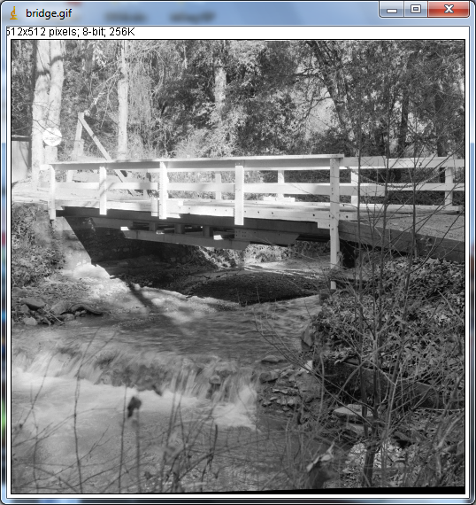
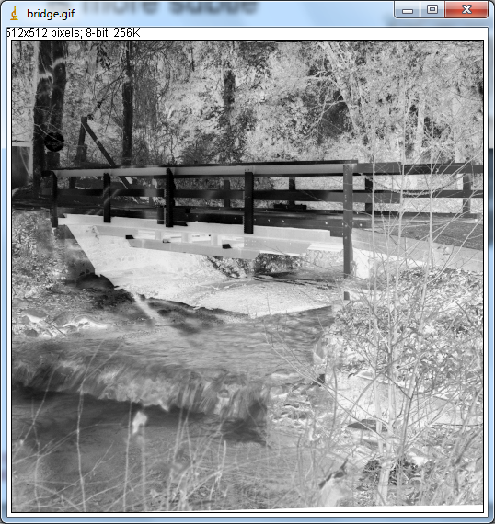
The Histogram Equalisation Algorithm
The second constraint is more subtle
  We don’t want to create an image that looks like a photographic negative
  Grey levels can’t cross when we apply the lookup function
  Mathematically we can write this as :
A ‘legal’ lookup function

Slide 12
The Histogram Equalisation Algorithm
Before we describe the algorithm we need to define one other simple image measure related to the histogram h(i)
  The cumulative histogram H(i)
  H(i) is defined as the number of pixels with grey level less than or equal to i.
  It’s easy to compute H(i) from h(i)
    Just add up the histogram entries up to and including the i^{th}
    Mathematically:
    We also know that:
    Since computing the histogram is very efficient, so is computing the cumulative histogram
    We will see how our lookup function g(i) is simply defined in terms of H(i)

Slide 13
The Histogram Equalisation Algorithm
We can now derive the lookup function which performs our histogram equalisation
Let the actual histogram and cumulative histogram be h(i) and H(i)
Let the desired histogram and desired cumulative histogram be h’(i) and H’(i)
Let the transformation be g(i)
The ‘optimum’ h(i) is a constant occupying the full dynamic range of grey levels
  This makes the ‘optimum’ corresponding H(i) a ramp function
H’(i)
h(i)
i
g(i)
g(i)
h’(i)
H’(i)

Slide 14
The Histogram Equalisation Algorithm
We can now derive the histogram equalisation algorithm
We apply the key constraint of non-crossing over of grey levels after application of g(i)
  Gives us the final expression for g(i) in terms of H(i)

Slide 15
Worked example
A simple worked example will show how we apply g(i)
32 x 32 bit image with grey levels quantised to 3 bits
  We can see from the last column how the histogram occupies a much wider band of grey levels
0
197
197
1.35→1
-
1
256
453
3.10→3
197
2
212
665
4.55→5
-
3
164
829
5.67→6
256
4
82
911
6.23→6
-
5
62
993
6.65→7
212
6
31
1004
6.86→7
246
7
20
1024
7.0→7
113

Slide 16
Histogram Equalization
ImageJ demo
  http://rsb.info.nih.gov/ij/signed-applet/

Slide 17


Frequencies in Images
The image histogram tells us nothing about the distribution of pixel intensities in an image.
For example, a “U” shaped histogram with peaks around black and white values could be either of the images below.
We can refer to the frequency content of an image.
Smooth areas are low frequency.
Edges and other rapid changes are high frequency.
increasing
frequency
These images have
the same histogram.
increasing
frequency

Slide 18
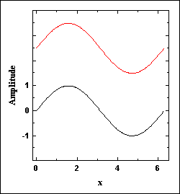


Frequencies in Images
Signals are often efficiently represented by the addition of simple sine or cosine waves.
But there’s a problem. If we try to create a SQUARE shaped wave using these simple waves, the ripples never go away. As we add smaller and smaller amounts of higher frequency sine waves we still have ripples.
The animation on the right shows the result of adding sine waves of higher and higher frequency. The sine wave is shown on the top and the sum of all the waves is shown on the bottom. See how a rippled square shaped signal appears.
Images often contain many sharp edges just like the square wave. You can often see these rippling or ringing artefacts about edges in heavily compressed images and video.
http://www.numerit.com/samples/fours/doc.htm
Demonstration of ringing www.utdallas.edu/~dxa081000/IMAGEFILTERING.ppt

Slide 19
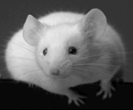

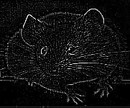
Filtering Frequencies
We can adjust the amount of frequencies in signals and images.
Low-pass filtering preserves (passes) lower frequencies but drops higher frequencies.
High-pass filtering preserves (passes) higher frequencies but drops lower frequencies.
Both high- and low-pass filters have their uses. Low-pass filters can remove noise from poor quality images by smoothing. High-pass filters can usefully pick out edges.
Original
After low-pass filtering.
Appears smooth or blurred.
After high-pass filtering.
Edges remain.

Slide 20
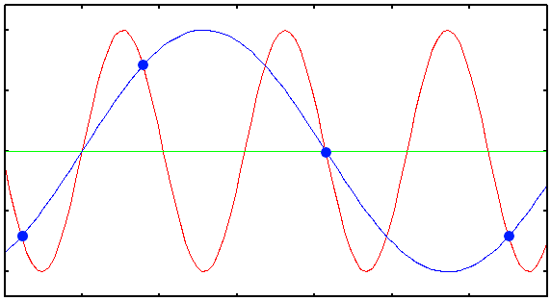
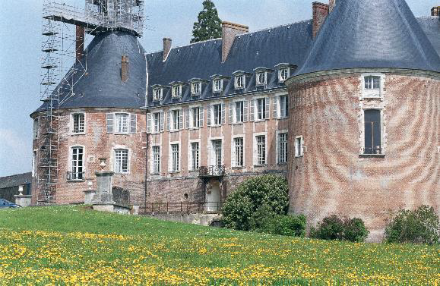
Aliasing
We have a fixed pixel spacing which defines the spatial sampling frequency
  We need to sample at a rate of at least twice per cycle of highest frequency signal in the image
    Nyquist’s theorem
  If we don’t we get ‘low frequency wraparound’ which produces artefacts in the image

Slide 21
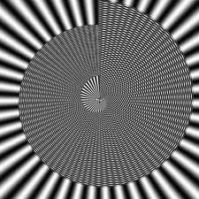
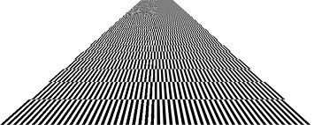
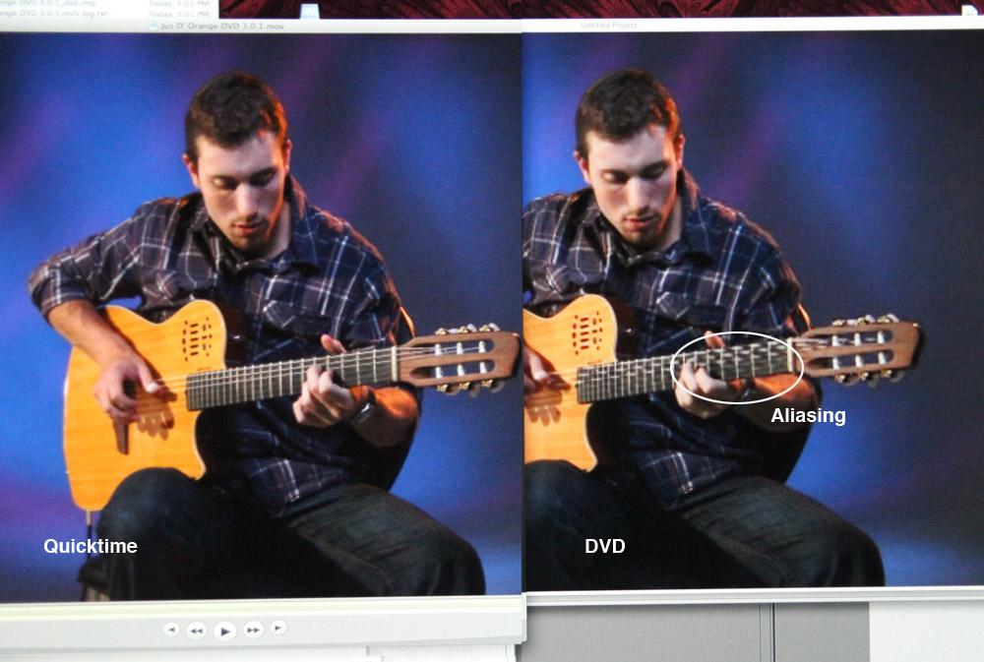
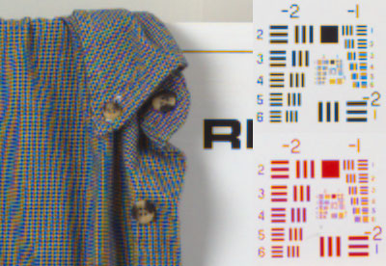
Aliasing
Below are a few examples of aliasing in images

Slide 22
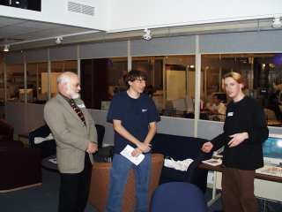
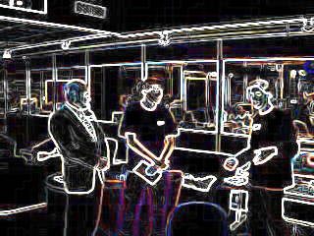
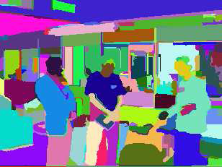
Image Processing
Low-level
  working at the pixel level, identification of edges
Medium-level
  identification of regions and shapes
High-level
  associating shapes with real objects.
Low
Medium
High

Slide 23
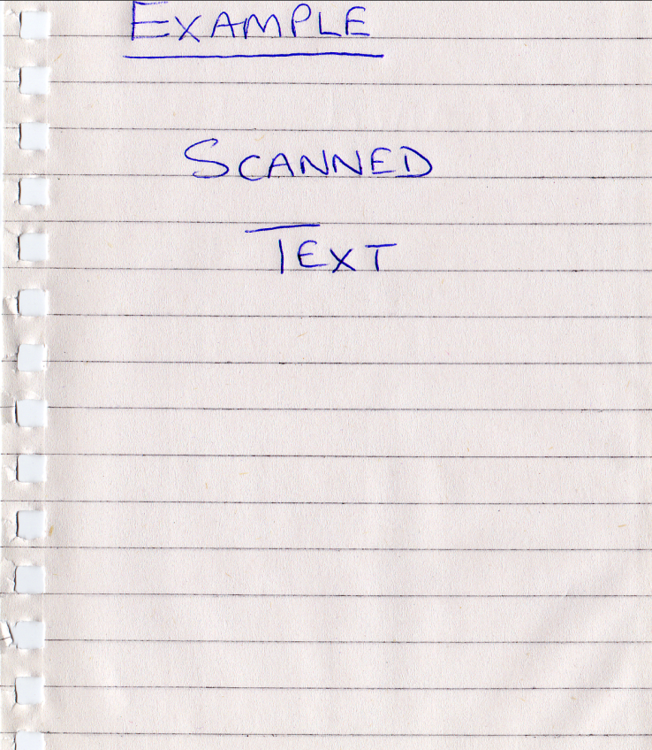
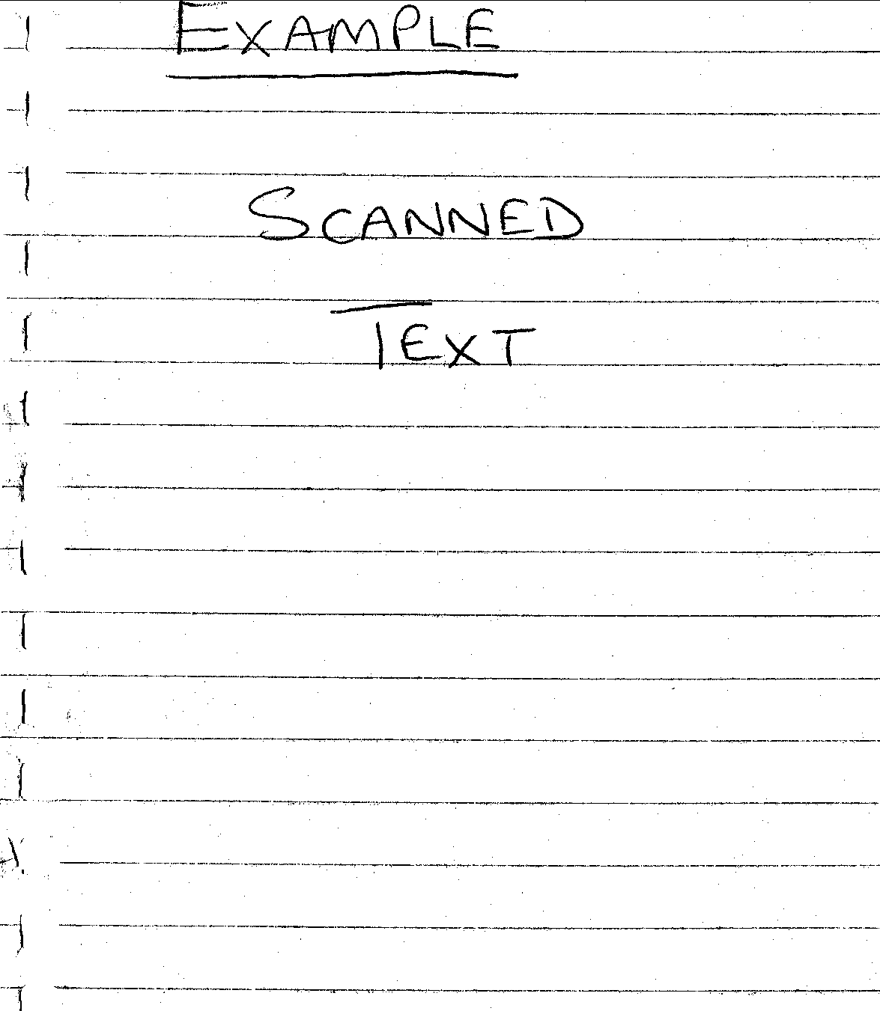
Low-level Image Processing Examples
Adjusting brightness
To lighten or darken images we can simply add or subtract a constant value from all pixel values.
Thresholding
Used to remove grey-levels in an image or segment components.
It involves changing pixel values if they are above or below a certain value (threshold).
For example, setting all pixel values below a threshold to zero and/or above a certain value to a maximum.
Example of simple thresholding
Before : top After : below
(threshold = 180)

Slide 24
Thresholding
Thresholding is a useful tool is extracting ‘objects’ from images
  Enables us then to, for example, measure the size distribution of objects (such as asbestos fibres or cells)
  Often applied interactively
ImageJ demo
  http://rsb.info.nih.gov/ij/signed-applet/

Slide 25
Simple Image Filtering

Slide 26
Operations on Images
Simple image operators can be classified as 'point-wise' or 'neighbourhood' (filtering) operators
Histogram equalisation is a point-wise operation
More general filtering operations use neighbourhoods of pixels
  Filtering operations are generally used to extract useful features from images such as edges
  Filters come in many shapes and sizes

Slide 27
Image Filtering
The output g(x,y) can be a linear or non-linear function of the set of input pixel grey levels {f(x-M,y-M)…f(x+M,y+M}.
  The function used defines the type of filter
  Typically filters are classified into linear and non-linear filters
  We will look in more detail at linear filters but we will also see an example of a useful non-linear filter
A 3x3 filter

Slide 28
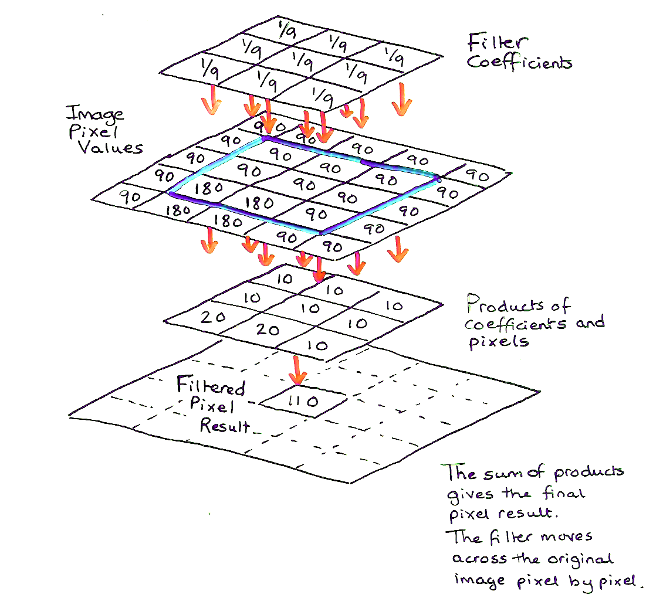
Template Operations
Templates (in this context) are arrays of values.
Here are 3 examples;
They are very useful as simple image filters.
For example, for image smoothing or edge detection.

Slide 29
Template Operations
We apply a template filter to the image using a convolution operation.
Convolution involves moving the template step-by-step over the image creating a window over pixel neighbours. This will be demonstrated in the lecture.
Template and pixel values are used for computation (typically multiplication and addition) at each step. This process is referred to as convolution of the template with the image.
You will see that the new result is smaller than the original. We could avoid this by wrapping edges together (periodic convolution) .

Slide 30
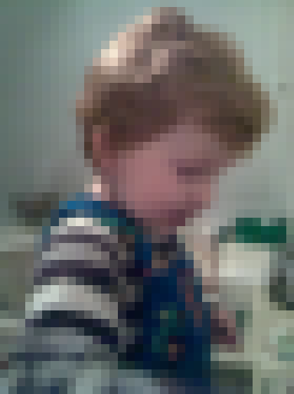

Common Templates
This is a simple 3x3 averaging (smoothing/blurring) template :-
It is an example of a low-pass filter. It passes low frequency and removes high frequency.
Left: A low resolution original image.
Right: After 3x3 averaging filter.
Notice the blurring effect.
This is caused by the averaging of pixels across every block of 9 pixels.
In a higher resolution image the effects would be less noticeable for such a small filter.

Slide 31




Common Templates
This is a simple high-pass filter.
Both high- and low-pass filters have their uses.
Low-pass filters can remove noise from poor quality images by smoothing.
High-pass filters can detect edges. Horizontal edges, vertical edges and diagonal edges.
Simple examples of detected edges.
Top left: a low resolution original,Top right: horizontal edges
and Below left: vertical edges and Below right: All edges

Slide 32
Examples

Slide 33
Examples
ImageJ demo
  http://rsb.info.nih.gov/ij/signed-applet/

Slide 34
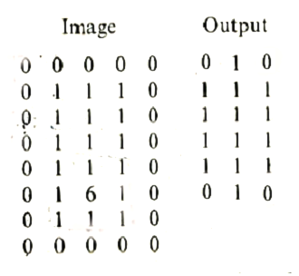
Median Filtering
Median filtering is useful for removing noise but usefully preserves edges.
  The median is the central value in a range
  Median {4,2,0,1,3,0,5} = 2
Median filtering is a popular filtering method. Pixel values are sorted and the median (middle value) is output.
Median filtering removes sparse outliers.
Sparse outliers appear as “salt and pepper” noise in images, i.e., dark pixels in light areas and light pixels in dark areas. This type of noise was common in analogue television.
You will use some simple filters in the laboratory. A median filter will be used to remove noise.
Passing a 3x3 median filter over the image pixels shown above on the right produces the output on the right.
Notice how the outlier (the 6) is removed.

Slide 35
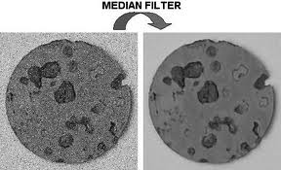
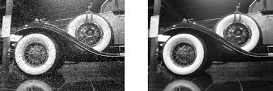
Median Filtering examples
Median filtering is a useful tool as it can remove image noise but doesn’t interfere with useful image detail
  The downside is that, although there are computational ‘speed ups’ that can be applied, there is no equivalent ‘fast’ algorithm to the Fast Fourier Transform (FFT) in linear filtering

Slide 36
Median Filtering
ImageJ demo
  http://rsb.info.nih.gov/ij/signed-applet/

Slide 37
This concludes our introduction to image processing.
You can find course information, including slides and supporting resources, on-line on the course web page at
Thank
You
http://www.eee.bham.ac.uk/spannm/Courses/ee1f2.htm

