Slide 1
Multimedia Data
Introduction to Data Compression and Lossless Compression
Dr Mike Spann
http://www.eee.bham.ac.uk/spannm
M.Spann@bham.ac.uk
Electronic, Electrical and Computer Engineering

Slide 2
Content
An introduction to data compression
  Lossless and lossy compression
  Measuring information
  Measuring quality
    Objective and subjective measurement
    Rate/Distortion graphs
An introduction to lossless compression methods including:-
  Run-length coding
  Huffman coding
  Lempel-Ziv coding

Slide 3

Optional Further Reading
The Data Compression Book
(recently out of print but several copies in our library)
Mark Nelson and Jean-loup Gailly,
M&T Books
2nd Edition.
ISBN 1-55851-434-1

Slide 4
What is Compression?
Compression is an agreement between sender and receiver to a system for the compaction of source redundancy and/or removal of irrelevancy.
Humans are expert compressors. Compression is as old as communication.
We frequently compress with abbreviations, acronyms, shorthand, etc.
A classified advertisement is a simple example of compression.
Lux S/C aircon refurb apt, N/S, lge htd pool, slps 4, £350 pw, avail wks or w/es Jul-Oct. Tel (eves)…
Luxury self-contained refurbished apartment for non-smokers. Large heated pool, sleeps 4, £350 per week,available weeks or weekends July to October. Telephone (evenings) …

Slide 5
The 40 Most Commonly Used Words
1 the
2 of
3 to
4 and
5 a
6 in
7 is
8 it
9 you
10 that
Ave. length
=2.4 letters
11 he
12 was
13 for
14 on
15 are
16 with
17 as
18 I
19 his
20 they
Ave. length
=2.7 letters
21 be
22 at
23 one
24 have
25 this
26 from
27 or
28 had
29 by
30 hot
Ave. length
=2.9 letters
31 word
32 but
33 what
34 some
35 we
36 can
37 out
38 other
39 were
40 all
Ave. length
=3.5 letters
Notice that more commonly used words are shorter

Slide 6
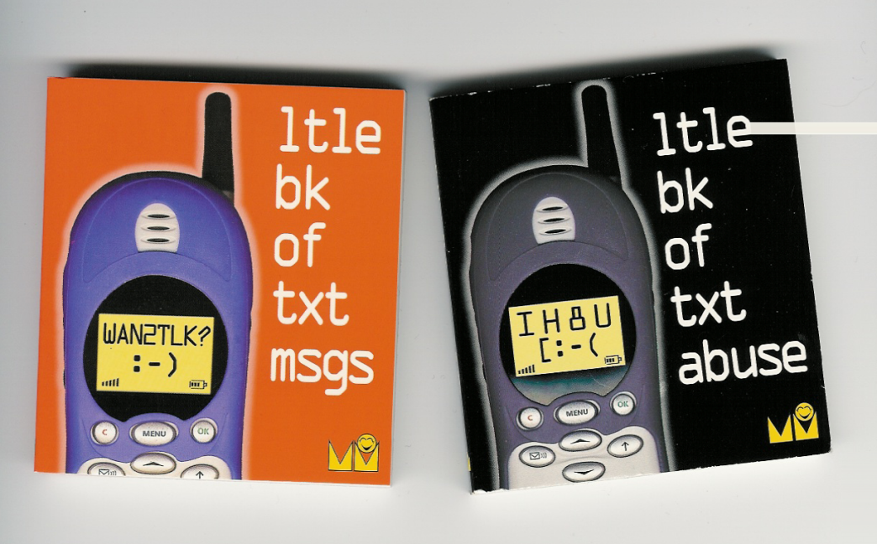
Text Message Abbreviation
IYSS
BTW
L8
OIC
PCM
TTFN
LOL
IYKWIMAITYD

Slide 7
Data Compression Trade-Offs
More
efficient (cheaper)
storage
and faster (cheaper)
transmission.
Coding delay
Legal issues (patents and licences)
Specialized hardware
Data more sensitive to error
Need for decompression ‘key’

Slide 8
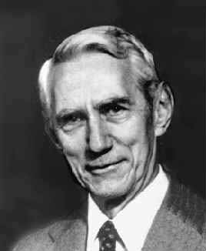
Measuring Information
The entropy of a source is a simple measure of the information content. For any discrete probability distribution, the value of the entropy function (H) is given by:-
(r=radix = 2 for binary)
The units of entropy are bits/symbol.
We can compare the performance of our compression method with the calculated source entropy.
Where the source ‘alphabet’ has q symbols of probability p_{i} (i=1..q).
Note: Change of base :
Note: Thermodynamic entropy measures the amount of disorder in a system and always increases in closed systems
Claude Shannon
1916-2001
Founder of information theory
Published
“A Mathematical Theory of Communication”
in the Bell System Technical Journal (1948).

Slide 9
Measuring Information
So what is H?
  H is the average ‘information’ emitted by the source per symbol
  The information of the i^{th} source symbol is log₂ 1/p_{i} (in bits)
    Essentially information is the measure of uncertainty of a symbol
    Or how many bits it takes to represent its outcome
Example – we throw a fair n-sided dice so the outcome is a number between 1 and n with equal probability p=1/n
  Takes log₂ n bits to represent the outcome (eg. n=8, 3 bits)
  Maximum uncertainty
If only ever 1 number comes up takes log₂ 1 = 0 bits to represent the outcome
  Zero uncertainty

Slide 10


Lossless and Lossy Compression
Lossless compression (reversible) produces an exact copy of original.
Lossy compression (irreversible) produces an approximation of original.
Lossy compression is used on image, video and audio files where imperceptible (or “tolerable”) losses to quality are exchanged for much larger compression ratios.

Slide 11
Lossless vs. Lossy Compression
Lossless compression achieves much less compression than lossy compression.
It can be difficult to get a lossless compression ratio of more than 2:1 for images, but most lossy image compression can usually achieve 10:1 without too much loss of quality.
Increasing lossy compression beyond specified limits can result in unwanted compression artefacts (characteristic errors introduced by compression losses).
Lossless
Lossy

Slide 12

Measuring “Quality”
How do we measure the “quality” of lossy compressed images?
Objective:- impartial measuring methods
Subjective:- based on personal feelings
We need definitions of “quality” (“degree of excellence”?) and to define how we will compare the original and decompressed images.

Slide 13
Measuring “Quality”
Objectively
E.g., Root Mean Square Error (RMSE)
  Calculates the root mean square difference of pixels in the original image f(x,y) and pixels in the decompressed image f’(x,y). Hence, RMSE tells us the average pixel error.
Subjectively
E.g., Mean Opinion Score (MOS)
  Observer opinion rated according to the scales below.
  The viewers personal opinion of perceived quality.
    5=very good … 1=very poor
    or...
    5=perfect, 4=just noticeable, 3=slightly annoying, 2=annoying, 1=very annoying

Slide 14
The Rate/Distortion Trade-Off
Rate distortion graphs are useful in clearly showing the trade-off between the bits per pixel and measured quality or error.
We would normally expect larger MOS values and smaller RMSE for more bits per pixel.

Slide 15
Optimizing the Rate/ Distortion
Quality can fall rapidly
When viewed full screen a significant drop in quality can be seen between these example images c-d-e.
Notice the relatively small change in compression ratio between images c) d) and e).
The images were compressed with a method called DCT.
CR = compression ratio, QF tells us the amount of quantization used to compress the image. QF=25 is the most lossy.

Slide 16
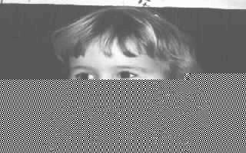
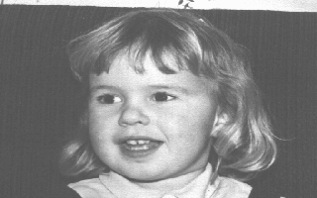
Compression and Channel Errors
Noisy or busy channels are especially problematic for compressed data.
Unless compressed data is delivered 100% error-free (i.e., no changes and no lost packets) the whole file is often destroyed.
Compress
Decompress
Errors can be introduced by the communication channel here.
Error starts here and propagates to the end of file.

Slide 17
Multimedia Data
Introduction to Lossless Data Compression
Dr Mike Spann
http://www.eee.bham.ac.uk/spannm
M.Spann@bham.ac.uk
Electronic, Electrical and Computer Engineering

Slide 18
Lossless Compression
An introduction to lossless compression methods including:-
  Run-length coding
  Huffman coding
  Lempel-Ziv

Slide 19
Run-Length Coding (Reminder)
Run-length coding is a very simple example of lossless data compression. Consider the repeated pixels values in an image …
000000000000555500000000 compresses to (12,0)(4,5)(8,0)
24 bytes reduced to 6 gives a compression ratio of 24/6 = 4:1
There must be an agreement between sending compressor and receiving decompressor on the format of the compressed stream which could be (count, value) or (value, count).
We also noted that a source without runs of repeated symbols would expand using this method.

Slide 20
Patent Issues
There is a long history of patent issues in the field of data compression. Even run length coding is patented.
From the comp.compression faq :
Tsukiyama has two patents on run length encoding: 4,586,027 and 4,872,009 granted in 1986 and 1989 respectively. The first one covers run length encoding in its most primitive form: a length byte followed by the repeated byte. The second patent covers the 'invention' of limiting the run length to 16 bytes and thus the encoding of the length on 4 bits.
Here is the start of claim 1 of patent 4,872,009, just for interest:
“A method of transforming an input data string comprising a plurality
of data bytes, said plurality including portions of a plurality of
consecutive data bytes identical to one another, wherein said data
bytes may be of a plurality of types, each type representing different
information, said method comprising the steps of: [...]”

Slide 21
Huffman Compression
Source character frequency statistics are used to allocate codewords for output.
Compression can be achieved by allocating shorter codewords to the more frequently occurring characters. For example, in Morse code
E= • Y= - • - -).

Slide 22
Huffman Compression
By arranging the source alphabet in descending order of probability, then repeatedly adding the two lowest probabilities and repeating, a Huffman tree can be generated.
The resultant codewords are formed by tracing the tree path from the root node to the codeword leaf.
Rewriting the table as a tree, 0s and 1s are assigned to the branches. The codewords for each symbols are simply constructed by following the path to their nodes.

Slide 23
Huffman Compression

Slide 24
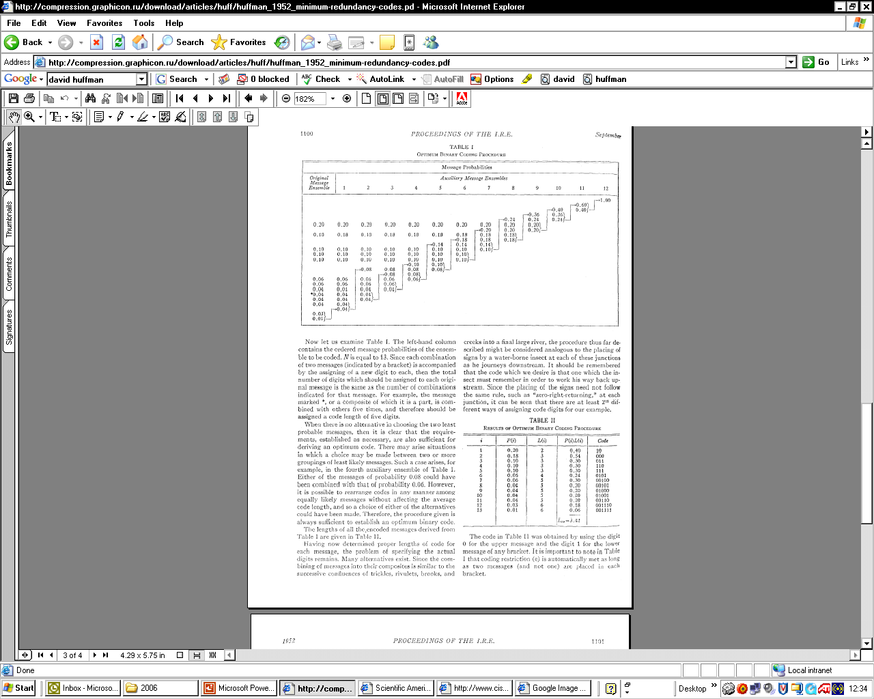
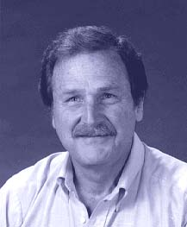
Is That All There is to it?
David Huffman invented this method in 1951 while a graduate student of Robert Fano. He did not invent the idea of a coding tree. His insight was that by assigning the probabilities of the longest codes first and then proceeding along the branches of the tree toward the root, he could arrive at an optimal solution every time.
Fano and Shannon had tried to work the problem in the opposite direction, from the root to the leaves, a less efficient solution.
When presented with his student's discovery, Huffman recalls, Fano is said to have exclaimed: "Is that all there is to it!"
From the September 1991 issue of Scientific American, pp. 54, 58.
Top right – Original figures from IRE Proc. Sept 1952

Slide 25
Huffman Compression
Questions:
What is meant by the ‘prefix property’ of Huffman?
What types of sources would Huffman compress well and what types would it compress inefficiently?
How would it perform on images or graphics?

Slide 26
Static and Adaptive Compression
Compression algorithms remove/exploit source redundancy by using some definition (model) of the source characteristics.
Compression algorithms which use a pre-defined source model are static.
Algorithms which use the data itself to fully or partially define this model are referred to as adaptive.
Static implementations can achieve very good compression ratios for well defined sources.
Adaptive algorithms are more versatile, and update their source models according to current characteristics. However, they have lower compression performance, at least until a suitable model is properly generated.

Slide 27
Lempel-Ziv Compression
Lempel-Ziv published mathematical journal papers in 1977 and 1978 on two compression algorithms (these are often abbreviated as LZ’77 and LZ’78)
Welch popularised them in1984
LZW was implemented in many popular compression methods including .GIF image compression and the Unix/Linux file compression utility compress
It is lossless and universal (adaptive)
It exploits string-based redundancy
It is not good for image compression (why?)

Slide 28
Lempel-Ziv Dictionaries
How they work :-
Parse data character by character generating a dictionary of previously seen strings
LZ’77 uses a sliding window dictionary
LZ’78 uses a full dictionary history
  Refinements added to the LZ’78 algorithm by Terry Welch in 1984
  Known as the LZW algorithm
LZ’78 Description
With a source of 8-bits/character (i.e., source values of 0-255.) Extra characters will be needed to describe strings in our dictionary. So we will need more than 8 bits.
Start with output using 9-bits. So now we can use values from 0-511.
We will need to reserve some characters for ‘special codewords’ say, 256-262, so dictionary entries would begin at 263.
We can refer to dictionary entries as D1, D2, D3 etc. (equivalent to 263, 264, 265 etc.)

Slide 29
Lempel-Ziv Compression
LZ’78 Description (cont)
  Simple idea of assigning codewords to individual characters and sub-strings which are contained in a dictionary
  Pseudocode is relatively simple
  BUT careful implementation required to efficiently represent the dictionary
Example - encoding the string ‘THETHREETREES’
STRING = get input character
WHILE there are still input characters DO
CHARACTER = get input character
IF STRING+CHARACTER is in the dictionary then
STRING = STRING+character
ELSE
output the code for STRING
add STRING+CHARACTER to the dictionary
STRING = CHARACTER
END of IF
END of WHILE
output the code for STRING

Slide 30
Lempel-Ziv Compression (Example)
String | Character | Generated dictionary codeword | Meaning of dictionary codeword | Code output | Meaning of output
---- | T | --- | --- | --- | ---
T | H | D1 | TH | T | T
H | E | D2 | HE | H | H
E | T | D3 | ET | E | E
T | H | String “TH” in dictionary – no codeword generated | --- | --- | ---
TH | R | D4 | D1+R=THR | D1 | TH
R | E | D5 | RE | R | R
E | E | D6 | EE | E | E
E | T | String “ET” in dictionary | --- | --- | ---
ET | R | D7 | D3+R=ETR | D3 | ET
R | E | String “RE” in dictionary | --- | --- | ---
RE | E | D8 | D5+E=REE | D5 | RE
E | S | D9 | ES | E | E
S | end | --- | --- | S | S

Slide 31
Lempel-Ziv Compression
So the compressed output is “THE<D1>RE<D3><D5>ES”.
Each of these 10 output codewords is represented using 9 bits.
So the compressed output uses 90 bits
  The original source contains 13x8-bit characters (=104 bits) and the compressed output contains 10x9-bit codewords (=90 bits)
  So the compression ratio = (old size/new size):1 = 1.156:1
So some compression was achieved. Despite the fact that this simple implementation of Lempel-Ziv would normally start by expanding the data, this example has achieved compression. This was because the compressed string was particularly high in repeating strings, which is exactly the type of redundancy the method exploits
For real world data with not so much redundancy, compression doesn't begin until a sizable table has been built, usually after at least one hundred or so characters have been read in

Slide 32
Lempel-Ziv Decompression
You might think that in order to decompress a code stream, the dictionary would need to be transmitted first
This is not the case!
  A really neat feature of Lempel-Ziv is that the dictionary can be built as the code stream is being decompressed
  The reason is that a code for a dictionary entry is generated by the compression algorithm BEFORE it is output into the code stream
  The decompression algorithm can mirror this process to reconstruct the dictionary

Slide 33
Lempel-Ziv Decompression
Again the pseudo code is quite simple
We can apply this algorithm to the code stream from the compression example to see how it works
Read NEW_CODE
output NEW_CODE
OLD_CODE=NEW_CODE
WHILE there are still input characters DO
Read NEW_CODE
STRING = get translation of NEW_CODE
output STRING
CHARACTER = first character in STRING
add OLD_CODE + CHARACTER to the dictionary
OLD_CODE = NEW_CODE
END of WHILE

Slide 34
Lempel-Ziv Decompression (Example)
Old code | New code | Character | Dictionary entry | Output
--- | T | --- | --- | T
T | H | H | TH=D1 | H
H | E | E | HE=D2 | E
E | D1 | T | ET=D3 | TH
D1 | R | R | D1+R=THR=D4 | R
R | E | E | RE=D5 | E
E | D3 | E | EE=D6 | ET
D3 | D5 | R | D3+R=ETR=D7 | RE
D5 | E | E | D5+E=REE=D8 | E
E | S | S | ES=D9 | S
S | end | --- | --- | ---

Slide 35
Lempel-Ziv Exercises
Compress the strings “rintintin” and “banananana”
Decompress the string “WHERE∇T<D2>Y∇<D2><D4><D6><D2>N” (“∇” represents the space character)
Only for the very keen …. What is the “LZ exception”?
  (an example can be found at http://www.dogma.net/markn/articles/lzw/lzw.htm )
  Try decoding the code for banananana

Slide 36
This concludes our introduction to selected lossless compression.
You can find course information, including slides and supporting resources, on-line on the course web page at
Thank
You
http://www.eee.bham.ac.uk/spannm/Courses/ee1f2.html

Slide 37
rintintin
String | Character | Generated dictionary codeword | Meaning of dictionary codeword | Code output | Meaning of output
r | --- | --- | --- | --- | ---
i | i | D1 | ri | r | r
n | n | D2 | in | i | i
t | t | D3 | nt | n | n
i | i | D4 | ti | t | t
in | n | --- | --- | --- | ---
t | t | D5 | int | D2 | in
ti | i | --- | --- | --- | ---
n | n | D6 | tin | D4 | ti
 | end |  |  | n | n

Slide 38
banananana
String | Character | Generated dictionary codeword | Meaning of dictionary codeword | Code output | Meaning of output
b | --- | --- | --- | --- | ---
a | a | D1 | ba | b | b
n | n | D2 | an | a | a
a | a | D3 | na | n | n
an | n | --- | --- | --- | ---
a | a | D4 | ana | D2 | an
an | n | --- | --- | --- | ---
ana | a | --- | --- | --- | ---
n | n | D5 | anan | D4 | ana
na | a | --- | --- | --- | ---
 | end |  |  | D3 | na

Slide 39
WHERE∇T<D2>Y∇<D2><D4><D6><D2>N
Previous code | New code | Character | Dictionary entry | Output
--- | W | --- | --- | W
W | H | H | WH=D1 | H
H | E | E | HE=D2 | E
E | R | R | ER=D3 | R
R | E | E | RE=D4 | E
E | ∇ | ∇ | E∇=D5 | ∇
∇ | T | T | ∇T=D6 | T
T | D2 | H | TH=D7 | HE
D2 | Y | Y | D2+Y=HEY=D8 | Y
Y | ∇ | ∇ | Y∇=D9 | ∇
∇ | D2 | H | ∇H=D10 | HE
D2 | D4 | R | D2+R=HER=D11 | RE
D4 | D6 | ∇ | D4+∇=RE∇=D12 | ∇T
D6 | D2 | H | D6+H=∇TH=D13 | HE
D2 | N | N | D2+N=HEN | N
N | End | --- | --- | ---

Slide 40
ban<D2><D4><D3>
Previous code | New code | Character | Dictionary entry | Output
--- | b | --- | --- | b
b | a | a | ba=D1 | a
a | n | n | an=D2 | n
n | D2 | a | na=D3 | an
D2 | D4 |  |  | ???
Previous code | New code | Character | Dictionary entry | Output
--- | b | --- | --- | b
b | a | a | ba=D1 | a
a | n | n | an=D2 | n
n | D2 | a | na=D3 | an
D2 | D4 | a | ana=D4 | ana
D4 | D3 | n | anan=D5 | na
D3 | end | --- | --- | ---

