Slide 1
Multimedia Data
Video Compression
The MPEG-1 Standard
This lecture provides a short introduction to video compression using the original MPEG-1 standard as an example.
Dr Mike Spann
http://www.eee.bham.ac.uk/spannm
M.Spann@bham.ac.uk
Electronic, Electrical and Computer Engineering

Slide 2
Contents
Analogue TV
Basic digital TV – the problem
MPEG-1 definition
Decimation (spatial, temporal and colour)
Spatial compression
Temporal compression
Difference coding
Motion compensation

Slide 3
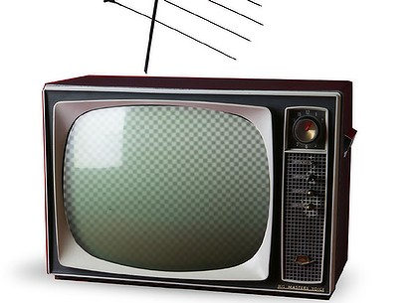
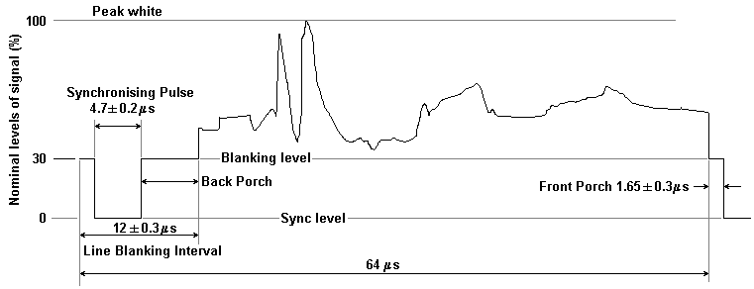
Analogue Television
How much bandwidth would we need for uncompressed digital television?
The European analogue TV format was 625 scan lines, 25 interlaced frames per second, 4:3 aspect ratio
  However 50 lines are lost for ‘field blanking’
It used interlacing to reduce the vertical resolution by half
Horizontal resolution was 575/2*(4/3) = 383 points
  For 25 frames per second, the line duration is about 52µs
  Therefore the bandwidth required is about 383/52 MHz or about 7.3MHz
  The value used in practice is 5.5MHz as additional bandwidth makes no difference subjectively
Analogue colour information was quite cleverly added without increasing bandwidth (NTSC, PAL and SECAM standards)
http://graffiti.virgin.net/ljmayes.mal/var/tvband.htm

Slide 4
Digital Television – Raw Video
For digital use, let’s say an 8 bit resolution is adequate.
For colour pictures we will need Red, Green and Blue (RGB.)
To digitise, we need to sample at twice the highest frequency (Nyquist’s Theorem) of 5.5MHz and convert three colours (RGB) at 8 bits each.
  Bitrate = (5.5x2) x 3 x 8 = 264 Mbits/sec
    Compare with analogue bandwidth of 5.5MHz)
Digitising the analogue television signal created a huge digital bandwidth requirement. We needed some efficient compression.

Slide 5
Coding of Moving Pictures and Associated Audio for Digital Storage Media at up to about 1.5 Mbits/sec.
International Standard IS-11172, completed in 10.92
Commonly known as MPEG-1
Moving Picture Experts Group – 1st phase
Video CD - A standard for video on CD’s at ‘VHS’ quality.
Audio CD’s have a data rate of 1.5Mb/s – video has a raw data rate of 264Mb/s about 200 times higher!
Something had to be lost.

Slide 6
MPEG-1 Decimation
This means just throwing data away ...
Where can we decimate?
  Spatial
  Colour
  Temporal
  (also audio)
Temporal - Interlacing is dropped giving 25 full frames per second

Slide 7
Spatial Decimation
European broadcast TV standard
Resolution is reduced to 352 (width) by 288 (height) pixels
  Source Input Format (SIF)
625
Half-lines
417 lines
288
pixels
352 pixels

Slide 8
Colour Decimation
Human perception is most sensitive to luminance (brightness) changes
Colour is less important e.g. a black and white photograph is still recognisable
RGB encoding is wasteful – human perception tolerates poorer colour.
Use YUV and only encode chrominance (UV) at half resolution in each direction (176 by 144) – Quarter SIF.) This gives 0.25 data for U and V compared to Y.

Slide 9
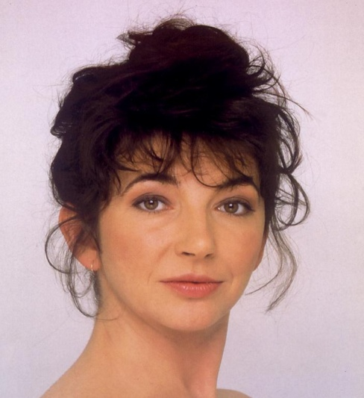




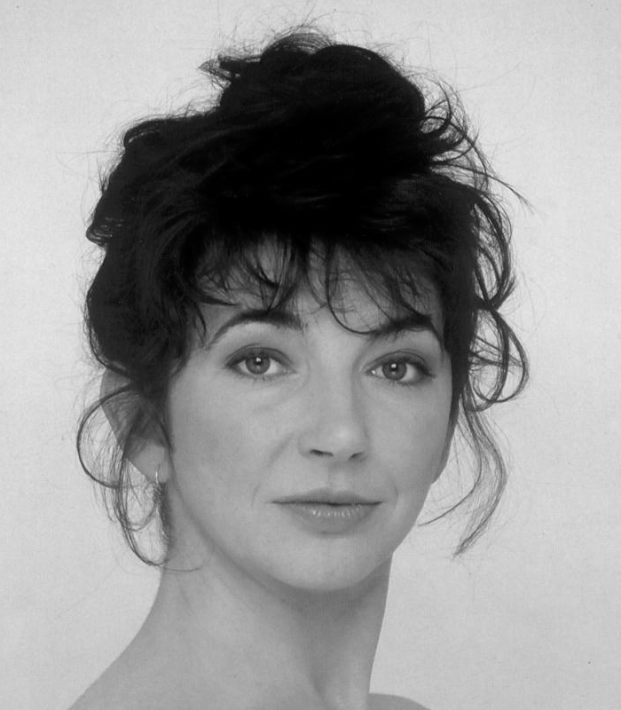
Colour Decimation Example
Original (100%)
0.5 UV (25%)
0.25 UV (6.25%)
0.2 UV (4%)
0.1 UV (1%)
0.0 UV (0%)

Slide 10
Temporal Decimation
Three standards for frame rate in use today
  Cinema uses 24 FPS
  European TV uses 25 FPS
  American TV uses 30 FPS
Lowest acceptable frame rate is 25 FPS so little decimation can be achieved for Video CD
MPEG-1 does allow much lower frame rates e.g. for internet video – but quality is reduced

Slide 11
Decimation – The Result
After throwing away all this information, we still have a data rate of (assuming 8 bits per YUV):
  Y = (352*288) * 25 * 8 = 20.3 Mb/s
  U = (352/2 * 288/2) * 25 * 8 = 5.07 Mb/s
  V = (352/2 * 288/2) * 25 * 8 = 5.07 Mb/s
  TOTAL (for video) = 30.45 Mb/s
  MPEG 1 audio runs at 128Kb/s
  Video CD - Target is 1.5Mb/sec
  Space for video = 1.5 – 0.128Mb/s = 1.372Mb/s
So now use compression to get a saving of 22:1

Slide 12
Spatial Compression
A video is a sequence of images – and images can be compressed.
JPEG uses lossy compression – typical compression ratios are around 10:1 and, with deteriorating, quality up toward 20:1
We could just compress images and send these.
Time does not enter into the process.
This is called intra-coding (intra = within)
  Generically called Motion JPEG (M-JPEG)
  Typically used by digital cameras

Slide 13
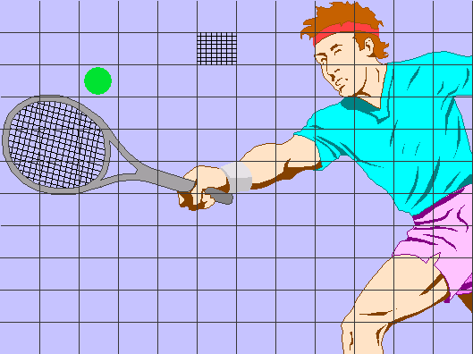
Spatial Compression
Very similar to JPEG
Image divided into 8 by 8 pixel sub-blocks
Number of blocks = 352/8 by 288/8 = 44 by 36 blocks
Each block DCT coded
Quantisation - dropping low-amplitude coefficients
Huffman coded
This produces a complete frame called an Intra frame (I)

Slide 14
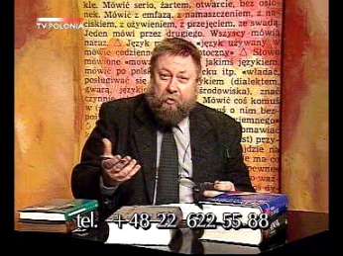
Temporal Compression
Spatial compression does not take into account similarities between adjacent frames
Talking Heads - Backgrounds don’t change
Consecutive images (1/25th second apart) are very similar
Just send the difference between adjacent frames

Slide 15
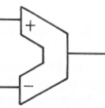
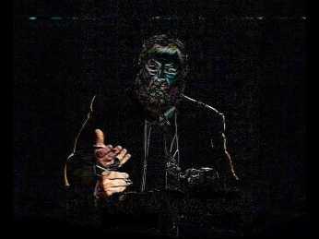
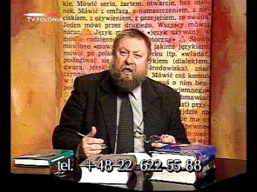
Difference Coding
Only send difference between this frame and previous frame
Result is very sparse – high compression now possible using block-based DCT as before

Slide 16
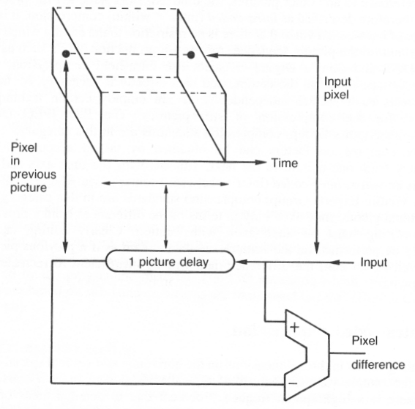
Difference Coding
Using the previous frame and the encoded difference frame we can recreate the original – this is called a predicted frame (P frame).
This recreated frame can then be used to form the next frame and the process is repeated.
Usually a sequence of P frames is created until the next I frame (maybe a scene change!)
I
P
P
P
P
I
P
.....

Slide 17
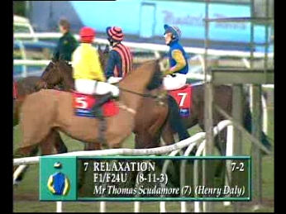
Difference coding
Difference coding is good for ‘talking heads’
Not good for scenes with lots of movement

Slide 18
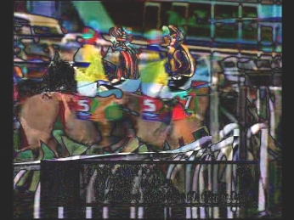
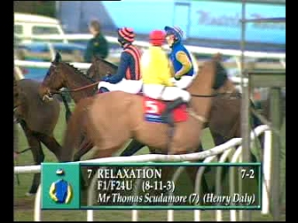
Motion Compensation
Difference coding is good, but often an object will simply change position between frames.
DCT coding not as good as for ‘sparse’ difference image.

Slide 19
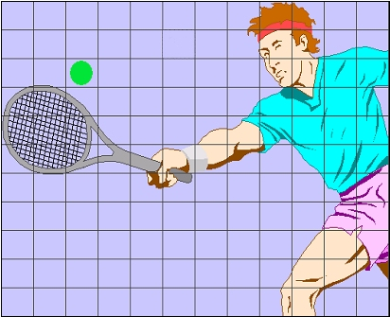
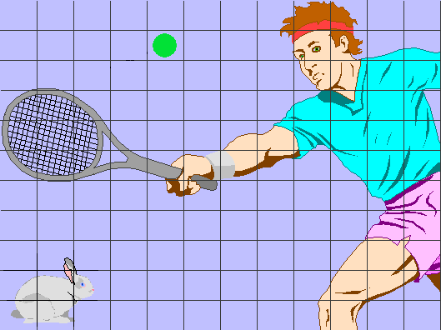
Motion Compensation
Motion compensation is a simple and efficient means of accounting for the motion of objects
Assumes the frame is split up into macroblocks of typically 16x16 pixels
Instead of transmitting the pixel colours for a macroblock in the current frame, we search for the position it in the previous frame (reference frame) and simply transmit the motion vector
  Relies on simplistic assumptions
  The search is computationally expensive
Reference frame
(dx,dy)
Current frame

Slide 20
Motion Compensation
Block Matching--how to find the matching block?
  Matching criteria:
    In practice we couldn’t expect to find the exactly identical matching block, instead we look for close match.
    Most motion estimation schemes look for minimum mean square error(MMSE) between block in the current frame and the block in the previous frame at some displacement (dx,dy).
  Matching block size:
    The block size will affect coding efficiency and computational complexity
      For MPEG, a block size of 16×16 is used

Slide 21
Motion Compensation
http://www.compression.ru/video/motion_estimation/index_en.html

Slide 22
Motion Compensation – The Problems
Objects rarely move and retain their shape.
But what is an object? We have an array of pixels.
Could try and segment image into separate objects – but very intense processing!
  Basis of the MPEG4 standard
Simple option - split image up into small blocks (macroblocks)
  Assumption is that the motion across a macroblock is uniform
    Roughly correct if a macroblock is internal to an object but not if it straddles 2 objects
Doesn’t straddle motion boundary
Straddles motion boundary

Slide 23
MPEG1 Compression
MPEG1 uses the DCT to encode the difference between the motion compensated current frame and the reference frame
Also motion vectors are predictively coded
The whole system is quite complex and a detailed knowledge is beyond the scope of this course!
  The diagram below shows a simplified MPEG encoder
Scale
factor
Rate
controller
Buffer
fullness
IN
Frame
recorder
Variable-length
coder
Transmit
buffer
OUT
DCT
Quantize
DC
Motion
predictor
Prediction
De-
quantize
Prediction
encoder
Reference
frame
Inverse
DCT
Motion vectors

Slide 24
I, P and B frames
We have seen that an I frame is a frame coded without reference to previous frames
A P frame (predicted frame) use preceding frame as reference image
  Sometimes it is necessary to use the both the preceding frame and following frame as reference images – B frame (Bi-directional)

Slide 25
I, P and B frames
X
Z
Available from earlier frame (X)
Available from later frame (Z)
Y

Slide 26
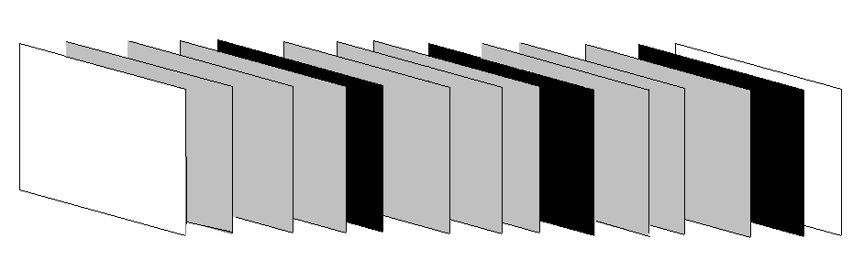
Group of Pictures - GOP
Problem with P and B frames is any errors are propagated (like making copies of copies of copies) - so we regularly send full (I) frames to eliminate errors
Every 0.5 seconds approx we send a full frame (I)
In the event of an error, data stream is resynchronised after 12/25th of a second (or 15/30th for USA)
The sequence between ‘I’s is called a Group Of Pictures
I B B B P B B B P B B B P I
GOP

Slide 27
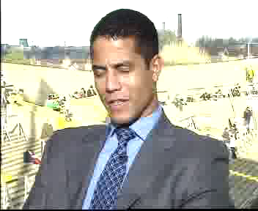

Multimedia presentation on the internet
The following are a couple of video clips are ‘low’ and ‘high’ compression:
  ‘Heads’ high compression ……
  ‘Heads’ low compression …....

Slide 28
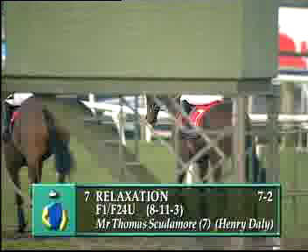
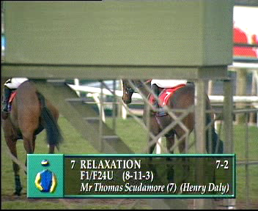
Multimedia presentation on the internet
  ‘Horses’ high compression ……
  ‘Horses’ low compression ……

Slide 29
MPEG - xxx
There are a number of standards covering different technologies and target bit rates
  MPEG-1: “Coding of moving pictures and associated audio for digital storage media” (1992)
    Target was VHS Quality at 1.5MBits/s
    Basis of Video-CD
    MP3 is still with us! (MPEG-1 Layer 3)
  MPEG-2: “Generic coding of Moving Pictures and Associated Audio”
    Broadcasting and storage
    Bitrates: 4-9 MBits/s
    Satellite TV, DVD
  MPEG-4: “Coding of audio-visual objects”
    Started as very low-bitrate project
    Turned out to be much more:
      Coding of media objects
      64kbps to 240Mbps (Part 10/H.264)
      Synthetic/Semi-synthetic objects
      XMT: Like HTML, but to build videos
      First standard with Intellectual Property Management

Slide 30
MPEG - xxx
Where is MPEG – xxx used?
  MPEG-1
    Video-CD
    Usually .mpg or .mpeg files are MPEG-1
    DAB Digital Radio is MP2 (MPEG-1 Layer 2)
    MP3 files (MPEG-1 Layer 3)
  MPEG-2:
    .vob, .m2v, rarely .mpg files
    Anything to do with DVD
      Camcorders, DVD players, DVD recorders, TiVo
    Digital TV
  MPEG-4:
    High Quality AVI files
    Video Phones
    DivX
    Some advanced audio players support MPEG-4 Advanced Audio Coding (AAC)

Slide 31
Summary
Analogue TV
Basic digital TV – the bandwidth problem
MPEG-1 definition
Decimation (spatial, temporal and colour)
Spatial compression
Temporal compression
Difference coding
Motion compensation
MPEG - xxx

Slide 32
This concludes our introduction to video compression.
You can find course information, including slides and supporting resources, on-line on the course web page at
Thank
You
http://www.eee.bham.ac.uk/spannm/Courses/ee1f2.htm

