Slide 1
Multimedia Data
Introduction to JavaScript and
Scalable Vector Graphics (SVG)
Dr Mike Spann
http://www.eee.bham.ac.uk/spannm
M.Spann@bham.ac.uk
Electronic, Electrical and Computer Engineering

Slide 2
Summary of Content
Clients, Servers and Web Browsers
HTML (HyperText Markup Language)
  An introduction
  Examples of HTML tags
Introduction to JavaScript
  Objects, properties, methods
  Events
  Values and variables, operators
  Simple JavaScript examples
    Alert boxes and rollovers
Introduction to SVG (Scalable Vector Graphics)
  Simple demonstration by example

Slide 3
Clients, Servers and Web Browsers
Server
Client
Runs web browser which interprets html
http response plus html document
http GET request
Internet

Slide 4
HTML (HyperText Markup Language)
HTML is the basic language of the web. It comprises a set of ‘tags’ which are instructions to web browsers, e.g.,
  <b>bold</b> text appears as
    bold text
  <b> applies bold until </b>, similarly
  <i> applies italics until </i>
  <u> for underline,
  <p> for paragraph,
  <br> for line break
  also
  <center> <left> and <right> for positioning
  adding links:-
  <a href=“web address”>Link text</a>

Slide 5
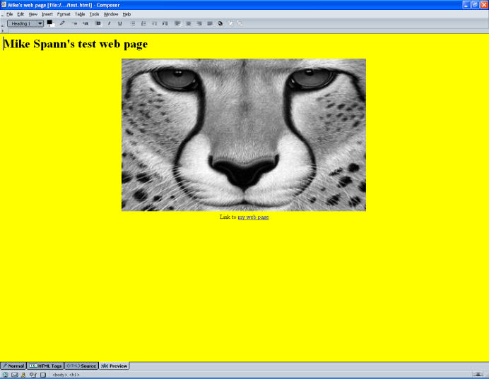
A Simple HTML File test.html
Simple html file
Demo
<html>
<head>
<title>Mike's web page</title>
</head>
<body style="background-color: white;">
<h1> Mike Spann's test web page</h1>
<center>
<img src="Demos/Images/cheetah.gif" alt="" picture=""
style="width: 640px; height: 400px;">
<br>
Link to <a href="../../M.Spann.html">my web page</a>
</center>
</body>
</html>

Slide 6
Introduction to JavaScript
JavaScript is not Java
  Java is a full-feature OO programming language developed by Sun Microsystems. It is a descendant of C and C++ and was designed to be cross-platform. Java is used to create web “applets” (small programs downloaded over the internet and run inside web browsers) as well as standalone application and network (client/server) applications
  JavaScript - Netscape added a basic scripting ability to its Navigator web browser called “Livescript” ... at a time when Java was new/exciting .... and renamed Livescript, JavaScript. JavaScript is a scripting language which can manipulate simple webpage objects.
    A script is a program written for a special run time environment that can interpret (rather than compile) the code
    Typically very high level

Slide 7
How JavaScript Works
Everything that is needed to execute JavaScript is provided by the browser (or the client) so it is also called Client Side Scripting Language.
  Many web technologies involve server side processing (CGI, ASP, Perl, PHP etc)
The browser fetches a page which might have embedded JavaScript, or refers to a separate JavaScript file in which case that file is also fetched by the browser.
Next up, depending upon what you want your JavaScript code to do and how you structured it, it will either execute as soon as the file loads or wait for a triggering event (like a click, or load).
The code is executed line by line. JavaScript is an interpreted language, which means you don’t need to compile the code into another form to execute it. All of the changes you make, instantly take effect.

Slide 8
About JavaScript
JavaScript is an object-oriented scripting language.
Objects have properties
  e.g.,
    cat has a name
    computer has a make
    car has a colour
    window has title
Changing a property of an object can modify the object. Objects can share properties. Properties can be objects, i.e., objects can have sub-objects.
  car.engine.horsepower
The things objects do are called methods, e.g.,
    cats purr
    computers crash
JavaScript objects have methods, e.g.,
    buttons click()
    windows open()
    text selected()
(brackets indicate that we are referring to a method rather than a property.)
Objects and properties are separated by a “.”, e.g.
    cat.name
referring to methods :-
    cat.purr()

Slide 9
Events
Event | What it handles
onAbort | User aborts loading the page
onBlur | User leaves the object
onChange | User changes the object
onClick | User clicked on an object
onError | The script encountered an error
onFocus | User made an object active
onLoad | Object finished loading
onMouseover | Cursor moved over an object
onMouseout | Cursor moved off an object
onSelect | User selects content of an object
onSubmit | User submitted a form
onUnload | User left the window
Events are actions that a user (i.e., a viewer) performs whilst visiting your page.
JavaScript can react to events with event handlers.
In JavaScript, if the user clicks on a button the onClick event handler will take note of the action and perform the specified task.
When we write scripts we do not need to anticipate every possible event the user might take, we just encode the ones we want. E.g., pages load as normal without an onLoad event handler.

Slide 10
Values, Variables and Operators and Script Tags
In JavaScript, pieces of information are values, e.g., numbers, strings, Booleans, nulls, objects, functions.
Variables contain values.
E.g., myname = “mike”
  (“=” can be read as “is set to”)
Notes
  JavaScript is CaSEseNSiTivE!
  Variable names should not start with numbers nor contain spaces.
As in other languages, operators are the symbols used to work with variables, e.g., +, -, *, / etc.
JavaScript must be enclosed in <script> tags and can be inserted into the head or body of a web page.
A simple “HELLO WORLD” example:
  Demo
Hiding script from old browsers is easily achieved by enclosing the script in HTML comments.
<script type="text/javascript">
document.write('Hello World!');
</script>
<script type="text/javascript">
<!--
document.write('Hello World!');
//-->
</script>

Slide 11
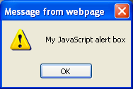
What JavaScript Can Do?
Simple examples of JavaScript functionality include:-
  Reactions to user actions
  Detection of browser type, version and plug-ins
  Status bar messages
  Date- and time-related messages
  Alert boxes
Alert box example:
<SCRIPT LANGUAGE = “JAVASCRIPT”>
alert(“My JavaScript alert box”)
</SCRIPT>
Demo

Slide 12
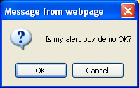
What JavaScript Can Do?
Conditional alert box example
<SCRIPT LANGUAGE = “JAVASCRIPT”>
if(confirm(“Is my alert box demo OK?”))
{
alert(“You said OK ... thanks!”)
}
else
{
alert(“You said Cancel (but must have clicked the wrong button)”)
}
</SCRIPT>
Demo

Slide 13
Simple Image “Rollovers”
These are neat things to add to web pages
  Allow 2 different images to be displayed at 1 location
  Easy to do in html
  Involves handling the ‘OnMouseover’ and ‘OnMouseout’ events
Demo

Slide 14
Simple Image “Rollovers”
<!DOCTYPE HTML PUBLIC "-//W3C//DTD HTML 4.01 Transitional//EN">
<html>
<head>
<title>Mike's web page</title>
</head>
<body style="background-color: yellow;">
<h1> Mike Spann's test web page</h1>
<center>
<img src="Demos/Images/cheetah.gif" alt="Picture rollover demo" picture=“” border="10" name="mypicture"
style="width: 640px; height: 400px;“
onMouseover="document.mypicture.src='Demos/Images/test.gif'"
onMouseout="document.mypicture.src='Demos/Images/cheetah.gif'"
<br><br>
Link to <a href="../../M.Spann.html">my web page</a>
</center>
</body>
</html>

Slide 15
An Introduction to SVG
SVG is short for Scalable Vector Graphics
It is a part of "XML" ; the "eXtensible Markup Language" XML
  XML is a `metalanguage' — a language for describing other languages.
  Unlike HTML which is a fixed format markup language, XML allows us to design our own customized markup languages for different types of documents (e.g. for representing music or hieroglyphs.)
  See http://www.w3.org/ - the worldwide web consortium web pages for details.
SVG is the graphical component of XML - it allows the rendering of graphics in a web page
  IE 9 has svg capability (but not earlier versions)
  Mozilla Firefox and Safari (amongst others) can also handle svg
It is a very useful, and much more efficient, alternative to bitmap images (i.e., an alternative to .gif and .jpeg images.) The scalability means that web browser graphics automatically resize according to the size of the browser window.

Slide 16
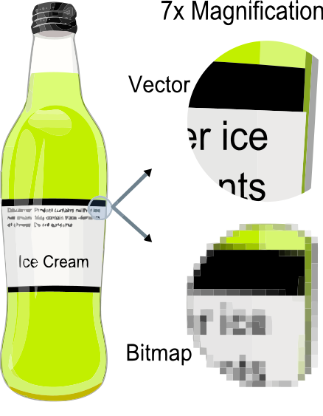
Vector Graphics
Vector graphics represent graphical objects (points, lines, curves, and shapes or polygons), by their mathematical description rather than a rendering of the object itself
  Leads to small file sizes and automatic rescaling according to the window size
Demo showing difference between raster and vector graphics

Slide 17
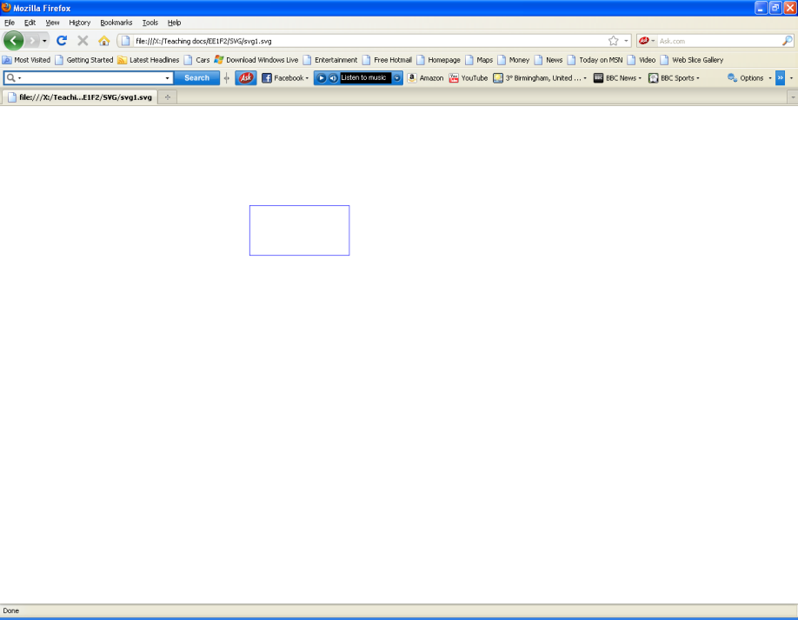
An Introduction to SVG
SVG can be used to create interactive functionality like JavaScript.
SVG authoring tools are available.
The most popular commercial multimedia graphics alternative is Adobe Flash© using an alternative SWF vector graphics format.
The following slides demonstrate some very basic capabilities of SVG by example. These and other demonstration files can be found on the course web page
<!--File svg1.svg-->
<svg viewBox="0 0 1000 1000">
<!-- Draw a blue rectangle -->
<rect x="200" y="200" width="200" height="100" stroke="blue" fill="none"/>
</svg>

Slide 18
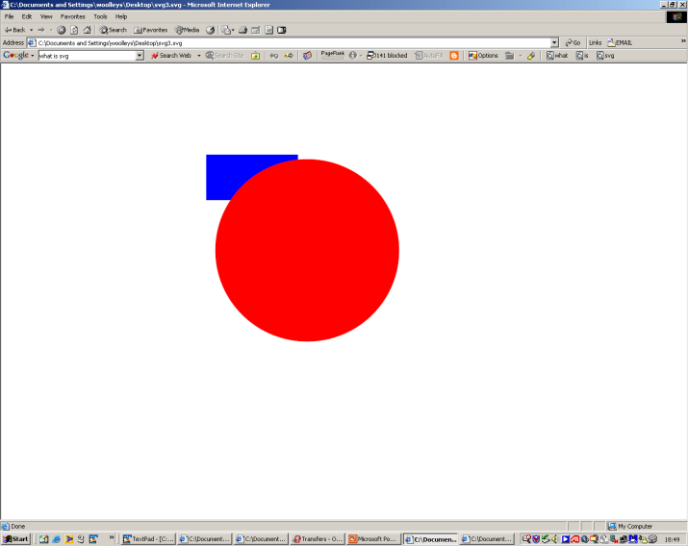
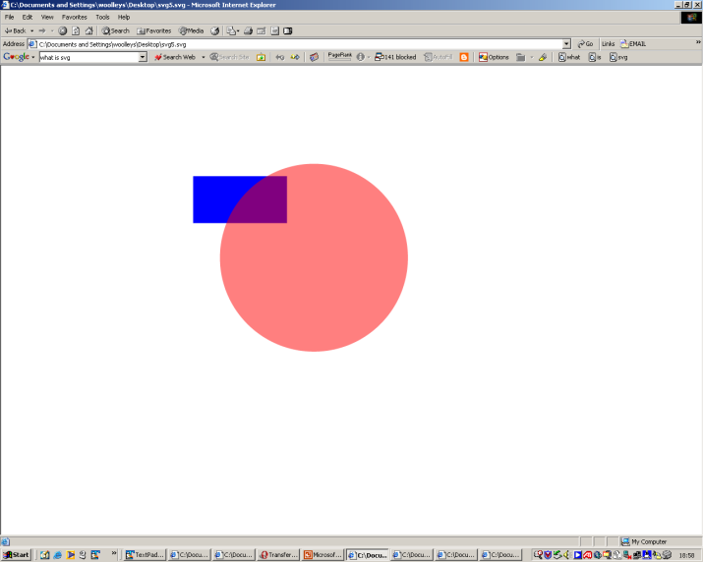
SVG Examples
Simple Examples for Illustration – SVG code NOT assessed.
<svg viewBox="0 0 1000 1000">
<!-- svg3.svg Draw a blue rectangle and a red circle -->
<rect x="200" y="200" width="200" height="100" fill="blue" />
<circle cx="420" cy="410" r="200" fill="red" />
</svg>
<svg viewBox="0 0 1000 1000">
<!-- svg5.svg Draw a moving blue rectangle and a red semi-opaque circle -->
<!-- Draw the rectangle. -->
<rect x="-100" y="-50" width="200" height="100" fill="blue">
<animateMotion dur="10s" repeatCount="indefinite" path="M 220,410 A 200 200 0 1 1 620 410 A 200 200 0 1 1 220 410" />
</rect>
<!-- Draw the circle -->
<circle cx="420" cy="410" r="200" fill="red" opacity="0.5"/>
</svg>

Slide 19
SVG Demos
http://blogs.sitepointstatic.com/examples/tech/svg-curves/cubic-curve.html
http://raphaeljs.com/analytics.html
http://www.themaninblue.com/experiment/Blobular/

Slide 20
This concludes our introduction to JavaScript and SVG.
All the demonstration files can be found on the course web page.
You will not be required to write any JavaScript or SVG code in the exam. But you may expect bookwork questions on the content of these slides, for example, about what these languages provide or about what objects, properties or events are.
You can find course information, including slides and supporting resources, on-line on the course web page at
Thank
You
http://http://www.eee.bham.ac.uk/spannm/Courses/ee1f2.htm

Slide 21
EE1F2 Exam Information
The exam is 100% if the 10 credit module mark
Answer 2 questions out of 3 in 1½ hours
Which parts of the syllabus are examinable?
  Everything is fair game except:
    Detailed mathematical understanding of RSA or DES although you need to understand why prime factorization relates to private/public key selection
    Detailed mathematical understanding of the DCT (although you should understand why it is applied in JPEG and MPEG)
    Detailed knowledge of SVG code

Slide 22
EE1F2 Exam Information
Other things to bear in mind
  The exam tests basic understanding along with ability to apply what you have learnt
  The ‘structure’ of the paper hasn’t changed over the past few years even though I only took over the course 2 years ago
    Attempting previous years papers is by far the easiest way to revise

