Slide 1
Waste management in Student Accommodation
CE 1IEE Energy Engineering Team Project University of Birmingham client presentation
29th January

Slide 2
Sustainable Projects Coordinator for Hospitality and Accommodation Services (HAS)
Main Roles and Objectives
Responsible for the development and implementation of environmental and sustainability initiatives which support both the University Environmental Policy and Sustainability Strategy focusing particularly on student residences.
Reducing energy usage and water consumption
Reducing general waste- increasing recycling
Research sustainable solutions to increase Student Accommodations Environmental credentials
Maintain KPI’s to assess environmental performance
Manage and organise volunteering schemes and run annual awareness raising events and campaigns
Involves working with- Estates, Halls Managers, Students, Guild, Birmingham City Council, Staff, internal and external partners
The work I do is more orientated to the demand side of reducing carbon.

Slide 3
Overview of the University’s situation
Strategic framework, Carbon targets, challenges, legislation and performance

Slide 4
Strategic framework University Vision
‘We are producing an environmental strategy which sets out our core ambition to reduce our carbon footprint and evaluate the environmental impact of all our activities. This will encompass imaginative projects to ensure that our historic estate can be managed sustainably, preserving the legacy of our founders while updating it to meet the challenges of the future.’
‘Our Carbon Management Strategy will deliver a range of responses to ensure we achieve a 20% reduction in our carbon emissions by 2020, whilst preserving the iconic cultural heritage embodied by our historic estate.’

Slide 5
Which carbon (or equivalent) is counted?
Scope 1 - direct emissions from sources owned or controlled by the organisation, for example emissions from combustion in owned or controlled boilers/furnaces/vehicles
Scope 2 - accounts for emissions from the generation of purchased electricity
Scope 3 - other indirect emissions from sources not owned or controlled by the organisation –waste, water, commuting, business travel and procurement.
Consider both supply and demand side...

Slide 6
Trends, legislation and expectations
Carbon Reduction Commitment Tax...
University pay £500,00 HAS pay £80,000
HEFCE target to reduce carbon emissions by 60% by 2050
People and Planet Green League- Times Higher
Browne Report- higher expectations
Sustainability is becoming mainstream
Rising utility costs
Scope 3 emissions- accountability
Financial incentives
Reputation
Global warming pressures
Community expectations

Slide 7
Challenges to Carbon Reduction
Research led University- Russell Group
EPS, MDS etc
Listed buildings
Aston Webb, M&M
Sector performance
63% increased emissions from 2005-2006
On site renewables?
Behavioural change of residents and staff
Student Accommodation is all inclusive fee
Diverse range of buildings, various stages of development and age

Slide 8
How you can help the University for today and the future?
Environmental sustainability is identified as an underpinning principle of our strategic framework and we will continue to take action to reduce carbon emissions.
As you can see there are many challenges and various obstacles to consider in implementing new policies and achieving these targets.
Where we want you to help is with waste management at Student Accommodation delivering proposals on how we manage both our heat and solid waste, ensuring we are looking at and being accountable for our scope 3 emissions.
There are two projects here which need evaluating based on University Carbon Management plans and other sustainability indicators.

Slide 9
Proposal 1: heat waste
Proposal 2: solid waste- (pre and post consumer waste)

Slide 10
Proposal one: Heat waste
We are committed to reducing energy consumption at Student Accommodation. In certain buildings we have noticed an increase in energy use, most notably heating. We want to know why and How we can reduce our consumption?
Key points:
Consider both technological and behavioural changes
All inclusive fee for accommodation- what is the incentive?
Lack of awareness and understanding
Behaviour of individuals heat management in their flats
Maintenance issues?

Slide 11
Proposal two: Solid Waste
Student Accommodations current waste and recycling contract is coming to and end and we are looking to go out to tender. We want to reduce the amount of general waste and maximise recycling and reusing of waste as much as possible.
Things to consider when going out to tender:
What does the current situation look like?
What waste streams to consider
What facilities will we require to achieve our objectives
Risks of contamination to waste streams
How to educate residents
Costs!?
Space management
Education and implementation
Measurement

Slide 12
HOW WE FARE....
Current performance

Slide 13
Our performance
Target from a 2005/06 baseline
Increased in staff and student population but reduced CO2_{e}

Slide 14
The University of Birmingham CO2 Emissions by College 10/11
Data centres contribute 4% emissions and the total from IT is around 12%
HAS account for almost a quarter of emissions and residences contribute 15% of the total.
The Colleges account
for almost 60% of emissions

Slide 15
Half of the University’s C0₂ Emissions from energy are in 13 buildings
3 sites from student accommodation make up this 13...

Slide 16
Energy use and CO2 Emissions for Student Accommodation 2009/10
Building | Total Energy (kWh) | Total CO₂ (Tonnes)
Pritchatts Park Village
Ashcroft | 897,476 | 223
Social Centre | 985,704 | 537
Pritchatts Park inc 3,7,9 & 11 | 1,438,476 | 595
Spinney | 828,039 | 205
Selly Oak Village
Jarratt Hall | 2,984,934 | 1,627
The Vale Village
Aitken | 402,421 | 219
Chamberlain- Eden Tower and Hampton | 2,933,933 | 776
Eden Wing – Staff Accommodation | 2,146 | 1
Elgar Court | 911,509 | 497
Maple Bank | 2,207,693 | 530
Mason Hall | 5,528,338 | 1,539
Shackleton Hall | 3,528,350 | 1,401
Centre Court | 709,104 | 176
Tennis Court | 2,337,905 | 608
Squash Courts Laundry | 51,222 | 15
Central Kitchen (Chamberlain) | 809,162 | 277
Total | 26,556,412 (kWh) | 9226 Tonnes

Slide 17
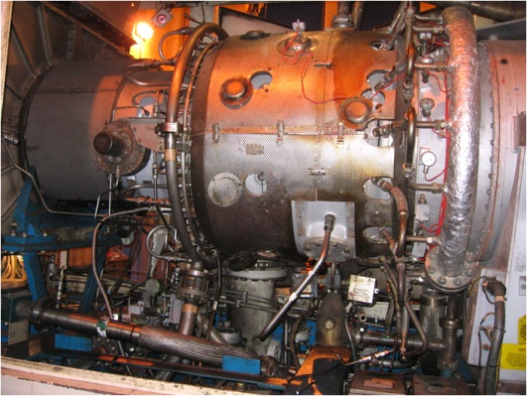
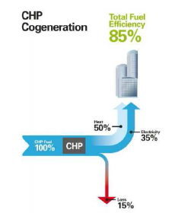
Powering the University-CHP
In 1990 the University launched their Gas fired CHP supplying;
Electricity to most of the Campus and
Heat to the core of the Campus
Conventional Generation
The heat produced is dumped to the atmosphere.
Electricity and heat are distributed around the campus by the
University's own
network of pipes and cables.
CHP Generation
The heat produced is captured and used to heat buildings and produce hot water increasing efficiency.

Slide 18
Current Projects completed/on going...
Over-cladding & double glazing of Gisbert Kapp/52 Pritchatts Road buildings- reduce heat requirements by 30%.
Refurbishment of Metallurgy and Materials building- save 550 tonnes C02e/year- space utilisation
Extension of University’s district heating system to provide heat to medical school-save 1,800 tonnes C02e per year.
Draught stripping of metal framed windows.
Free cooling of process loads
LEDs light trial for street lighting and corridors- save an estimated 44 tonnes C0₂e a year.

Slide 19
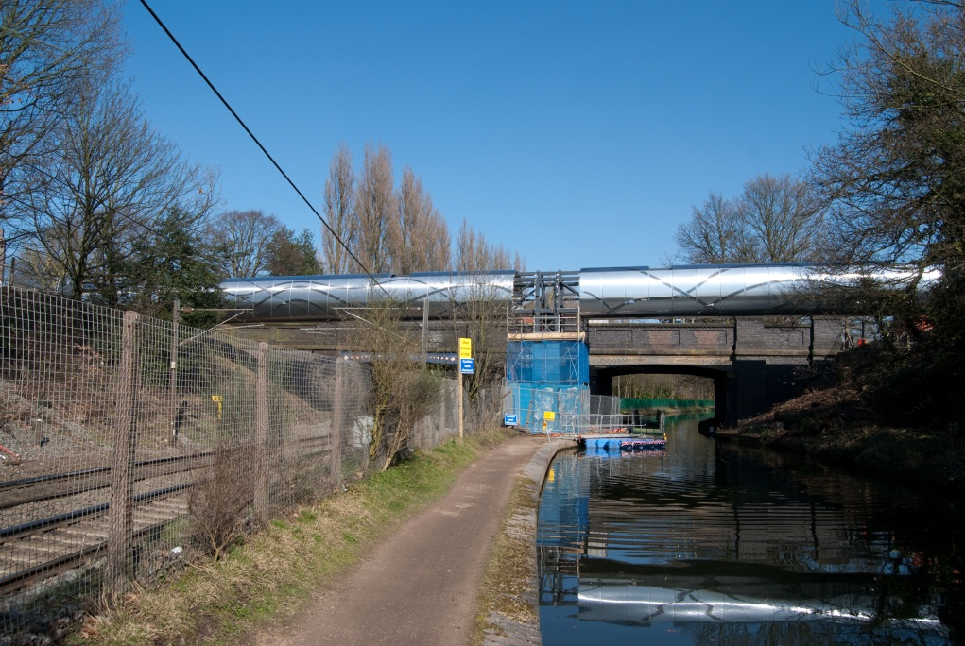
What is the stainless steel tube over the canal and railway?
It is a bridge to transport steam from the CHP station to the Medical School
From autumn 2011 this bridge has enabled the combined heat and power station to provide heat to the Medical School reducing our CO₂ emissions
by more than 1,800 tonnes/year and increasing the security of supply.
This scheme was recently short listed for a prestigious Green Gown Award

Slide 20
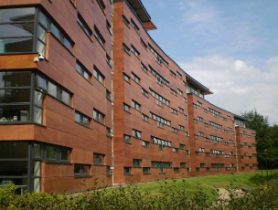
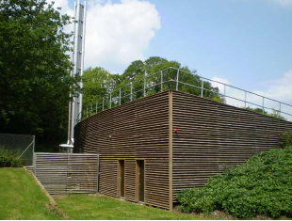
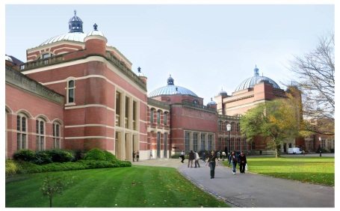
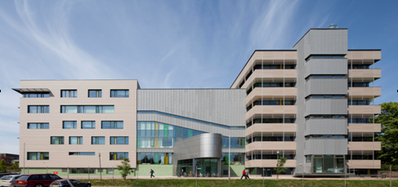
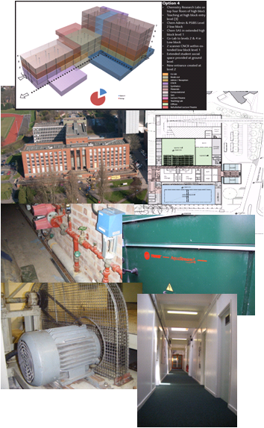
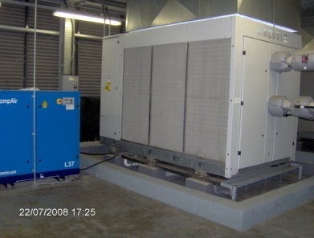
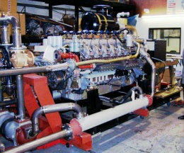
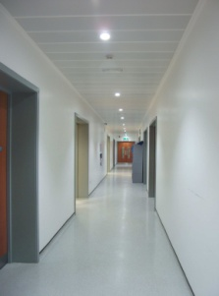
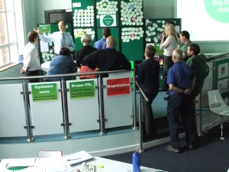
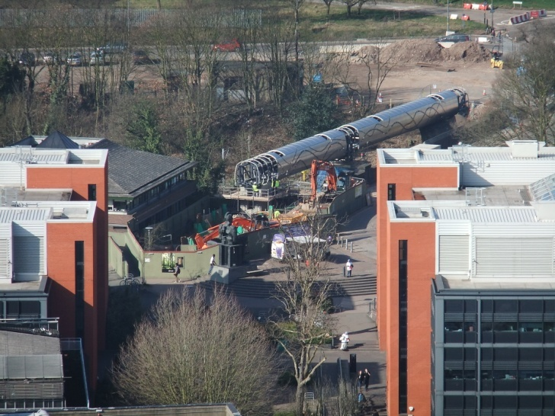
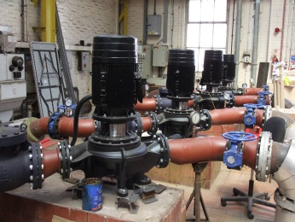
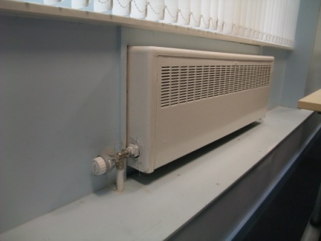
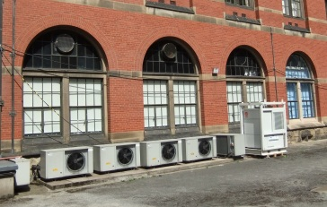
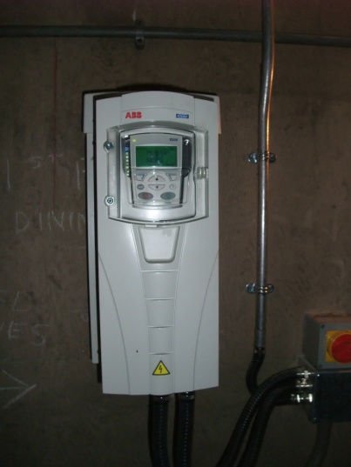
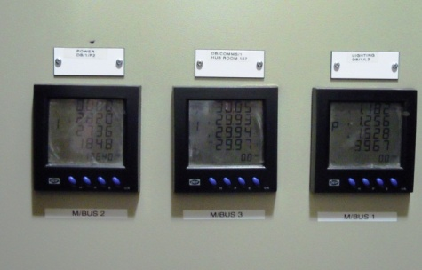
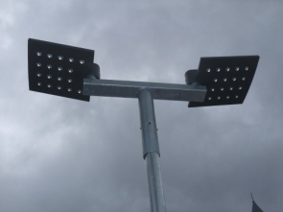
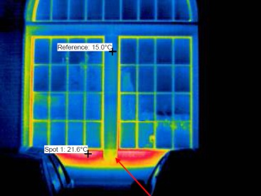
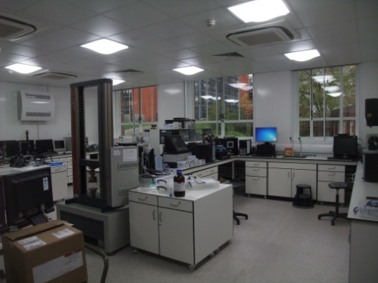
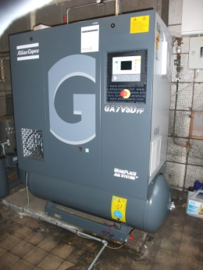
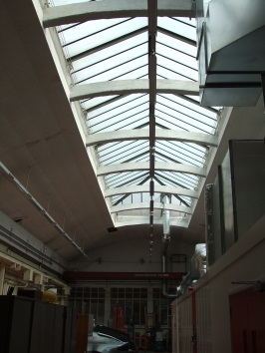
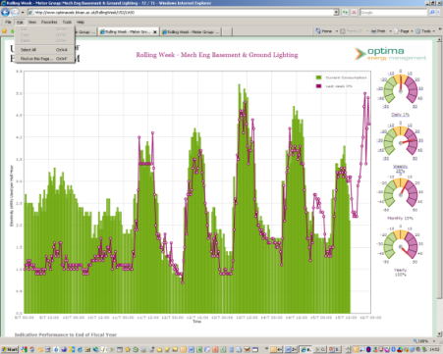
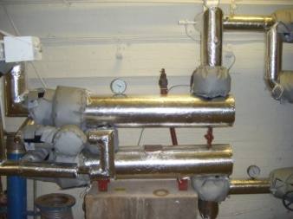
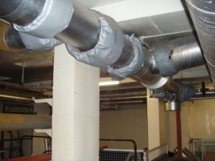
Energy reduction projects [Tonnes of CO₂]
+300
-350
-xx70
-350
-100
More than-1,500
-xx70
-1,500
-16
-xx70
-35
-13
-xx70
-3
-xx70
XX
-22
-70
-5
-200
-70
-44
-xx7
-7
-70
-xx70
-32
-26
-5
-50
-x0

Slide 21
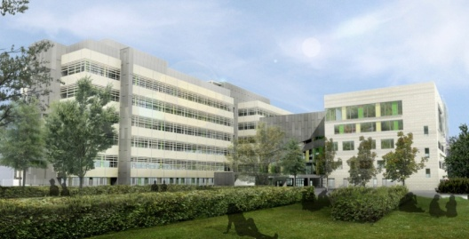
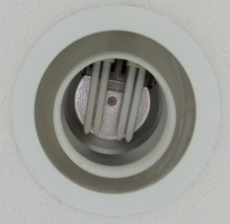
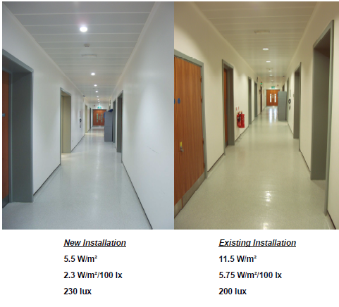
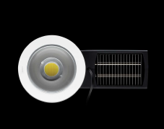
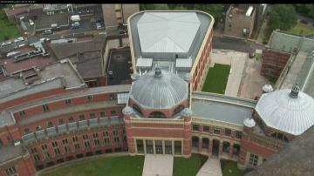
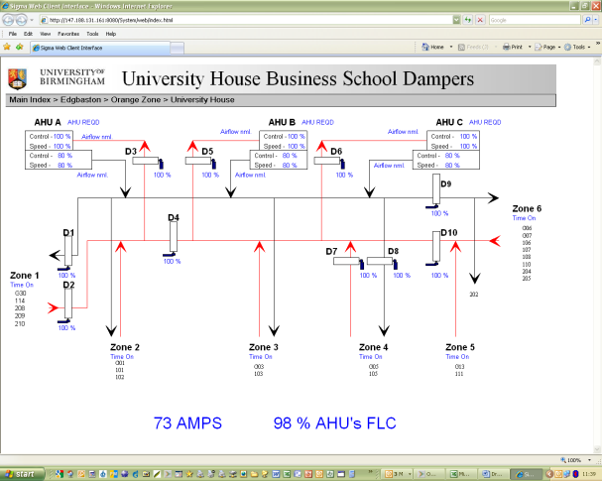
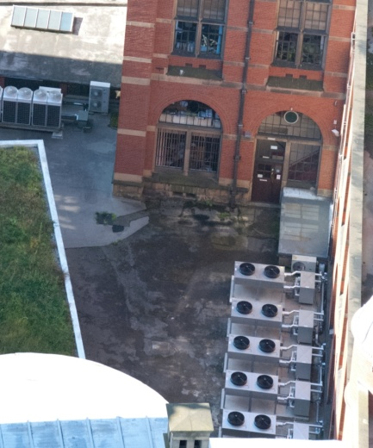
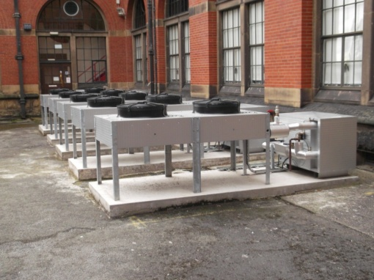
Energy Reduction Projects
Sportex Building – 50% reduction in lighting load
Improving Gisbert Kapp (above) has offset the CO2 from the New Bramall Music Building (below).
Aston Webb Block B – IT Server Room Cooling
Business School – Ventilation & BMS
Free cooling
30 % reduced load
Also M&M and Medical Physics
Central System
3 Air handling units
All on 100% or off
Dampers installed
Zoned vent system
Occupancy linked to timetable via BMS
£15k/year
100 tCO₂
12% of power
Notes:
Completed in 1973.
Concrete structure clad with metal panels, deteriorating exposed concrete and poorly sealed single glazing.
Inefficient and unreliable fixed speed mechanical ventilation/ heating system.
Inherently high energy consumption.
Refurbishment brief to extend the life of the building, improve energy efficiency and enhance the external appearance.
Improved thermal efficiency of new façade (see image right). Components:
1 Increased air tightness
2 170mm insulation
3 Terracotta cladding
New high performance aluminium double glazing with openings configured to promote efficient cooling of internal space.
Roof insulation.
New boilers and heating system with separate boilers for heating & domestic hot water.
New ventilation system.
New efficient lighting and automatic controls.
Originally was a F rated at 140
Now at D 100.

Slide 22
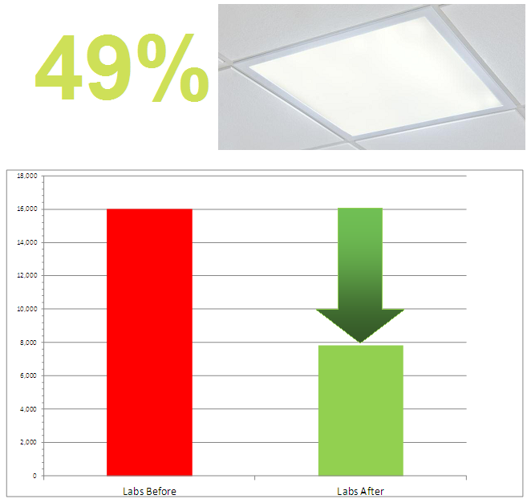
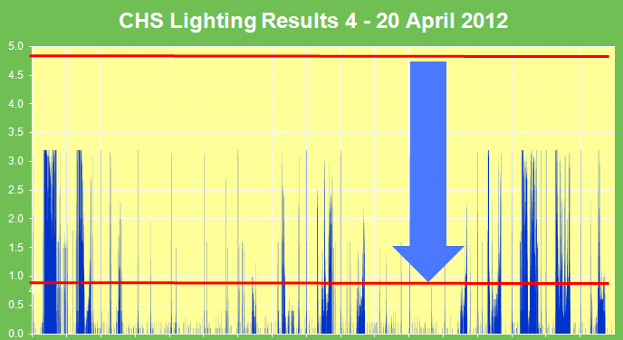
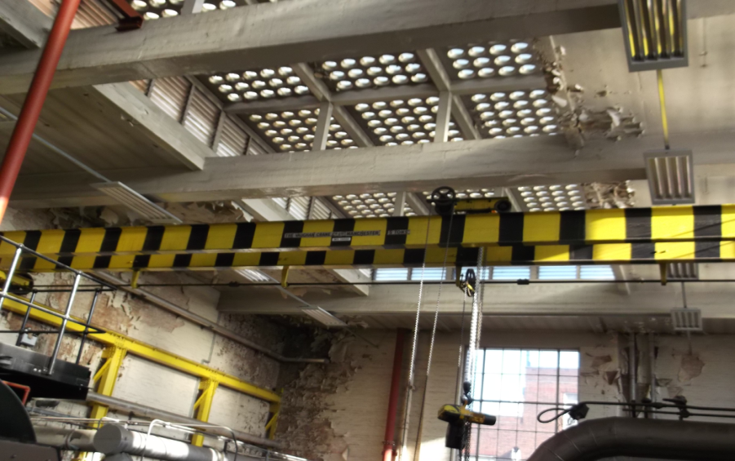
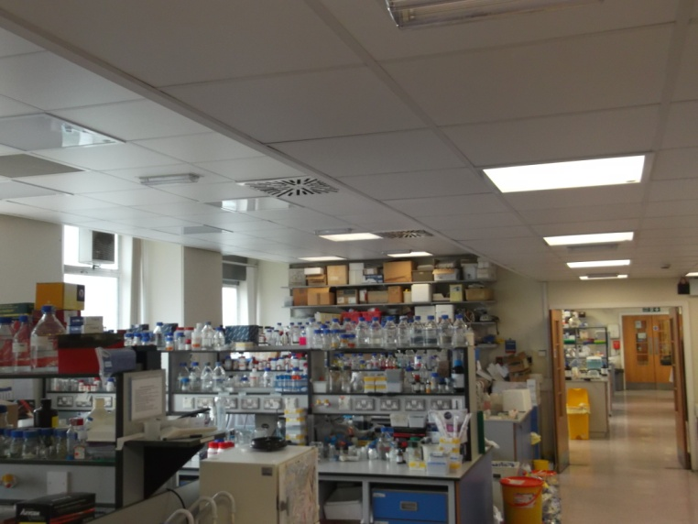
Energy Reduction Projects
Bioscience Labs – New lighting with integral controls
Plantroom – New lighting with occupancy and daylight controls
84 % energy saving
Notes:
Completed in 1973.
Concrete structure clad with metal panels, deteriorating exposed concrete and poorly sealed single glazing.
Inefficient and unreliable fixed speed mechanical ventilation/ heating system.
Inherently high energy consumption.
Refurbishment brief to extend the life of the building, improve energy efficiency and enhance the external appearance.
Improved thermal efficiency of new façade (see image right). Components:
1 Increased air tightness
2 170mm insulation
3 Terracotta cladding
New high performance aluminium double glazing with openings configured to promote efficient cooling of internal space.
Roof insulation.
New boilers and heating system with separate boilers for heating & domestic hot water.
New ventilation system.
New efficient lighting and automatic controls.
Originally was a F rated at 140
Now at D 100.

Slide 23
Mixed Recycling on campus

Slide 24
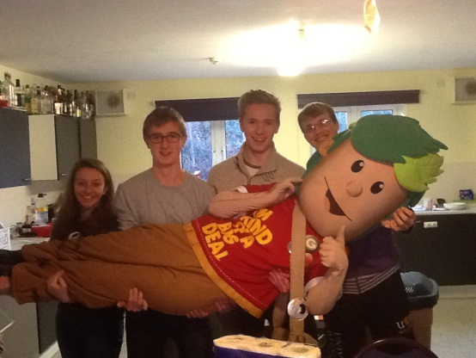
Current HAS Projects
A mixed recycling scheme is being introduced across campus, both internal/external. Produced 140 tonnes of MR in 2013.
Zero waste to landfill- Energy from Waste Incinerator facility 725 tonnes of waste produced in 2013
Implementation of 5 year Sustainable Travel Plan.
New Tennis Court refurbishment linked up to Mason CHP.
Now extending district heating system to supply Jarratt Hall and new sports campus. Shortlisted for a Green Gown 2012 award and 2013 Civic Trust Award
Green Impacts Awards for staff.
Junkbusters- Award winning community project
To reduce waste, promote recycling and reuse
GREG-Green. Reduce. Environment. Genius
is Student Accommodations sustainable mascot.

Slide 25
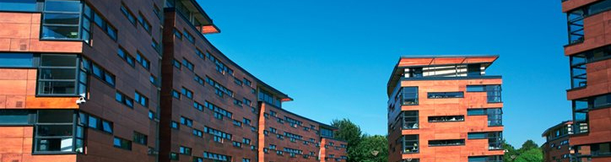
Mason redevelopment 2008
40% more students, 15% less energy use
Above specification insulation fitted
Complied to approved building standards at the time
District heating system;
More control over temperature
Improved energy efficiency
Enhanced environmental protection
Decreased life cycle costs
Decreased building capital costs

Slide 26
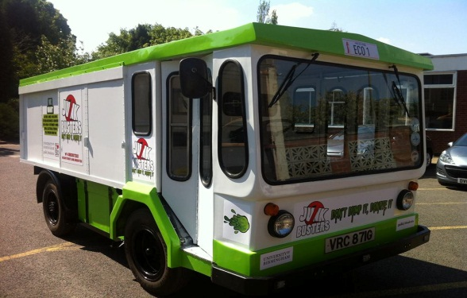
Transport
Green Machine electric vehicle
Introduction of 2nd electric vehicle, a spruced up milk float.
Hydrogen Micro cabs and our own Hydrogen refuelling station.
Hybrid Smart car
Runner up in the innovation in fleet management category in the Energy Saving Trusts Fleet Hero Award 2012.
Travel Survey launched in Feb 2013 to measure staff and student travel options. Beginning of scope 3 accounting.
Using more sustainable transport all contributes towards the University’s carbon footprint.

Slide 27
Key POINTS

Slide 28
…be imaginative and think holistically
Space utilisation
Energy usage
Food waste?
Convenience
Waste reduction and recycling
Communications strategy
Behavioural change
Technology, smart phones, apps?
Who is your audience?

Slide 29
Possible stakeholders....
University of Birmingham
Birmingham City Council
Staff at Student Accommodation
NGO’s and interest groups
Local community
Maintenance
Estates office at the University
Students/tenants
Contractors on site
Government grants and funding
Energy suppliers etc

Slide 30
Finally...
Push the boundaries- exceed 20:20 target
Feasible business proposal;
Cost of the project
Carbon reduction
Payback
Reputation

