Slide 1
Lecture 2
Introduction to Energy Engineering
  Electrical Energy Generation
Dr Mike Spann
School of EECE
m.spann@bham.ac.uk

Slide 2
Part I
  The Fundamentals of Electricity Generation

Slide 3
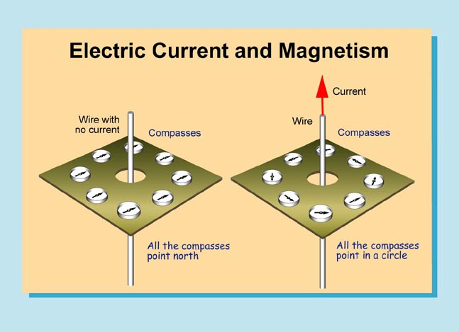
Electricity and Magnetism
The link between an electric current and magnetic fields was known about early in the 19th century
A compass needle placed near a wire through which an electric current flows causes the compass needle to move just as if the wire were a magnet
Also two wires carrying electric current exert force on each other, just like two magnets
  The forces can be attractive or repulsive depending on the direction of current in both wires

Slide 4
Electricity and Magnetism
The magnetic field of a coil is identical to the field of a disk-shaped permanent magnet
We shouldn’t be surprised at this as the magnetism of certain materials is caused be tiny electric currents
  The electrons moving around the nucleus which carry electric charge and thus create currents within an atom
These currents create the magnetic fields that determine the magnetic properties of atoms

Slide 5
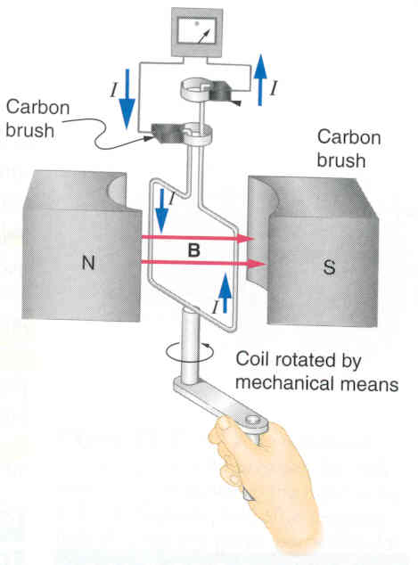
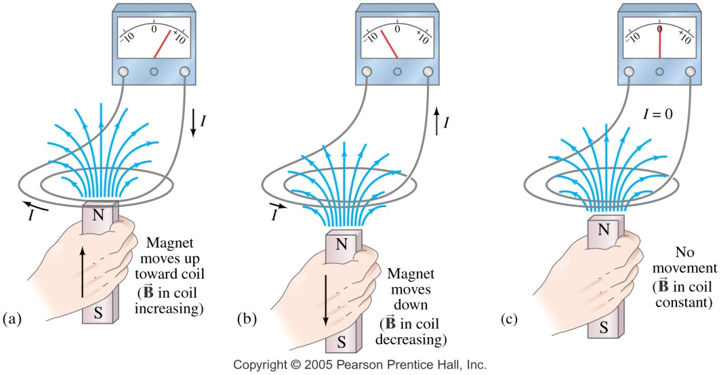
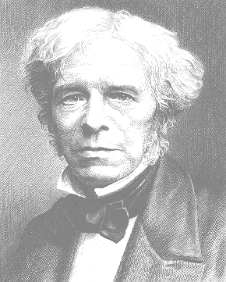
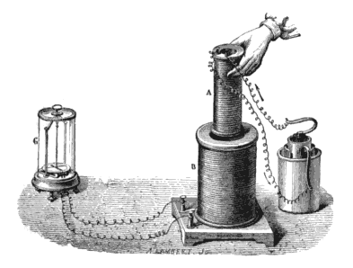
Electromagnetic Induction
In a series of experiments around 1830 Michael Faraday investigated the idea of generating electricity from magnetism
The basic idea is that a changing magnetic field linking a conductor induces an emf (and hence a current) in that conductor
Michael Faraday

Slide 6
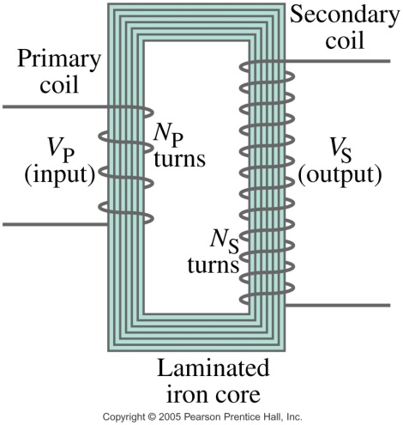
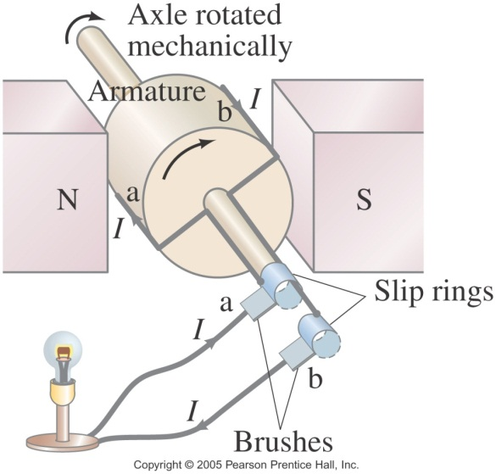
Electromagnetic Induction
We can change the magnetic field by
  Changing the current producing it
    Principle of the transformer
  Moving the magnet producing it relative to the conductor
The basic design of a generator comprises a rotor spinning in a magnetic field
  In modern systems, the magnetic field is produced by field coils on the rotor fed by a dc current
  The rotor spins inside a fixed stator containing heavier coils – the armature windings

Slide 7
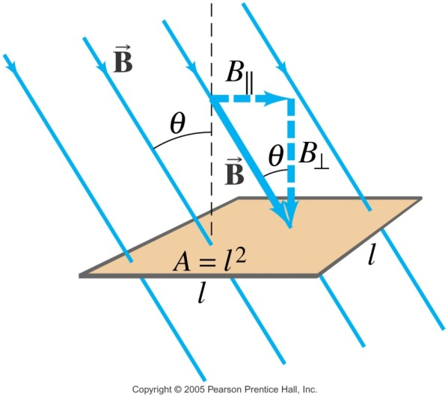
Electromagnetic Induction
The basic physical principles behind electromagnetic induction are well established
  Magnetic flux Ф_{B} ‘flowing’ through an area A depends on the flux density B (which is a vector)
  Unit of flux density is the Tesla, T
  Unit of magnetic flux: weber, Wb
    1 Wb = 1 T·m²
  It is the rate of change of flux ‘linking’ (or flowing through) which generates the induced emf and hence power if it forms part of a circuit

Slide 8
Electromagnetic Induction
Faraday’s law of electromagnetic induction states that
Actually this would be for a single turn of a coil rotating in a magnetic field. For an N-turn coil
  More turns creates an ‘amplifying effect’
So why the minus sign?
  Lenz’s law which simply stated means the direction of induced emf opposes the change that created it!

Slide 9
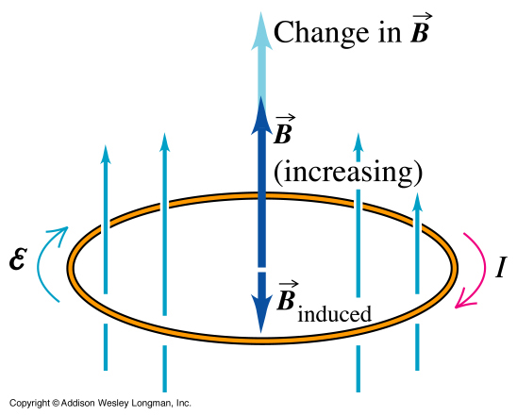
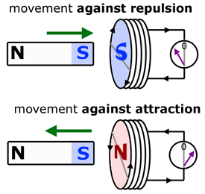
Electromagnetic Induction
Lenz’s law really amounts to conservation of energy!
  It’s application depends on how exactly the emf is induced
    A moving magnet
    A changing electric current
  A changing magnetic field linking a coil induces an emf which creates a current which creates a magnetic field in the opposite direction
  Or a magnetic moving towards a coil creates an induced emf in the coil in a direction which produces a current which creates a field to oppose the motion of the magnet

Slide 10
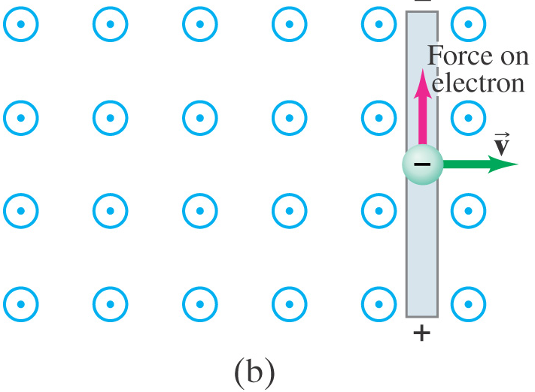
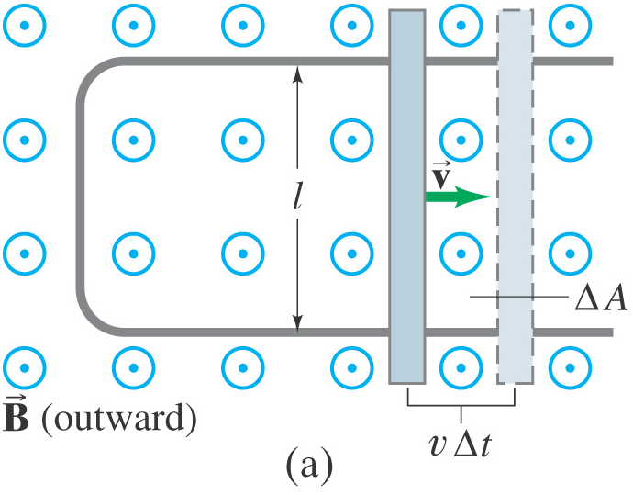
Electromagnetic Induction
Another way the magnetic flux can change is to imagine a conductor rolling across some iron rails with a perpendicular magnetic field coming up through them (a)
The induced current is in a direction that tends to slow the moving bar – it will take an external force to keep it moving (b)
Doing the energy calculation for this simple scenario is fairly easy and you can see exactly how energy is conserved
  I will leave it as an exercise!

Slide 11
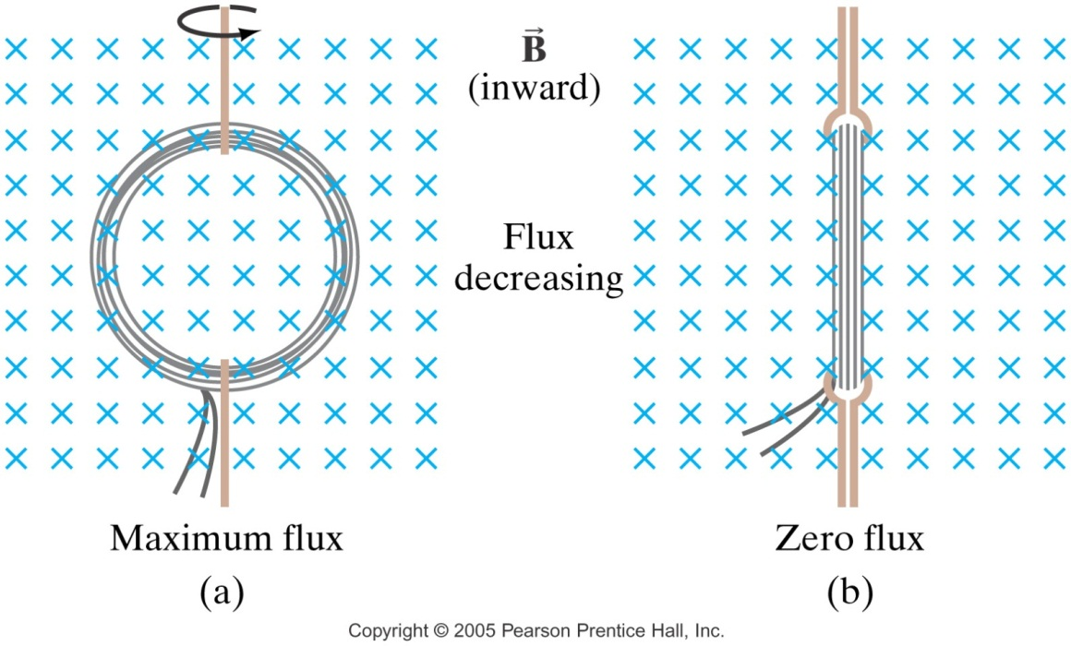
Electromagnetic Induction
From this idea of flux linkage, it’s not hard to see how a spinning coil in a magnetic field generates a sinusoidally varying induced emf
This is the basic principle of the power generator
  Although practical designs are way more complex than this!
  Something you will look at in more advanced courses

Slide 12
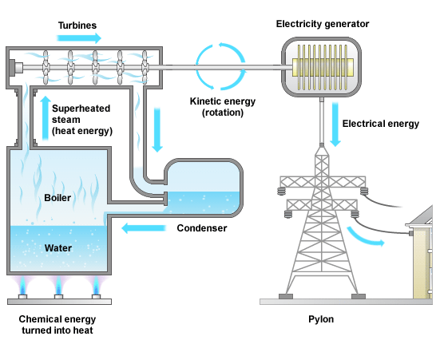
Power Generation
The big picture
  Energy from burning fossil fuels is used to hear water in a boiler
  Steam is produced at high pressure
  The steam is used to rotate turbines which then provides the mechanical power in a generator
  After various stages of conversion, the electrical power is fed to the distribution system
Often the mechanical motion is provided directly
  For example, wind turbines

Slide 13

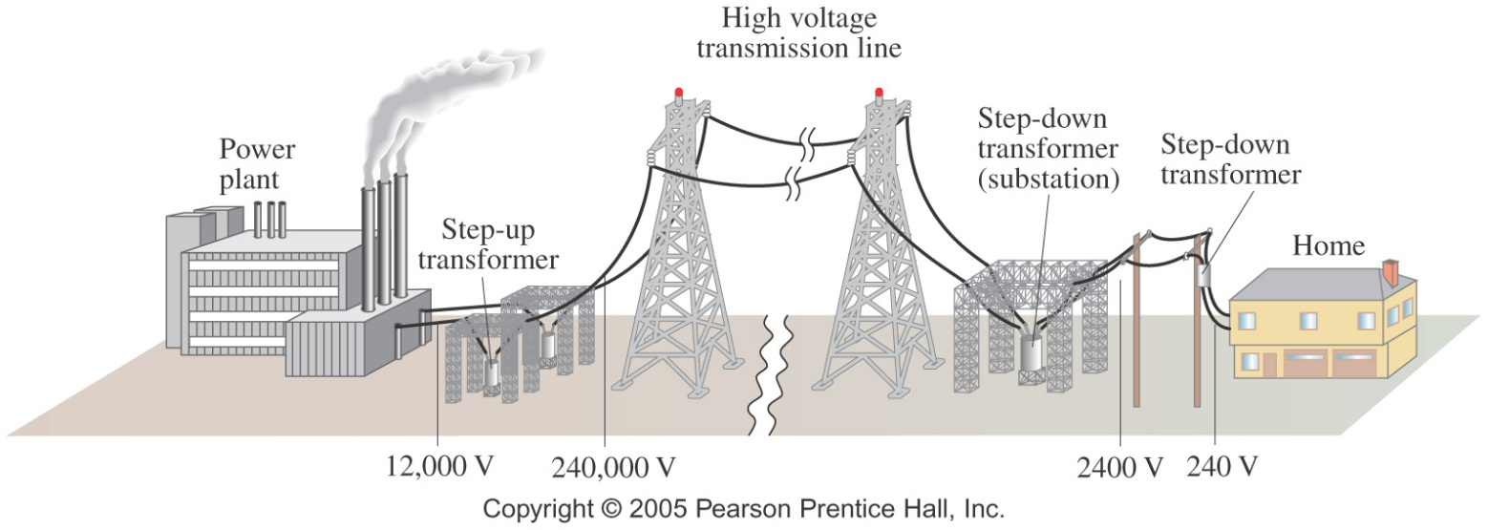
Power Generation
Step-up transformer
Transformers step up the voltage for transmission and then step down the voltage prior to domestic usage
Transformers work only if the current is changing; this is one reason why electricity is transmitted as ac

Slide 14
Part II
  Power Generation from Non-Renewables

Slide 15
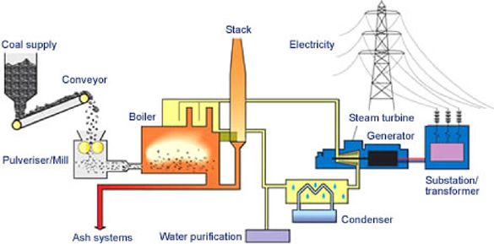
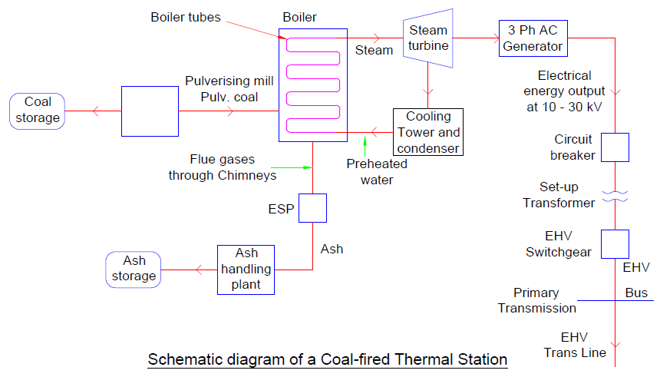
Coal and Oil Based Power Generation
Coal represents about 50% of the world’s power generation (about 31% in the UK)
  It is old technology which comprises a well established number of distinct steps
  Heat is created
    Before the coal is burned, it is pulverized to the fineness of talcum powder. It is then mixed with hot air and blown into the firebox of the boiler. Burning in suspension, the coal/air mixture provides the most complete combustion and maximum heat possible
  Water turns to steam
    Highly purified water, pumped through pipes inside the boiler, is turned into steam by the heat. The steam reaches temperatures of up to 1,000 degrees Fahrenheit and pressures up to 3,500 pounds per square inch, and is piped to the turbine

Slide 16

Coal and Oil Based Power Generation
  Steam turns the turbine
    The enormous pressure of the steam pushing against a series of giant turbine blades turns the turbine shaft. The turbine shaft is connected to the shaft of the generator, where magnets spin within wire coils to produce electricity
  Steam turns back into water
    After doing its work in the turbine, the steam is drawn into a condenser, a large chamber in the basement of the power plant. In this important step, millions of gallons of cool water from a nearby source (such as a river or lake) are pumped through a network of tubes running through the condenser. The cool water in the tubes converts the steam back into water that can be used over and over again in the plant.
  Finally the cooling water is returned to its source without any contamination, and the steam water is returned to the boiler to repeat the cycle
Video. How a coal fired power station works

Slide 17
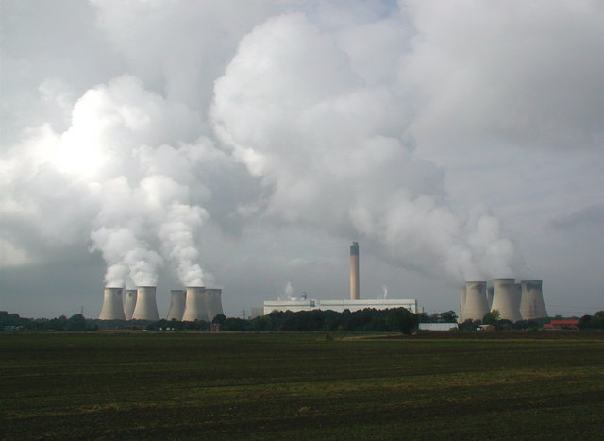
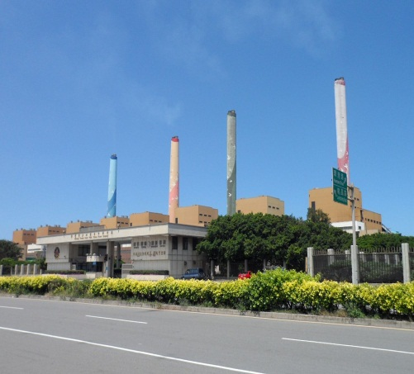
Coal and Oil Based Power Generation
The largest coal fired power station in the UK (and in Europe) is Drax, in north Yorkshire
  It’s output is 3,960 MW providing about 7% of the United Kingdom's electricity supply
One third of the UK’s coal fired power stations are expected to close by 2016 so that they meet EU air quality legislation
The world’s largest coal fired power plant is Taichung Power Plant in Taiwan with a generation capacity of 5,500 MW
  It also the world's largest emitter of carbon dioxide
Drax
Taichung Power Plant

Slide 18
Clean Coal Technology
Carbon Dioxide (CO₂)
The development of ‘clean’ coal technology is being pursued in order to reduce carbon emissions and other pollutants
  Historically, the primary focus was on sulphur dioxide and nitric oxide, the most important gases in causing acid rain, and particulates which cause visible air pollution
  More recent focus has been on carbon dioxide (due to its impact on climate change and concern over toxic species such as mercury
Carbon capture and storage technologies are a range of technologies being developed to reduce CO₂ emissions
Coal
Capture
Transport (pipeline)
Process plant
Storage in a depleted oil or gas field
Or in a saline aquifer

Slide 19
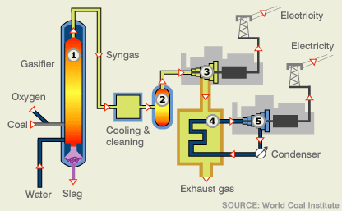
Clean Coal Technology
A range of approaches of carbon capture and storage systems are being investigate
  None have yet to be made available on a large-scale commercial basis because of the costs involved
In Integrated Gasification Combined Cycle systems, coal is not combusted directly but reacts with oxygen and steam to form a "syngas" (primarily hydrogen and carbon dioxide which can easily be removed)
  After being cleaned, it is burned in a gas turbine to generate electricity and to produce steam to power a steam turbine
  This is promising technology for cleaner coal but very expensive

Slide 20
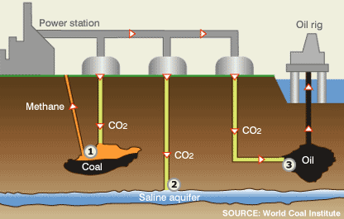
Clean Coal Technology
Carbon dioxide is, once captured can be pumped underground
  It can be pumped into disused coal fields displaces methane which can be used as fuel
  Tt can be pumped into and stored safely in saline aquifers
  It can pumped into oil fields helps maintain pressure, making extraction easier

Slide 21
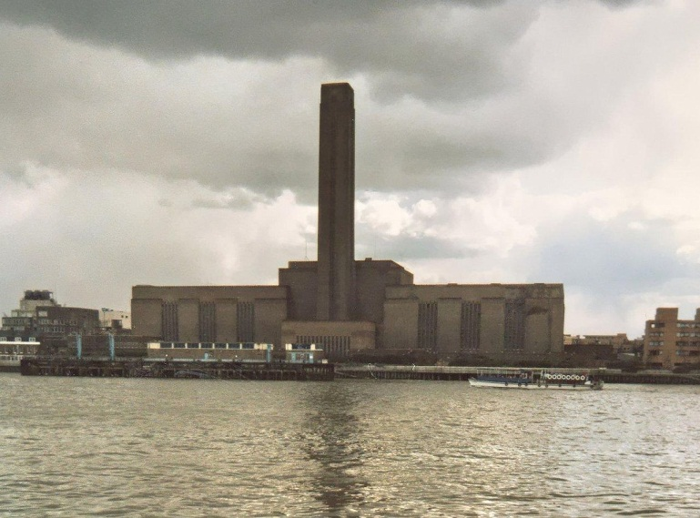
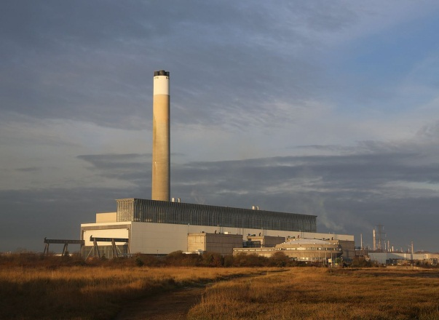
Coal and Oil Based Power Generation
Generating electricity by burning oil is costly and releases a high level of greenhouse gases. Consequently, oil-fired power stations are currently used only to provide backup power, when there is a chance that demand for electricity might not be met by less costly and carbon-intensive energy sources
  Oil is not expected to play any part in the UK's electricity generation mix beyond 2015, as all 3 of the country's oil-fired power stations are scheduled to have closed down by this time
  One major problem is transporting the oil either by tanker or pipeline to the power stations
    There have been a number of environmental catastrophes involving oil transportation
Bankside Power Station
Fawley Power Station

Slide 22
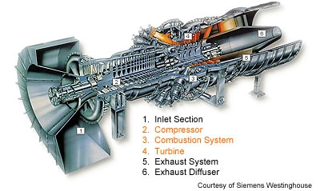
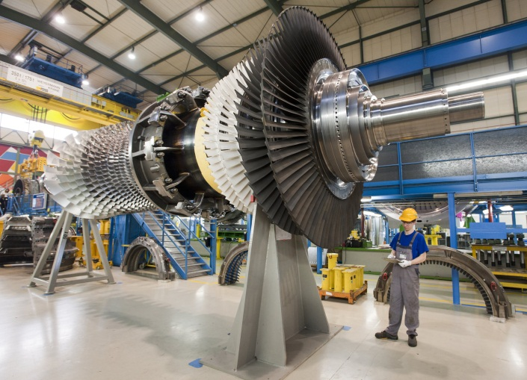
Natural Gas Based Power Generation
Natural gas accounts for around 30% if power production in the UK
  North sea reserves are dwindling meaning much of the gas has to be imported making it’s supply price sensitive
Natural gas power plants are based around a gas turbine which operates in much the same way as a jet engine
  A compressor sucks in air form the atmosphere and compresses it to pressures in the range of 15 to 20 bar
  The air from the compressor passes into the combustor and mixed with the fuel and burnt at around 1400 to 1500 °C. Hot gases leave the combustion chamber with high energy levels
  The turbine does the main work of energy conversion. The turbine portion also consists of rows of blades fixed to the shaft. The kinetic energy of the hot gases impacting on the blades rotates the blades and the shaft

Slide 23
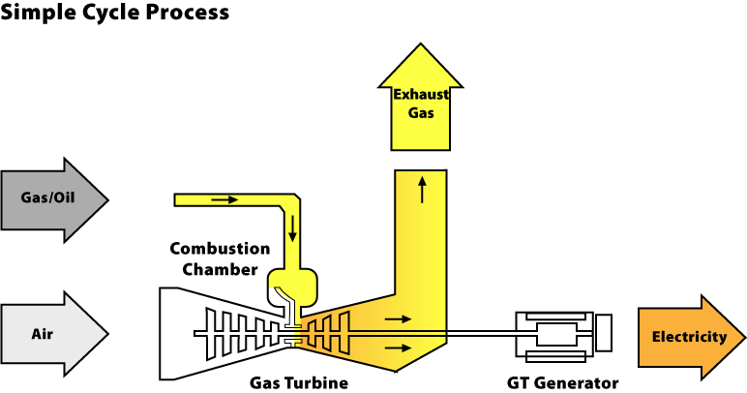
Natural Gas Based Power Generation
The simplest gas based power plant is the simple-cycle gas turbine and electric generator
  This just comprise a single generator attached to the turbine
  Their advantage is that they are cheap and their ability for it to quickly reach full power. They are typically usually used as peaking power plants, which can operate from several hours per day to a couple of dozen hours per year, depending on the electricity demand
  A typical large simple cycle gas turbine may produce 100 to 300 megawatts of power and have 35–40% thermal efficiency. The most efficient turbines have reached 46% efficiency

Slide 24
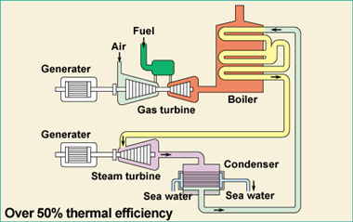
Natural Gas Based Power Generation
The combined cycle power generator has a second steam driven generator powered by the exhaust gases from the gas turbine
  This leads to greater efficiency – typically 50%
  Roughly the steam turbine cycle produces one third of the power and gas turbine cycle produces two thirds of the power output of the combined cycle power generator
  By combining both gas and steam cycles, high input temperatures and low output temperatures can be achieved. The efficiency of the cycles adds, because they are powered by the same fuel source
A rather annoying YouTube video

Slide 25
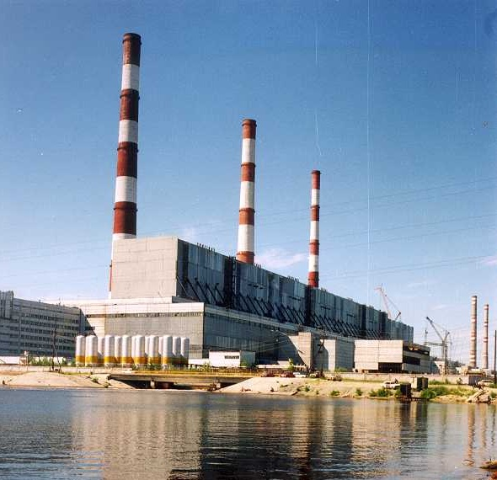
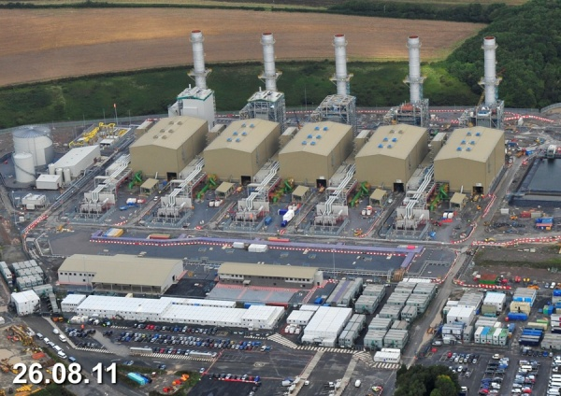
Natural Gas Based Power Generation
The Surgut-2 Power Station is the largest gas fired power station in the world with an installed capacity of 5,597.1 MW
  It has a combined cycle power generator with overall efficiency rates of 56%
In the UK the Pembroke combined cycle gas turbine power plant is located in west Wales.
  It has a total generating capacity of 2,160MW and thermal efficiency of 60%,
  It is one of the largest and the most efficient natural gas power plants in the UK
Surgut -2
Pembroke CCGT plant

Slide 26

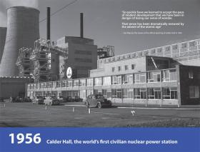
Nuclear Power
Provides about 12% of the world’s electricity and about 70% of the Europe’s non-carbon electricity generation
There are 16 nuclear power plants in the UK which provides about 17% of our power
200+ plants in the Europe
  Leader is France where about 80% of its power from nuclear
The adoption of nuclear power is often politically influenced
  All 54 of Japan's nuclear reactors were temporarily shut down as of May 6, 2012 following the Fukushima disaster
  Germany has decided to phase out nuclear power as have a number of other countries
  There are many countries with no nuclear power plants
Calder Hall

Slide 27
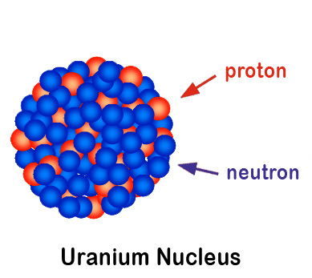
The Physics of Nuclear Power
The basic physics behind nuclear power involves the structure of atoms and their nuclei
  An atom comprises a nucleus and electrons
  A nucleus comprises protons (positively charged) and neutrons (no charge)
  The atomic number of an atom is just the number of protons (equal to the number of electrons)
  The atomic mass of an atom is the total number of protons and neutrons
  An isotope is a different form of the same element with a different atomic mass
    Uranium has an atomic number 92
    Uranium 238 has 92 protons and 238-92 neutrons
    Uranium 235 has 92 protons and 235-92 neutrons

Slide 28
The Physics of Nuclear Power
The key process behind nuclear energy is nuclear fission
  Nucleus breaks down into two or three fragments accompanied by a few free neutrons and the release of very large quantities of energy
Fission of 1 kg of uranium - 235 produces as much energy as burning 3000 tonnes of coal.
Free neutrons are available for further fission reactions
Elements which undergo fission following capture of a neutron such as uranium - 235 are known as fissile
Krypton
Uranium 235
n
n
n
More decays
n
Barium
Energy

Slide 29
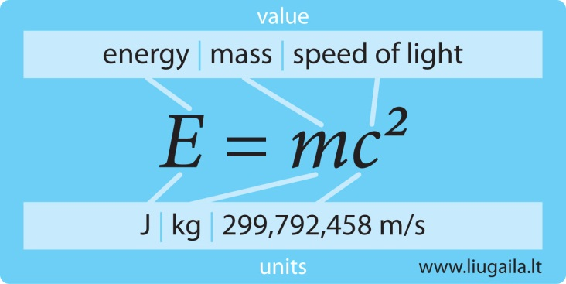
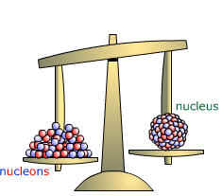
The Physics of Nuclear Power
The energy resulting from fission comes from what is termed the ‘binding energy’ of atomic nuclei
  Nuclear binding energy is the energy required to split the nucleus into its component parts
  The mass of an atom's nucleus is usually less than the sum of the individual masses of the constituent protons and neutrons when separated due to Einstein’s mass-energy equivalence formula
  For large nuclei such as uranium, when it splits into smaller components (fission), binding energy is released which is the opposite to energy being released when smaller nuclei (such as hydrogen) are joined (fusion)
    This is why large nuclei are not stable as they emit radioactive particles thus releasing energy
+
Binding energy

Slide 30
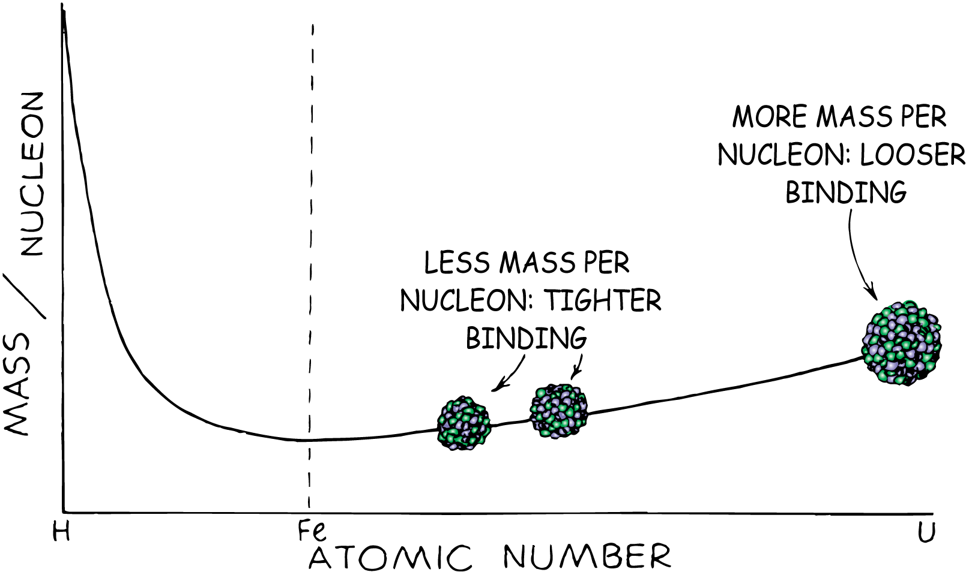
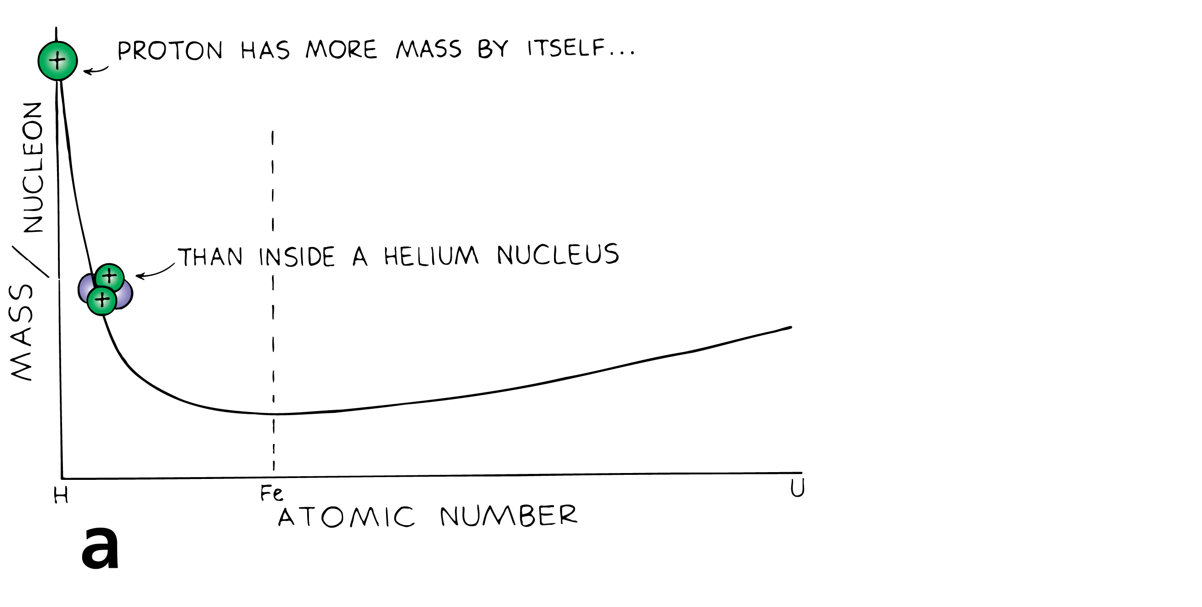
The Physics of Nuclear Power
One way to interpret this mass change is that a nucleon inside a nucleus has less mass than its rest mass outside the nucleus
  The mass difference is related to the “binding energy” of the nucleus
  Iron (Fe) has the lowest ‘effective mass’ as iron nuclei are the most stable with the highest binding energy
If a uranium nucleus splits in two, the masses of the fission fragments lie about halfway between uranium and hydrogen
  The mass per nucleon in the fission fragments is less than the mass per nucleon in the uranium nucleus
  This explains the release of energy in fission
  It also explains why fusion releases much more energy per nucleon than fission

Slide 31
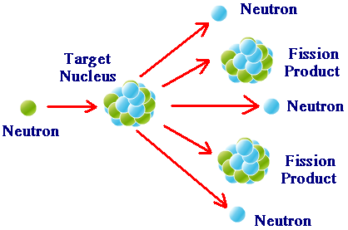
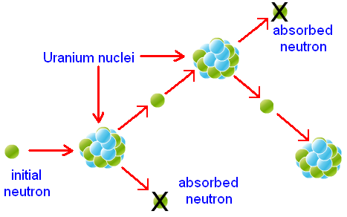
The Physics of Nuclear Power
A chain reaction occurs when fission of uranium- 235 yields 2 - 3 free neutrons.
  If exactly one of these triggers a further fission , then a chain reaction occurs, and continuous power can be generated
  Unless designed carefully the free neutrons will be lost and the chain reaction will stop
  If more than one neutron creates a new fission the reaction would be super-critical
    A bomb has been created!
When the amount of fissile material is small
  Many of the neutrons don’t strike a nucleus
    The chain reaction stops
The critical mass is the amount of fissile material necessary for a chain reaction to become self-sustaining

Slide 32
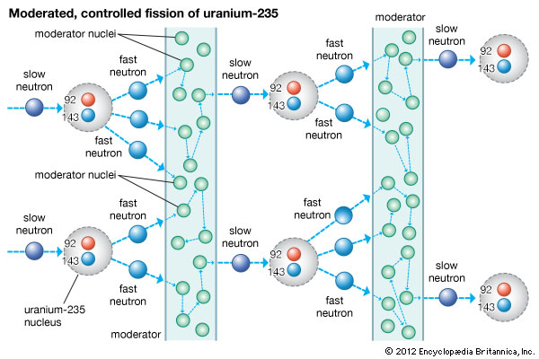
The Physics of Nuclear Power
Naturally occurring uranium consists of 99.3% uranium 238 which is not fissile, and 0.7% of uranium 235 which is fissile
  Normal reactors primarily use the fissile properties of ²³⁵U and enrich naturally occurring uranium to about 3% uranium 235
  A bomb needs about 90% uranium 235
In natural form, uranium cannot sustain a chain reaction: free neutrons are travelling fast to successfully cause another fission, or are lost to the surrounds.
  Moderators are thus needed to slow down/and or reflect the neutrons in a normal fission reactor
Chain reaction in a nuclear reactor at a critical state

Slide 33
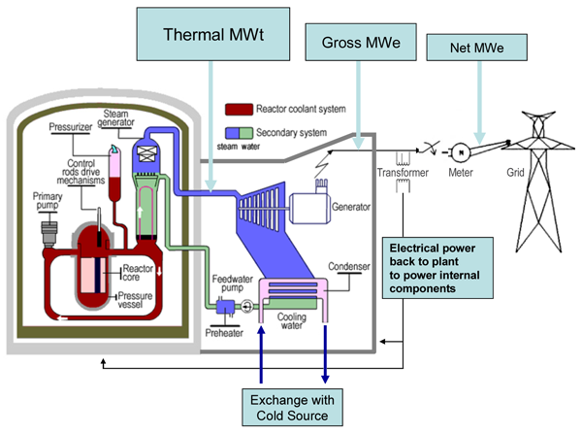
Overview of Reactor Design
There are several components common to most types of reactors:
  Fuel. Uranium is the basic fuel. Usually pellets of uranium oxide (UO₂) are arranged in tubes to form fuel rods. The rods are arranged into fuel assemblies in the reactor core
  Moderator. Material in the core which slows down the neutrons released from fission so that they cause more fission. It is usually water, but may be heavy water or graphite
  Control rods. These are made with neutron-absorbing material such as cadmium, hafnium or boron, and are inserted or withdrawn from the core to control the rate of reaction, or to halt it.
  Coolant. A fluid circulating through the core so as to transfer the heat from it. In light water reactors the water moderator functions also as primary coolant. Except in BWRs, there is secondary coolant circuit where the water becomes steam

Slide 34
Overview of Reactor Design
There are several components common to most types of reactors:
  Pressure vessel or pressure tubes. Usually a robust steel vessel containing the reactor core and moderator/coolant
  Steam generator (not in BWR) Part of the cooling system where the high-pressure primary coolant bringing heat from the reactor is used to make steam for the turbine, in a secondary circuit. Essentially a heat exchanger
  Containment. The structure around the reactor and associated steam generators which is designed to protect it from outside intrusion and to protect those outside from the effects of radiation in case of any serious malfunction inside. It is typically a metre-thick concrete and steel structure

Slide 35
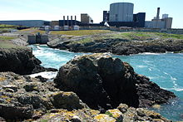
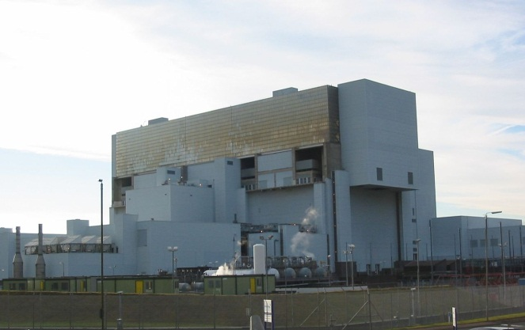
Summary of Reactor Types
Magnox
  Original British Design named after the magnesium alloy used as fuel cladding. 8 reactors of this type were built in France, One in each of Italy, Spain and Japan. 26 units were built in UK
  The first Magnox power station, Calder Hall, was the world's second nuclear power station
  Now only one MAGNOX reactor remains in use – Wylfa on Angelest
AGR - Advanced Gas Cooled Reactor
  Solely British design. 14 units are in use. The original demonstration Windscale AGR is now being decommissioned. The last two stations Heysham II and Torness (both with two reactors), were constructed to time and have operated to expectations
Wylfa
Torness

Slide 36
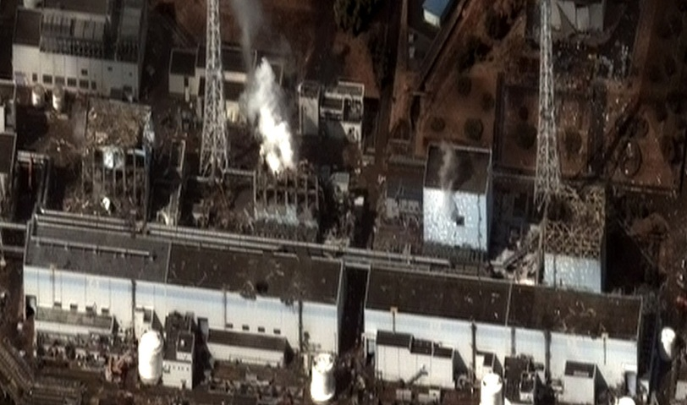
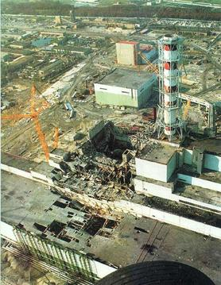
Summary of Reactor Types
PWR - Pressurized Water Reactor
  Originally an American design of (also known as a Light Water Reactor LWR) Now the most common reactor
    Three Mile Island
BWR - Boiling Water Reactor
  A derivative of the PWR in which the coolant is allowed to boil in the reactor itself. Second most common reactor in use
    Fukushima
RMBK - Light Water Graphite Moderating Reactor (LWGR)
  A design unique to the old USSR
  16 units still in operation in Russian and Lithuania with 9 shut down
    Chernobyl
Fukushima
Chernobyl

Slide 37
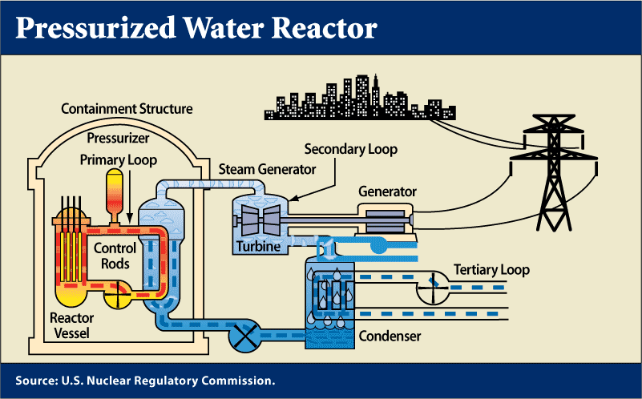
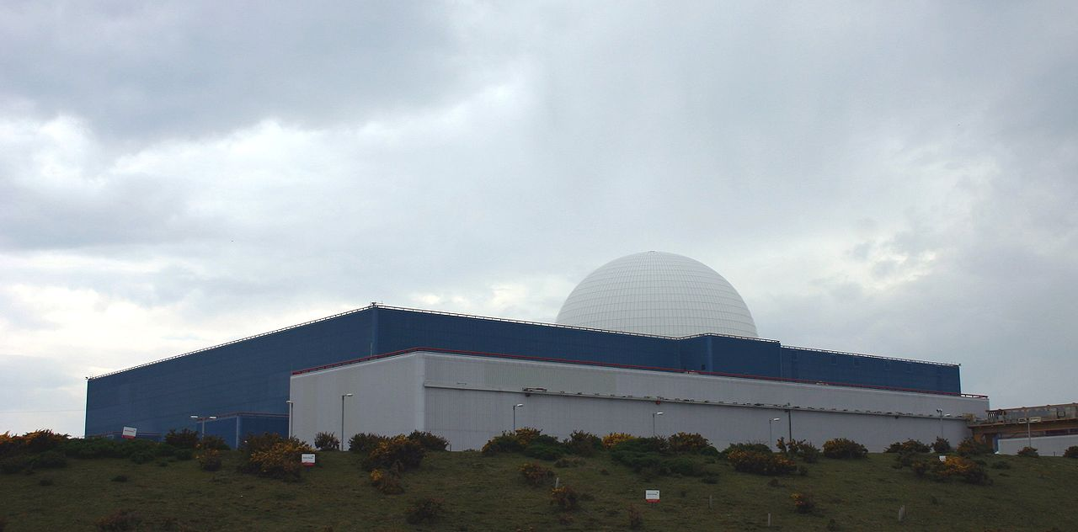
Light Water Reactors (PWR, BWR)
The most commonly used reactor worldwide
A PWRs use ordinary water as both coolant and moderator
It has a primary cooling circuit which flows through the core of the reactor under very high pressure, and a secondary circuit in which steam is generated to drive the turbine
Water in the reactor core reaches about 325°C, hence it must be kept under about 150 times atmospheric pressure to prevent it boiling
Sizewell B is the UK's only commercial PWR power station
Sizewell B

Slide 38
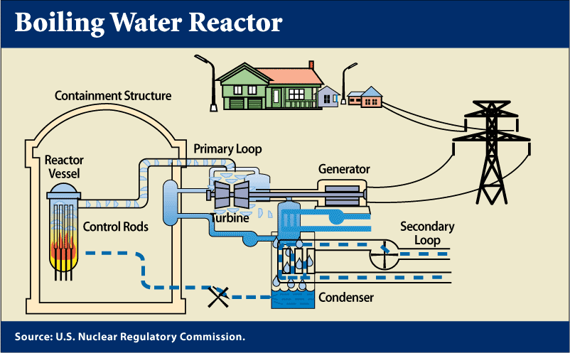
Light Water Reactors (PWR, BWR)
A BWR has many similarities to the PWR, except that there is only a single circuit in which the water is at lower pressure (about 75 times atmospheric pressure) so that it boils in the core at about 285°C
The steam passes through drier plates (steam separators) above the core and then directly to the turbines, which are thus part of the reactor circuit
Since the water around the core of a reactor is always contaminated with traces of radionuclides, it means that the turbine must be shielded and radiological protection provided during maintenance

Slide 39
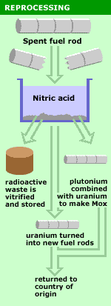
Fuel Reprocessing
Reprocessing is the chemical operation which separates the useful fuel for recycling from the waste
There are only two commercial reprocessing plants in the world - Sellafield in the UK and Cogema in France
Originally reprocessing was used solely to extract plutonium for producing nuclear weapons
  Reprocessed plutonium is now recycled back into nuclear fuel in external reprocessing plants along with spent uranium
    This has raised concerns about nuclear proliferation and terrorism
      Plutonium is the ‘bridge’ between civil and military uses of nuclear power
    Nuclear reprocessing reduces the volume of high-level waste

Slide 40
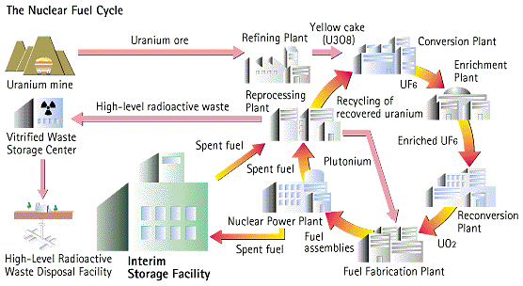
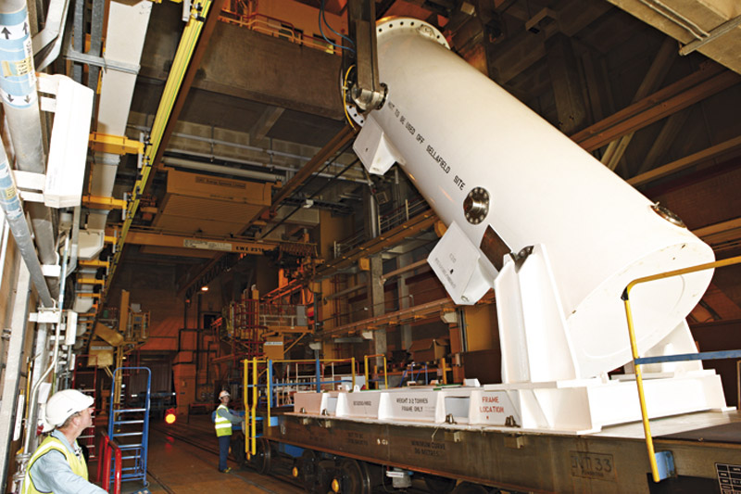
Fuel Reprocessing
Reprocessing adds additional stages to the nuclear fuel cycle
In reprocessing 95% of spent fuel can be recycled to be returned to usage in a nuclear power plant
Thorp reprocessing plant in Cumbria reprocesses both UK and foreign spent fuel but will close in 2016
  Alternatives to reprocessing such as the use air-cooled dry casks to store spent nuclear fuel instead of reprocessing are being considered as the price of raw uranium continues to fall

Slide 41
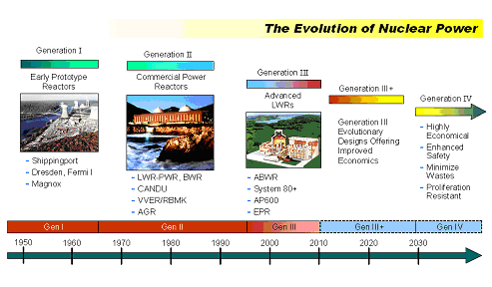
Experimental Reactor Design
Research is currently being conducted for design of the next generation of nuclear reactor designs.
The next generation designs focus on:
  Proliferation resistance of fuel
  Improved fuel efficiency
  Minimizing nuclear waste
  Improved efficiency
  Economics

Slide 42

Pro’s and Con’s of Nuclear Power
Pros
  Less of an immediate environmental impact compared to fossil fuels
  Carbon-free source of electricity - no greenhouse gases emitted
  May be able to generate H-fuel
Cons
  Generates radioactive waste
  Many steps require fossil fuels (mining and disposal)
  Expensive
  Safety issues and public perception

Slide 43

The Future of Nuclear Power
At present there are over 440 nuclear power reactors operating in 30 countries. In total, they provide about 15% of the world’s electricity
Enthusiasm for new nuclear build at present is concentrated in Asia and Russia with relatively weaker enthusiasm in Europe and USA
Worldwide there are 60 new nuclear plants under construction with 131 more proposed
  China alone plans a six-fold increase in nuclear power capacity by 2020, and has more than one hundred further large units proposed
  The new build programme in Europe (excluding Russia) amounts to just six reactors in four countries: Finland, France Romania and Slovakia
  In the UK The government has given the go-ahead for the UK's first new nuclear station in a generation
      France's EDF Energy will lead a consortium to build the Hinkley Point C plant in Somerset

Slide 44

Nuclear Power v Fossil Fuels
In comparing nuclear and fossil fuels, different criteria can be used
  Cost (per unit energy produced)
  Environmental Impact
  Sustainability of resources
  Number of human deaths
  Amount of human disruption
  etc
Generally these criteria are not simple to evaluate as, for example, cost is strongly influenced by government subsidies and environmental impact has to take into account the ‘carbon chain’

Slide 45
Nuclear Power v Fossil Fuels
We can make a few simple comparisons which are non-controversial!
  Energy density comparisons (The amount of energy produced by 1kg of fuel)
  Coal: 3 kW·h
  Oil: 4 kW·h
  Uranium: 50 000 kW·h (3 500 000 kW·h with reprocessing)
Consequently, a 1000 MW(e) plant requires the following number of tonnes (t) of fuel annually:
  2 600 000 tons coal: 2000 train cars (1300 tons each)
  2 000 000 tons oil: 10 supertankers
  30 t uranium: 10 cubic metres
Firewood (dry) | 16 MJ/kg
Brown coal (lignite) | 10 MJ/kg
Black coal (low quality) | 13-23 MJ/kg
Black coal (hard) | 24-30 MJ/kg
Natural Gas | 38 MJ/m³
Crude Oil | 45-46 MJ/kg
Uranium - in typical reactor | 500,000 MJ/kg (of natural

Slide 46


Nuclear Power v Fossil Fuels
Environmental pollutants
  A 1000 MW(e) ‘dirty’ coal plant without abatement technology typically produces annually an average of some 44 000 tonnes of sulphur oxides and 22 000 tonnes of nitrous oxides, 320 000 tonnes of ash containing 400 tonnes of heavy
  A 1000 MW(e) nuclear power plant does not release noxious gases or other pollutants and produces annually only some 30 tonnes of discharged high level radioactive spent fuel along with 800 tonnes of low and intermediate level radioactive waste
  A 1000 MW(e) coal plant emits around 6 000 000 tonnes annually of CO₂
    Countries with significant nuclear power have markedly lower CO₂ emissions per unit of energy produced than countries with high fossil fuel
    France over the past 30 years has, through a rapid expansion in nuclear power, lowered its CO₂ emissions by more than 80%

Slide 47
Part III
  Power Generation from Renewables

Slide 48


Power Generation from Renewables
The adoption of renewable power generation sources is to crucial in both reducing our dependence on nuclear as a low carbon source of power and to reduce overall CO₂ emissions in the long term
  Global climate change policy is to significantly reduce emissions over the next decade

Slide 49

Wind Power
The wind is created by the movement of atmospheric air mass as a results of variation of atmospheric pressure, which results from the difference in solar heating of different parts of the earth surface
Wind power describes the process by which the wind is used to generate mechanical energy or electrical energy
Wind energy is the kinetic energy of the large mass of air over the earth surface
Wind turbines converts the kinetic energy of the wind into mechanical energy first and then into electricity if needed
It is the design of the blades that is primarily responsible for converting the kinetic energy into mechanical energy
  This is key in designing efficient wind turbines
Off-shore wind turbines

Slide 50
The Physics of Wind Power
The kinetic energy of a stream of air of mass m and velocity V
The kinetic energy of the air stream available for the turbine
The air parcel interacting with the rotor per unit time has a cross sectional area of A and thickness equal V
Power is energy per unit time and is hence equal to:
= Volume of air parcel
available to the rotor

Slide 51

The Physics of Wind Power
The wind power increases with the cube of the wind speed
  Doubling the wind speed gives eight times the wind power
Unfortunately it’s not quite that simple!
  The effective usable wind power is less than indicated by the above equation
  The wind speed behind the wind turbine
  can not be zero, since no air could follow. Therefore, only a part of the kinetic energy can be extracted
  The wind speed before the wind turbine is larger than after. Because the mass flow must be continuous, the area A₂ after the wind turbine is bigger than the area A₁ before. The effective power is the difference between the two wind powers
  We can define a power coefficient c_{p} as the ratio between the effective power and the actual wind power

Slide 52
The Physics of Wind Power
We can calculate a theoretical maximum for this power efficiency using some simple assumptions
  We assume that V₁ A₁ = V₂ A₂ ≈ (V₁ + V₂)A/2
  The first equality is simply conservation of mass flowing through the wind turbine
  The power efficiency depends on the ratio V2/V1
  We can compute the maximum efficiency by some simple calculus
    Leads to a maximum of c_{p} equal to around 59% for V2/V1 equal to 1/3
    This is known as the Betz limit or Betz coefficient (0.593)
    Modern day wind turbines achieve an efficiency of around about 80% of the Betz limit

Slide 53


Wind Turbines
There are 2 main types of wind turbines
  Horizontal axis
    Requires a control mechanism to take account of the wind direction
  Vertical axis
    Can handle winds from all directions
The horizontal axis turbine is the most prevalent for large scale wind farms
Large turbines generally use a wind sensor coupled with a servo motor to rotate the turbine
Most have a gearbox, which turns the slow rotation of the blades into a quicker rotation that is more suitable to drive an electrical generator
Since a tower produces turbulence behind it, the turbine is usually positioned upwind of its supporting tower

Slide 54


Wind Turbines
A typical wind turbine consists of the following components:
  The Tower which are mostly cylindrical, made of steel, painted light grey, and from 25 to 75 metres in height.
  Rotor Blades - Wind turbines can have from one to three rotor blades, made of fibreglass-reinforced polyester or wood-epoxy. The blades are usually between 30 and 80 metres in diameter. The longer the blades, the greater the energy output. They rotate at 10-30 revolutions per minute at constant speed, although an increasing number of machines operate at a variable speed. The blades can be rotated to change the pitch angle and modify power output

Slide 55

Wind Turbines
A typical wind turbine consists of the following components:
  The Yaw Mechanism turns the turbine to face the wind
  Wind Speed & Direction Monitor Sensors are used to monitor wind direction and the tower head is turned to line up with the wind. Power is controlled automatically as wind speed varies and machines are stopped at very high wind speeds to protect them from damage.
  The Gear Box - Most wind turbines have gearboxes, although there are increasing numbers with direct drives
Video. Wind Turbine Operation

Slide 56


Wind Turbines
A key feature of wind turbines is the design of the blade
It follows an aero foil design and essentially lift turns the blade
  Air flow over the blade develops lift force and causes the blade to rotate
  The optimum angle of attack for maximum lift and minimum drag depends on the relative wind speed
  This varies along the length of the blade so the blade is twisted slightly from root to tip
  Also the blade pitch angle is varied to vary the rotation speed of the rotor

Slide 57


Wind Power
The generator converts the rotational energy into electrical energy
  The transformer converts the electricity from around 700 Volts (V) to the right voltage for distribution, typically 33,000V. The National Grid transmits the power around the country
Wind power is an intermittent energy source which must be used when available
  Typically a wind farm will operate at about 40% capacity (averaged annual output)
  Power management techniques such as having excess capacity storage, geographically distributed turbines, storage such as pumped-storage hydro-electricity, exporting and importing power to neighbouring areas or reducing demand when wind production is low, can greatly mitigate these problems
Small domestic wind power systems, with a single turbine, can be wired directly to the domestic supply

Slide 58


Wind Power
Typically wind turbines being manufactured now have power ratings ranging from 250 watts to 1.8 MW
  For example a large 1.8-MW turbine can produce more than 5.2 million kWh a year which is enough to power about 520 households
Wind farms are collections of wind turbines
  They have to be designed with a minimum spacing to avoid turbulence
  There are 5,276 wind turbines with a total installed capacity of over 10 GW : 6,831 MW of onshore capacity and 3,653 MW
  Whitelee wind farm is the largest on-shore wind farm in the UK with 215 turbines and a total capacity of 539MW
  The Alta Wind Energy Center in California, United States is the largest on shore farm outside of China, with a capacity of 1,020 MW (over 300 turbines occupying 36km²)
  As of April 2013, the 630 MW London Array in the UK is the largest offshore wind farm in the world
Whitelee Wind Farm
Alta Wind Energy Center

Slide 59


Solar Power
Solar power involves harnessing the solar radiation hitting Earth’s surface to generate heat and power
The daily average solar irradiation (insolation) for Earth is approximately 250 W/m²
  This corresponds to a daily irradiation of 6 kWh/m²
The figure varies drastically according to location (latitude) and season
  In tropical and sub-tropical climates it can be twice this average
  By contrast the UK's insolation is less than 120 W/m² (2.9 kW·h/m²/day, or 1050 kW·h/m²/year)
  Nevertheless, even in the UK, by February 2012 the installed capacity for solar energy had reached 1,000 MW, the size of a single typical power station

Slide 60


Solar Power
On application of solar power is in concentrated solar power (CSP) systems
These use the direct heat from the sun to heat ultimately drive a steam
Large mirrors are used to focus the radiation in order to convert the sun's energy into high-temperature heat
The heat energy is then used to generate electricity in a steam generator. Heat exchanger plus steam turbine
The United States houses the largest CSP plant Ivanpah in the Mojave Desert with 173,500 heliostats and 3 power towers with a 400MW capacity
Heliostat

Slide 61


Solar Power
The enormous amount of energy, coming out of the sun rays, concentrated at one point (the tower in the middle), produces temperatures of between 500 and 1500 deg C
The latest technology in CSP systems is to use molten salt for energy storage
  It offers much higher energy density than water -- the plant can operate for 15 hours on the stored heat –
  The salt comprises 60% sodium nitrate and 40% potassium nitrate and can be heated to extremely high temperatures, typically 1000 deg C
  Using salt to store heat is extremely efficient
The Power Tower Project "Solar II" (California)

Slide 62


Photovoltaic Power Generation
Photovoltaics (PV) is a method of generating electricity by converting solar radiation into direct current electricity using semiconductors, typically silicon, that exhibit the photovoltaic effect
Photovoltaic power generation employs solar panels composed of a number of solar cells containing a photovoltaic material
  The photovoltaic effect was first observed by French physicist A.E.Becquerel in 1839 and involves electrons being excited in a semi conductor through incident light so that they become free and not bound to molecules
Grid-connected PV systems have been in use for over twenty years and currently have a global capacity of around 139GW
Copper Mountain 150 MW solar PV plant in Nevada

Slide 63

The Physics of Photovoltaic Cells
PV cells are based around semi-conductors of which the vast majority use silicon
The atomic structure of silicon is the key to understanding it’s behaviour as a semi-conductor
A silicon atom has 14 electrons and 14 protons
e⁻
e⁻
e⁻
e⁻
e⁻
e⁻
14+
14-
14+
14-
14+
14-
e^{-e-}
N
14+
e⁻
e⁻
14+
14-
14+
14--
14+
14-
e⁻
e⁻
e⁻
e⁻
e⁻
e⁻
e⁻
e⁻
e⁻
e⁻
e⁻
e⁻
14+
14-
14+
14-
14+
14-
e⁻

Slide 64


The Physics of Photovoltaic Cells
The outer 4 electrons, together with the 4 from their adjacent atoms, form octets which is a stable crystalline structure
Electrons don’t “wander off” (from this structure
  To remove electrons from these stable covalent bonds requires energy
  Essentially enough energy has to be inputted to get electrons to jump across an ‘energy gap’ into the conduction band
  The size of the band gap determines whether the substance is a conductor, semiconductor or an insulator

Slide 65
The Physics of Photovoltaic Cells
When sunlight strikes a piece of silicon, however, the solar energy knocks and frees electrons from their atom structure (the octets structure)
The freed electrons randomly move within the material
This random motion of charge cannot be utilized for power generation
    In order to utilize the energy from the sun, this flow of charges must be directed in one direction
    By using silicon within a pn-junction configuration, the flow of electrons can be directed
Heat or light
e⁻
e⁻
e⁻
e⁻
e⁻
e⁻
14+
14-
14+
14-
14+
14-
e^{-e-}
14+
N
e⁻
e⁻
14+
14-
14+
13-
14+
14-
e⁻
e⁻
e⁻
1-
e⁻
e⁻
e⁻
e⁻
e⁻
e⁻
e⁻
e⁻
e⁻
14+
14-
14+
14-
14+
14-
e⁻
Freed electron

Slide 66

p and n doping
Doping is a technique used to vary the number of electrons and holes in semiconductors.
  Doping creates n-type material when semiconductor materials from group IV (such as silicon) are doped with group V atoms (such as phosphorus, arsenic , or antimony)
  p-type materials are created when semiconductor materials from group IV are doped with group III atoms (such as boron, aluminum or gallium )
n-type materials increase the conductivity of a semiconductor by increasing the number of available electrons; p-type materials increase conductivity by increasing the number of holes present
Bubble
Flow
(current flow)
Think of conduction by holes as bubbles rising in a bottle
Water flow
(electron flow)

Slide 67



pn-junction
Interesting things happen when you put an n-type material in contact with a p-type material to form a pn-junction
  Before making the contact, both p and n type materials are electrically neutral
After making contact, electrons and holes diffuse across the junction and a depletion layer is formed
  In the boundary layer, the free electrons in the n-type materials combine with the holes in the p-type
  Consequently, the p-type side of the boundary layer is negatively charged and n-type side is positively charged
  An electric field across the junction is formed

Slide 68
Operation of a Solar Cell
sunlight
A solar cell is simply a pn-junction with an anti-reflective coating so incident sunlight is not reflected back
When sunlight strikes atoms in the pn- junction and knocks out more electrons (and creates corresponding holes), the free electrons are expelled by the negative charge on the p-type side and hence move towards the n-type side
If a load is connected across the cell, electric current is formed and the energy is transmitted to the load
p-type
(Negatively charged)
n-type
(Positively charged)
sunlight
p-type
n-type

Slide 69
Operation of a Solar Cell
A solar cell is simply a pn-junction
P
P
Current appears to be in the wrong direction through the diode! It is delivering power rather like a battery
A
N
Short Circuit
N
High insolation
Normal operation point
(Maximum Power point)
Current(I)
Low insolation
P
I x V = W
V
N
Voltage(V)
about 0.5V (Silicon)
Open Circuit

Slide 70

Solar Cell Efficiency
Solar cell efficiency is the ratio of the electrical output of a solar cell to the incident energy in the form of sunlight
The energy conversion ratio(η) is the percentage of the solar energy to which the cell is exposed that is converted into electrical energy
This is calculated by dividing a cell's power output (in watts) at its maximum power point (P_{m}) by the input light (E, in W/m²) and the surface of the solar cell (A_{c} in m²)
Efficiencies of around 40% are achievable but are typically around 20% in commercial devices
Example - a solar panel with 20% efficiency and an area of 1 m² will produce 440 kWh of energy per year in tropical and sub-tropical locations but only 175 kWh annual energy yield in southern England

Slide 71

Structure of a Solar Cell
A typical solar cell consists of a glass or plastic cover, an anti-reflective layer, a front contact to allow electrons to enter a circuit, a back contact to allow them to complete the circuit, and the semiconductor layers where the electrons begin and complete their journey
Because the amount of power produced by a single solar cell is relatively small, one to two watts, designers group solar cells together to form modules (panels) that supply a more useful level of voltage, current, and power
  Solar cells may be connected in series to produce higher voltages

Slide 72

Solar PV Stations
A Solar PV station (sometimes called a solar farm or PV farm, solar plant, solar power plant or PV power plant) feeds power directly into the grid using arrays of PV panels
It would typically comprise
  Power inverters that convert the direct current (DC), generated by the solar panels into alternating current (AC)
  A tracking system to maximize solar energy input at different times of day
  A monitoring system to control the parameters of the solar power plant
  Measurement units to monitor the performance of the system and control the amount of electricity to sell it using the "green" tariff
  The supporting steel structures for placing solar panels on the ground, roof, etc

Slide 73


Solar PV Stations
Olmedilla Photovoltaic Park, Spain
The world’s largest Solar PV station is Olmedilla PV Park in Spain
It uses 162,000 flat solar photovoltaic panels to deliver 60 MW of electricity on a sunny day
A number of similarly large parks are under construction in the Mojave desert in California
In the UK installed capacity had reached 1,000 MW from smaller domestic systems
Whilst growth has been impressive over the past decade, it still only represents a small part of the UK renewable energy capacity
UK Renewable Energy Growth In 2012

Slide 74



Domestic Solar Power
Domestic systems are either direct water heaters or PV panels to provide power (to sell back to the grid)
Other components include an inverter to convert the DC output to AC and a meter to monitor the amount of power fed back
More sophisticated systems might incorporate a GPS tracker
In the UK, PV installations are generally considered permitted development and don't require planning permission
  You would typically get 0.2kW peak power for a 1m² panel
  Feed-in tariffs apply for domestic solar power
    You get paid for all the electricity you generate (even if you use it yourself) as well as all electricity you export to the grid

Slide 75


Hydropower
Hydroelectric power comes from water at work, water in motion
It arises through the hydrological cycle which arises ultimately from the sun’s energy
  Atmospheric water reaches Earth’s surface as precipitation
  Some of this water evaporates, but much of it either percolates into the soil or becomes surface runoff
  Water from rain and melting snow eventually reaches ponds, lakes, reservoirs, or oceans where evaporation is constantly occurring
  A dam constructed in a river valley artificially raises the level in a natural water body forming a reservoir from which hydropower can be produced

Slide 76
The Physics of Hydropower
The physics behind hydropower is very simple
Consider a mass m of water that falls down a vertical height h
  The potential energy of the mass is mgh, and it gets converted into kinetic energy when the mass descends the vertical distance h.
  Within a time equal to Δt, the mass of water that will flow through the tube is
  ρ is the water’s density (1000kg/m³) and ΔV is the volume it occupies
  The rate of change of this potential energy, that is, the power P, is given by the change in potential energy divided by the time taken for that change, so
m
h
ρ
ΔV

Slide 77

The Physics of Hydropower
The quantity Q =ΔV/Δt is known as the volume flow (volume per second) and so:
This is the power available for generating electricity
Typically the following units are often used so a conversion factor is required
  Power = the electric power in kilowatts
  Head = the distance the water falls (in feet)
  Flow = the amount of water flowing (in cubic feet per second)
  Efficiency = How well the turbine and generator convert the power of falling water into electric power
    This can range from 60% for older plant to 90% for more modern plants
  11.8 = Index that converts units of feet and seconds into kilowatts
A standard equation for calculating energy production:
Power = (Head) x (Flow) x (Efficiency)
11.8

Slide 78

The Physics of Hydropower
As an example, we can how much power can be generated by the power plant at Roosevelt Dam, the uppermost dam on the Salt River in Arizona.
  Although the dam itself is 357 feet high, the head is 235 feet
  The typical flow rate is 2200 cfs
  Let’s assume say the turbine and generator are 80% efficient
Roosevelt’s generator is actually rated at a capacity of 36000kW
Power = (Head) x (Flow) x (Efficiency) kW
11.8
Power = 235 x 2200 x 0.6) = 35,051kW
11.8

Slide 79


Hydropower Plants
Hydropower plants are actually based on a rather simple concept -- water flowing through a dam turns a turbine, which turns a generator
A typical plant comprises the following parts
  Dam - Most hydropower plants rely on a dam that holds back water, creating a large reservoir
  Intake - Gates on the dam open and gravity pulls the water through the penstock, a pipeline that leads to the turbine Water builds up pressure as it flows through this pipe
  Turbine - The water strikes and turns the large blades of a turbine, which is attached to a generator above it by way of a shaft. A turbine can weigh as much as 172 tons and turn at a rate of 90 revolutions per minute
  Generators - Giant magnets rotate past copper coils, producing alternating current
  Transformer - The transformer inside the powerhouse takes the AC and converts it to higher-voltage current
  Outflow - Used water is carried through pipelines, called tailraces, and re-enters the river downstream

Slide 80


Hydropower Schemes
Three Gorges Dam on the Yangtze river in China is the largest hydroelectric dam (in electricity production), with a generating capacity of 22,500 MW
It has design of state-of-the-art large turbines and is extremely efficient
  However, the dam flooded archaeological and cultural sites and displaced some 1.3 million people, and is causing significant ecological changes, including an increased risk of landslides
    When at its full capacity the reservoir flooded a total area of 632 square kilometres
  Hydropower does play a large role in Chinese energy production and is a significant contributor to reducing it’s reliance on fossil fuels

Slide 81


Pumped Storage Schemes
Pumped-storage hydroelectricity (PSH) is a means of hydroelectric power storage used by for load balancing
The method stores energy in the form of gravitational potential energy of water, pumped from a lower elevation reservoir to a higher elevation
Low-cost off-peak electric power is used to run the pumps
Currently, there is over 90 GW of pumped storage in operation worldwide although these schemes require massive capital expenditure
The Dinorwig Power Station is a 1,728 MW pumped storage hydroelectric scheme in the Snowdonia national park
  It is run as a short term operating reserve, providing a fast response to short-term rapid changes in power demand or sudden loss of power stations (typically overall demand increases of up to 2,800 MW)

