Slide 1

The Outlook for Energy:
A View to 2040
Dr. David Khemakhem
Global Energy Security Forum
Miami, February 12, 2013
This presentation includes forward-looking statements. Actual future conditions (including economic conditions, energy demand, and energy supply) could differ materially due to changes in technology, the development of new supply sources, political events, demographic changes, and other factors discussed herein and under the heading "Factors Affecting Future Results" in the Investors section of our website at: www.exxonmobil.com. The information provided includes ExxonMobil's internal estimates and forecasts based upon internal data and analyses as well as publically-available information from external sources including the International Energy Agency. This material is not to be used or reproduced without the permission of Exxon Mobil Corporation. All rights reserved.

Slide 2
Energy Outlook Development
100 countries
15 demand
sectors
20 fuel
types
technology & policy
ExxonMobil 2013 Outlook for Energy

Slide 3
CO₂ Policies
2030
2040
CO₂ “Proxy” Cost
CO₂ “Proxy” Cost
~ 60 $/ton
< 10 $/ton
~ 15 $/ton
~ 20 $/ton
~ 80 $/ton
ExxonMobil 2013 Outlook for Energy

Slide 4


Global fundamentals

Slide 5
Population Trends Impacts Energy Use
Population
Fertility Rate*
Global Demographics*
Billion
Children per Woman
Billion
Age 65+
Other Non OECD
Africa
Age 15-64
India
China
OECD
Age 0-14
ExxonMobil 2013 Outlook for Energy
* Source: World Bank & United Nations

Slide 6
Economic Growth Drives Energy Demand
Energy Demand
GDP
Energy Demand
Quadrillion BTUs
Trillion 2005$
Quadrillion BTUs
2010-2040 AAGR %
2010-2040 AAGR %
2010-2040 AAGR %
World
2.8%
World
1.0%
Other Non OECD
3.9%
World
1.0%
Energy Saved ~500
China
5.6%
Other OECD
1.8%
United States
2.3%
ExxonMobil 2013 Outlook for Energy

Slide 7
Tale of Two Worlds
Non OECD
OECD
Quadrillion BTUs
Quadrillion BTUs
Other Renewables
Biomass
Nuclear
Coal
Gas
Oil
ExxonMobil 2013 Outlook for Energy

Slide 8
Energy Mix Continues to Evolve
Quadrillion BTUs
0.8%
2040
Average Growth / Yr.
2010 - 2040
1.7%
2010
1.0%
-0.1%
2.4%
0.4%
5.8%
1.8%
ExxonMobil 2013 Outlook for Energy

Slide 9
Electricity Generation Leads Growth
Energy Demand by Sector
Energy Demand by Sector
Quadrillion BTUs
Quadrillion BTUs
2040
2025
Electricity Demand
2010
ExxonMobil 2013 Outlook for Energy

Slide 10


Residential/commercial

Slide 11
Household Growth Drives Residential Demand
2040
Million Households
2040
2010
ExxonMobil 2013 Outlook for Energy

Slide 12
Residential/Commercial Outlook
By Sector
Residential Energy Intensity
Fuel Demand
Quadrillion BTUs
Million BTUs per Person
Quadrillion BTUs
North America
Commercial
Other
Electricity
Europe OECD
Japan
China
Biomass
Residential
Coal
Gas
India
Oil
ExxonMobil 2013 Outlook for Energy

Slide 13


Industrial

Slide 14






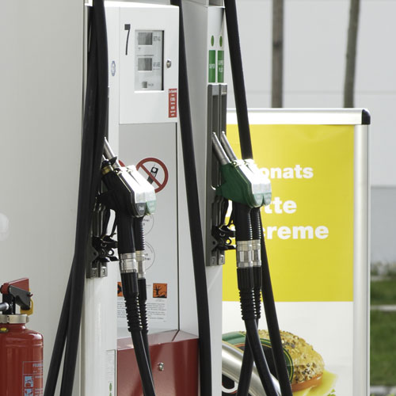
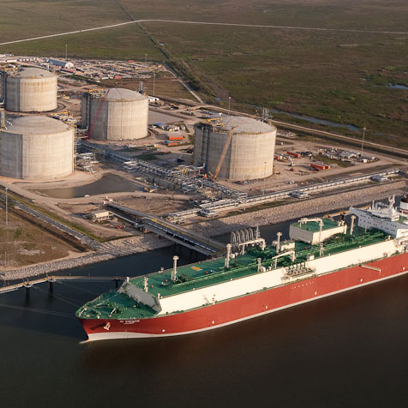



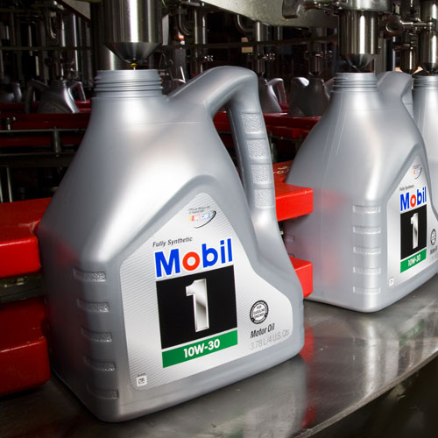
Industry Energy Demand Increases
Quadrillion BTUs
Paint
Fertilizer
Plastics
Chemicals
Automobiles
Textiles
Steel
Manufacturing & Industry
Natural Gas
Liquid Fuels
Coal
Energy Industry
Lubricants
Asphalt
Other
Agriculture
ExxonMobil 2013 Outlook for Energy

Slide 15
Industrial Energy Demand
By Fuel
By Region
Quadrillion BTUs
Quadrillion BTUs
Market Heat
Electricity
Rest of Non OECD
Renewables
Coal
India
Gas
China
Oil
OECD
ExxonMobil 2013 Outlook for Energy

Slide 16


Electricity generation

Slide 17
Electricity Demand by Region
Non OECD
OECD
Thousand TWh
Thousand TWh
Other Non OECD
Russia/Caspian
Southeast Asia
Middle East
Africa
Other OECD
India
Europe OECD
China
North America
ExxonMobil 2013 Outlook for Energy

Slide 18
Fueling Electricity Generation Varies by Region
Electricity Generation
Electricity Generation
Growth in Fuels from 2010 to 2040
Quadrillion BTUs
Quadrillion BTUs
Quadrillion BTUs
Renewables
Renewables
Nuclear
Non OECD
Nuclear
Coal
Gas
Coal
OECD
Oil
Gas
Oil
ExxonMobil 2013 Outlook for Energy

Slide 19
Global Electricity Generation Mix Evolves
Global Capacity
By Generation
Global Capacity Utilized
GW
k TWh
GW
Gas
Coal
Nuclear
Wind & Solar
Other Renewables
Oil
ExxonMobil 2013 Outlook for Energy

Slide 20

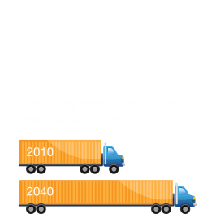
Transportation

Slide 21
Transportation Demand
Sector Demand
Demand by Region
MBDOE
MBDOE
Rail
‘40
Marine
Aviation
‘25
Heavy Duty
‘10
Light Duty
ExxonMobil 2013 Outlook for Energy

Slide 22
Light Duty Vehicle Fleet Grows, Mix Changes
Powertrain Technology
Powertrain Technology
Powertrain Technology
Millions of Vehicles
Millions of Vehicles
Millions of Vehicles
2010
2040
2025
ExxonMobil 2013 Outlook for Energy
*Full Hybrid, Plug-in Hybrid, Electric Vehicles

Slide 23
Light Duty Vehicle Sales & Efficiency
Annual New Car Sales by Type
Incremental Vehicle Efficiency Gains
Million Cars
Miles per Gallon
47 MPG
Hybrid
Vehicle Size
Body & Accessories
Average
27 MPG
Powertrain
ExxonMobil 2013 Outlook for Energy

Slide 24

Today’s Vehicle Technology Choices
Estimated Driving Distance per Fill-up
5-Year Cost & Savings
2012$k
Full hybrid: 515 miles
Diesel: 435 miles
Cost above Conventional
Gasoline: 350 miles
E85: 260 miles
Fuel Savings
CNG: 210 miles
Electric: Up to 100 miles
PHV: Up to 40 miles + 450 miles
ExxonMobil 2013 Outlook for Energy

Slide 25
Heavy Duty Transportation Efficiency
New Truck Efficiency
Efficiency Impact
% Improvement, 2010-2040
MBDOE
Truck Size
Hybrid
Body
Powertrain
Logistics & Congestion
Body
Powertrain
Technology
Regional Impact
ExxonMobil 2013 Outlook for Energy

Slide 26
Transportation Fuel Mix
Fuel Demand
Growth in Demand from 2010 to 2040
MBDOE
MBDOE
Other
Natural Gas
Fuel Oil
Jet Fuel
Biodiesel
Diesel
Ethanol
Gasoline
ExxonMobil 2013 Outlook for Energy

Slide 27


Supply

Slide 28
Remaining Oil Resource
Crude and Condensate (BBO)
~1,000
Source: IEA
~1,100
~1,100
~100
Russia/Caspian
Europe
North America
~650
~150
Middle East
~200
Asia Pacific
~4,300
Latin America
Africa
Global
ExxonMobil 2013 Outlook for Energy

Slide 29
Liquids Supply
Supply by Type
Resource*
MBDOE
TBO
Biofuels
Other Liquids
NGLs
Oil Sands
Tight Oil
Remaining Resource
Deepwater
Conventional Crude & Condensate
Cumulative Production
ExxonMobil 2013 Outlook for Energy
* Source: IEA

Slide 30
Global Gas Resource
Source: IEA; *Includes Europe Non OECD
6.2
4.3
1.6
4.9
Europe OECD
Russia/ Caspian*
North America
4.5
1000 TCF
Middle East
2.6
Unconventional
2.5
Asia Pacific
Africa
Latin America
Conventional
Over 200 years coverage at current demand
ExxonMobil 2013 Outlook for Energy

Slide 31
Natural Gas Supply and Demand Shifts
North America Gas Supply
Global Gas Supply
BCFD
BCFD
LNG
Rest of World Unconventional
North America Unconventional
Local Unconventional
Rest of World Conventional
Local Conventional
North America Conventional
ExxonMobil 2013 Outlook for Energy

Slide 32
Growth in Unconventional Production
Production by Type
Production by Region
BCFD
BCFD
Rest of World
Asia Pacific
Shale
Americas
Coal Bed Methane
Tight
ExxonMobil 2013 Outlook for Energy

Slide 33
North America Energy Balance
Quadrillion BTUs
Oil
Net Exports
Net Imports
Regional Supply
Total Energy Balance
Net Exports
Gas
Net Imports
Net Exports
Regional Supply
Regional Supply
ExxonMobil 2013 Outlook for Energy

Slide 34
Asia Pacific Energy Balance
Quadrillion BTUs
Oil
Net Imports
In-country supply
Total Energy Balance
Gas
Net Imports
In-country supply
Net Imports
In-country supply
ExxonMobil 2013 Outlook for Energy

Slide 35

Conclusions
ExxonMobil 2013 Outlook for Energy

Slide 37
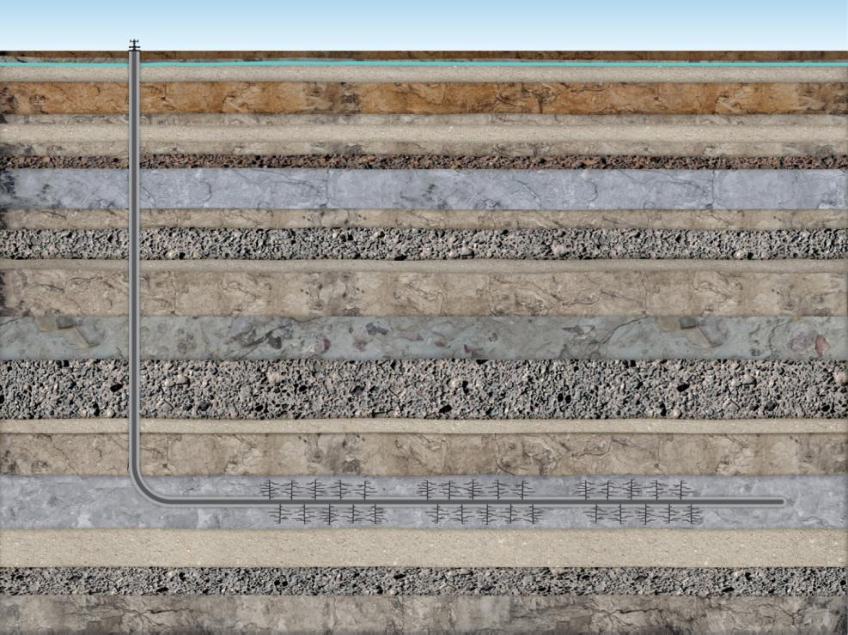




Shale Gas and Hydraulic Fracturing
Conductor Casing
Surface Casing
Thousands of feet of solid rock
Intermediate Casing
Production Casing*
*14,000 feet measured depth

Slide 38
Regional Energy Trends Evolve
By Region
Percent of World Total
North America
Europe
Russia/Caspian
China
Other AP
Africa
Middle East
Latin America
ExxonMobil 2013 Outlook for Energy

Slide 39
Economic Choices for U.S. Electricity
Baseload, Startup 2030
2012 cents/kWh
$60/ton of CO₂
Reliability Cost
$0/ton
*Wind and solar exclude costs for integration, backup capacity and additional transmission
ExxonMobil 2013 Outlook for Energy

Slide 40
Renewables Gain Share
United States
Europe
Asia Pacific
Percent of TWh
Percent of TWh
Percent of TWh
*Biomass includes Municipal Solid Waste
ExxonMobil 2013 Outlook for Energy

Slide 41
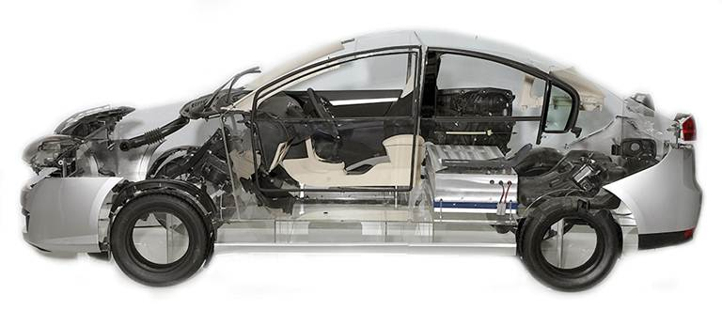
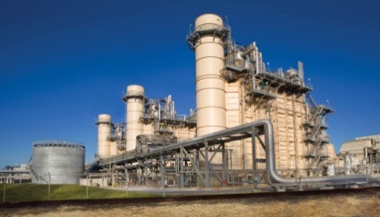
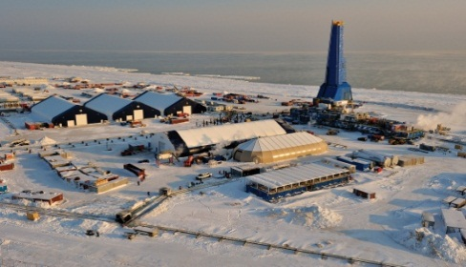
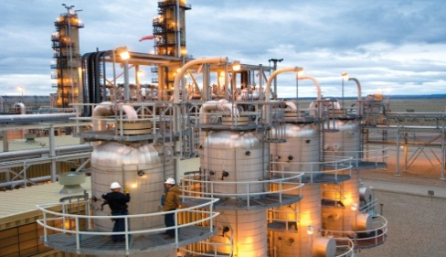
ExxonMobil: Technology for Energy Challenges
Technology to address the twin challenges of increased energy demand while mitigating risk from GHG emissions
Improving Efficiency
  Automotive technologies
    Vehicle light weighting
    ExxcoreTM: tire lining technology
    Advanced synthetic lubricants
  Power generation
    Cogeneration
    Wind turbine lube oils
Expanding Supplies
  Directional drilling
  Unconventional and liquefied natural gas
  Advanced biofuels
Reducing Emissions
  Natural gas for power generation
  Controlled Freeze Zone™
  Carbon capture and storage
  Global Climate & Energy Project

Slide 42

Costs Impact U.S. Heavy Duty Choices
3-Year Cost of Ownership
5-Year Cost of Ownership
$k
$k
2012
2012
Vehicle Cost
Vehicle Cost
Fuel
Cost
Fuel
Cost
Long Haul Truck
Short Haul Truck
LNG Tanks
CNG Tanks
ExxonMobil 2013 Outlook for Energy

Slide 43

Bio for David Khemakhem (k’mak’m)
David Khemakhem is an Energy and Technology Advisor at ExxonMobil. He is a member of the Corporate Strategic Planning Department, where he is responsible for assessing energy trends, emerging energy technologies, and related market and public policy issues around the world. He is one of the principal contributors to ExxonMobil’s long-term global Energy Outlook. He is also active in communicating ExxonMobil’s view of the future of energy to a wide variety of audiences.
David has worked with Exxon then ExxonMobil since 1997 in numerous technical and management assignments covering activities in the United States and around the world.
He started his career with Exxon Production Research Company in the area of Wellbore Design and eventually became Team Lead for the Well Integrity Group at ExxonMobil Upstream Research.
In 2001, he transferred to ExxonMobil Production Company as a Subsurface Engineer overseeing completion and workover operations in Colorado, Wyoming, California and South Texas.
In 2003, David relocated to Qatar, where he spent six years in a variety of assignments, including Drilling and Completions Engineering Manager. In this role he led a team of engineers working on RasGas’s 14 drilling rigs during the development of the North Field.
In 2009, David transferred back to Houston, joining the ExxonMobil Upstream Research Company as Well Performance Manager and then in 2010, he became the Unconventional Gas Recovery Manager.
The following year, in 2011, David moved to ExxonMobil Headquarters to join the Corporate Strategic Planning team where he is helping in the development of the Energy Outlook for 2013 and beyond.
David holds a Ph.D. in Mechanical Engineering from the University of Minnesota.
Text in Box: Short Bio

Slide 44







Conductor Casing
Fresh Water Aquifer
Surface Casing
Intermediate Casing
Production Casing*
14,000 feet measured depth

