Slide 1
Throwing Teddy Bears Off The Roof
EE3GP Group Project
30 credit compulsory module (MEng 3 only)
Coordinator: Dr Costas Constantinou
Supervisors: Dr Costas Constantinou and Mr Phil Atkins

Slide 2
Aims & Objectives
Hard science; no spoon-feeding
Advantages & disadvantages of group working
Mature from a group into a team
Develop initiative
  both the task and process are only very loosely defined
Introduce essential new skills not covered elsewhere
  research skills
  using data books
  using new microprocessors
  etc.
Learn to search for information in libraries & other repositories
  distinguishing between reliable and unreliable sources of information

Slide 3
Academia vs. “real world”
GP reflects real-world job experience for engineers
  No on choice on who is in “your” group
  Failure of social dynamics (e.g. finger-pointing, finding scapegoats, etc.) = failure of group project (& whole degree)
  You have to work to a budget
  You have to work to deadlines
  “It works” is not good enough – your product will have to compete with others
  You have to deal with a “customer” who knows what he wants but won’t pin in down to a specification
Performance criteria same as those applied to professional engineers

Slide 4
Useful information
Your laboratory is in room N.216 (UG project laboratory)
  hot-benched, no specialised hardware and software provided
Budget of £1200 per group
No other useful information!

Slide 5
Dates for your diary
1st field demonstration & 1st presentation Wed, 5 Dec 2012 (wk 11, autumn)
Interim group report + CVs
12 noon, Fri, 7 Dec 2012 (wk 11, autumn)
2nd field demonstration & 2nd presentation
Wed, 20 Mar 2013 (wk 11, spring)
Final group report + CVs
12 noon, Mon, 8 Apr 2013 (wk 3, Easter)
Poster (project open day) + Mark apportionment
Thu, 25 April 2012 (wk 1, summer)
5%
5%
10+10%
67.5%
2.5% (peer)

Slide 6
Don’t
Plagiarise
Produce “hot air”
Rely just on powerpoint for presentations
Exceed submission page/word limits
Submit late (–5% per day)
Break any law:
  health and safety
  radio transmissions
  laws I haven’t thought of!
Comply with ethical review guidelines

Slide 7
Mark apportionment
Read Appendix C of the project handout very, very carefully indeed
Marks must be accompanied by justification of apportionment to be given to external examiners
If you decide to deviate significantly from the suggested procedure you must seek my approval for your scheme

Slide 8
Rules
Keep the entire exercise legal
Please respect university property and grounds
Keep radio transmissions compliant with UK spectrum usage laws
During outdoors work and/or demonstrations wear sensible shoes and clothing
Perform a real risk assessment and stop other members of your team from getting into trouble
No other rules at this stage, but we reserve the right to make changes or add to these rules until noon of Friday week 2 of the Spring term

Slide 9
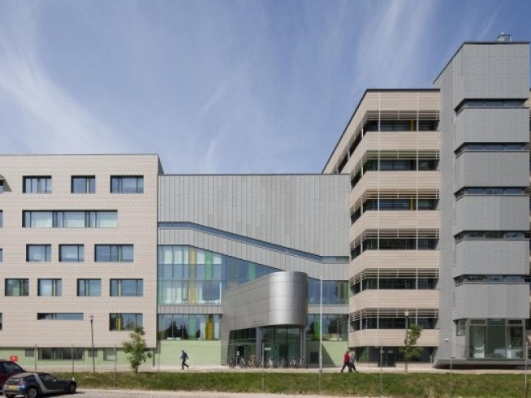

The 2012 – 2013 Project
Throwing Teddy Bears off the Roof

Slide 10
Throwing Teddy Bears off the Roof
You are required to design, prototype and demonstrate a system comprising
  a launch subsystem that can be operated by a member of staff on your group’s behalf on the roof of the Gisbert Kapp building,
  an autonomously steerable “flying” teddy bear (max. descend speed of 1 m/s), and
  a homing signal subsystem surrounding a target of 1 m in diameter on the ground
No other information will be given to you

Slide 11
Throwing Teddy Bears off the Roof
The launch subsystem must be:
  100% safe to operate
  sufficiently lightweight and compact for one person to carry (i.e. weigh no more than 10 kg and its dimensions should not exceed 30 cm x 30 cm x 200 cm); the assessors are likely to be more impressed by light-weight solutions
  capable of being operated by a person standing at least 60 cm away from the roof railings
  operated without the need for accurate pointing at a particular direction
  operated through the push of a simple button

Slide 12
Throwing Teddy Bears off the Roof
The teddy bear must be:
  autonomous
  capable of landing on the target without suffering damage over repeated launches
  capable of being remotely put into an emergency “landing” mode to ensure that in the event of strong wind gusts it does not drift outside a predetermined cordoned off area at the back of the Gisbert Kapp building and presenting a risk of colliding with any humans or objects
  limited in the maximum terminal-velocity it can reach to 1 ms^{–1} and this value may only be exceeded in the first 2m of descent following launch
The homing signal subsystem must be:
  wireless or passive
  battery powered

Slide 13
The teams
Group A: Supervisor PRA
Title | Surname | Initial(s)
Mr | Aleem | R
Mr | Bagherigolroodbari | A
Mr | Hosseini Sohi | SA
Mr | Jahanian | H
Mr | Mahari | M
Mr | Sperin | K

Slide 14
The teams
Group B: Supervisor CCC
Title | Surname | Initial(s)
Mr | Amar | Y
Ms | Baharali | P
Mr | Lewis | C
Mr | Mashhadi Hossein Khabaz | M
Mr | Moaz | M
Mr | Willetts | B

Slide 15
Good luck!

