Slide 1
EE3GP Group Project
30 credit compulsory module
(MEng 3 only)
Coordinator: Dr Costas Constantinou
Supervisors: Mr Philip Atkins and Dr Costas Constantinou

Slide 2
EE3GP Group Project
MEng 3 only (Compulsory)
Years 1 and 2 are very prescriptive
Key skills to be developed in year 3:
  Undertaking a programme of study where the task and process are only very loosely defined (if at all)
  Responsibility for obtaining the necessary laboratory equipment, software and analytical models
  Group working skills

Slide 3
Aims of Group Project
To undertake some “hard science” without being spoon-fed
To introduce research skills into the undergraduate curriculum
To introduce a range of new skills that will not be covered elsewhere in the course in a non-prescriptive manner, e.g. using data books and new microprocessors
To ensure that students have to search for information in libraries and other repositories of information
To introduce you to the advantages and disadvantages of working as a group
To develop by trial-and-error the skills required to transform a group into a team

Slide 4
Objective of Group Project
You will have delivered something substantial and tangible
By the end of the group project you experience what goes right and what goes wrong within a technical team
Therefore, when you are aware of similar situations arising within your period of paid employment, you should have some idea about which techniques are appropriate for a given situation

Slide 5
Assessment of Group Project
1st Bench inspection/interrogation by project assessment team and other students – 5%
Interim Group Report – 5%
2nd Bench inspection/interrogation by project assessment team and other students – 20%
Poster session on project open day (peer assessed) – 2.5%
Final Group Report – 67.5%
A single group mark is awarded is divided by the group members among themselves (mark apportionment is moderated)

Slide 6
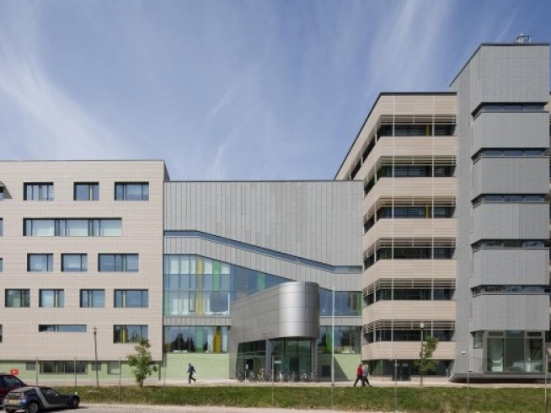

The 2012 – 2013 Project
Throwing Teddy Bears off the Roof

Slide 7
Throwing Teddy Bears off the Roof
You are required to design, prototype and demonstrate a system comprising
  a launch subsystem that can be operated by a member of staff on your group’s behalf on the roof of the Gisbert Kapp building,
  an autonomously steerable “flying” teddy bear (max. descend speed of 1 m/s), and
  a homing signal subsystem surrounding a target of 1 m in diameter on the ground
No other information will be given to you

