Slide 1
Statistical Shape Modelling
Multimodal Interaction
Dr. Mike Spann
m.spann@bham.ac.uk
http://www.eee.bham.ac.uk/spannm

Slide 2
Contents
Introduction
Point distribution models
Principal component analysis
Shape modelling using PCA
Case study. Face image analysis
Application to model-based object location

Slide 3
Introduction
Statistical shape models attempt to model the shapes of objects found in images
The images can either be 2D or 3D
Why ‘statistical’?
We normally attempt to build a ‘model’ of a shape from a training set of ‘typical’ shapes
Our model characterizes the variation of shapes within the training set
This variation is described by statistical parameters (eg. deviation from the mean shape)

Slide 4
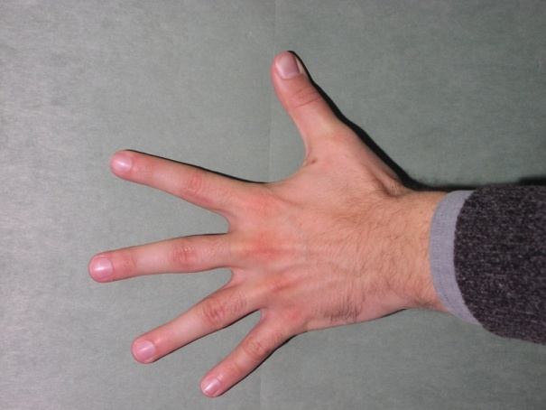
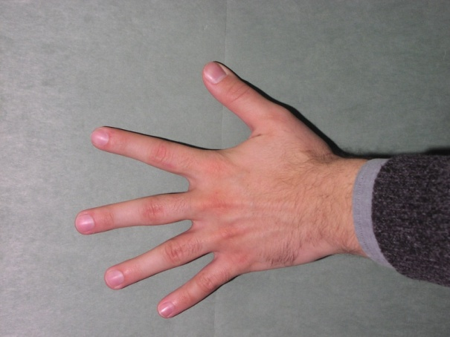
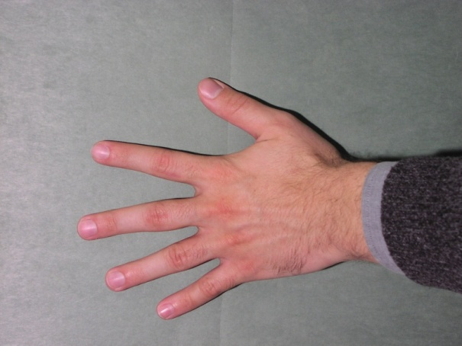
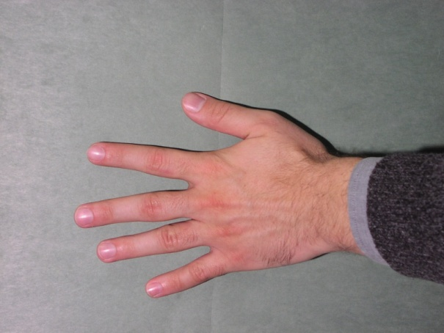
Introduction

Slide 5
Introduction
In the images of a hand, we want to represent the shape of each hand efficiently to enable us to describe the subtle variations in the shape of each hand
How?
Outline contour?
Not that easy to fit and we still have the problem of accurately determining contour descriptors such as B-spline parameters
Landmarks?
We have a fighting chance of finding suitable landmark points and we can describe discrete points using point distribution models

Slide 6
Introduction

Slide 7
Introduction
We can apply this concept of shape representation using landmarks to face images
Significant facial features such as the lips, nose, eyebrows and eyes constitute the ‘shape’ of the face
As we will see, by modelling the spatial distribution of these landmarks across a training set, our model parameters will allow us to develop face and lip tracking algorithms

Slide 8
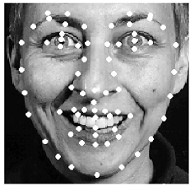
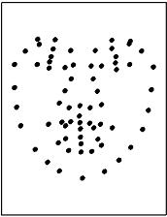
Introduction
Landmarked face
‘Shape’

Slide 9
Introduction
So what do we mean by ‘shape’?
Shape is an intrinsic property of an object
Shape is not dependant on the position, size or orientation of the object
This presents us with a problem as we have to ‘subtract out’ these properties from the object before we determine its shape
In a training image database, it means we have to align the objects with respect to position, size and orientation before constructing our shape model
This process is normally done after landmark points have been extracted so we align the pointsets

Slide 10
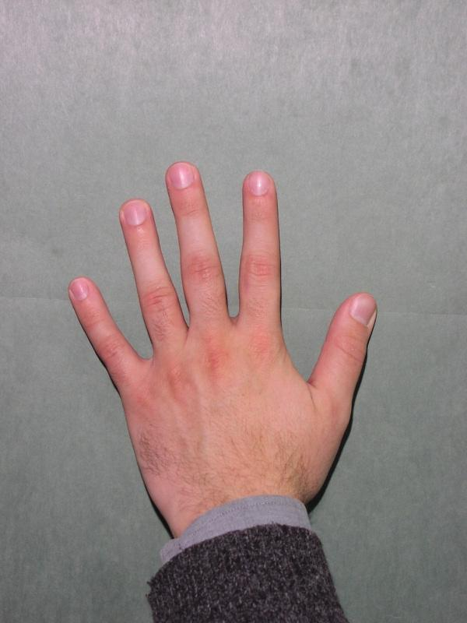
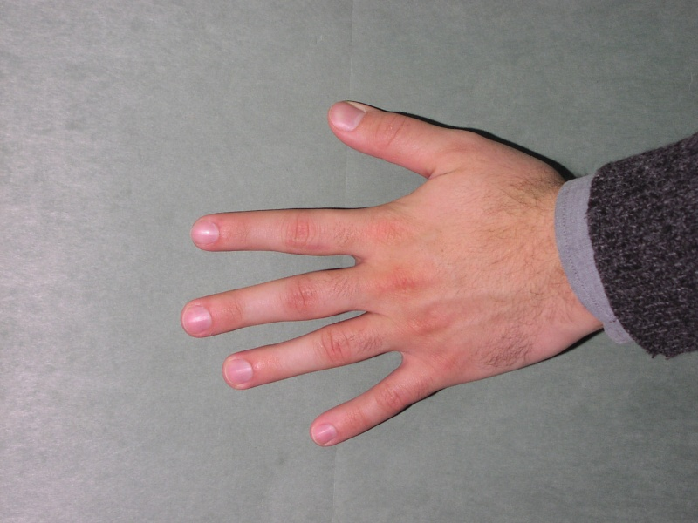
Introduction
rotate
scale

Slide 11
Introduction
Why do we need a shape model?
A shape model is a global constraint on an objects shape
More effective than local constraints such as imposed by snake type algorithms
Essentially we are looking for a shape in a certain eigenspace (see later) in our search/tracking algorithm
What’s it got to do with multi-modal interaction?
In a speech recognition system, an effective approach is to combine the shape of the lips with audio descriptors
We need a real time lip tracking algorithm
Statistical shape model parameters can be feature descriptors
In general, facial feature tracking has many applications in areas such as biometric identification and digital animation

Slide 12
Point distribution models
We have seen how the boundary shape of an object can be represented by a discrete set of coordinates of ‘landmark points’
Consider set of training images in a database, for example face images or hand images
Each image will generate a set of landmark points
A point distribution model (pdm) is a model representing the distribution of landmark points across the training images
It uses a statistical technique known as Principle Component Analysis (PCA)

Slide 13
Point distribution models
‘Shape’
Landmarked face

Slide 14
Point distribution models
We can label each point set x_{s} for each training shape s=1..S
Our ultimate goal is to build a statistical model from our point sets
But until our point sets are aligned, any statistical model would be meaningless
We can imagine each x_{s} to be a point in some 2n dimensional space (assuming there are n landmark points)

Slide 15
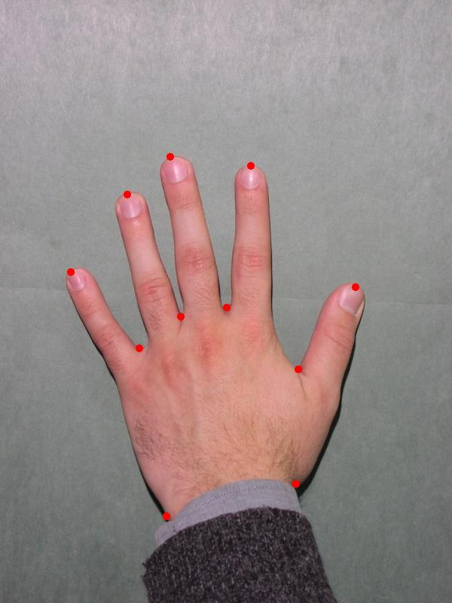
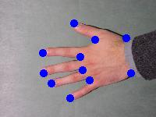
Point distribution models

Slide 16
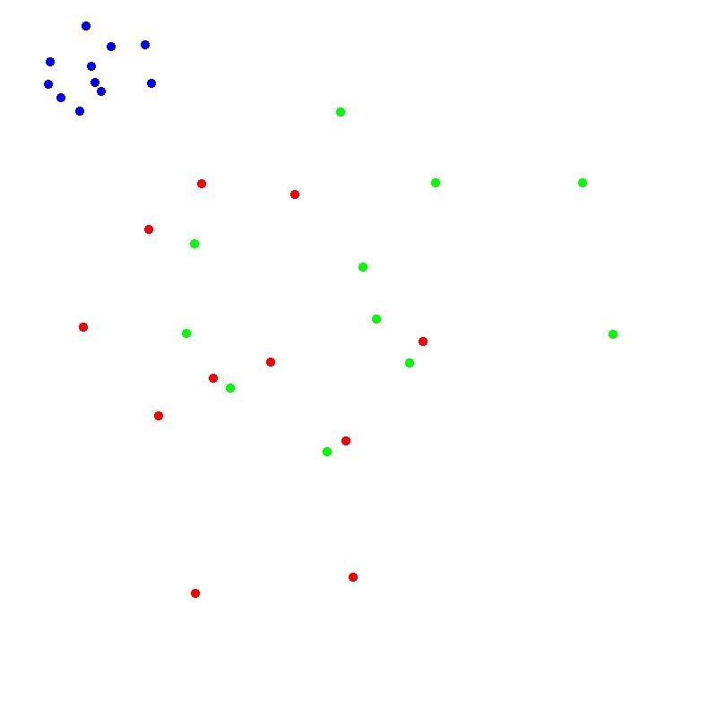
Point distribution models
We can superimpose our landmarks on a single image frame

Slide 17
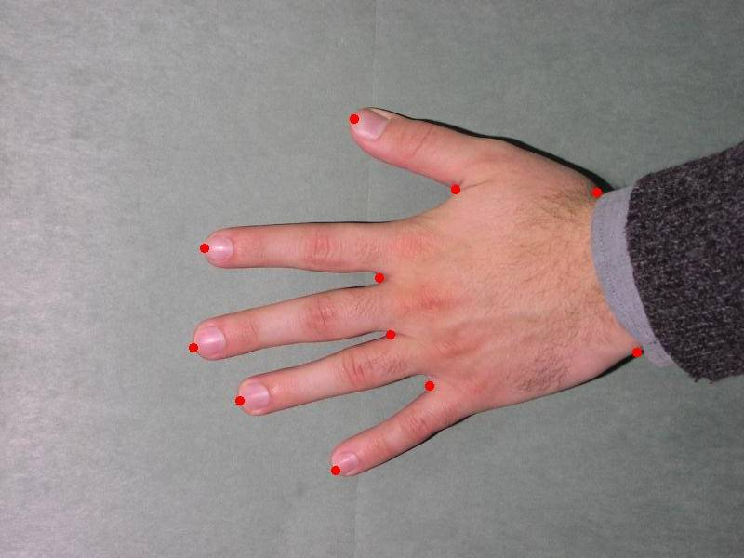
Point distribution models
We can rotate/scale our images so they are registered

Slide 18
Point distribution models

Slide 19
Point distribution models
Alignment of landmark points essentially registers the points by rotating/scaling to a common axis
It forms tight clusters of points in our 2n dimensional space for similarly shaped objects in the training set
As we shall see later, it then allows us to apply principal components analysis on these clusters
The idea is to try and describe the point distribution efficiently and represent the principal features of the distribution and hence the object shape

Slide 20
Point distribution models
Unaligned
Aligned

Slide 21
Point distribution models
How do we align our pointsets?
Let’s assume we have 2 pointsets
We are looking for a transformation T which when applied to x_{s} aligns it with x'_{s}
We are looking for the transformation which minimizes E the sum of squared distances between the pointsets

Slide 22
Point distribution models
We can consider different types of transformation
Translation
Scaling
Rotation

Slide 23
Point distribution models
The rotation matrix is a simple axis rotation in 2D

Slide 24
Point distribution models
Rotation is an example of a similarity transform
The Euclidean length of the vectors is unchanged after such a transform
The general form of a similarity transform is :
The affine transform is an unrestricted transform and can include geometrical transforms which skew the (x,y) axes

Slide 25
Point distribution models
We will look at finding the optimum affine transformation which best aligns to pointsets
Thus we wish to find the parameters (a,b,c,d,t_{x},t_{y}) which minimizes :
This is a straightforward but tedious exercise in calculus which is solved by differentiating the above equation with respect to the parameters (a,b,c,d,t_{x},t_{y})

Slide 26
Point distribution models
The result is expressed in terms of the following moments of the (x,y) coordinates of pointsets x_{s} and x_{s’}

Slide 27
Point distribution models
Note that (S_{x},S_{y}) is the centre of gravity of pointset x

Slide 28
Point distribution models
To simplify the algebra, let’s assume that the pointset x is defined so that it is centred on the origin
This involves simply subtracting (S_{x},S_{y}) from each landmark coordinate
This results in (S_{x},S_{y}) =(0,0) which in turn leads to :
The final result for the rest of the parameters becomes :

Slide 29
Point distribution models
We can easily apply these equations to align two shapes expressed by the two pointsets x and x’
A trickier problems is to align a set of pointsets {x_{s} : s=1..S }in a training database
An analytic solution to the alignment of a set of shapes does exist
These techniques align each shape so that the sum of distances to the mean shape D is minimized :

Slide 30
Point distribution models
However, a simple iterative algorithm works just as well
Translate each pointset to centre at the origin
Choose an arbitrary pointset (eg s=0) as an initial estimate of the mean shape and scale each pointset to an arbitrary size (eg all |x_{s}|=1)
Align all the pointsets with the current mean estimate using the affine transformation
Re-estimate the mean pointset from the aligned pointsets
Re-align the mean pointset with x₀ and re-scale to modulus 1
If not converged go back to 3

Slide 31
Point distribution models
Step 5 is important in making the procedure well defined
Otherwise, the mean pointset is defined by the aligned point sets and the aligned pointsets are defined by the mean pointset
Convergence is usually determined when the estimated mean doesn’t change above some specified threshold
Typically convergence is in a couple of iterations

Slide 32
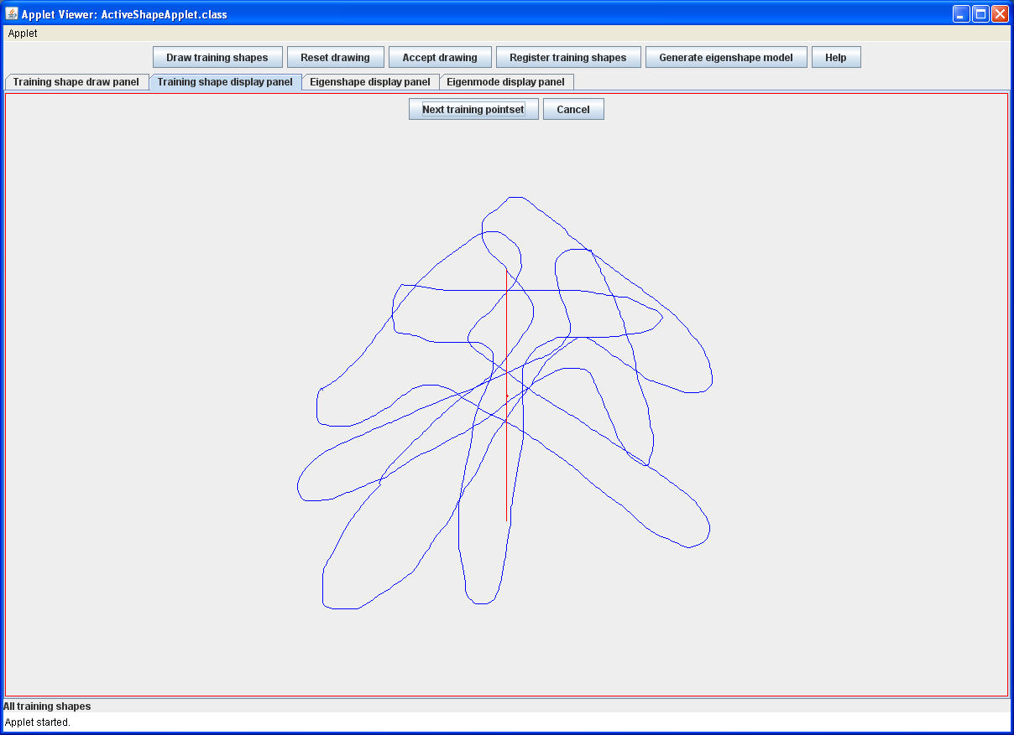

Slide 33
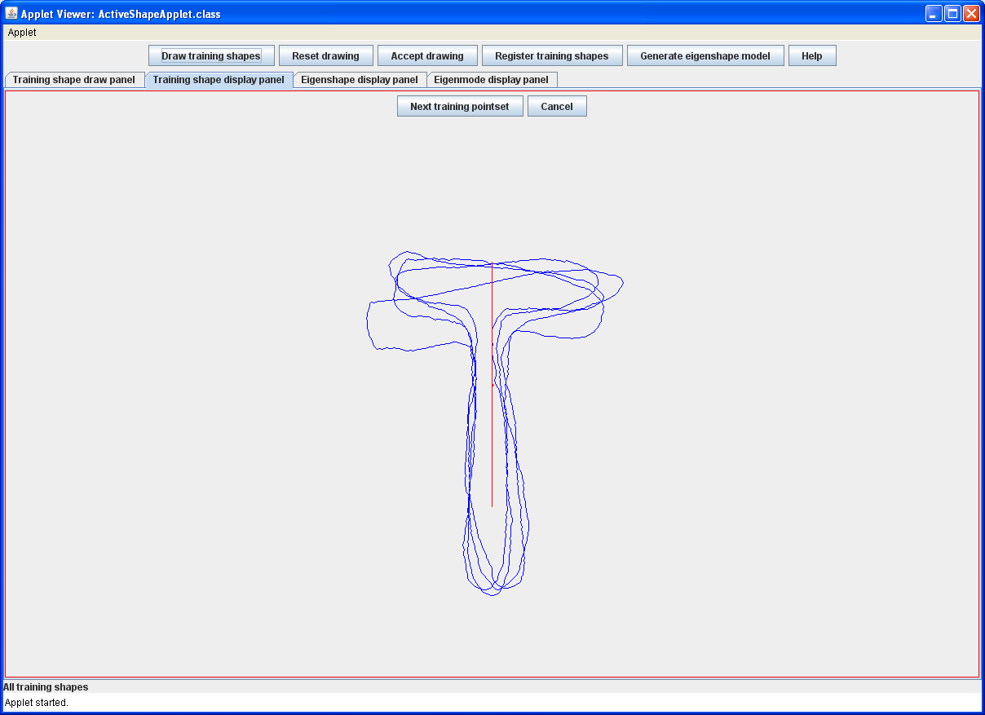

Slide 34
Principal component analysis
Principal component analysis (PCA) is an important statistical technique for analysing data and is crucial in understanding statistical shape models
PCA involves discovering patterns in data and what aspect of our data is important and what is less important
In particular, our data is multidimensional (eg pointsets) so PCA asks the question what dimensions are important (in other words account for significant variation in shape) and which are less important

Slide 35
Principal component analysis
PCA is analysing multidimensional data, in other words, random vectors
A random vector is a vector with random components
For example, n-component column vector x_{s}
It is sometimes helpful to imagine x_{s} being a random position in n-dimensional space and a set of these random vectors being a cloud of these points in this space

Slide 36
Principal component analysis
PCA attempts to determine the principal directions of variation of the data within this cloud
Significant variation in this direction
But not in this direction

Slide 37
Principal component analysis
We will review some basic measures of random vectors before introducing PCA
Mean vector
Covariance matrix

Slide 38
Principal component analysis
The covariance matrix is a sum of outer vector products and results in an nxn matrix
For example in the 2D case:
The covariance matrix is a 2x2 matrix with the diagonal elements being the data variance in each dimension
Essentially the covariance matrix expresses the variation about the mean in each dimension

Slide 39
Principal component analysis
Variation in x expressed by σ_{x}
Variation in y expressed by σ_{y}
Un-correlated data
Correlated data

Slide 40
Principal component analysis
Particularly popular is the Gaussian model where all of the statistical properties of the data are specified by the mean vector and covariance matrix
The probability distribution completely defines the statistics of the data
The exponent is a quadratic form which defines an ellipsoid in n-dimensional space which are the surfaces of constant probability

Slide 41
Principal component analysis
Covariance matrix defines the ellipsoid axes

Slide 42
Principal component analysis
For correlated data the ellipsoids are oriented at some angle with respect to the axes
We are looking to determine the variations along each axis
If our data was uncorrelated, this variation would be the diagonal elements of the covariance matrix
Thus our goal is to de-correlate the data
Or, diagonalize the covariance matrix
This re-orients the ellipsoid to have its axes along the data coordinate axes
This is the goal of PCA
To determine the principal axes of the data which are the directions of the re-oriented axes

Slide 43
Principal component analysis
Correlated data
Un-correlated data

Slide 44
Principal component analysis
We will derive the equations of principal component analysis using simple linear (matrix-vector) algebra
Our data x are statistical features (in our example landmark pointsets) represented by a vector
PCA determines a linear transformation of the data which diagonalizes the covariance matrix of the transformed data
Our transformed data is represented by vector b
Let Ф be a matrix whose columns are the eigenvectors of the covariance matrix C_{x}

Slide 45
Principal component analysis
It is fairly simple matrix algebra to determine the mean and covariance of the transformed vector b

Slide 46
Principal component analysis
Because Ф is a matrix whose columns are the eigenvectors of the covariance matrix C_{x} :
The λ’s are the eigenvalues of C_{x}
Finally, from the previous equation, since Ф is an orthogonal matrix :

Slide 47
Principal component analysis
We can summarise our procedure so far
Given a random data vector x with covariance matrix C_{x}
We apply a transformation to the data which diagonalizes the covariance matrix
Ф is a matrix whose columns are the eigenvectors of the covariance matrix C_{x}
The covariance matrix of b is now a diagonal matrix with diagonal elements being the eigenvalues of C_{x}

Slide 48
Principal component analysis
Worked example
We will do a worked example on synthetic 2D data
x | y
2.5 | 2.4
0.5 | 0.7
2.2 | 2.9
1.9 | 2.2
3.1 | 3.0
2.3 | 2.7
2 | 1.6
1 | 1.1
1.5 | 1.6
1.1 | 0.9
x | y
0.69 | 0.49
-1.31 | -1.21
0.39 | 0.99
0.09 | 0.29
1.29 | 1.09
0.49 | 0.79
0.19 | -0.31
-0.81 | -0.81
-0.31 | -0.31
-0.71 | -1.01

Slide 49
Principal component analysis
1.5
-1.5
1.5
-1.5

Slide 50
Principal component analysis
We can compute the covariance matrix of the data
Next we compute the eigenvectors and eigenvalues
For 2D data this is nothing more than solving a quadratic equation

Slide 51
Principal component analysis
We can readily interpret these results in terms of the original data
The two eigenvectors are orthogonal unit vectors :
In fact, the two eigenvectors are a complete orthogonal subspace for our 2D feature space
Any feature vector is a linear combination of our two eigenvectors

Slide 52
Principal component analysis
We can overlay the eigenvector directions on our original plot
1.5
-1.5
1.5
-1.5

Slide 53
Principal component analysis
The component of each transformed data point is a projection along each direction specified by the eigenvectors
For a given data point x the two parameters b₁ and b₂ are known as shape parameters
Because the eigenvectors are a complete orthogonal subspace the shape parameters completely determine the original data point

Slide 54
Principal component analysis
1.5
-1.5
1.5

Slide 55
Principal component analysis
We have seen that the covariance matrix of the transformed data vectors b is diagonal matrix with diagonal elements equal to the eigenvalues of C_{x}
These eigenvalues are the variances of each component b₁ and b₂
The variances define the spread of the transformed data vectors along the coordinate axes defined by the eigenvectors
In our example, λ₁< λ₂ telling us that the data is more spread along the e₂ axis

Slide 56
Principal component analysis
1.5
Spread in this direction related to λ₁
-1.5
1.5
Spread in this direction related to λ₂

Slide 57
Shape modelling using PCA
We can use PCA to represent a shape (represented by a landmark pointset)
We are going to represent shape features as the projection of the zero-centred data vector on the subspaces spanned by the eigenvectors of the covariance matrix
As we will see, a key point is that we can rank the importance of each feature in terms of the size of the corresponding eigenvalue
This is the same as the variation of the data in each of the directions in multidimensional feature space represented by each eigenvector

Slide 58
Shape modelling using PCA
Assume we have a landmark pointset x
We can apply our eigenvector transformation on zero centred data
We can easily solve this for x since Φ is an orthogonal matrix
We can rewrite this equation in terms of the individual eigenvectors
The set of b_{i}’s across all of the pointsets in the database represents the i^{th} mode of variation of the original data
Its essentially the variation in the transformed data along the e_{i} axis

Slide 59
Shape modelling using PCA
For n dimensional data, there are n modes of variation equivalent to the n eigenvectors of the covariance matrix
A key question is whether we can accurately represent our data by m<n modes
In other words, how accurate is the following approximation?
Also, how do we determine the best modes of variation in our approximation
This will allow us to represent our data with a feature vector of m components which faithfully represents the original dataset

Slide 60
Shape modelling using PCA
If m=0, it is easy to work out the error
We are assuming a database of S pointsets and we work out the average error over all of these pointsets
If m=0 we are representing all pointsets by the mean pointset
The error becomes :

Slide 61
Shape modelling using PCA
Let’s assume we add a single mode i to our data so m=1
The error becomes :
After some tedious manipulation, the result is :
Remembering that the shape parameters b have a mean of zero, the final and intuitive result is :

Slide 62
Shape modelling using PCA
This result generalizes in an obvious way if we represent the data with modes i₁ , i₂ , i₃…..i_{k}
In other words, for every mode we include, the error decreases by the eigenvalue corresponding to the eigenvector representing that mode
Therefore modes are added in the order of decreasing size of the eigenvalue (in other words we start with the largest eigenvalue) until a certain squared error value is reached
This allows us to reduce the dimension of the space that we need to represent our dataset

Slide 63
Shape modelling using PCA
Assuming we order the eigenvalues λ₁ > λ₂ > λ₃….. λ_{n} we choose the k modes corresponding to the eigenvalues for which:
f is some fraction (say 95%) of the variation in the original dataset that we want to explain in our transformed feature space
Clearly, in the limiting case of k=n we can reconstruct our original dataset using all n modes of variation

Slide 64
Shape modelling using PCA
We can apply this procedure to our simple 2D example
We have computed the following eigenvectors and eigenvalues :
Rearranging the eigenvectors in decreasing order of eigenvalue, we have :
The eigenvector corresponding to the largest eigenvalue is known as the principal component

Slide 65
Shape modelling using PCA
We represent our data using a single mode of variation corresponding to the largest eigenvalue
We first compute the transformed data which is the original zero centred data projected onto the principal component direction
We can then reconstruct the data using this mode only and compare it with the original data

Slide 66
Shape modelling using PCA
x | y
0.69 | 0.49
-1.31 | -1.21
0.39 | 0.99
0.09 | 0.29
1.29 | 1.09
0.49 | 0.79
0.19 | -0.31
-0.81 | -0.81
-0.31 | -0.31
-0.71 | -1.01
b₁
-0.828
1.778
-0.992
-0.274
-1.676
-0.913
0.099
1.144
0.438
1.224

Slide 67
Shape modelling using PCA
We can reconstruct our (zero-centred) data using the principal component
Obviously in each case, the reconstructed data is the original data point projected onto the axis corresponding to the principal component (the eigenvector with the largest eigenvalue)
This gives us the minimum least-squares reconstruction error over all possible 1D projections

Slide 68
Shape modelling using PCA
1.5
-1.5
1.5
Reconstructed data
Original data

Slide 69
Shape modelling using PCA
In the case of shape landmark pointsets we can create a range of shapes by varying the b parameters (called shape parameters)
We know the variance of shape parameter b₁ :
It’s normal to restrict the variation of b₁ to generate shapes which resemble the training shapes :

Slide 70
Shape modelling using PCA
In the case of our simple example, we could move along both eigenvector axes to generate a ‘realistic’ datapoint
1.5
-1.5
1.5
‘new’ datapoint

Slide 71
Shape modelling using PCA
An obvious and slightly more challenging question is that given some shape landmark pointset x' not in the training set, how can we decide whether x' is a plausible example of the class of shapes represented by our model
The approach is to assume that the training pointsets are generated by some probability distribution p(x)
If we can estimate p(x) from the training set, then small p(x ') would indicate that x' is an implausible shape

Slide 72
Shape modelling using PCA
1.5
-1.5
1.5
Plausible shape?

Slide 73
Shape modelling using PCA
By projecting a vector onto the space spanned by the columns of Ф we are generating a least squares approximation
Ф subspace

Slide 74
Shape modelling using PCA
Let us define the residual error in the least squares approximation as r
Obviously we could look at the magnitude of r in order to determine whether x' is plausible
However, its more well-founded statistically to try and estimate p(x')
x' comprises two components which we can assume to be statistically independent
The shape parameters b
The deviation from the Φ subspace r

Slide 75
Shape modelling using PCA
We can use simple Gaussian probability distributions to determine p(b) and p(r) and estimate them from the training set
We assume that each shape parameter b_{i} is a Gaussian with standard deviation equal to the corresponding eigenvalue λ_{i}
More sophisticated models can be used such as Gaussian mixture models (GMM’s) but estimating the parameters of a GMM is more difficult

Slide 76
Shape modelling using PCA
Example - Metacarpal analysis
We can give a realistic example taken from automatic hand X-ray analysis.
The finger bones (metacarpals) have characteristic long, thin shape with bulges near the ends - precise shape differs from individual to individual, and as an individual ages.
Scrutiny of bone shape is of great value in diagnosing bone aging disorders and is widely used by paediatricians.
From a collection of X-rays, 40 landmarks (so vectors are 80 dimensional) were picked out by hand on a number (approximately 50) of segmented metacarpals.
The next figure illustrates (after alignment) the mean shape, together with the actual positions of the landmark points from the entire data set.

Slide 77
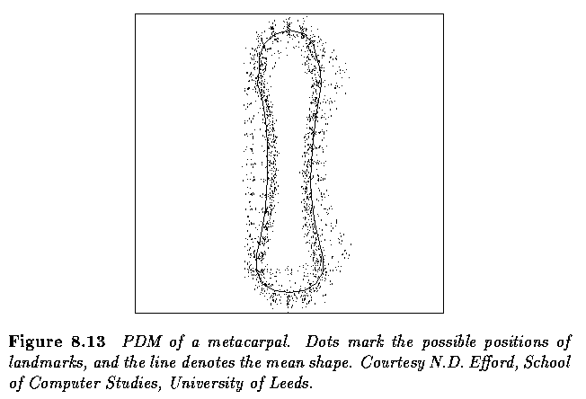
Shape modelling using PCA

Slide 78
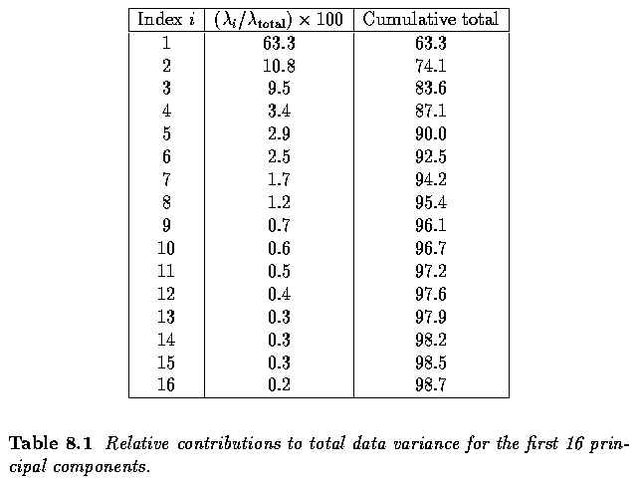
Shape modelling using PCA

Slide 79
Shape modelling using PCA
We can see that we have a realistic model of the shape variation
95% of the variation is explained by the first 8 modes
Over 60% of the variation is explained by the first mode
Usually the first mode explains 3D pose differences which are not taken out by the 2D alignment algorithm
Higher modes account for more subtle variations of the shape
For example gesture differences in the case of face modelling
But sometimes the differences can’t be explained by physical processes

Slide 80
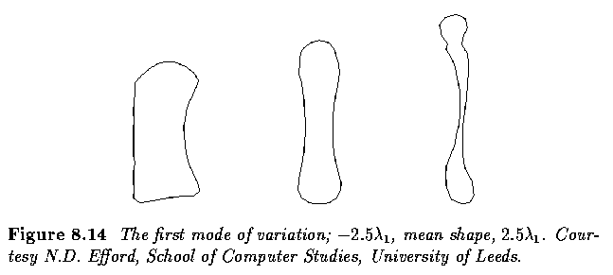
Shape modelling using PCA

Slide 81
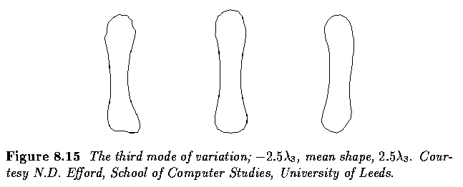
Shape modelling using PCA

Slide 82
Case study. Face image analysis
We will look at an application of statistical shape modelling to face image analysis
Recent approaches to face image analysis have involved modelling the shape of the face (as determined by facial landmarks) and the appearance of the face (the distribution of colour and texture across the face)
The main goals of the analysis is face tracking and face recognition
The use of shape and appearance models have played a significant role in these applications
We will look at appearance models later

Slide 83
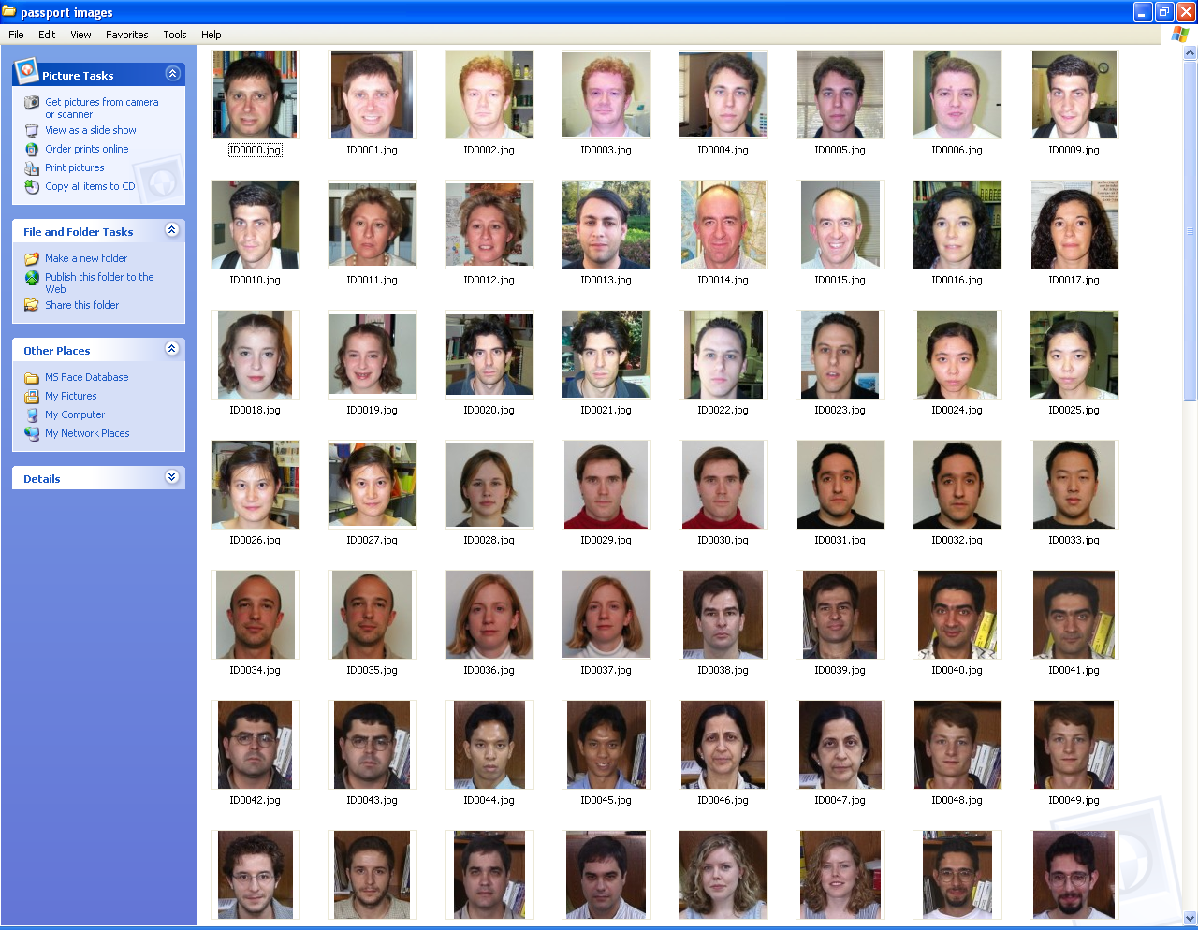

Slide 84
Case study. Face image analysis
We have a training image database comprising 129 passport-type photos
The images have not been aligned but the faces are roughly the same size
Approximately the same pose but no restrictions on gesture or wearing glasses
97 landmarks points
Eyebrow
Eye
Pupil
Nose
Lip
Inner lip
Facial outline
Forehead
Upper hairline

Slide 85
Case study. Face image analysis
The images have been hand labelled
The landmark images are displayed with interpolating contours for effect
The contours are not used in the shape model
This database has been used in a facial image compression project (M.Eng project 2006) based on shape and appearance models

Slide 86
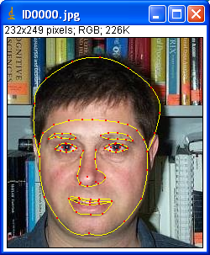
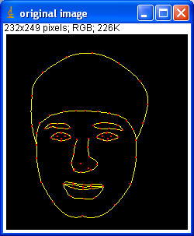
Case study. Face image analysis

Slide 87
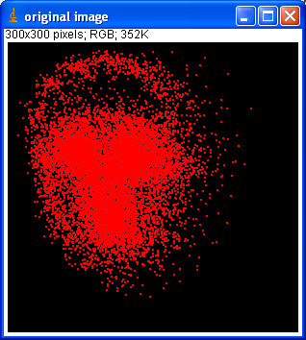
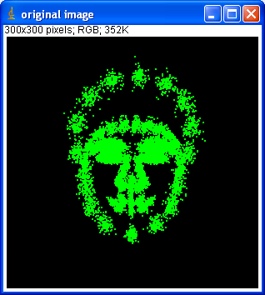
Case study. Face image analysis
Unaligned landmarks
Aligned landmarks

Slide 88
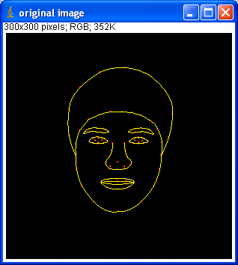
Case study. Face image analysis
Mean landmarks across all training images

Slide 89
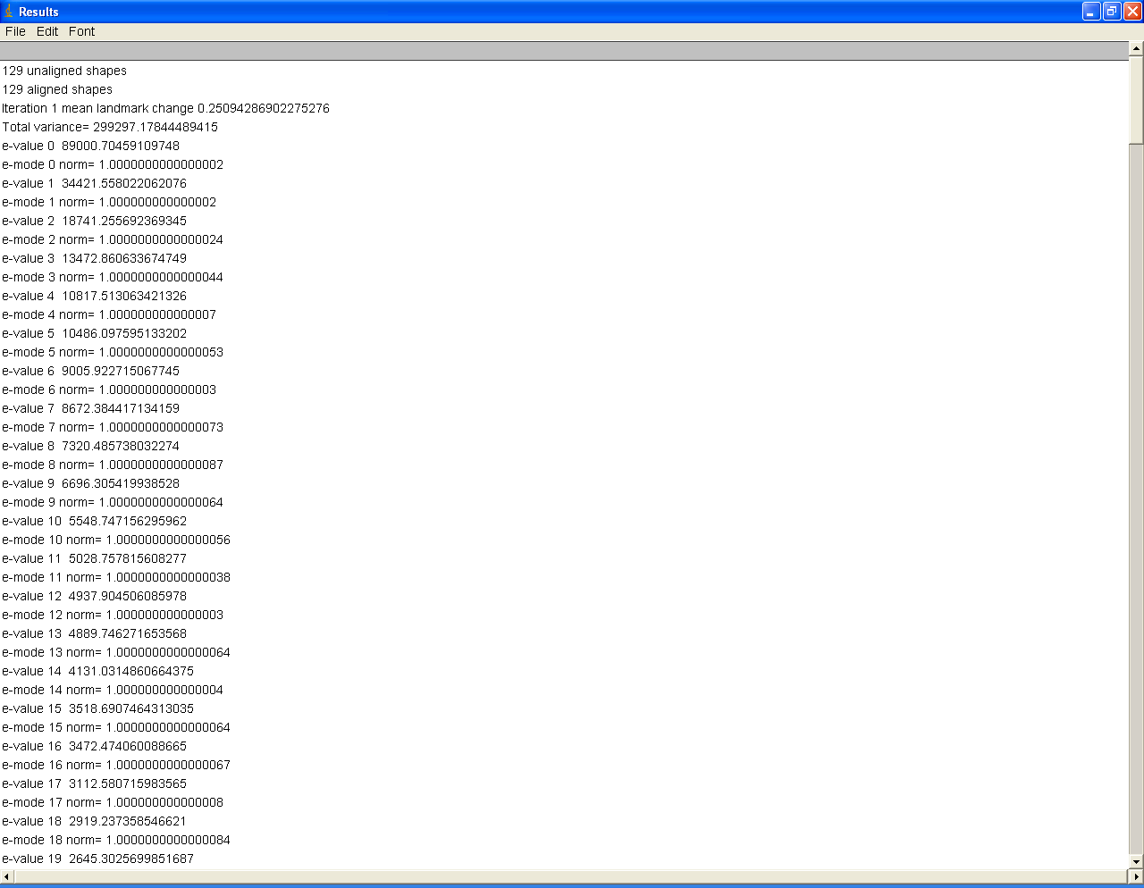

Slide 90
Demo\ImageJ\ImageJ.exe

Slide 91
Application to Model-based object location
Given a rough starting approximation, we want to search for an instance of model in an image
For example, face location in an image based on facial landmarks
Our model provides a global constraint to our search
We are looking for objects which are plausible examples of our shape model
In other words, we constrain the shape parameters of our model whilst searching
Also we are trying to find the best pose parameters of the object
In other words the translation, rotation and scaling parameters between the model domain and the image domain

Slide 92
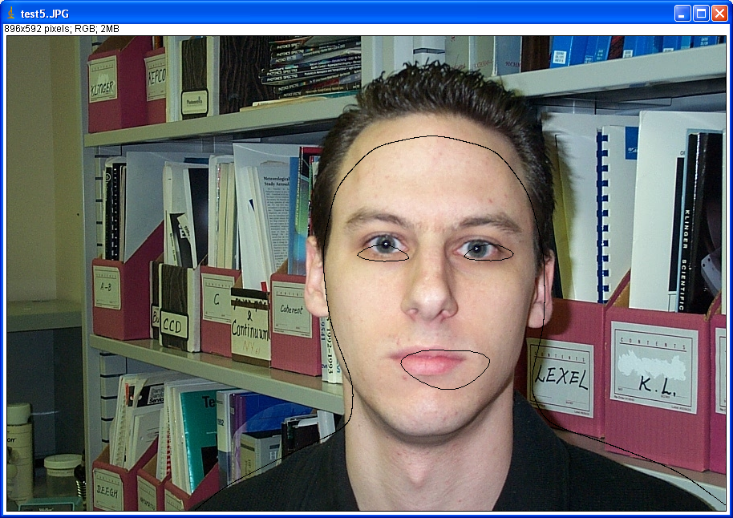
Application to Model-based object location
Initial Model

Slide 93
Application to Model-based object location
An efficient approach to object location is to use the PDM as the basis of an Active Shape Model (ASM)
Here, we iterate toward the best fit by examining an approximate fit, locating improved positions for the landmark points (based on nearest image boundary points), then recalculating pose and shape parameters
Improving the model fit is usually done by finding the nearest boundary point in the image perpendicular to the model boundary
Model point
Nearest image point to model point
Image boundary

Slide 94
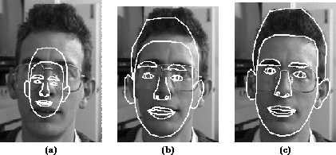
Application to Model-based object location
Initial
10 iterations
Convergence

Slide 95
Application to Model-based object location
Demo\Animations for ASM Search.htm
We will look in detail at the ASM algorithm in a later lecture

Slide 96
Summary
We have looked at how we can represent shape using landmark features as point distribution models
We have looked at applying principal component analysis on a set of landmark pointsets and shown how we can capture most of the variation in a small number of eigenmodes
We have looked at a case study involving a database of face images

