Slide 1
Computer Networking A few notes on reading
Dr Sandra I. Woolley

Slide 2
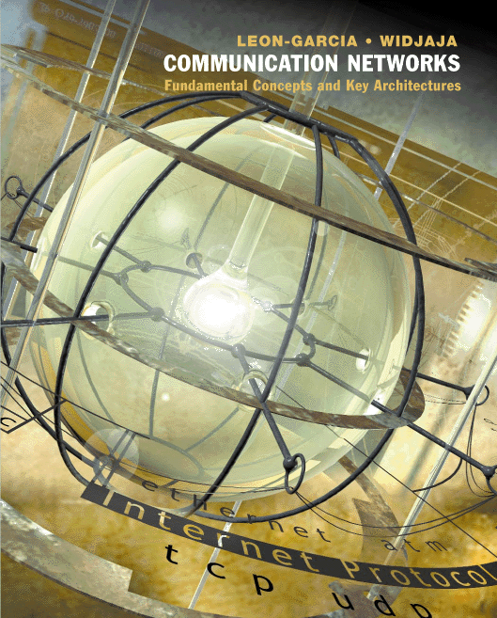
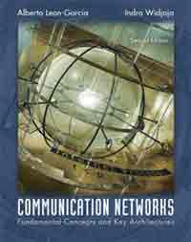
Recommended Text
Communication Networks
A. Leon-Garcia & I. Widjaja
McGraw-Hill
2nd (Blue) edition printed August 2003. A 3rd edition is anticipated.
Copies in the library (week and short loan).

Slide 3
Cryptography Text
Relevant as background to the cryptography covered in the course.
Not required for revision.

Slide 4
Course Content (and location in course text)
Introduction to the course and computer networks - Chapter 1
Layered architectures - Chapter 2
LANs and medium access control: Chapter 6
Error control coding - Chapter 3 - section 8
Packet switching - Chapter 7
TCP/IP - Chapter 8
Network Quality-of-Service (QoS)
Queueing - Appendix A
Cryptography - Chapter 11 and (optionally) Simon Singh's, “The Code Book”. The 3 page handout is available on the course web page.
Network management and security- An overview of Appendix B and sections of Chapter 11 plus security case study examples (from Stallings). Chapter 11 contains more details on security protocols such as IPsec and secure sockets which are not covered and are not part of the assessed material.

Slide 5
Course Content (and location in course text)
Introduction to the course and computer networks - Chapter 1
An expanded version of our introductory slides. Provides an overview and introduces concepts. Important terms are shown in bold. Note we focus on computer networks (i.e. skip telephone networks.)
Layered architectures - Chapter 2
(2.4 Berkeley API not assessed. 2.5 light coverage).
LANs and medium access control: Chapter 6
(minimal coverage 6.3 and 6.4. 6.5 not assessed. 6.6 and 6.7 assessed (light on faster Ethernet specifics). 6.8-6.10 inclusive not assessed. 6.11 assessed.
Error control coding - Chapter 3
section 8 assessed
Packet switching - Chapter 7
(7.6 –end not assessed.)

Slide 6
Thank you

