Slide 1
Computer Networking Course Introduction
Dr Sandra I. Woolley

Slide 2
Content
Course Summary
The Recommended Text
Course Structure, Content and Assessment
Recommended Software

Slide 3
The Course Summary

Slide 4
The Recommended Text
Communication Networks
A. Leon-Garcia & I. Widjaja
McGraw-Hill
The 2nd Edition (August 2003) is recommended

Slide 5
Cryptography Text (optional further reading)
The Code Book
Simon Singh
ISBN: 1857028899

Slide 6
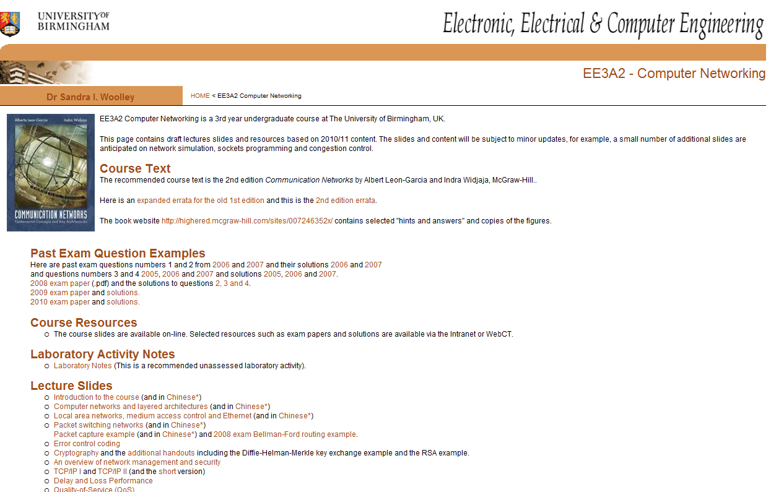
Course Resources
Course lecture slides at http://www.eee.bham.ac.uk/woolleysi/teaching/computernetworking/index.htm
Or follow the link from CANVAS.

Slide 7
Outline of Course Themes
Introduction to the course
Computer networks and layered architectures
Local area networks and medium access control
Practical LANs and packet switching
Cryptography
An overview of network management and security
Error control coding
TCP/IP
Network packet capture example and Quality-of-Service (QoS)

Slide 8
Course Content, Structure and Assessment
Course themes are introduced in lectures.
Lectures introduce subjects, explain concepts and guide self-study.
Self-study of the recommended textbook is important to fill-in the details.
The course is assessed by examination.
There is a recommended unassessed laboratory activity and there are tutorial/example classes.
Practical self-study exercises are recommended.

Slide 9
General Notes on the Course Content
Computer networking is a vast subject and it comprises many active areas of research.
The course aims to cover the fundamentals of computer networks with an emphasis on generic methods rather than specific implementations in specific architectures.
The course does not cover topics already covered in detail in other modules. For example, communication fundamentals such as modulation coding are not included but error control coding and cryptography are covered.
Abbreviations are abundant in computer networking. It will be important to learn some of them.

Slide 10
Recommended Software

Slide 11
Recommended Exercises
A significant difference between versions 1 and 2 of the recommended text is the introduction of suggested practical exercises in version 2.
The use of a network analyzer and various IP (Internet Protocol) tools are recommended.
A network analyzer allows us to look at network packets and to view their contents.

Slide 12
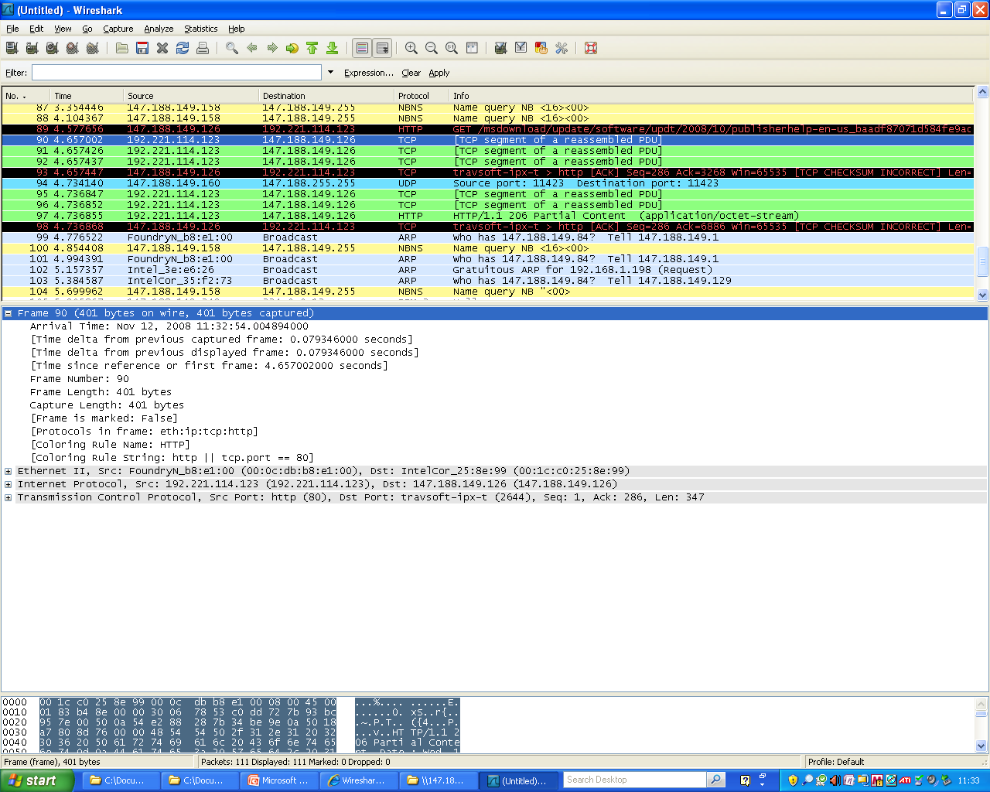
Ethereal/Wireshark Protocol Analyser
The Ethereal protocol analyzer recommended by the course text has been renamed Wireshark* http://www.wireshark.org
Wireshark is a free and open-source packet analyzer.
*http://www.wireshark.org/faq.html#q1.1
Wireshark automatically installs WinPCap for packet capture.

Slide 13
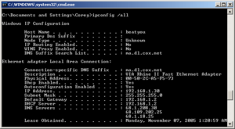
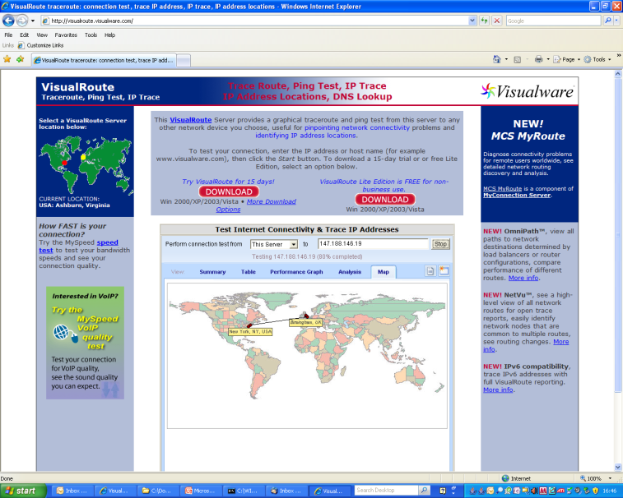
Other Network Tools
IP utilities
Type “command” in the Windows “Run” box to open a window and experiment with
netstat : displays network connections
ipconfig : displays network values
ping : tests if hosts are reachable
tracert : traceroute
Traceroute tools
E.g., 3D traceroute (note - will work only if your provider allows traceroute requests)
http://www.mycooltools.com/ (traceroute and other tools which are supported by the remote server)
http://en.wikipedia.org/wiki/Ipconfig

Slide 14
Thank You

