Slide 1
Computer Networking
Security and Cryptographic Algorithms
Dr Sandra I. Woolley

Slide 2
Contents
A summary of security threats and requirements
Cryptography vs steganography
Keys and the Caesar cipher
Cryptanalysis
The Vigenère cipher
DES (Data Encryption Standard)
Diffie-Hellman-Merkle key exchange
RSA (Rivest, Shamir and Adleman)
PGP (Pretty Good Privacy)

Slide 3
Network Security Threats
Information can be observed and recorded by eavesdroppers.
Imposters can attempt to gain unauthorised access to a server.
An attacker can flood a server with requests, causing a denial-of-service for legitimate clients.
An imposter can impersonate a legitimate server and gain sensitive information from a client.
An imposter can place themselves in the middle, convincing a server that it is a legitimate client and a client that it is a legitimate server.

Slide 4
Security Requirements
Privacy or confidentiality - information should be readable only by the intended recipient.
Integrity - the recipient can confirm that the message has not been altered during transmission.
Authentication - it is possible to verify the identity of the sender and/or receiver.
Non-repudiation - the sender cannot deny having sent a given message.
The above requirements are not new and various security mechanisms have been used for many years in important transactions.
What is new is the speed and distance associated with modern security threats.

Slide 5
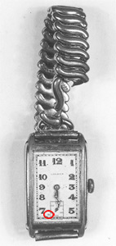
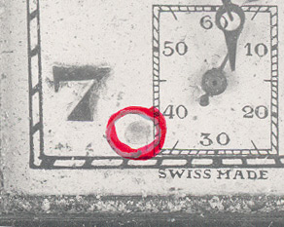
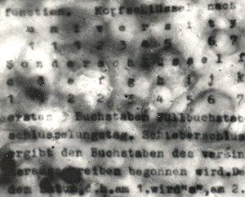
Steganography
Steganography (from Greek steganos-covered and graphein-to write) involves hiding the existence of a message.
Herodotus (chronicler of the 5th century BC Greece/ Persian conflicts) recounts how an important message was written onto the shaved head of a messenger and delivered when his hair had grown back.
Many hidden message systems have been used in the past;
  The Chinese wrote on fine silk which was covered in wax and swallowed.
  A 16th century Italian scientist described how to write on a hard-boiled egg with alum and vinegar. The solution passes clearly through the shell but stained the egg.
  The FB1 found the first microdot (a photographed page reduced to the size of a full stop pasted into a document) in 1941.
  More recently images were shown to be easily communicated in the LSBs of higher-resolution images.
  German WWII microdot example from MI5
  http://www.mi5.gov.uk/output/microdots.html

Slide 6
Cryptography
Cryptography (Greek : kryptos-hidden) is the science of making messages secure.
The original message is the plaintext.
The encryption/decryption algorithm is called the cipher.
The encrypted message is the ciphertext.
Unlike steganography, the communication between parties may be observable, however, with cryptography the content is secure.

Slide 7
Caesar Cipher
The Caesar cipher applies a simple shift between the plain alphabet and cipher alphabet. The exact shift can be considered as the cipher key.
  An example of a 3 letter shifted Caesar cipher (lower case for plaintext and UPPERCASE for ciphertext.
  a b c d e f g h i j k l m n o p q r s t u v w x y z
  D E F G H I J K L M N O P Q R S T U V W X Y Z A B C

Slide 8
Keys and the Caesar Cipher
The simple Caesar cipher has just 25 keys (i.e., 25 possible shifts). So that cryptanalysts could quickly break the code by trying all possible shifts.
Allowing any pair of substitutions results in many, many more combinations, approx. 4x10²⁶ but the communication and safe preservation of the key becomes more difficult.
A compromise involves the use of a keyword or keyphrase, e.g.,
  a b c d e f g h i j k l m n o p q r s t u v w x y z
  J U L I S C A E R T V W X Y Z B D F G H K M N O P Q

Slide 9
Cryptanalysis
In “The Code Book” Simon Singh describes how early Arabian scholars invented cryptanalysis, for example, using frequency analysis to identify substitutions.
Relative frequencies of letters of the alphabet:
a | 8.2 | h | 6.1 | o | 7.5 | v | 1.0
b | 1.5 | i | 7.0 | p | 1.9 | w | 2.4
c | 2.8 | j | 0.2 | q | 0.1 | x | 0.2
d | 4.3 | k | 0.8 | r | 6.0 | y | 2.0
e | 12.7 | l | 4.0 | s | 6.3 | z | 0.1
f | 2.2 | m | 2.4 | t | 9.1
g | 2.0 | n | 6.7 | u | 2.8

Slide 10

The Vigenère Cipher
The Vigenère cipher was published in 1586. It is a polyalphabetic cipher (as opposed to a monoalphabetic cipher) because it uses several cipher alphabets per message (and hence makes frequency cryptanalysis more difficult).
Again a key (keyword or keyphrase) is required.

Slide 11
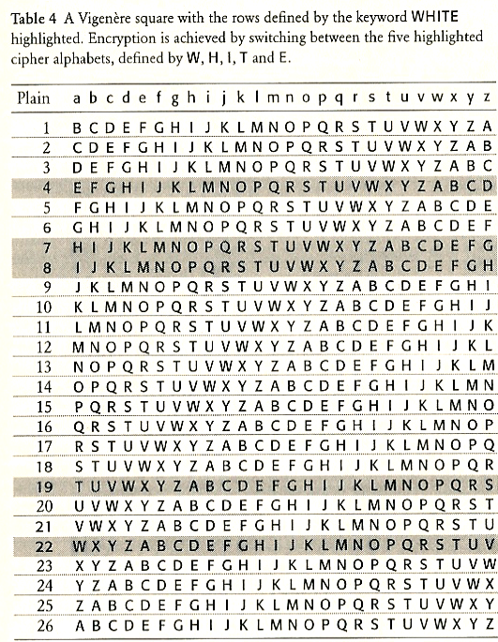

Slide 12
DES – The Data Encryption Standard
IBM invented "Lucifer", an encryption system adopted as the Data Encryption Standard (DES) in 1976.
DES repeatedly scrambles (mangles) blocks of 64 bits with an encryption key of 56bits.
The key was reduced from a longer key to 56bits as required by the American NSA (National Security Agency).

Slide 13
Triple DES
For added security ....DES can use two keys as follows:-
  C=E_{K1}(D_{K2}(E_{K1}(P)))
and
  P=D_{K1}(E_{K2}(D_{K1}(C)))
C = ciphertext and P = plaintext
and
E_{K1} denotes Encrypt with key K1,
D_{K2} denotes Decrypt with key K2,
etc.

Slide 14
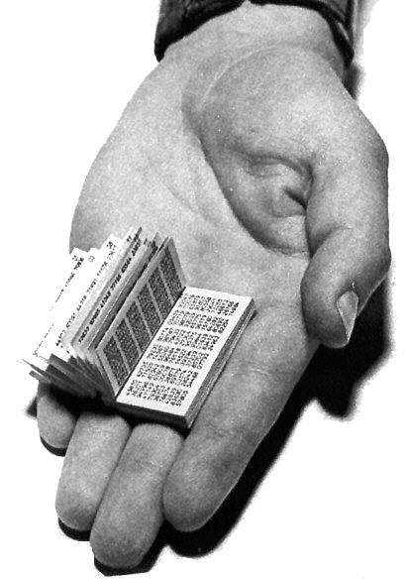
One-Time Pad
A one-time pad is a system in which a randomly generated key is used only once to encrypt a message that is then decrypted by the receiver using a matching one-time pad and key.
The Vernam Cipher is a common binary version that adds the message and key modulo 2.
Messages encrypted with keys based on randomness have the advantage that there is theoretically no way to "break the code" by analyzing a succession of messages.
Each encryption is unique and bears no relation to the next encryption so that some pattern cannot be detected. However, the decrypting party must have access to the same key used to encrypt the message.
One-time pads have sometimes been used when both parties started out at the same physical location. They were used for secret message transmission and espionage before and during World War II and in the Cold War era.
“Cubem autem in duos cubos, aut quadratoquodratum in duos quadratoquadratos, et generaliter nullam in infinitum ultra quadratum potestatem in duos eiusdem nominis fas est dividere. Cuius rei demonstrationem mirabilem sane detexi hanc marginis exiguitas non careret.”
The one time pad text used in Simon Singh’s Code Challenge.
Fermat’s original Latin text written in the margin.
http://codebook.org/node30.html
A Russian one-time pad captured by MI5.

Slide 15
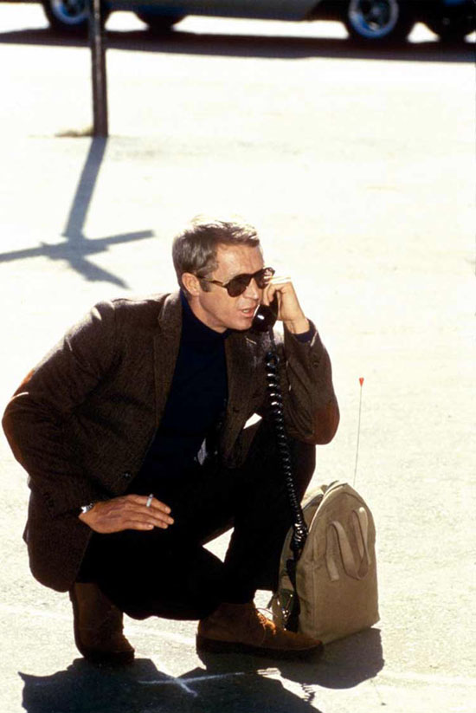
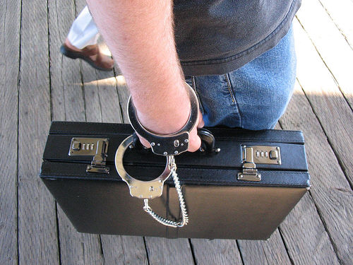
The Key Distribution Problem
How can secret keys be exchanged by parties who want to communicate?
In the late 1970s, banks distributed keys by employing special dispatch riders who had been vetted and were among the company's most trusted employees. They would travel across the world with padlocked briefcases, personally distributing keys to everyone who would receive messages from the bank over the next week.

Slide 16
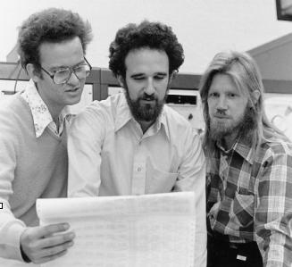
Diffie-Hellman-Merkle
Whitfield Diffie and Martin Hellman.
Diffie accepted a research position with Hellman and was later joined by Ralph Merkle at Stanford.
Diffie imagined two strangers (Alice and Bob) meeting on the Internet and wondered how they could send each other an encrypted message which an eavesdropper (Eve) could not read).
Although safe key exchange had been considered impossible ...
(c) Chuck Painter/Stanford News Service
- Ralph Merkle, Martin Hellman, Whitfield Diffie (1977)

Slide 17
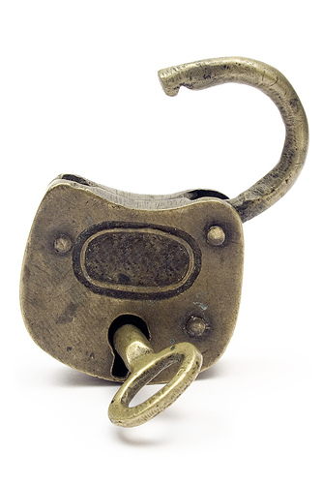
A Simple Padlock Example
It is possible to imagine secure message exchange over an insecure communication system.
Imagine Alice sends a package to Bob securing it with a padlock. Bob can't open it – but adds his own padlock to it and sends it back to Alice who removes her padlock and sends it back to Bob – Bob can now open his own padlock. QED.
Alice and Bob both kept their keys safe and the package was never unlocked in the system.
The problem with applying this simple solution was the order of events. Encryption methods up to this time has required a "last on, last off" ordering.

Slide 18
Public Key Cryptography

Slide 19
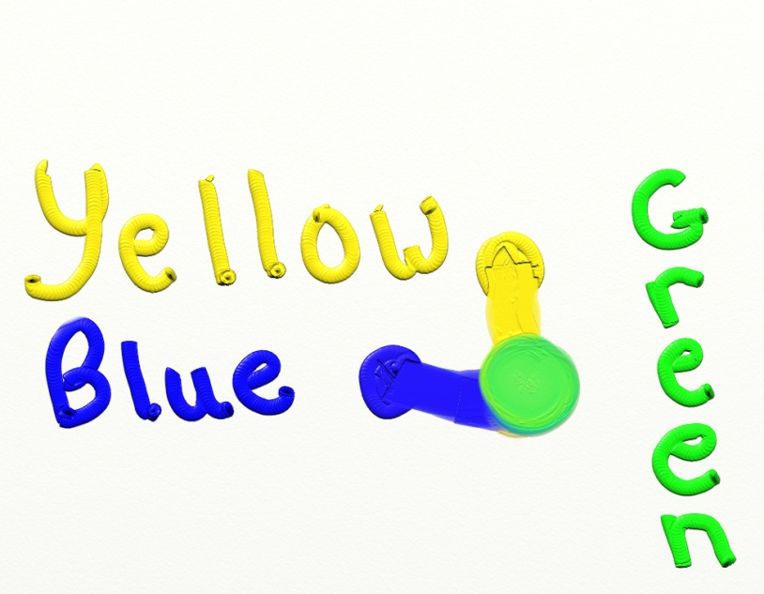
One-way Functions
Most mathematical functions are two-way. E.g., doubling functions can be undone by halving. That is, most operations are reversible and the two operations tend to be of similar orders of complexity.
One-way functions are impossible, or very difficult to reverse. There is an analogy with mixing paint. For example, it is very easy to make green paint by mixing yellow and blue paints, but it would be very hard to get back to blue and yellow paints.
http://www.filarecki.com/green.jpg

Slide 20
Modular Arithmetic for One-way Functions
Solutions to modular arithmetic functions have apparently random results which makes guessing solutions based on adjacent results impossible.
  x 1 2 3 4 5 6
  3^{x} 3 9 27 81 243 729
  3^{x}(mod7) 3 2 6 4 5 1
In the simple example above it is very easy to calculate 3^{x}(mod7) given x, but more difficult to reverse the process, i.e., to find x given 3^{x}(mod7).
With larger values, e.g., 453^{x}(mod 21,997), it is still relatively easy to encode x, but decoding would be extremely difficult.
In 1976, Diffie, Hellman and Merkle invented a system for safe key exchange using modular arithmetic to provide one-way functions.

Slide 21
DHM Key Exchange
Diffie-Hellman-Merkle (DHM) key exchange uses the one-way function Y^{x}(mod P). Communicating parties agree prime values for Y and P.
Alice choose a number, A.
Alice calculates α where
  α = Y^{A} (mod P)
Alice uses β to calculate
β^{A} (mod P)
Bob chooses a number, B
Bob calculates β where
  β = Y^{B} (mod P)
Bob uses α to calculate
α^{B} (mod P)
α and β
are exchanged
These values yield the same key since
β^{A} (mod P)= Y^{BA} (mod P)= Y^{AB} (mod P)= α^{B} (mod P)
DHM requires interaction between parties. With no authentication it is vulnerable to man-in-the-middle attacks.

Slide 22
Public-key Cryptography
A disadvantage of the Diffie-Hellman-Merkle key exchange is that it requires interaction (mutual exchange of information) between Alice and Bob, i.e., spontaneous interchange of encrypted messages is not possible.
Diffie went on to specify the requirements for an asymmetric key system, i.e., a system where the encryption and decryption keys are different.
The encryption key is the public key and the decryption key is the private key.
Again, with the padlock analogy, the public key is like a padlock - anyone can lock it - but opening it requires a private key kept safe by the owner.
So Alice can encrypt messages to Bob (without any special exchanges) using his widely-available public key.

Slide 23
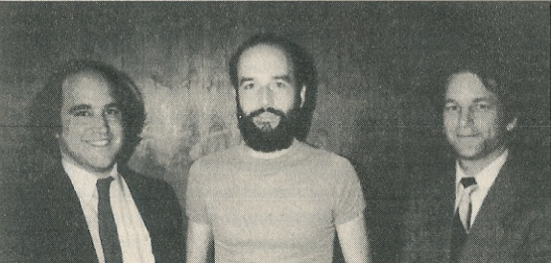
RSA (Rivest, Shamir and Adleman)
Rivest, Shamir and Adleman at MIT developed the necessary public-key cryptography (RSA) specified by Diffie.
RSA was announced in Scientific American in August 1977.
The system involves large primes, p and q which are multiplied together (N=pxq) as part of the public key.
Factoring N into p and q is extremely difficult for large N.
For banking transactions, N>10³⁰⁸ provides an extremely high level of security (a hundred million PCs would take more than 1000 years to find p and q.)

Slide 24
RSA
Select two large primes, p and q
N=pxq
Select an integer, e, ensuring e and (p-1)x(q-1) are relatively prime.
Public key = N,e (N should be unique, but e need not be)
The ciphertext, C, of a message, M, is given by
C=Me(mod N)
So, everyone can encrypt their messages, since N and e are publicly available.
The private key, d, is calculated as
exd (mod(p-1)x(q-1)) =1
Decryption is performed by solving:-
M=C^{d} (mod N)

Slide 25
Pretty Good Privacy (PGP)
Phil Zimmermann believed everybody had a right to the kind of privacy offered by RSA encryption. He developed a user-friendly implementation of RSA called PGP.
Since RSA is quite computationally complex, Zimmerman designed PGP to use RSA to encrypt the key of a cipher called IDEA, which is similar to DES.
With the key safely encrypted with RSA, all message data is then encrypted with the simple cipher, IDEA.
To send a message to Bob, Alice encrypts (and sends) an IDEA key with Bob’s public RSA key and encrypts (and sends) her message with the IDEA key.
Bob uses his private RSA key to decrypt Alice’s IDEA key which he then uses to decrypt Alice’s message.

Slide 26
Digital Signatures for Verification
How can Bob be sure the message he receives is from Alice? Anyone can use his public key to encrypt messages for him.
  Solution: Alice can use her PRIVATE key to ENCRYPT the message (note - the private key is usually used for decryption).
  Any message encrypted with the private key can be decrypted by the public key - so this is not secure (everyone has the public key) - but it does prove authorship.
  So, if Alice encrypts with Bob’s public key, privacy is guaranteed. If she encrypts with her private key, she can prove authorship.
  To ensure privacy AND authorship - she first encrypts the message with her private key then encrypts the result with Bob’s public key.
  Real digital signatures support non-repudiation and integrity. A checksum or hash of the original message is encrypted with the sender’s private key.

Slide 27
The Technology and Ethics of Internet Behaviour
Private study questions for assessment and in-class discussion.
Does everyone have a right to privacy?
Why is Internet misuse increasingly common as a reason for employment dismissal?
What is on-line disinhibition and why is it a problem?
White hat, grey hat, black hat – what are the ethics of hacking?
Is the “dark Internet” as dark as it seems? Does TOR ensure anonymity?
Is that phone/device on or off? Are deleted messages deleted?

Slide 28
Thank You

