Slide 1
Computer Networking
Local Area Networks,
Medium Access Control and Ethernet
Dr Sandra I. Woolley

Slide 2
Contents
Network Types
Broadcast Networks
Medium Access Control
  Random Medium Access
    ALOHA
    Slotted ALOHA
    CSMA
    CSMA-CD
  Scheduled Medium Access
    Reservation
    Polling

Slide 3
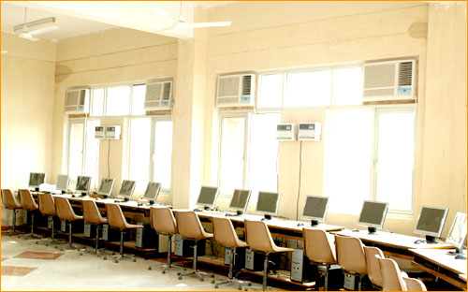
Basic Network Types
Switched networks – connected via multiplexers and switches which direct packets from the source toward the destination.
Broadcast networks – data is received by all receivers. Local Area Networks (LANs) have traditionally been broadcast networks.

Slide 4
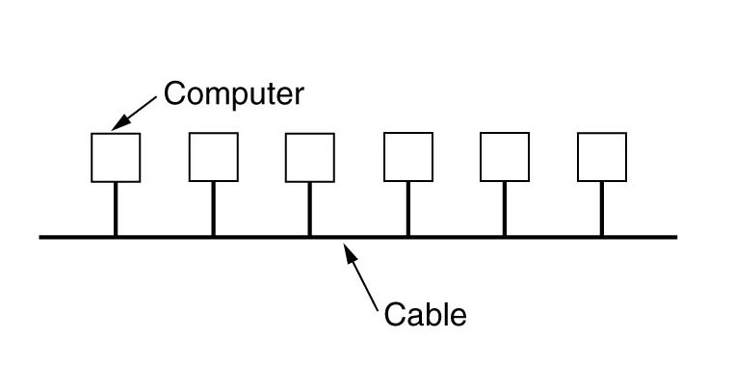
Broadcast Networks
Advantages
  No routing.
  Simple, flat addressing scheme, hence low overhead.
  Cheap and simple.
Disadvantages
  Not scalable.
  If we want to avoid static partitioning (channelization) we will need some form of access control.
Examples
  Radio communications
  Satellite communications
  Bluetooth (2.4GHz radio)
  Ethernet networks

Slide 5
Medium Access Control (MAC)
In broadcast networks collisions occur when transmissions happen at the same time and interfere.
The protocol to prevent or minimise collisions, and efficiently and fairly share the channel, is called a Medium Access Control (MAC) protocol.
All devices that share the medium are said to be in the same broadcast domain.
All devices need to agree on the MAC protocol and be coordinated even if they are not involved in the current message on the network.
There are two basic MAC schemes:
Random Access - like a meeting without a chairperson - collisions can occur but the protocol does something to address this.
Scheduling – like a meeting with a chairperson - communicating slots are allocated in turn.

Slide 6
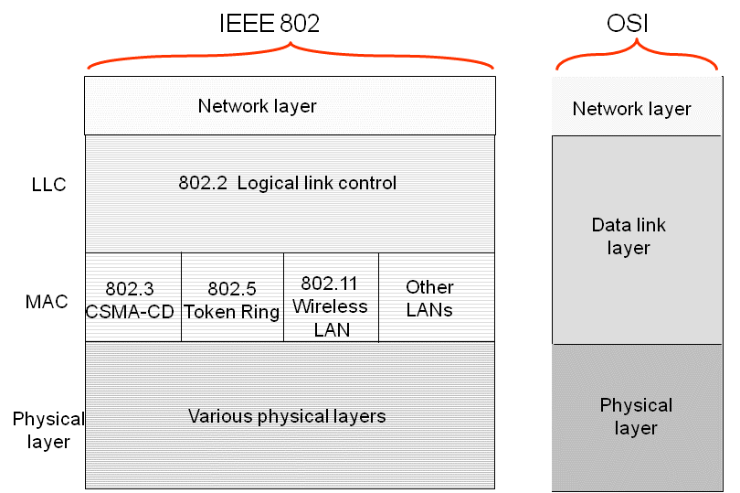
Medium Access Control Sublayer
The IEEE 802 Data Link Layer is divided into two sublayers:
Logical Link Control (LLC) Sublayer
  Between Network layer and MAC sublayer
Medium Access Control (MAC) Sublayer
  Coordinates access to medium.
  Provides connectionless frame transfer service.
  Hosts identified by MAC (physical) address.
  Frames broadcast with MAC addresses.

Slide 7
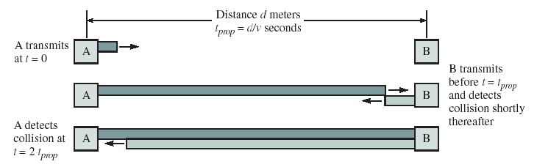
What is a Collision?
Collisions can happen when stations transmit at the same time. We need to consider propagation delay.
Even if the channel is empty collisions can occur.
For a collision, host B must transmit between 0 and t_{prop}
In the worst case, host A does not detect collision until 2t_{prop}

Slide 8
Setup Time
Host A must wait at least 2t_{prop} before it knows the channel is free – this is called the negotiation or coordination time.
If the bit rate is R bps, then this setup time uses 2t_{prop}R bits.

Slide 9
MAC Delay Performance
Frame transfer delay
  The time from when first bit exits the source MAC until the last bit of the frame is delivered at the destination MAC.
Throughput
  The actual transfer rate through the shared medium.
  Measured in frames/sec or bits/sec.
Parameters
  R = bit rate and L= no. bits in a frame
  X=L/R seconds/frame
  Suppose stations generate an average arrival rate of λ frames/second
  Load (normalized throughput) ρ = λ X, rate at which “work” arrives.
  Maximum throughput (@100% efficiency): R/L frames/second

Slide 10
Efficiency of Two-Station Example
Each frame transmission requires 2t_{prop} of quiet time
  Station B needs to be quiet t_{prop} before and after time when Station A transmits
  R transmission bit rate
  L bits/frame
Normalized Delay-Bandwidth Product
Propagation delay
Time to transmit a frame

Slide 11
Typical MAC Efficiencies
If a<<1, then efficiency close to 100%
As a approaches 1, the efficiency becomes low
A network with a large bandwidth-delay product is known as a long fat network (shortened to LFN and often pronounced "elephant"). As defined in RFC 1072, a network is considered an LFN if its bandwidth-delay product is significantly larger than 10⁵ bits.
Normalized Delay-Bandwidth Product
Propagation delay
Time to transmit a frame
CSMA-CD (Ethernet) protocol:

Slide 12
Typical Delay-Bandwidth Products
The table below shows the number of bits in transit in one-way propagation delay assuming propagation speed of 3x10⁸m/s.
(Max size Ethernet frame: 1500 bytes = 12000 bits)
Distance | 10 Mbps | 100 Mbps | 1 Gbps | Network Type
1 m | 3.33 x 10⁻⁰² | 3.33 x 10⁻⁰¹ | 3.33 x 10⁰ | Desk area network
100 m | 3.33 x 10⁰¹ | 3.33 x 10⁰² | 3.33 x 10⁰³ | Local area network
10 km | 3.33 x 10⁰² | 3.33 x 10⁰³ | 3.33 x 10⁰⁴ | Metropolitan area network
1000 km | 3.33 x 10⁰⁴ | 3.33 x 10⁰⁵ | 3.33 x 10⁰⁶ | Wide area network
100000 km | 3.33 x 10⁰⁶ | 3.33 x 10⁰⁷ | 3.33 x 10⁰⁸ | Global area network

Slide 13
Normalized Delay versus Load
E[T]/X
E[T] = average frame
transfer delay
At low arrival rates, only frame transmission time
At high arrival rates, increasingly longer waits to access channel
Max efficiency typically less than 100%
X = average frame
transmission time
Transfer delay
1
ρ
ρ_{max}
1
Load

Slide 14
Dependence on t_{prop}R/L
E[T]/X
a′ > a
a′
a
Transfer Delay
1
ρ
ρ′_{max}
ρ_{max}
1
Load

Slide 15
Random Access MAC

Slide 16
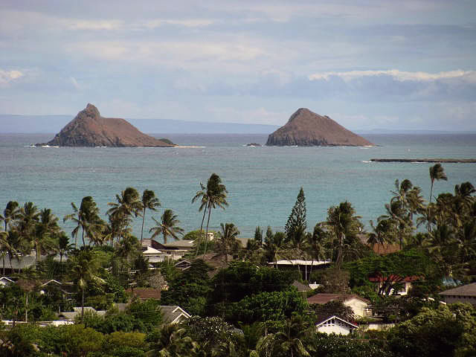
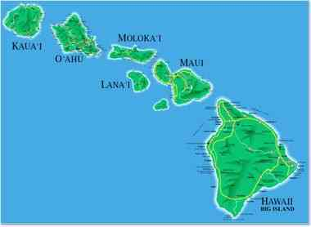
Random Access MAC
Simplest form is just to transmit when desired – don’t listen for silence first.
First system was ALOHA – University of Hawaii needed to connect terminals on different islands.
Used radio transmitters that send data immediately – this gives no setup delay.
Transmitters detect collision by waiting for a response – if a collision occurs, there will be data corruption and the receiver says ‘send again’.
Collisions result in complete re-transmission
For light traffic, low probability of collision so re-transmissions are infrequent.

Slide 17
ALOHA
Problem: A collision involves at least two devices. Both will need to re-transmit
If both devices re-transmit immediately (or after the same delay) another collision will occur and could again, and again if the delay is unchanged.
ALOHA requires a random delay after collision before re-transmission
Since devices don’t listen for silence before transmission this delay must allow one transmitter to complete its transmission. The delay is long to ensure this.
The likelihood of collision is increased after each collision.

Slide 18
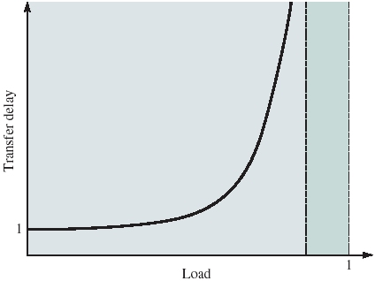
Collision Limit Reminder
For lightly loaded network, get very few collisions so throughput is high.
As traffic increases, more and more collisions generate more and more collisions which waste bandwidth.

Slide 19
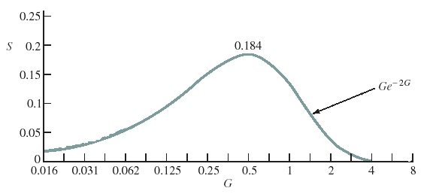
Collision Dominated
In heavily loaded networks collisions increase and every packet takes many attempts to get through and ultimately the network becomes collision dominated and throughput (S) goes down to zero. G is the total load.
For ALOHA peak throughput is 18.4% of channel capacity.

Slide 20
Slotted ALOHA
Slotted ALOHA reduced collisions to improve throughput.
It constrained stations to transmit in specific synchronised time slots.
Time slots are all the same and packets occupy one slot.
All devices share the slots – collisions are reduced since they can only occur at the start of the slot – cannot have a collision half way through a transmission.
A ‘Don’t interrupt me once I’ve started’ protocol !

Slide 21
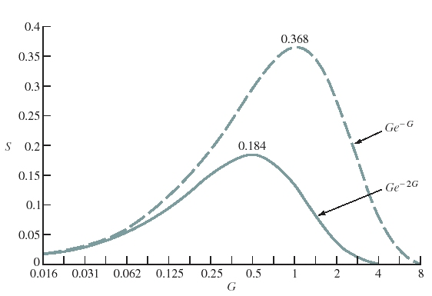
Slotted ALOHA
Better performance under light load than pure ALOHA.
Maximum throughput is 36.8%

Slide 22
ALOHA Problem
Channel bandwidth is wasted due to collisions.
We can reduce collisions by avoiding transmissions that are certain to cause a collision.
ALOHA transmits without first listening to check if the channel is free.
A Carrier Sense Multiple Access (CSMA) MAC scheme could usefully sense the medium for presence of a signal before transmitting.

Slide 23
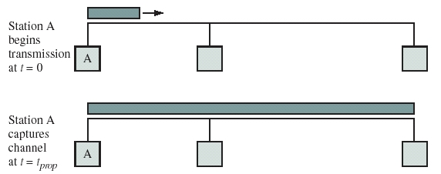
CSMA
Station A transmits – as other stations detect the signal, they defer any transmissions.
After t_{prop} station A has captured the channel.
Vulnerable period is t= t_{prop}

Slide 24
CSMA – When to stop waiting?
If the channel is busy, station wishing to transmit waits until what happens?
1-Persistent CSMA
  Wait until channel is free and transmit immediately, but we can expect that more than one transmitter is waiting so a collision is likely.
  It is a ‘greedy’ access mechanism resulting in high collision rate.

Slide 25
CSMA – When to stop waiting?
Non-persistent CSMA
  Stations wanting to transmit sense the channel.
  If busy, they re-schedule another sense for later.
  Re-scheduling method is called the backoff algorithm.
  If channel is free at re-sense, transmit, else re-schedule again.
  Since stations do not persist in sensing the channel and ‘come back later’ for another look, collisions are reduced.
  The drawback is the re-sense may be scheduled for a lot longer than needed – channel may be free before backoff algorithm times out so efficiency is lower than 1-Persistent CSMA.

Slide 26

CSMA – When to stop waiting?
p-Persistent CSMA
  A combination of 1-Persistent and Non-Persistent.
  Stations wanting to transmit sense the channel.
  If busy, they continuously re-sense until it becomes idle.
  With a probability p, the station transmits immediately.
  With a probability 1-p, the station re-schedules another sense (often delay is t_{prop})
  Note - delay is from channel becoming free – with Non-Persistent the delay was from first sense time.

Slide 27
Advantages of p-Persistent
Efficiency is good since there is a probability p of instant transmission when channel is free – the higher p the better (ultimately p=1 becomes 1-Persistent CSMA.)
Probability p of two devices transmitting causing a clash – the lower p the better (ultimately p=0 becomes 0-Persistent or Non-Persistent CSMA.)
…. hence the value of p is a compromise and depends on many factors.

Slide 28
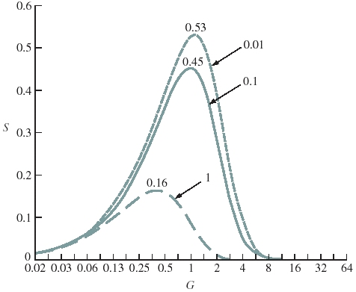
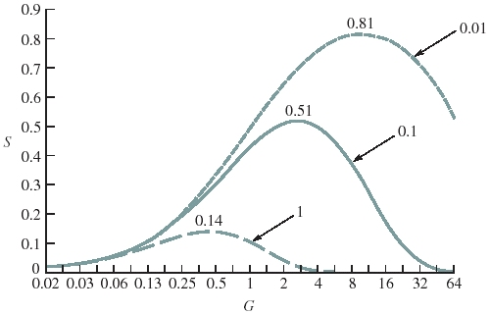
CSMA Performance
Typical performance 53% to 81% - better than ALOHA (18% to 37%). Note the effect of varying the normalized delay-bandwidth products (a=1,0.1 and 0.01).
1-Persistent
Non-Persistent

Slide 29
CSMA and ALOHA Problem
Both CSMA and ALOHA collisions involve an entire packet – the collision is not detected until the entire packet is sent.
E.g. a 1500 bit packet, collision occurs after 10 bits, the remaining 1490 bytes are still sent and will be corrupted.
The receiver will detect this (via a checksum) and respond with a Negative Acknowledgement (NAK) and the data will be sent again.
This is inefficient – the last 1490 bits are a waste of channel capacity.

Slide 30
CSMA-CD
Better channel usage if we detect the collision when it occurs rather than waiting until the end of the packet.
Carrier Sense Multiple Access with Collision Detection - CSMA-CD
Performed by the transmitting station listening to itself and if what it hears is different from what it sends then there is a collision.
If this occurs, transmitter sends a short jamming signal which notifies all stations there has been a collision – without this the receiver will not know there has been a collision and will continue to listen.
Then the transmission is aborted and a re-try scheduled.

Slide 31
Protocol - Without a chairman = CSMA-CD
One person speaks, all others listen.
Before someone speaks, they check that nobody else is talking, then they talk.
If two people start talking at the same time, both stop and apologise, and one of them re-starts talking.
Multiple Access – MA
Carrier Sense – CS
Collision Detect - CD

Slide 32
Scheduling MAC

Slide 33
Scheduling MAC Approach
The MAC’s we considered earlier were random access.
They were simple to implement and had good performance except under heavy load when they are collision dominated.
Scheduling Systems are a way of controlling access to the media – like a meeting with a chairperson.
Each station has a reserved slot when it can transmit, so there are no collisions.
The disadvantage is that some stations may not want to transmit and the slot is wasted.

Slide 34
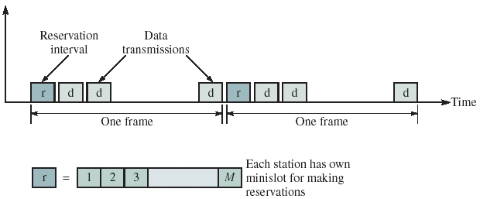
Reservation Systems
To overcome slot wasting, we can have a special timeslot where devices say if they want to use the channel – this is a minislot within the reservation interval.

Slide 35
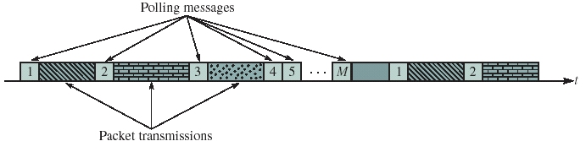
Polling
Polling is an alternative approach to sharing medium access.
It does not require fixed time slots.
There may be a central controller that sends polling messages to stations (in a round-robin or other order) to enable access to the channel if needed.
Without a central controller the stations need an established polling order.

Slide 36
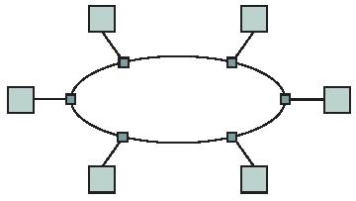
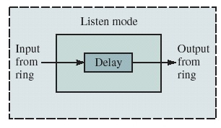
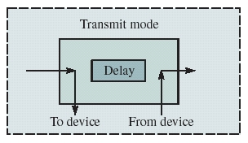
Token Passing Networks
In a ring network topology, token passing can be used as a way of polling without a central controller.
When listening, devices copy data from input to output, hence passing everything along.
When transmitting, devices receive data coming in, modify or add to it and send this on to the next station.

Slide 37
Token Passing
A station that wants to transmit waits for a free token.
The ‘free token’ is the polling message that allows access to the medium.
Station then modifies the token to say the medium is no longer free, adds its data and sends this on.
This full packet eventually reaches the destination where it is read. It can be removed by the receiver or transmitter.
After transmission is complete, a new free token needs to be re-inserted.
Most commonly whoever removed the full packet re-inserts a new free token.
What if device is switched off during this? Free token is lost.
Normally there is a nominated controller that re-starts the ring if the token is lost.

Slide 38
Summarizing and Comparing MAC Approaches
Aloha & Slotted Aloha
  Simple & quick transfer at very low load
  Accommodates large number of low-traffic bursty users
  Highly variable delay at moderate loads
  Efficiency does not depend on a
CSMA-CD
  Quick transfer and high efficiency for low delay-bandwidth product
  Can accommodate large number of bursty users
  Variable and unpredictable delay

Slide 39
Summarizing and Comparing MAC Approaches
Reservation
  On-demand transmission of bursty or steady streams
  Accommodates large number of low-traffic users with slotted Aloha reservations
  Can incorporate QoS (Quality-of-Service)
  Handles large delay-bandwidth product via delayed grants
Polling
  Generalization of time-division multiplexing
  Provides fairness through regular access opportunities
  Can provide bounds on access delay
  Performance deteriorates with large delay-bandwidth product

Slide 40
Summary
Network Types
Broadcast Networks
Medium Access Control
  Random Medium Access
    ALOHA
    Slotted ALOHA
    CSMA
    CSMA-CD
  Scheduled Medium Access
    Reservation
    Polling

Slide 41
Ethernet

Slide 42
Contents
The 802 IEEE standards
The Ethernet standard - IEEE 802.3 (and DIX)
Cable lengths and packet sizes
Addressing
Packet format
Physical connections and segment extensions
  Repeaters, bridges and routers
Fast Ethernet

Slide 43
IEEE 802 Standards

Slide 44
The IEEE 802 Standards
The IEEE 802 standards are for Local and Metropolitan Area Networks
  IEEE 802® : Overview & Architecture
  IEEE 802.1™ : Bridging & Management
  IEEE 802.2™ : Logical Link Control
  IEEE 802.3™ : CSMA/CD Access Method
  IEEE 802.4™ : Token-Passing Bus Access Method
  IEEE 802.5™ : Token Ring Access Method
  IEEE 802.6™ : DQDB Access Method
  IEEE 802.7™ : Broadband LAN
  IEEE 802.10™ : Security
  IEEE 802.11™ : Wireless
  IEEE 802.12™ : Demand Priority Access
  IEEE 802.15™ : Wireless Personal Area Networks
  IEEE 802.16™ : Broadband Wireless Metropolitan Area Networks

Slide 45
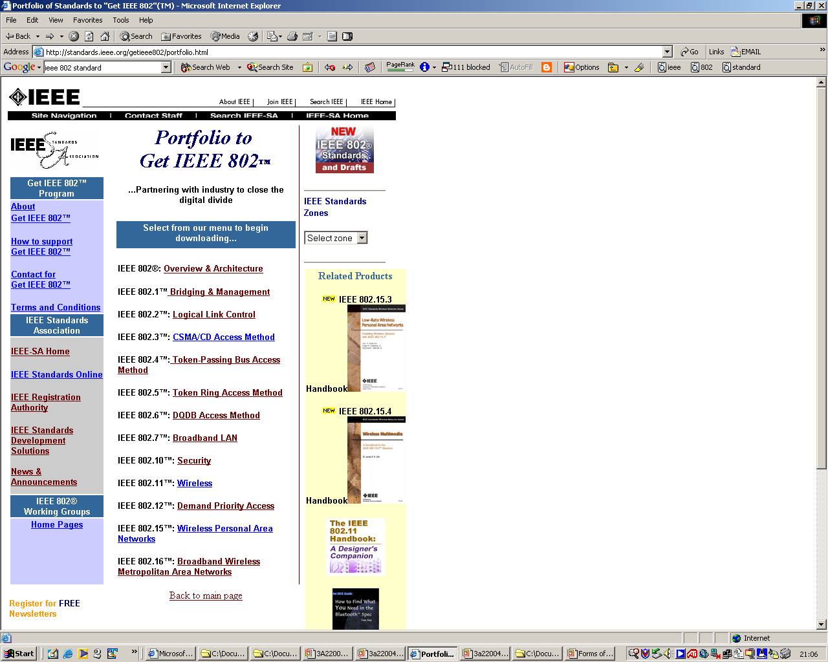
IEEE 802 Standards
At the time of writing the IEEE standards are available free on-line at http://www.ieee802.org/

Slide 46
Active 802 Working Groups
802.1 Higher Layer LAN Protocols Working Group
802.3 Ethernet Working Group
802.11 Wireless LAN Working Group
802.15 Wireless Personal Area Network (WPAN) Working Group
802.16 Broadband Wireless Access Working Group
802.17 Resilient Packet Ring Working Group
802.18 Radio Regulatory TAG
802.19 Wireless Coexistence Working Group
802.20 Mobile Broadband Wireless Access (MBWA) Working Group
802.21 Media Independent Handover Services Working Group
802.22 Wireless Regional Area Networks
802.23 Emergency Services Working Group
(802.15.1) Bluetooth;
(802.15.4) Sensor networks.

Slide 47
Ethernet
... an Example of a LAN Standard

Slide 48
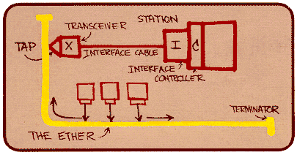
A Bit of History…
1970 ALOHAnet radio network deployed in Hawaiian islands
1973 Metcalf and Boggs invent Ethernet
1979 DIX Ethernet II Standard
1985 IEEE 802.3 LAN Standard (10 Mbps)
1995 Fast Ethernet (100 Mbps)
1998 Gigabit Ethernet
2002 10 Gigabit Ethernet
Ethernet is the dominant LAN standard
Metcalf’s Sketch

Slide 49
IEEE 802.3 MAC: Ethernet
MAC Protocol:
CSMA/CD
Slot Time is the critical system parameter
  upper bound on time to detect collision
  upper bound on time to acquire channel
  upper bound on length of frame segment generated by collision
  quantum for retransmission scheduling
Truncated binary exponential backoff
  for retransmission n: 0 < r < 2^{k}-1, where k=min(n,10)
  gives up after 16 retransmissions

Slide 50
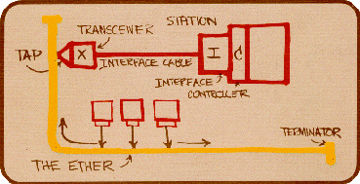
IEEE 802.3 Original Parameters
Transmission Rate: 10 Mbps
Min Frame: 512 bits = 64 bytes
Slot time: = 51.2 µsec
Max Length: 2500 meters + 4 repeaters
Each x10 increase in bit rate, must be accompanied by x10 decrease in distance.

Slide 51
Ethernet Cable and Frame Lengths
To detect a collision, packets must ‘fill the network’
If not, packets can cross over and be corrupted but the transmitters not detect the collision.

Slide 52
Ethernet Retransmission
After a collision we need a backoff time randomly selected before we transmit. The slot time is the fundamental unit for re-try.
After collision, both devices randomly try to send after 0 or 1 time slots.
If there is another collision, then each randomly try to send after 0,1,2 or 3 slots – this longer time reduces the probability of another collision.
If another collision occurred the each randomly try to send after 0,1,2,3,4,5,6,7 slots.
On the kth retry, between 0 and 2^{k}-1 slots are selected randomly.
The upper limit is 10 doublings (0 – 1023 minislots)
For 10Base5 this resulted in up to 1023x102.4 μs ~ 0.1 seconds
... then a further 6 retries at this limit after which an error is reported if transmission has not been successful.

Slide 53
IEEE 802.3 MAC Frame
Every frame transmission begins “from scratch”
Preamble helps receivers synchronize their clocks to transmitter clock
7 bytes of 10101010 generate a square wave
Start frame byte changes to 10101011
Receivers look for change in 10 pattern
802.3 MAC Frame
7
1
6
6
2
4
Preamble
Destination
address
Source
address
Length
Information
Pad
FCS
SD
Synch
Start
frame
64 - 1518 bytes

Slide 54
IEEE 802.3 MAC Frame
802.3 MAC Frame
7
1
6
6
2
4
Preamble
Destination
address
Source
address
Length
Information
Pad
FCS
SD
Synch
Start
frame
64 - 1518 bytes
Destination address
  single address
  group address
  broadcast = 111...111
Addresses
  local or global
Global addresses
  first 24 bits assigned to manufacturer;
  next 24 bits assigned by manufacturer
  Cisco 00-00-0C
  3COM 02-60-8C

Slide 55
IEEE 802.3 MAC Frame
Length: # bytes in information field
  Max frame 1518 bytes, excluding preamble & SD
  Max information 1500 bytes: 05DC
Pad: ensures min frame of 64 bytes
FCS: CCITT-32 CRC, covers addresses, length, information, pad fields
  NIC discards frames with improper lengths or failed CRC
802.3 MAC Frame
7
1
6
6
2
4
Preamble
Destination
address
Source
address
Length
Information
Pad
FCS
SD
Synch
Start
frame
64 - 1518 bytes

Slide 56
DIX Ethernet II Frame Structure
DIX: Digital, Intel, Xerox joint Ethernet specification
Type Field: to identify protocol of PDU in information field, e.g. IP, ARP
Framing: How does receiver know frame length?
  physical layer signal, byte count, FCS
Ethernet frame
7
1
6
6
2
4
Preamble
Destination
address
Source
address
Type
Information
FCS
SD
Synch
Start
frame
64 - 1518 bytes

Slide 57
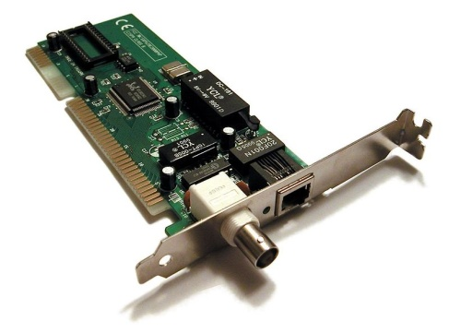
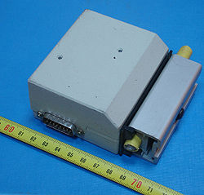
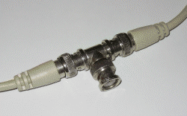
IEEE 802.3 Physical Layer
IEEE 802.3 10 Mbps medium alternatives
 | 10base5 | 10base2 | 10baseT | 10baseFX
Medium | Thick coax | Thin coax | Twisted pair | Optical fiber
Max. Segment Length | 500 m | 200 m | 100 m | 2 km
Topology | Bus | Bus | Star | Point-to-point link
transceivers
Thick Coax:
Stiff, hard to
work with
T connectors

Slide 58
Fast Ethernet
 | 100baseT4 | 100baseT | 100baseFX
Medium | Twisted pair category 3 UTP 4 pairs | Twisted pair category 5 UTP two pairs | Optical fiber multimode Two strands
Max. Segment Length | 100 m | 100 m | 2 km
Topology | Star | Star | Star
To preserve compatibility with 10 Mbps Ethernet:
Same frame format, same interfaces, same protocols
Hub topology only with twisted pair & fiber
Bus topology & coaxial cable abandoned
Category 3 twisted pair (ordinary telephone grade) requires 4 pairs
Category 5 twisted pair requires 2 pairs (most popular)
Most prevalent LAN today

Slide 59
Gigabit Ethernet
 | 1000baseSX | 1000baseLX | 1000baseCX | 1000baseT
Medium | Optical fiber multimode Two strands | Optical fiber single mode Two strands | Shielded copper cable | Twisted pair category 5 UTP
Max. Segment Length | 550 m | 5 km | 25 m | 100 m
Topology | Star | Star | Star | Star
Slot time increased to 512 bytes
Small frames need to be extended to 512 B
Frame bursting to allow stations to transmit burst of short frames
Frame structure preserved but CSMA-CD essentially abandoned
Extensive deployment in backbone of enterprise data networks and in server farms

Slide 60
10 Gigabit Ethernet
 | 10GbaseSR | 10GBaseLR | 10GbaseEW | 10GbaseLX4
Medium | Two optical fibers Multimode at 850 nm 64B66B code | Two optical fibers Single-mode at 1310 nm 64B66B | Two optical fibers Single-mode at 1550 nm SONET compatibility | Two optical fibers multimode/single-mode with four wavelengths at 1310 nm band 8B10B code
Max. Segment Length | 300 m | 10 km | 40 km | 300 m – 10 km
Frame structure preserved
CSMA-CD protocol officially abandoned
LAN PHY for local network applications
WAN PHY for wide area interconnection using SONET OC-192c
Extensive deployment in metro networks anticipated

Slide 61
Example Ethernet Deployment
Server farm
Server
Server
Server
Gigabit Ethernet links
Switch/router
Switch/router
Gigabit Ethernet links
Server
Ethernet switch
Ethernet switch
Server
Ethernet switch
Server
100 Mbps links
100 Mbps links
100 Mbps links
Hub
Hub
Hub
10 Mbps links
10 Mbps links
10 Mbps links
Department A
Department B
Department C

Slide 62
LAN Bridges and Ethernet Switches
(Section 6.11 in the course text)

Slide 63
Interconnecting Networks
There are several ways of interconnecting or extending networks:
  When two or more networks are connected at the physical layer, the type of device is called a repeater. A multi-port repeater is a hub.
  When two or more networks are connected at the MAC or data link layer, the type of device is called a bridge.
  When two or more networks are connected at the network layer, the type of device is called a router.
  Repeaters simply copy everything, including errors, so we are limited to how many repeaters we can have.
  Interconnections at higher layers is done less frequently. The device that connects at a higher level is usually called a gateway.

Slide 64
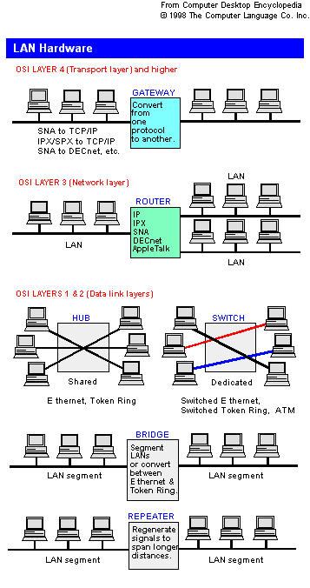
What is a Switch?
The term “LAN bridge” found in standards is often referred to as a “LAN switch” in industry. In the course text these terms are used as synonyms.
We will use the terminology used in the course text.
Multi-layer switches are devices that can work at layer 2 (data link) and layer 3 (network).

Slide 65
Hubs vs Bridges
Repeaters and hubs aren’t intelligent. They copy all traffic, including errors, onto all connections.
This creates one larger collision domain which will tend to saturate as the number of stations increase or the amount of traffic increases.
Bridges extend LANs by creating multiple collision domains.
They examine the MAC addresses of frames. Only frames destined for an address on the other side of the bridge are sent.

Slide 66
Transparent Bridges
IEEE 802.1d defines transparent bridges. The term transparent refers to the fact that stations are unaware of the presence of the bridge.
“Ethernet switches are simply multiport transparent bridges for interconnecting stations using Ethernet links.”
A transparent bridge does the following:
  Forwards frames from one LAN to another.
  Learns where stations are attached to the LAN.
  Prevents loops in the topology.
S1
S2
S3
LAN1
Bridge
LAN2
S4
S5
S6

Slide 67
Transparent Bridges
Bridges create and use lookup tables called forwarding tables or forwarding databases.
They
  discard frames, if the source and destination are in the same LAN.
  forward frames, if the source and destination are in different LANs.
  use flooding, if the destination is unknown.
Use backward learning to build their forwarding table. They
  observe source addresses of frames from arriving LANs.
  handle topology changes by removing old entries.
S1
S2
S3
LAN1
Bridge
LAN2
S4
S5
S6

Slide 68
An Example: Creating Forwarding Tables
S1
S2
S3
S4
S5
LAN1
LAN2
LAN3
B1
B2
Port 1
Port 2
Port 1
Port 2
Address Port
Address Port

Slide 69
S1→S5
S1
S2
S3
S4
S5
S1 to S5
S1 to S5
S1 to S5
S1 to S5
LAN1
LAN2
LAN3
B1
B2
Port 1
Port 2
Port 1
Port 2
Address Port
Address Port
S1
1
S1
1

Slide 70
S3→S2
S1
S2
S3
S4
S5
S3→S2
S3→S2
S3→S2
S3→S2
S3→S2
LAN1
LAN2
LAN3
B1
B2
Port 1
Port 2
Port 1
Port 2
Address Port
Address Port
S1
1
S1
1
S3
2
S3
1

Slide 71
S4→S3
S1
S2
S3
S4
S5
S4 S3
S4→S3
S4→S3
S4→S3
LAN1
LAN2
LAN3
B1
B2
Port 1
Port 2
Port 1
Port 2
Address Port
Address Port
S1
1
S1
1
S3
2
S3
1
S4
2
S4
2

Slide 72
S2→S1
S1
S2
S3
S4
S5
S2→S1
LAN1
S2→S1
LAN2
LAN3
B1
B2
Port 1
Port 2
Port 1
Port 2
Address Port
Address Port
S1
1
S1
1
S3
2
S3
1
S4
2
S4
2
S2
1

Slide 73
Adaptive Learning
In a static network, tables eventually store all addresses and learning stops.
But in practice, stations are often added or moved. To accommodate changes forwarding table entries are timed.
So when a bridge adds a new address to its table it assigns a timer (of typically a few minutes).
The timer is decremented until it reaches zero and then the address entry is removed from the table.
In this way table entries are regularly refreshed.

Slide 74
Avoiding Loops
Our bridge learning works well as long as there are no loops, i.e. there is only one path between two LANs.
While loops may be desirable for link redundancy. Loops in a bridged network would result in a broadcast storm, a network flood of broadcast frames.
IEE 802.1 defines a spanning tree algorithm designed to resolve the problem.
LAN1
B1
B2
B3
LAN2
B4
LAN3
B5
LAN4

Slide 75
Spanning Tree Algorithm
Select a root bridge among all the bridges.
  root bridge = the lowest bridge ID.
Determine the root port for each bridge except the root bridge.
  root port = port with the least-cost path to the root bridge
Select a designated bridge for each LAN.
  designated bridge = bridge has least-cost path from the LAN to the root bridge.
  designated port connects the LAN and the designated bridge.
All root ports and all designated ports are placed into a forwarding state. These are the only ports that are allowed to forward frames. The other ports are placed into a “blocking” state.

Slide 76
Spanning Tree Algorithm Example
LAN1
All segments have equal cost. Port names are in parentheses ().
(1)
(1)
B1
B2
(1)
(2)
(2)
(3)
B3
LAN2
(1)
(2)
B4
(2)
LAN3
(1)
B5
(2)
LAN4

Slide 77
LAN1
(1)
(1)
Bridge 1 selected as root bridge
B1
B2
(1)
(2)
(2)
(3)
B3
LAN2
(1)
(2)
B4
(2)
LAN3
(1)
B5
(2)
LAN4

Slide 78
LAN1
(1)
R
(1)
Root port selected for every bridge except root port.
B1
B2
R
(1)
(2)
(2)
(3)
B3
LAN2
R
(1)
(2)
B4
(2)
LAN3
R
(1)
B5
(2)
LAN4

Slide 79
LAN1
D
(1)
R
(1)
Select designated bridge for each LAN
B1
B2
R
(1)
D
(2)
(2)
(3)
B3
LAN2
R
(1)
(2)
D
D
B4
(2)
LAN3
R
(1)
B5
(2)
LAN4

Slide 80
LAN1
D
(1)
R
(1)
All root ports and designated ports put in forwarding state.
All others are blocked and the network is now loop-free.
B1
B2
R
(1)
D
(2)
(2)
(3)
B3
LAN2
R
(1)
(2)
D
D
B4
(2)
LAN3
R
(1)
B5
(2)
LAN4

Slide 81
Summary
Local area networks
Medium access control (MAC)
Random access MAC
Scheduling MAC
The 802 IEEE standards
Interconnecting networks

Slide 82
Thank You
Recommended Private Study
Read Chapter 6 of the course text.
(Note: Token Rings (6.8) are not assessed beyond the content of these slides. Wireless LANs (6.10) are not assessed. Source Routing Bridges and following sections are not assessed. )

