Slide 1
Computer Networking Ethereal/Wireshark Packet Capture Example
Dr Sandra I. Woolley

Slide 2
Ethereal/Wireshark Example
Ethereal was a protocol analyzer that is now called Wireshark. It is used for opening passing network packets and exploring their contents. It can be used to observe all passing packets for any users on the shared network connection. It is sometimes called a “packet sniffer”.
The following slides are taken from the example in Chapter Two of the course textbook. Note edition 2 of the book recommends use of Ethereal (we will use its replacement, Wireshark.)
The example summarises what happens when a user clicks on the nytimes url. As well as providing a simple visual example of the processes and protocols involved in the delivery of web page information, the example serves as a good introduction to the protocol analyzer.

Slide 3
Network Analyzer Example
Our user clicks on http://www.nytimes.com/
The network analyzer captures all frames observed by its NIC (network interface controller).
The sequence of frames and their contents can be examined in detail down to individual bytes.
Internet

Slide 4
Encapsulation Reminder
HTTP Request
TCP Header contains source & destination port numbers
TCP header
HTTP Request
IP Header contains source and destination IP addresses; transport protocol type
IP header
TCP header
HTTP Request
Ethernet Header contains source & destination MAC addresses; network protocol type
Ethernet header
IP header
TCP header
FCS
HTTP Request

Slide 5
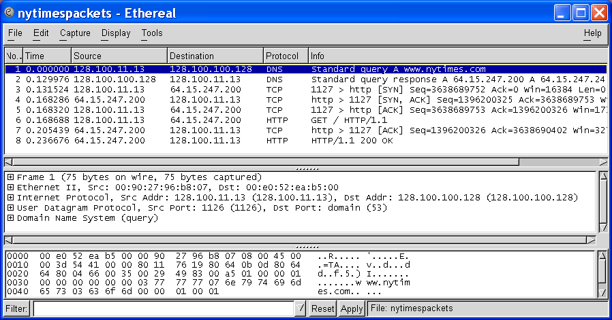
Ethereal/Wireshark Windows
Middle Pane shows encapsulation for a given frame
Top Pane shows frame/packet sequence
Bottom Pane shows hex & text

Slide 6
Top Pane: Frame Sequence
TCP Connection Setup
DNS Query
HTTP Request & Response

Slide 7
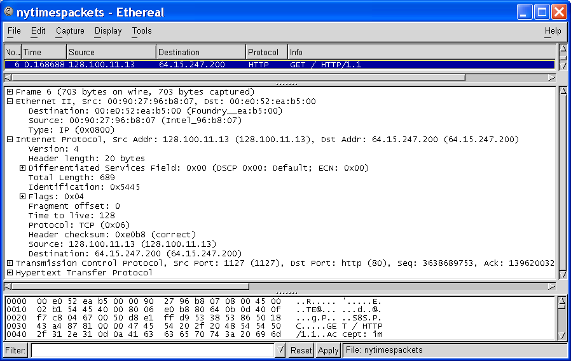
Middle Pane: Encapsulation
Ethernet Frame
Ethernet Destination and Source Addresses
Protocol Type

Slide 8
Middle pane: Encapsulation
And a lot of other stuff!
IP Packet
IP Source and Destination Addresses
Protocol Type

Slide 9
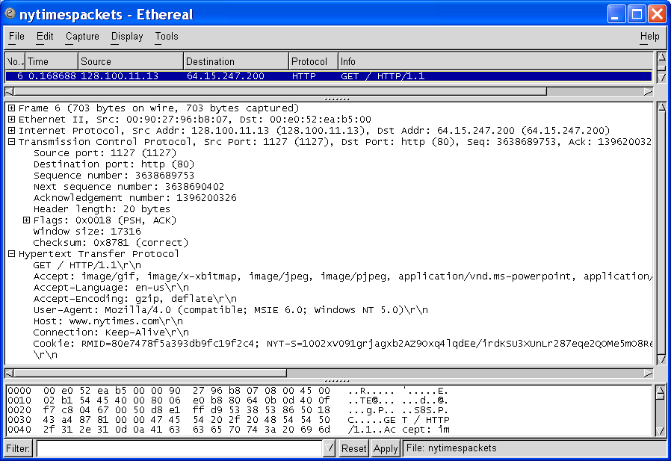
Middle Pane: Encapsulation
TCP Segment
Source and Destination Port Numbers
GET
HTTP Request

Slide 10
Thank You

