Slide 1
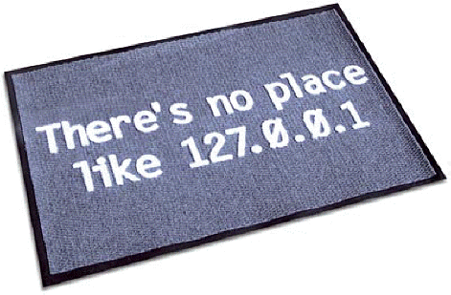
Computer Networking Network Management and Security
Dr Sandra I. Woolley
The IP loopback address is 127.0.0.1 for addressing your own computer.

Slide 2
Contents
Introduction to network management
SNMP
Traps
Managing servers and users
Network security
Footprinting, scanning and enumeration
Behaviour profiles
Malicious programs
Passwords
References :
Network security essentials - Applications and Standards, W. Stallings, Prentice Hall, 2000, 0-13-016093-8
Hacking exposed, Scambray, McClure and Kurtz, McGraw-Hill, 2nd Ed, 2001, 0-07-212748-1

Slide 3
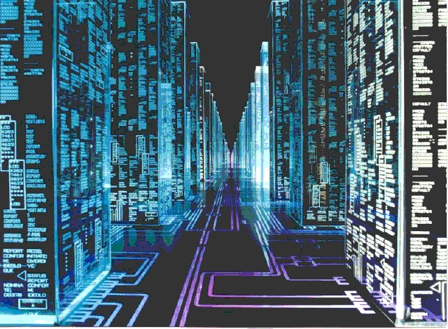
Network Management
The ability to manage and control an entire network and all its component parts.
The collection of hardware and software to do this is the Network Management System (NMS).
Modern networks are large and complex and need automated mechanisms to help with monitoring and management.

Slide 4
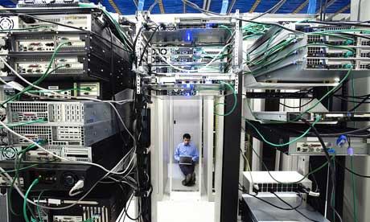
Network Management
We can split management into three parts.
Infrastructure management – the network infrastructure; cables, hubs, network cards, etc.
Server management – the information sources.
User management – “keeping the users under control”.
http://pacificcomputersolutions.com/images/server.room460x276.jpg

Slide 5
Network Infrastructure Management
Fault management - Detecting, isolating and correcting faults. Both active components (bridges, routers, LAN cards) and passive (cables.)
Accounting management – Accumulation and analysis of usage statistics. Useful for user monitoring and charging, particularly where public networks are used.
Configuration management – Monitoring and controlling the set-up and changes to network equipment.
Performance management – Gathering and analysing network statistics such as throughput and capacity. Used to identify bottlenecks, spare capacity and predict future requirements.
Security management – Controlling access to network operations. Includes access control, encryption and authorisation.

Slide 6
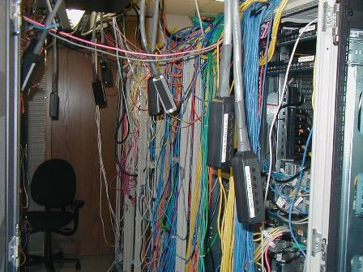
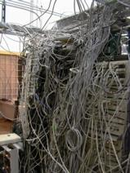
Historic Network Management
Early network devices were managed using proprietary systems.
They used custom protocols and often were not scalable outside the LAN.
Modern networks are multi-vendor* and extend to the WAN – a standard was needed.
*systems from multiple manufacturers
http://www.theregister.co.uk/2002/10/24/server_room_dangerous_heres_bofh/

Slide 7
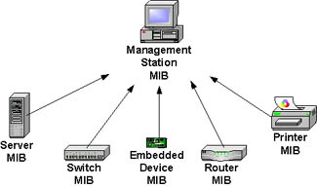
Simple Network Management Protocol (SNMP)
Usually abbreviated to SNMP
A standard TCP/IP protocol (RFC 1157, 1990)
There were a number of vulnerabilities in this first version including, for example, plaintext password communication.
Improvements to SNMP include V2 in 1993 and V3 in 2004.
SNMP defines a structure for collecting, delivering and storing network information.
MIB (Management Information Base)

Slide 8
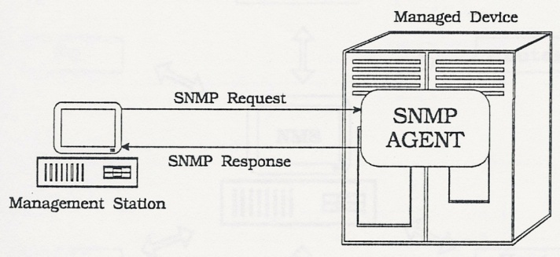
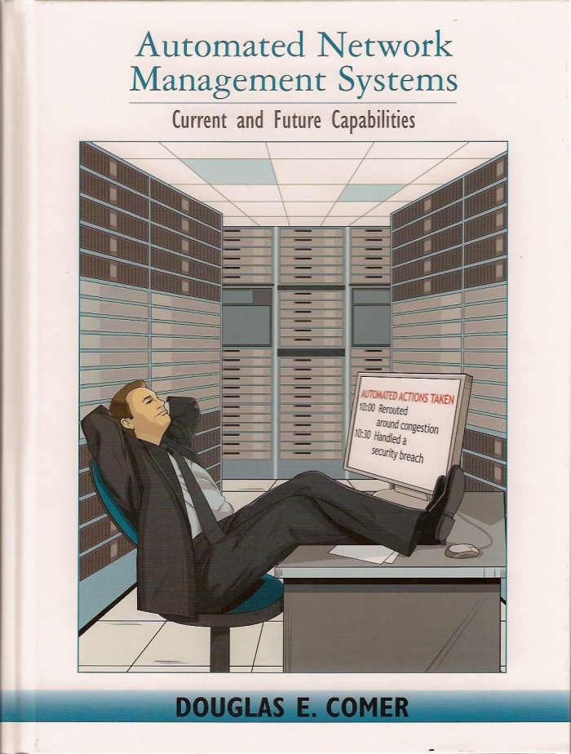
SNMP Functionality
SNMP devices collect statistics and the Network Management Station (NMS) receives this data regularly.
To minimise traffic, the collection period can be long, say 5 minutes.
However, something important may happen. A fast reporting mechanism is also needed.
Devices can ‘trap’ an event and send a message to the NMS for immediate action.

Slide 9
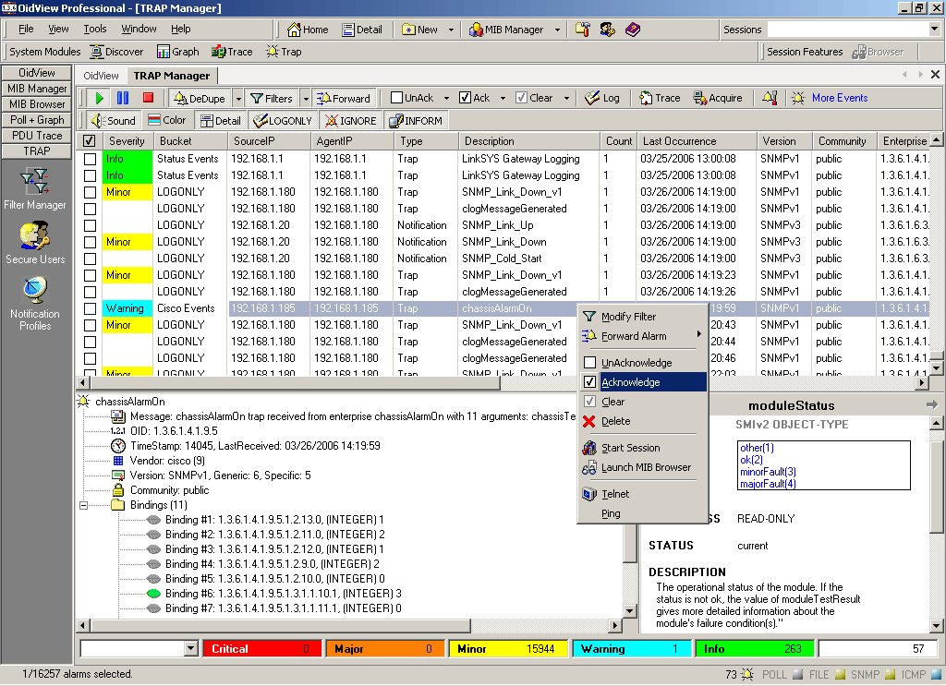
Traps
Traps can be used to quickly report things like:-
Excessive traffic
Excessive collisions (e.g., from CSMA/CD)
Low traffic (may indicate a fault somewhere?)
Broken or disconnected cables
Devices powered down (trap sent from another device)
SNMP Trap Managing Software
http://www.oidview.com/snmp_trap_management.html

Slide 10
Server Management
Servers: e.g., web, intranet, filespace.
Various operating systems including versions of Windows and Unix.
Each one has its own peculiarities.
Server management is closely linked to user management – preventing the users (and hackers!) damaging the systems.
Robust data backup is essential. In large systems active filespace would be stored on RAID systems (redundant array of inexpensive disks). Entire tape backups would be done regularly (say weekly) with incremental backups performed each night. Tapes would be stored in fire-proof, water-proof safes.

Slide 11
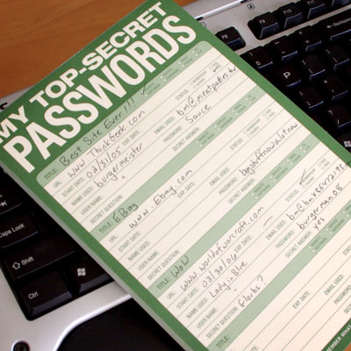
User Management
“Networks are totally reliable … until the users login.”
Accidental problems
forgotten passwords
deleted files etc.
Loopholes
web server
networked machines that allow user installs or user write access
Deliberate hacks
users trying to stop the system working for malicious reasons
http://www.thinkgeek.com/homeoffice/supplies/a475/

Slide 12
Smaller Networks
Small Networks
Most small networks are SOHO (small office/ home office) with up to about 10 users with no formal administrator.
Users may have full and shared access to networked computers and resources.
Medium Networks
Between 10 and 200 users, often with a single server.
May be managed by one administrator who controls everything.
Users still know each other by name, so casual file access may be tolerated.

Slide 13
Bigger Networks
Large Networks
Over a few hundred users, multiple servers and multiple administrators. E.g., the university network.
Some users will be computer literate and may enjoy the challenge of exploring or defeating security mechanisms.
Management becomes complex and more challenging.
Enormous Networks – The Internet
No real central control – available to anyone on the planet.
Users are not traceable – no need to logon to the Internet.
ISP’s may sign up anyone using a random name.
Email names are available with no checking.
There are very many hackers.

Slide 14
Network Security

Slide 15
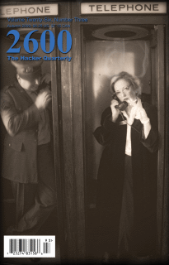
Content
Footprinting, scanning and enumeration.
Detecting intruders
Malicious programs
Passwords
Selected figures are from “Network Security Essentials – Applications and Standards”, W. Stallings, Prentice Hall, ISBN 0-13-016093 (The author has written other excellent titles in networking and security).
http://www.2600.com/

Slide 16
Security - Accessing Network Information
Footprinting
Gathering information on a network (creating a profile of an organization’s security posture - identifying a list of network and IP addresses.)
Scanning
Identifying live and reachable target systems. (Ping sweeps, port scans, application of automated discovery tools).
Enumeration
Extracting account information. (Examining active connections to systems).

Slide 17
Behaviour Profiles
from “Network Security Essentials – Applications and Standards”, W. Stallings, Prentice Hall, ISBN 0-13-016093 (The author has written other excellent titles in networking and security).

Slide 18
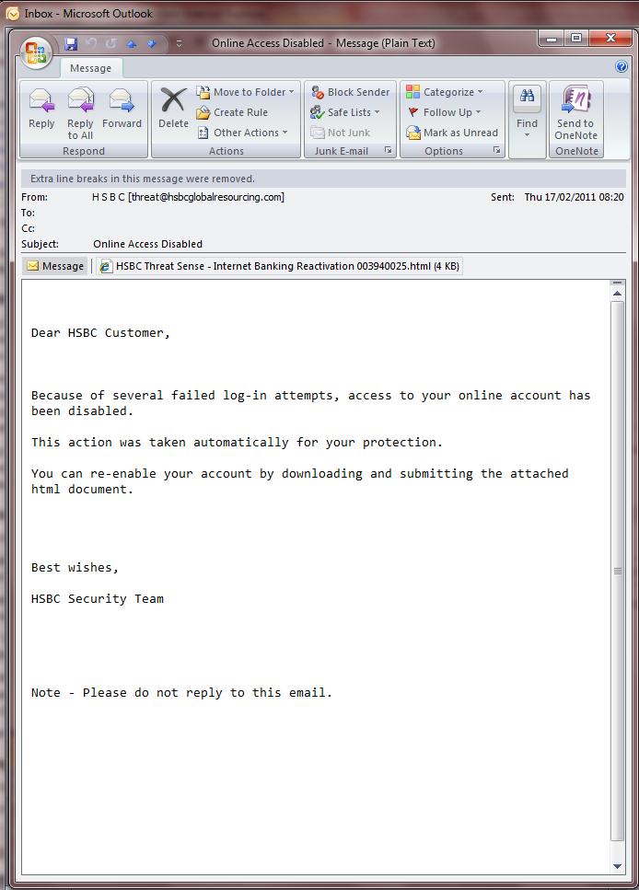
Social Engineering
Manipulating people to divulge confidential information rather than using technical cracking skills.
E.g., Phishing
Typically emails that appear to come from legitimate sources requesting information. Often provides a link to a web page that looks like the legitimate one.

Slide 19
Malicious Programs

Slide 20
Malicious Programs
Trap doors
A secret entry point into a program which circumnavigates the usual security access procedures.
Often legitimately used for debugging and testing - but vulnerable to misuse.
Logic bombs
Code embedded into a legitimate program that is set to ‘explode’ when some conditions are met.
E.g. test for dates. In a famous case, a logic bomb tested for an employee ID number and triggered if it failed to be listed on the payroll in 2 consecutive months.
Trojan horses
An apparently useful program containing hidden code that performs unwanted/harmful functions when invoked.

Slide 21
Malicious Programs
Viruses
A program that can infect other programs by modifying them (the modification includes a copy of the virus program).
Dormant phase : Virus is idle until activated by some event such as a date, presence of some other file or capacity of disk.
Propagation phase : The virus places a copy of itself into another program or filespace.
Triggering phase : The virus is activated by an event. This may be related to the number of copies made of itself.
Execution phase : The function is performed.
Worms
Use network connections to spread from system to system. Once active within a system, a network worm can behave as a virus or bacteria or could implant Trojan horses.
To replicate itself a worm needs a network vehicle, e.g., e-mail, remote login or execution capabilities.
Bacteria
Programs that do not explicitly damage files - but simply replicate. Eventually replication may result in taking up all processor capacity, memory, disk space.

Slide 22
Passwords
Some users, when allowed to choose any password, will select very short ones.
William Stallings is a famous network security author. He quotes the example here from Purdue University.
People also tend to select guessable passwords.

Slide 23
Passwords
Stallings references a report which demonstrates the effectiveness of password guessing.
The author collected UNIX passwords from a variety of encrypted password files.
Nearly 25% of passwords were guessed with the following strategy:-
Try user’s name, initials, account name (130 permutations for each).
Try dictionary words - including the system’s own on-line dictionary (60,000 words).
Try permutations of words from step above (Including making first letter uppercase or a control character, making the entire word uppercase, reversing the word, changing o’s to 0’s etc (another 1 million words to try).
More capitalization permutations (another million words to check).

Slide 25
Thank You

