Slide 1
Computer Networking Packet Switching Networks
Dr Sandra I. Woolley

Slide 2
Contents
Packet switching and the network layer
Structure of a packet switch
Routing in packet networks
Shortest path routing
Distance Vector (Bellman-Ford)
Link-State (Dijkstra)

Slide 3
Packet Switching
Transfer of information as payload in data packets.
Packets undergo random delays and possible loss.
Different applications impose differing requirements on the transfer of information.
How do we get packets from here to there?
t₀
t₁
Network

Slide 4
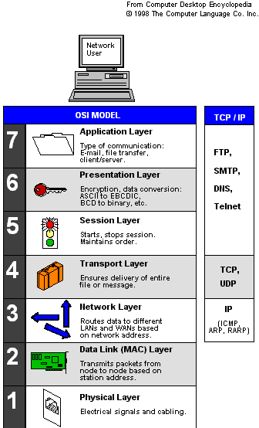
Network Layer
The network layer is the most complex layer.
Addressing needs to accommodate extremely large-scale networks and must work together with appropriate routing algorithms.
These two challenges, addressing and routing, are the essence of the network layer.
Addressing: where should information be directed to?
Routing: what path should be used to get information there?

Slide 5
Network Service
Messages
Messages
Transport
layer
Segments
Transport
layer
Network
service
Network
service
Network
layer
Network
layer
Network
layer
Network
layer
End system
α
Data link
layer
Data link
layer
Data link
layer
Data link
layer
End system
β
Physical
layer
Physical
layer
Physical
layer
Physical
layer
The network layer can offers services to transport layer.
The network service can be connection-oriented or connectionless. Best-effort or delay/loss guarantees.

Slide 6
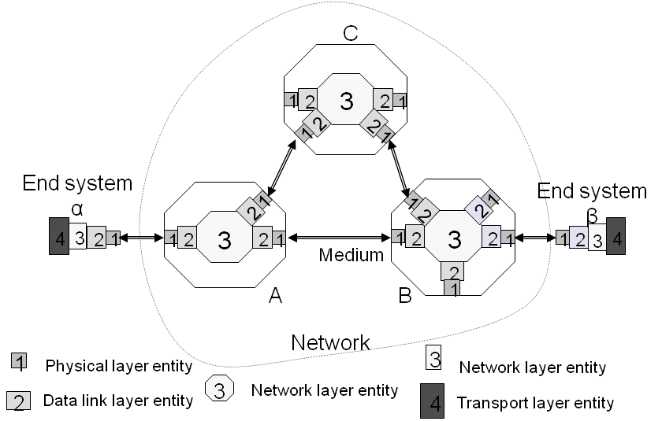
Complexity at the Edge or in the Core?
Complexity is best at the edge of the network.
Higher-level components at the ends are better positioned to check functionality and take corrective action.
Keeping the core of the network simple and adding the necessary complexity at the edges enhances scalability.

Slide 7
Network Layer Functions
Essential
Routing: mechanisms for determining the set of best paths for routing packets requires the collaboration of network elements.
Forwarding: transfer of packets from NE (network element) inputs to outputs.
Priority and Scheduling: determining order of packet transmission in each NE.
Optional
Congestion control, segmentation & reassembly, security.

Slide 8
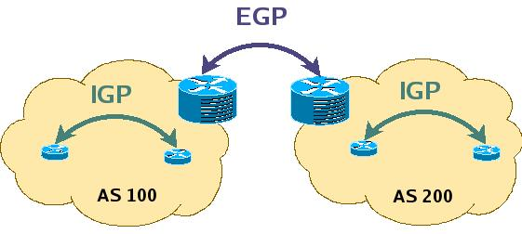
Key Role of Routing
How to get packet from here to there?
The decentralized nature of the Internet makes routing a major challenge.
Interior gateway protocols (IGPs) are used to determine routes within a domain.
Exterior gateway protocols (EGPs) are used to determine routes across domains.
Routes must be consistent and produce stable flows.
Scalability required to accommodate growth.
The hierarchical structure of IP addresses is essential to keeping size of routing tables manageable.

Slide 9
Packet Switching Network
The network service provided can be connection-oriented or connectionless.
Connection-oriented - setting up a connection across the network before information can be transferred.
Connectionless - does not involve setting up connections. Packets are routed independently until they reach their destination.
Both approaches need packet switches to direct packets.
Packet switches store and forward packets.
User
Transmission
line
Network
Packet
switch
Notes:
7-9
The text boxes are callouts or labels.

Slide 10
Connectionless/Datagram Packet Switching
Source and destination addresses are in packet headers.
Connectionless (datagram) packets are routed independently.
Packets may arrive out of order.
Packet 1
Packet 1
Packet 2
Packet 2
Packet 2

Slide 11
Routing Tables in Datagram Networks
Route is determined by table lookup.
Routing decision involves finding next hop along the route to given destination.
Routing table has an entry for each destination specifying the output port that leads to the next hop.
Table size becomes problematic for very large numbers of destinations.
Destination
Output
address
port
0785
7
1345
12
1566
6
2458
12

Slide 12
Example: Internet Routing
Internet protocol uses datagram packet switching across networks
Networks are treated as data links
Hosts have two-part IP address:
Network address + Host address
Routers do table lookup on network address
This reduces size of routing table
In addition, network addresses are assigned so that they can also be aggregated
Discussed as CIDR in TCP/IP lectures

Slide 13
Virtual Circuit Packet Switching
Virtual-circuit packet switching involves establishing a fixed path between source and destination. This is established prior to packet flow.
Routing tables are configured in every switch along the path.
All packets for a connection follow the same path. Packets arrive in sequence.
An abbreviated header identifies connection on each link.
Packets queue for transmission.
Variable bit rates possible, negotiated during call set-up.
Packet
Packet
Packet
Packet
Virtual circuit

Slide 14
Virtual Circuit Forwarding Tables
Each input port of packet switch has a forwarding table.
Lookup entry for VCI (virtual circuit identifier) of incoming packet.
Determine output port (next hop) and insert VCI for next link.
Very high speeds are possible.
Table can also include priority or other information about how the packet should be treated.
Input
VCI
Output
port
Output
VCI
12
13
44
15
15
23
27
13
16
58
7
34

Slide 15
Structure of a Packet Switch

Slide 16
Packet Switch: Where Traffic Flows Meet
Inputs contain multiplexed flows from access multiplexers and other packet switches.
Flows are demultiplexed at the input and forwarded to the correct output port.
Packets are buffered, prioritized, and multiplexed to output lines.
• • •
1
1
• • •
2
2
• • •
●
●
●
●
●
●
N
N

Slide 17
Generic Packet Switch
“Unfolded*” View of Switch
Ingress (receive) Line Cards
Header processing
Demultiplexing
Routing in large switches
Controller
Routing in small switches
Signalling and resource allocation (in connection-oriented mode)
Internal configuration and maintenance
Interconnection Fabric
Transfer packets between line cards
Egress (transmit) Line Cards
Scheduling & priority
Multiplexing
*Each line card contains both inputs and outputs.
Controller
1
Line card
Line card
1
2
Line card
Line card
2
3
Line card
Interconnection
fabric
Line card
3
…
…
…
…
N
Line card
Line card
N
Input ports
Output ports
Data path Control path
(a)

Slide 18
Crossbar Switches
The crossbar is a higher-speed alternative to serially transferred interconnection fabrics which can cause bottlenecks.
Large switches built from crossbar and multistage space switches
Can buffer at input, output, or both (performance vs. complexity)
(a) Input buffering
(b) Output buffering
Inputs
Inputs
1
3
1
2
8
3
2
3
3
…
…
N
N
…
…
1
2
3
N
1
2
3
N
Outputs
Outputs

Slide 19
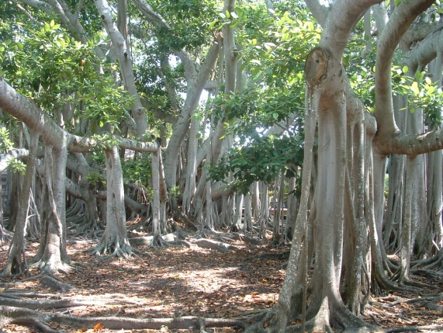
Self-Routing Switches: A Banyan Switch
Inputs
Outputs
0
0
1
1
2
2
3
3
4
4
5
5
6
6
7
7
A banyan is a fig that grows on a host tree. Its roots twist down toward the ground.
http://forest.puducherry.gov.in/forest/banyan%20tree.jpg
Stage 1
Stage 2
Stage 3
Self-routing switches do not require a controller.
The output port number determines the route.
101 → (1) lower port, (2) upper port, (3) lower port
In the example … 0=up and 1=down

Slide 20
Routing in Packet Networks

Slide 21
Routing in Packet Networks
There are three possible (loopfree) routes from 1 to 6:
1-3-6, 1-4-5-6, 1-2-5-6
But which is “best”?
Min delay? Min hop? Max bandwidth? Min cost? Max reliability?
1
3
6
4
2
Node
(switch or router)
5

Slide 22
Creating the Routing Tables
Need information on state of links.
Link up/down; congested; delay or other metrics
Need to distribute link state information using a routing protocol.
What information is exchanged? How often?
Exchange with neighbours; Broadcast or flood
Need to compute routes based on information.
Single metric; multiple metrics
Single route; alternate routes

Slide 23
Routing Algorithm Requirements
Responsiveness to change
Topology or bandwidth changes, congestion
Rapid convergence of routers to consistent set of routes
Freedom from persistent loops
Optimality
Resource utilization, path length
Robustness
Continues working under high load, congestion, faults, equipment failures, incorrect implementations
Simplicity
Efficient software implementation, reasonable processing load

Slide 24
Centralized vs. Distributed Routing
Centralized Routing
All routes determined by a central node
All state information sent to central node
Problems adapting to frequent topology changes
Does not scale
Distributed Routing
Routes determined by routers using distributed algorithm
State information exchanged by routers
Adapts to topology and other changes
Better scalability

Slide 25
Static vs Dynamic Routing
Static Routing
Set up manually, do not change; requires administration
Works when traffic predictable & network is simple
Used to override some routes set by dynamic algorithm
Used to provide default router
Dynamic Routing
Adapt to changes in network conditions
Automated
Calculates routes based on received updated network state information

Slide 26
Routing in Virtual-Circuit Packet Networks
The VCI (virtual-circuit identifier) has local significance.
A above has 2 VCs. VC1 goes toward B and VC5 goes on to D.
Route determined during connection setup.
Tables in switches implement forwarding that realizes selected route.
1
2
7
1
8
B
3
A
3
6
5
1
5
4
2
VCI
Host
4
3
5
Switch or router
2
C
5
6
D
2

Slide 27
VC Example: From A on VCI5 to D. (We assume VCs are bidirectional)
Node 3
Incoming Outgoing
Node 1
Node VCI Node VCI
Node 6
Incoming Outgoing
1 2 6 7
Incoming Outgoing
Node VCI Node VCI
1 3 4 4
Node VCI Node VCI
A 1 3 2
4 2 6 1
3 7 B 8
A 5 3 3
6 7 1 2
3 1 B 5
3 2 A 1
6 1 4 2
B 5 3 1
3 3 A 5
4 4 1 3
B 8 3 7
Node 4
Incoming Outgoing
Node VCI Node VCI
Node 2
2 3 3 2
Node 5
Incoming Outgoing
3 4 5 5
3 2 2 3
Incoming Outgoing
Node VCI Node VCI
5 5 3 4
Node VCI Node VCI
C 6 4 3
4 5 D 2
4 3 C 6
D 2 4 5
Example: VCI from A to D
From A & VCI 5 → 3 & VCI 3 → 4 & VCI 4
→ 5 & VCI 5 → D & VCI 2

Slide 28
Routing Tables in Datagram Packet Networks (Without a VC. From node 1 to node 5)
Node 3
Node 1
Destination Next node
Node 6
Destination Next node
1 1
Destination Next node
2 2
2 4
1 3
3 3
4 4
2 5
4 4
5 6
3 3
5 2
6 6
4 3
6 3
5 5
Node 4
Destination Next node
1 1
Node 2
2 2
Node 5
Destination Next node
3 3
5 5
Destination Next node
1 1
6 3
1 4
3 1
2 2
4 4
3 4
5 5
4 4
6 5
6 6

Slide 29
Non-Hierarchical Addresses and Routing
No relationship between addresses and routing proximity.
Routing tables will require 16 entries each.
0000 0111 1010 1101
0001 0100 1011 1110
1
4
3
R₁
R₂
2
5
0011 0110 1001 1100
0011 0101 1000 1111
0000 1 0111 1 1010 1 … …
0001 4 0100 4 1011 4 … …

Slide 30
Hierarchical Addresses and Routing
Prefix indicates network where host is attached.
Routing tables will require only 4 entries each.
0000 0001 0010 0011
0100 0101 0110 0111
1
4
3
R₁
R₂
2
5
1000 1001 1010 1011
1100 1101 1110 1111
00 1 01 3 10 2 11 3
00 3 01 4 10 3 11 5

Slide 31
Flat vs Hierarchical Routing
Flat Routing
All routers are peers
Does not scale
Hierarchical Routing
Partitioning: Domains, autonomous systems, areas...
Some routers part of routing backbone
Some routers only communicate within an area
Efficient because it matches typical traffic flow patterns
Scales to much larger numbers of hosts

Slide 32
Specialized Routing
Flooding
Useful in starting up network
Useful in propagating information to all nodes
Deflection Routing
Fixed, preset routing procedure
No route synthesis
Not covered here

Slide 33
Shortest Path Routing

Slide 34
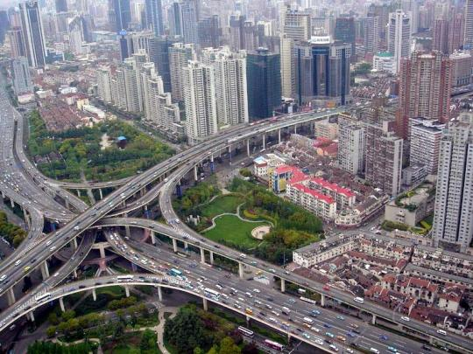
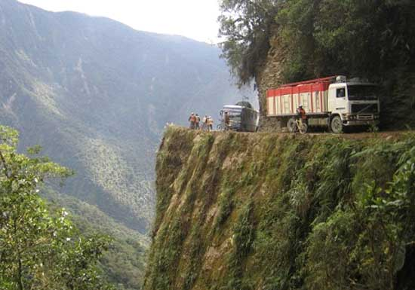
Shortest Paths & Routing
Many possible paths connect any given source and to any given destination.
Routing involves the selection of the path to be used to accomplish a given transfer.
Typically it is possible to attach a cost or distance to a link connecting two nodes.
Routing can then be posed as a shortest path problem.
Puxi Viaduct, Shanghai
http://trifter.com/practical-travel/adventure-travel/some-complicated-road-junctions/
http://winaresort.com/blog/blog/tag/world%E2%80%99s-worst-road/

Slide 35
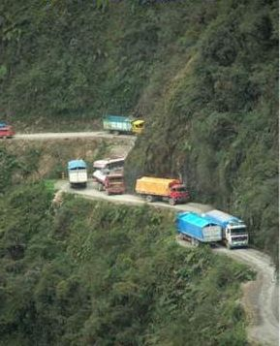
Routing Metrics
Means for measuring desirability of a path.
Path length = sum of costs or distances
Possible metrics
Hop count: rough measure of resources used
Reliability: link availability; BER
Delay: sum of delays along path; complex and dynamic
Bandwidth: “available capacity” in a path
Load: Link & router utilization along path
Cost: $$$
http://bitsandpieces1.blogspot.com/2006/07/worst-road-in-world.html

Slide 36
Shortest Path Approaches
Distance Vector Protocols
Neighbours exchange list of distances to destinations.
Best next-hop determined for each destination.
The distributed Bellman-Ford is an example.
Link State Protocols
Link state information flooded to all routers.
Routers have complete topology information.
Shortest path (& hence next hop) calculated.
Dijkstra (centralized) shortest path algorithm.

Slide 37
Distance Vector Routing
Local Signpost
Direction
Distance
Routing Table
For each destination list:
Next Node
Distance
Table Synthesis
Neighbours exchange table entries
Determine current best next hop
Inform neighbours
Periodically
After changes
Dest.
next
Dist.

Slide 38
Shortest Path to Rome
Let us consider how nodes find their shortest path to a given destination node, i.e. Rome.
Rome
D_{j}
C_{ij}
j
i
D_{i}
If D_{i} is the shortest distance to Rome from i
and if j is a neighbour on the shortest path,
then D_{i} = C_{ij} + D_{j}

Slide 39
Bellman-Ford Algorithm
Consider computations for one destination d
Initialization
Each node table has 1 row for destination d
Distance of node d to itself is zero: D_{d}=0
Distance of other node j to d is infinite: D_{j}=∞ , for j≠ d
Next hop node n_{j} = -1 to indicate not yet defined for j ≠ d
Send Step
Send new distance vector to immediate neighbours across local link
Receive Step
At node j, find the next hop that gives the minimum distance to d,
Min_{j} { C_{ij} + D_{j} }
Replace old (n_{j}, D_{j}(d)) by new (n_{j}*, D_{j}*(d)) if new next node or distance found
Go to send step

Slide 40
Bellman-Ford Algorithm
Now consider parallel computations for all destinations d
Initialization
Each node has 1 row for each destination d
Distance of node d to itself is zero: D_{d}(d)=0
Distance of other node j to d is infinite: D_{j}(d)= ∞ , for j ≠ d
Next node n_{j} = -1 since not yet defined
Send Step
Send new distance vector to immediate neighbours across local link
Receive Step
For each destination d, find the next hop that gives the minimum distance to d,
Minj { C_{ij}+ D_{j}(d) }
Replace old (n_{j}, D_{i}(d)) by new (n_{j}*, D_{j}*(d)) if new next node or distance found
Go to send step

Slide 41
Iteration | Node 1 | Node 2 | Node 3 | Node 4 | Node 5
Initial | (-1, ∞) | (-1, ∞) | (-1, ∞) | (-1, ∞) | (-1, ∞)
1
2
3
Table entry
@ node 1
for dest Rome
Table entry
@ node 3
for dest Rome
2
3
1
1
5
2
Rome
4
3
1
3
6
2
5
2
4

Slide 42
Iteration | Node 1 | Node 2 | Node 3 | Node 4 | Node 5
Initial | (-1, ∞) | (-1, ∞) | (-1, ∞) | (-1, ∞) | (-1, ∞)
1 | (-1, ∞) | (-1, ∞) | (6,1) | (-1, ∞) | (6,2)
2
3
D₃=D₆+1
n₃=6
1
D₆=0
2
3
1
1
5
2
0
4
Rome
3
1
3
6
2
5
2
4
2
D₅=D₆+2
n₅=6
D₆=0

Slide 43
Iteration | Node 1 | Node 2 | Node 3 | Node 4 | Node 5
Initial | (-1, ∞) | (-1, ∞) | (-1, ∞) | (-1, ∞) | (-1, ∞)
1 | (-1, ∞) | (-1, ∞) | (6, 1) | (-1, ∞) | (6,2)
2 | (3,3) | (5,6) | (6, 1) | (3,3) | (6,2)
3
3
1
2
3
1
1
5
3
2
0
4
Rome
3
1
3
6
2
5
2
6
4
2

Slide 44
Iteration | Node 1 | Node 2 | Node 3 | Node 4 | Node 5
Initial | (-1, ∞) | (-1, ∞) | (-1, ∞) | (-1, ∞) | (-1, ∞)
1 | (-1, ∞) | (-1, ∞) | (6, 1) | (-1, ∞) | (6,2)
2 | (3,3) | (5,6) | (6, 1) | (3,3) | (6,2)
3 | (3,3) | (4,4) | (6, 1) | (3,3) | (6,2)
1
3
2
3
1
1
5
3
2
0
4
Rome
3
1
3
6
2
5
2
4
6
4
2

Slide 45
Packet Switching Networks - continued
Dr Sandra I. Woolley

Slide 46
Iteration | Node 1 | Node 2 | Node 3 | Node 4 | Node 5
Initial | (-1, ∞) | (-1, ∞) | (-1, ∞) | (-1, ∞) | (-1, ∞)
1 | (-1, ∞) | (-1, ∞) | (6, 1) | (-1, ∞) | (6,2)
2 | (3,3) | (5,6) | (6, 1) | (3,3) | (6,2)
3 | (3,3) | (4,4) | (6, 1) | (3,3) | (6,2)
The shortest path to destination 6 was found on iteration 3
2
3
1
1
5
2
4
3
1
3
6
2
5
2
4

Slide 47
Iteration | Node 1 | Node 2 | Node 3 | Node 4 | Node 5
Initial | (3,3) | (4,4) | (6, 1) | (3,3) | (6,2)
1 | (3,3) | (4,4) | (4, 5) | (3,3) | (6,2)
2
3
Imagine now that the network is disconnected.
We will see a loop created between nodes 3 and 4.
1
5
3
2
3
1
1
5
3
2
0
4
Rome
3
1
3
6
2
5
2
4
4
2

Slide 48
Iteration | Node 1 | Node 2 | Node 3 | Node 4 | Node 5
Initial | (3,3) | (4,4) | (6, 1) | (3,3) | (6,2)
1 | (3,3) | (4,4) | (4, 5) | (3,3) | (6,2)
2 | (3,7) | (4,4) | (4, 5) | (5,5) | (6,2)
3
5
3
7
2
3
1
5
1
5
3
2
0
4
Rome
3
1
3
6
2
5
2
4
4
2
Node 4 could have chosen 2 as next node because of a tie.

Slide 49
Iteration | Node 1 | Node 2 | Node 3 | Node 4 | Node 5
Initial | (3,3) | (4,4) | (6, 1) | (3,3) | (6,2)
1 | (3,3) | (4,4) | (4, 5) | (3,3) | (6,2)
2 | (3,7) | (4,4) | (4, 5) | (5,5) | (6,2)
3 | (3,7) | (4,6) | (4, 7) | (5,5) | (6,2)
5
7
7
2
3
1
1
5
5
2
0
4
Rome
3
1
3
6
2
5
2
4
2
4
6
Node 2 could have chosen 5 as next node because of tie.

Slide 50
Iteration | Node 1 | Node 2 | Node 3 | Node 4 | Node 5
1 | (3,3) | (4,4) | (4, 5) | (3,3) | (6,2)
2 | (3,7) | (4,4) | (4, 5) | (2,5) | (6,2)
3 | (3,7) | (4,6) | (4, 7) | (5,5) | (6,2)
4 | (2,9) | (4,6) | (4, 7) | (5,5) | (6,2)
7
9
7
2
3
1
1
5
5
2
0
4
Rome
3
1
3
6
2
5
2
6
4
2
Node 1 could have chose 3 as next node because of tie.

Slide 51
Counting to Infinity Problem
(a)
1
2
3
4
Nodes believe best path is through each other
(Destination is node 4)
1
1
1
(b)
1
2
3
X
4
1
1
Update | Node 1 | Node 2 | Node 3
Before break | (2,3) | (3,2) | (4, 1)
After break | (2,3) | (3,2) | (2,3)
1 | (2,3) | (3,4) | (2,3)
2 | (2,5) | (3,4) | (2,5)
3 | (2,5) | (3,6) | (2,5)
4 | (2,7) | (3,6) | (2,7)
5 | (2,7) | (3,8) | (2,7)
… | … | … | …

Slide 52
Problem: Bad News Travels Slowly
Remedies
Split Horizon
Do not report route to a destination to the neighbour from which route was learned.
Split Horizon with Poisoned Reverse
Report route to a destination to the neighbour from which route was learned, but with infinite distance.

Slide 53
Split Horizon with Poison Reverse
(a)
1
2
3
4
1
1
1
Nodes believe best path is through each other
(b)
1
2
3
X
4
1
1
Update | Node 1 | Node 2 | Node 3
Before break | (2, 3) | (3, 2) | (4, 1)
After break | (2, 3) | (3, 2) | (-1, ∞) | Node 3 finds there is no route to 4. It advertises its route to 4 to node 3 as having distance infinity;
1 | (2, 3) | (-1, ∞) | (-1, ∞) | Node 2 finds there is no route to 4. It advertises its route to 4 to node 2 as having distance infinity;
2 | (-1, ∞) | (-1, ∞) | (-1, ∞) | Node 1 finds there is no route to 4

Slide 54
Link-State Algorithm
Basic idea: two step procedure
Each source node gets a map of all nodes and link metrics (link state) of the entire network.
Find the shortest path on the map from the source node to all destination nodes.
Broadcast of link-state information
Every node i in the network broadcasts to every other node in the network:
ID’s of its neighbours: N_{i}=set of neighbours of i
Distances to its neighbours: {C_{ij} | j ∈N_{i}}
Flooding is a popular method of broadcasting packets

Slide 55
Dijkstra’s Algorithm
N: set of nodes for which shortest path already found
Initialization: (Start with source node s)
N = {s}, D_{s} = 0, “s is distance zero from itself”
D_{j}=C_{sj} for all j ≠ s, distances of directly-connected neighbours
Step A: (Find next closest node i)
Find i ∉ N such that
D_{i} = min D_{j} for j ∉ N
Add i to N
If N contains all the nodes, stop
Step B: (update minimum costs)
For each node j ∉ N
D_{j} = min (D_{j}, D_{i}+C_{ij})
Go to Step A
Minimum distance from s to j through node i in N

Slide 56
Execution of Dijkstra’s Algorithm
✓
2
2
2
2
2
2
1
2
1
1
3
1
3
3
1
3
3
1
1
3
3
3
3
3
3
1
3
1
1
1
1
1
1
✓
6
6
6
6
6
6
6
5
5
5
5
5
5
2
5
2
2
2
2
2
2
3
3
3
3
3
3
3
✓
4
4
4
4
4
1
4
4
1
1
2
1
2
2
1
2
1
2
1
2
2
3
3
3
3
3
2
3
3
2
2
2
2
2
2
5
5
5
✓
5
5
4
5
5
4
4
4
4
4
4
Iteration | N | D₂ | D₃ | D₄ | D₅ | D₆
Initial | {1} | 3 | 2 | 5 | ∝ | ∝
1 | {1,3} | 3 | 2 | 4 | ∝ | 3
2 | {1,2,3} | 3 | 2 | 4 | 7 | 3
3 | {1,2,3,6} | 3 | 2 | 4 | 5 | 3
4 | {1,2,3,4,6} | 3 | 2 | 4 | 5 | 3
5 | {1,2,3,4,5,6} | 3 | 2 | 4 | 5 | 3
✓
✓
✓
✓
✓

Slide 57
Shortest Paths in Dijkstra’s Algorithm
2
3
1
2
3
1
1
1
3
6
6
5
2
5
2
3
3
1
4
2
1
4
2
3
3
2
2
4
5
4
5
2
3
1
2
3
1
1
3
1
3
6
6
5
2
5
2
3
3
1
4
2
1
4
2
3
3
2
2
4
5
4
5
2
3
1
2
3
1
1
3
1
3
6
6
5
2
5
2
3
3
1
4
2
1
4
2
3
3
2
2
4
5
4
5

Slide 58
Reaction to Failure
If a link fails …
router sets link distance to infinity & floods the network with an update packet.
all routers immediately update their link database and recalculate their shortest paths.
recovery very quick.
But watch out for old update messages
add time stamp or sequence no to each update message.
check whether each received update message is new.
if new, add it to database and broadcast.
if older, send update message on arriving link.

Slide 59
Summary
Packet switching and the network layer
Structure of a packet switch
Routing in packet networks
Shortest path routing
Distance Vector (Bellman-Ford)
Link-State (Dijkstra)

Slide 60
Thank You
Private Study Recommendation
Read Chapter 7
Packet network topology (assessed)
Details of virtual circuits (assessed)
ATM networks (not assessed)
Traffic management (not assessed)
Congestion control (not assessed – except TCP congestion control which is assessed)

